Slide 1
02 Therapy

Slide 2
Oxygen therapy
Oxygen is required for the functioning and survival of all body tissues and deprivation for more than a few minutes is fatal.

Slide 3
Oxygen Therapy
Goal of therapy is an SPO2 of >90%
As SPO2 normalises the patients vital signs improve:
  Heart rate should return to normal for patient
  Respiratory rate should decrease to normal for patient
  Blood pressure should normalize for patient
3

Slide 4
Oxygen therapy
When to use oxygen therapy?
Hypoxaemia – inadequate amount of O2 in blood (SPO2 < 90%)
Acute hypotension – low blood pressure.
Breathing inadequacy.
Trauma.
Severe anaemia.
During the peri-operative period.

Slide 5
Need For Oxygen Is Assessed By
Clinical evaluation
Pulse oximetry
ABG

Slide 6
Oxygen therapy
To ensure safe and effective treatment remember:
Oxygen is a prescription drug.
Prescriptions should include –
  Flow rate.
  Delivery system.
  Duration.
  Instructions for monitoring.
Notes:
Monitoring resps oxygen sats not definitive tool need to be looking at other things acccessory muscles etc

Slide 7
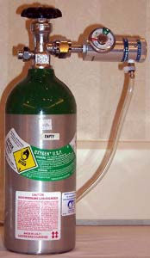
Methods of Dispensing Oxygen
Piped in
Cylinder
Oxygen concentrator

Slide 8
Classification of Oxygen Delivery Systems
Low flow systems
  Contribute partially to inspired gas client breathes
  Do not provide constant FIO2
  Ex: nasal cannula, simple mask
High flow systems
  Deliver specific and constant percent of oxygen independent of client’s breathing
  Ex: Venturi mask, non-rebreather mask, trach collar, T-piece

Slide 9
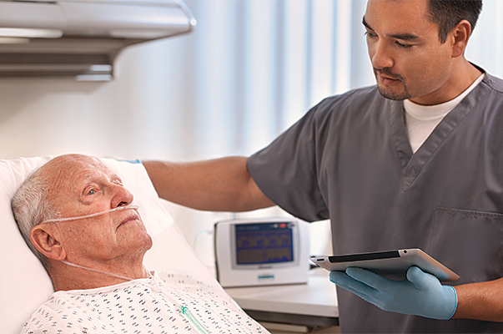
Nasal Cannula
Used for low-medium concentrations of O2
Can use continuously with meals and activity
Flow rates :
adults  6 LPM
infants/toddlers  2 LPM
children  3 LPM
FIO₂ is not affected by mouth breathing
FIO2 Fraction of Inspired Oxygen; it is a fraction of the amount of oxygen a patient is inhaling by an oxygen device.
The Cannula Provides:
1L O2 = FIO2 4%
6 L O2= FiO2 24%
Room air Contains 21% Oxygen, therefore:
1lt O2 = FIO2 25%
6L O2 = FiO2 45%

Slide 10
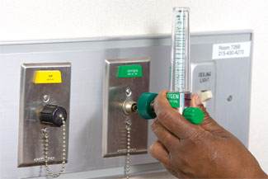
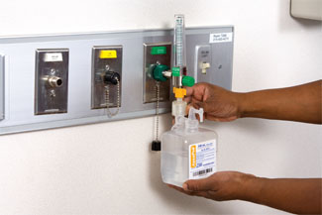
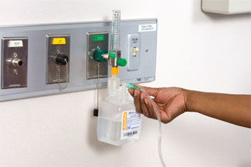
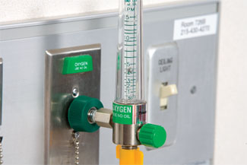
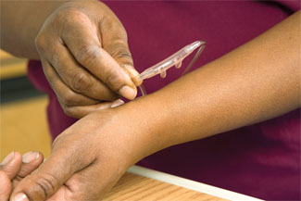
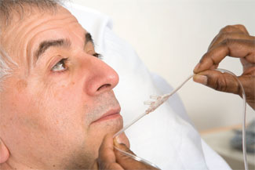
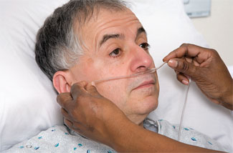
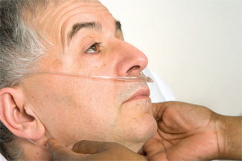
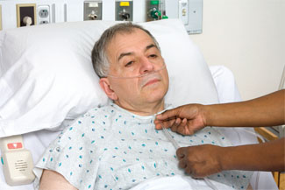
Utilising Nasal Cannula
Insert flowmeter into wall outlet
If using a high O2 flow, attach humidifier
Attach oxygen tubing to humidifier or direct to flowmeter
Turn on the oxygen at the prescribed rate
Ensure the oxygen is flowing through the tubing
Hold nasal cannula in proper position with prongs curving downward
Place cannula prongs into nares
Wrap tubing over and behind ears
Adjust plastic slide under chin until cannula fits snugly

Slide 11
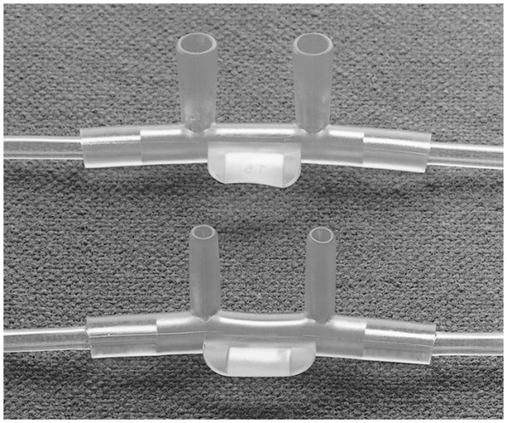
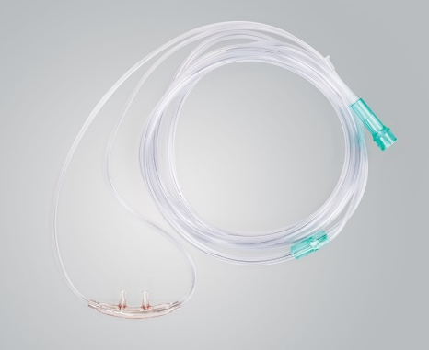
AirLife Standard & Cushion O₂ Cannulas
Available in a variety of sizes, lengths of oxygen tubing
  All cannulas come with crush-resistant tubing
Two top-selling categories: Standard & Cushion cannulas
  Standard available in flared tip and non-flared tip
  Cushion has a softer nosepiece
Code | Description | US Sales
001320 | CANNULA CRVD FLAIR TIP W/7FT DISP 50/CS | $1.7M
001325 | CANNULA CRVD N-FLAIR TIP W/7FT | $3.2M
002600 | CANNULA NASAL SOFT W/7FT TUBING 50/CS | $1.0M

Slide 12
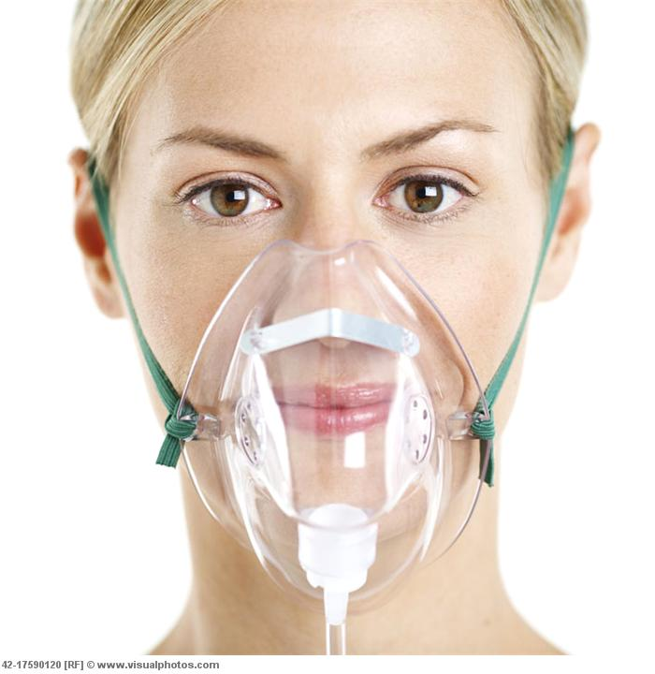
Simple Mask
Low to medium concentration of O2.
Client exhales through ports on sides of mask.
Should not be used for controlled O2 levels.
O2 flow rate- 5 to 10L.
Can cause skin breakdown; must remove to eat.
Inc Room Air:
1L O2=FIO2 35%
6L O2=FiO2 50%

Slide 13
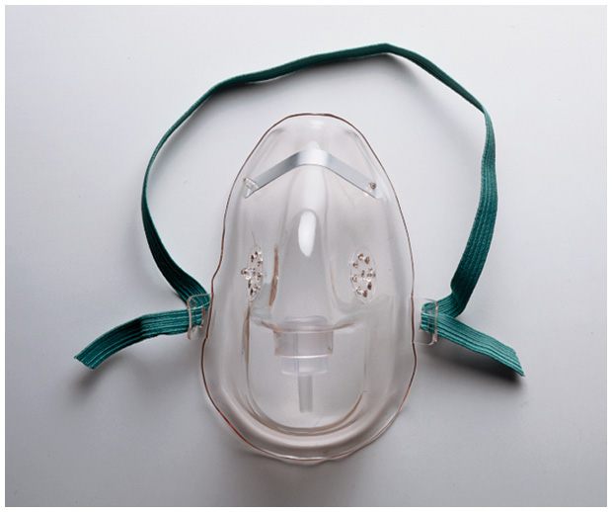
AirLife Oxygen Masks
AirLife “Simple” Mask
  Medium concentration rebreather mask (no valves, no reservoir bag)
  5-10 liters per minute*, 35%-50% FiO₂
  e.g. 001201
*AARC Clinical Practice Guideline; Respir Care 2002; 47(6):717-720)

Slide 14
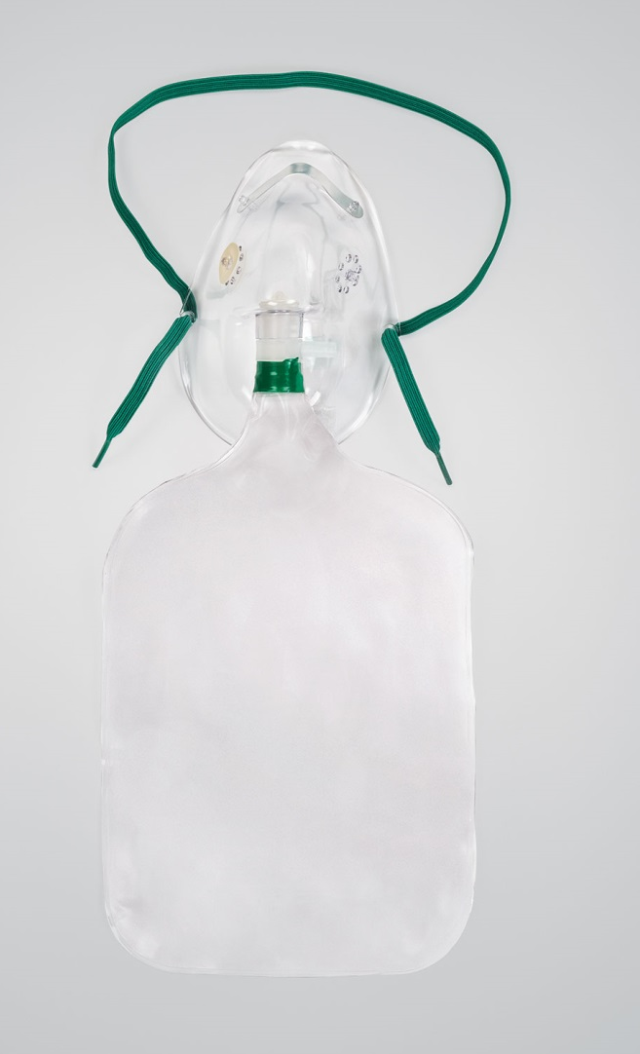
Partial Rebreather Mask
Consists of mask with exhalation ports and reservoir bag.
Reservoir bag must remain inflated.
O2 flow rate - 6 to 10L.
FIO2= 40% - 70%
Client can inhale gas from mask, bag, exhalation ports.
Poorly fitting; must remove to eat.

Slide 15
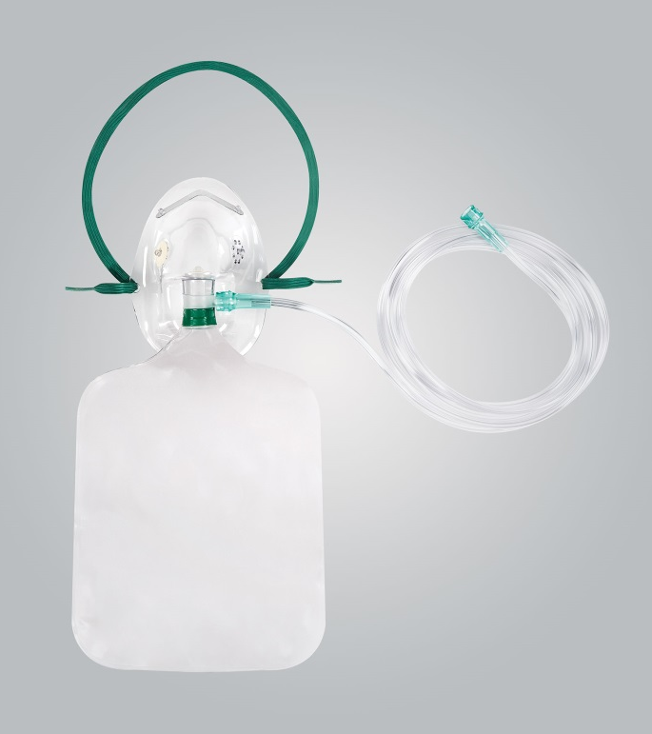
Non-Rebreathing Mask
Consists of mask, reservoir bag, 2 one-way valves at exhalation ports and bag.
Client can only inhale from reservoir bag.
Bag must remain inflated at all times.
O2 flow rate- 10 to 15L.
Fio2= 60 - 80%.
Poorly fitting; must remove to eat.

Slide 16
AirLife Oxygen Masks
AirLife Partial Rebreather Masks
  Simple mask with a reservoir bag
  Medium or high concentration
  6-10 liters per minute*, 40%-70% FiO₂
  e.g. 001205
AirLife Non-Rebreather Masks
  Includes reservoir bag and one-way valves
  High concentration
  Minimum flow of 10 liters per minute*, 60%-80% FiO₂
  e.g. 001203 – “3-in-1” mask
Revenue no’s
Code | Description | US Sales
001204 | MASK OXYGEN W/ TUBING | $23.69/case ($0.47 ea)
001203 | MASK OXYGEN ADULT 3-IN-1 W/ VENT AND TBG | $35.77 /case ($0.72 ea)
*AARC Clinical Practice Guideline; Respir Care 2002; 47(6):717-720)

Slide 17
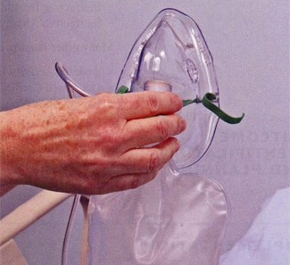
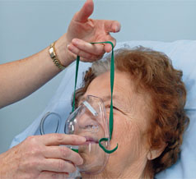
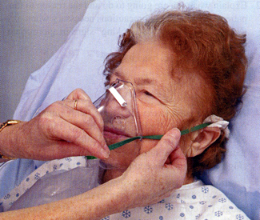
Utilising a Face Mask
Start as per Nasal Cannula
For a mask with a reservoir, be sure to allow oxygen to fill bag
Place mask on face, applying from the nose and over the chin
Adjust the metal rim over the nose and contour the mask to the face

Slide 18
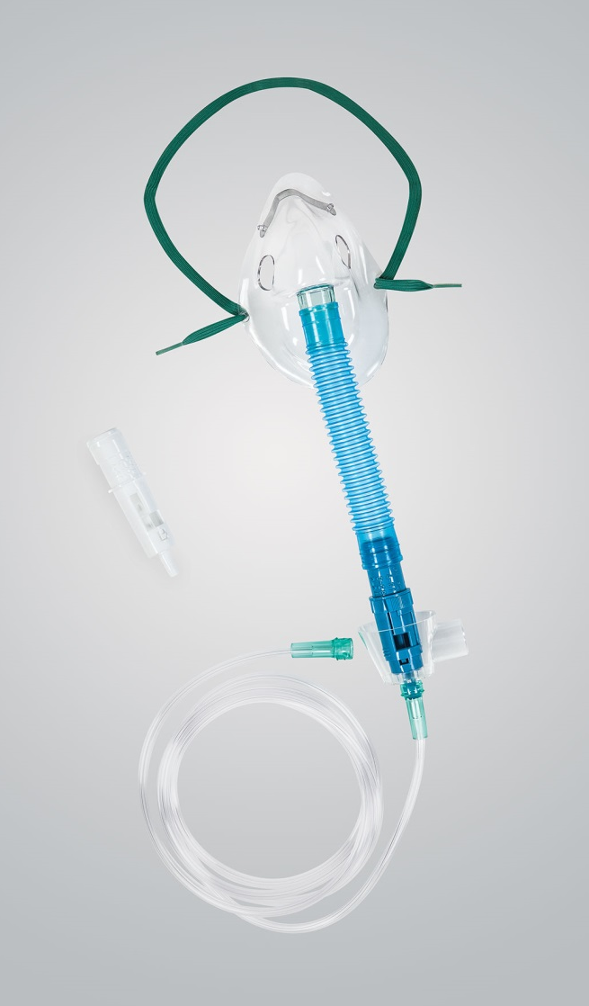
Venturi Mask
Most reliable and accurate method for delivering a precise O2 concentration.
Consists of a mask with a jet.
Excess gas leaves by exhalation ports.
O2 flow rate 2 to 15L.
Fio2, 24%-60%
Can cause skin breakdown; must remove to eat.

Slide 19
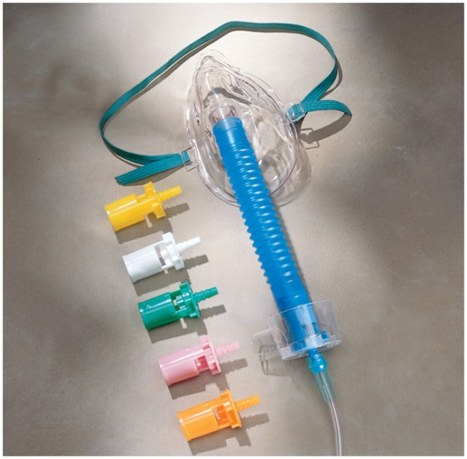
AirLife Venturi, Aerosol, Trach Masks
AirLife Venturi Masks
  Entrains oxygen with room air to achieve a
  specific FiO2
  Offered in two styles: diluter jets & dual dial
  “Lead With”: 001255
AirLife Aerosol Masks
  For medication delivery with small volume neb,
  aerosol treatment with large volume neb
AirLife Trach Masks
  For aerosol treatment direct to airway
Code | Description | US Sales
001240 | MASK AIR ENTRAIN ADULT 50/CS | $518K
001255 | MASK VENTURI DUAL DIAL ADULT 50/CS | $404K
001263 | MASK AEROSOL PED UNDER-CHIN 50/CS | $260k
001227 | MASK TRACHEOSTOMY ADULT 50/CS | $120k
Notes:
All masks (non-Southmedic) require minimum of 5 lpm
Venturi maks
-Two styles: dialed & individual nozzles
-Nozzles vary by color (differing FiO2 delivered)
-Room air entrained with O2 per the settings selected
3-in-1 masks can be used as a medium concentration (simple mask) & high concentration (non-rebreather or partial rebreather) mask

Slide 20
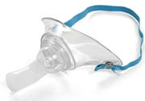
Tracheostomy Collar/Mask
O2 flow rate 8 to 10L.
Provides accurate FIO2.
Provides good humidity; comfortable.

Slide 21
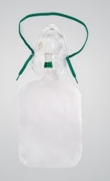

O2 range by product
Type of system | Nasal Cannula | Simple Oxygen Mask | Venturi Mask | Partial Re-breather | Non Rebreather
Type of system | Low Flow | Low Flow | High Flow | Low Flow | Low Flow
Respiratory Flow Rate (L/min) | 1 – 6 | 5 – 10 | 2 – 15 | 6 - 10 | 10 - 15
Oxygen Range % | 24 – 44 | 35 – 50 | 24 – 60 | 40 – 70 | 60 - 80
Accurate delivery of FiO2 | No | No | Yes | No | No
Ability to humidify | > 4 lpm | N | N | N | N

Slide 22

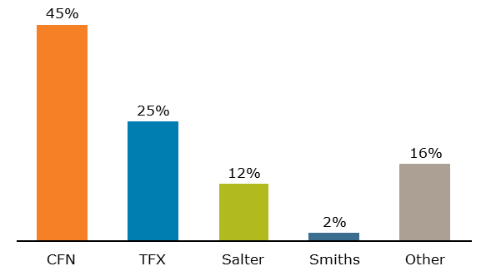

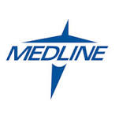


Competitive Analysis (U.S.) – O₂ Disposables
CFN Market Share
FY13: 41%
FY14: 45%
Data Source: GHX (Q2 2015)
*Tri-Anim data underreported in GHX report
22
Notes:
23

Slide 23
International View?...
Don’t know yet…. But…

Slide 24
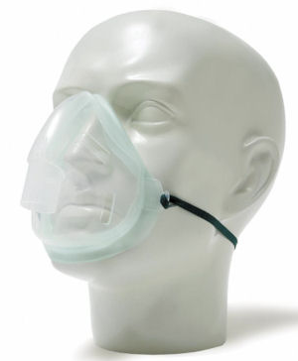
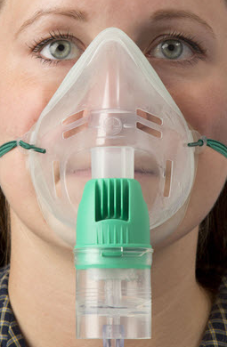
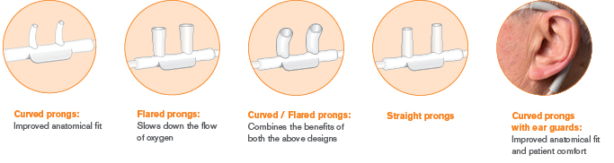

Competition
Intersurgical
Largest competitor for: Cannulas, Masks, Tubing, Small Volume Nebs
Strong on Tenders & Contracts
Broad range of cannula

Slide 25
Competition
Selling against Intersurgical
Emphasize portfolio breadth, particularly in GE IB.
Leverage non respiratory products.
CFN price competitive.
AirLife can offer a comparable portfolio.

Slide 26
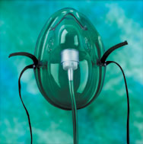
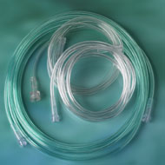

Competition
Teleflex - Hudson RCI
2nd Largest competitor for: Cannulas, Masks, Tubing, Large Volume Nebulizers, Bubble Humidifiers
2nd largest water/saline vendor
Good on contract
Hudson RCI Bi-Flo Cannulas for ETCO2
Softech Plus cannula (DEHP-free)

Slide 27
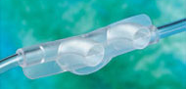

Competition
Selling against Hudson RCI
CFN price competitive

Slide 28
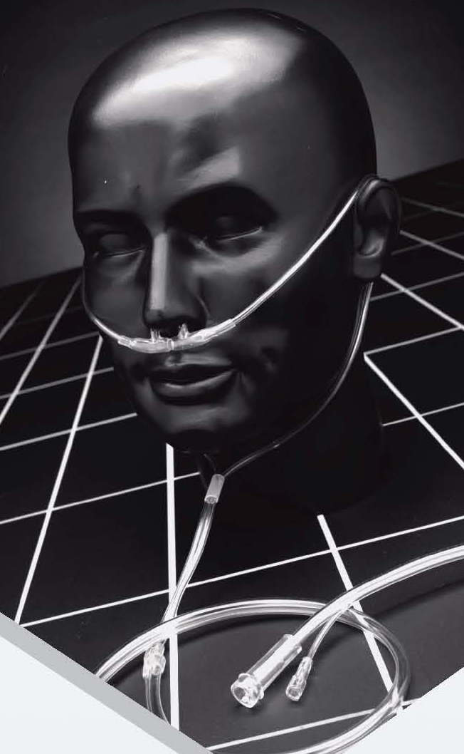
Competition
Salter Labs
Competitor for: Cannulas, Masks, Tubing
  Used to be part of the CareFusion portfolio in US
Patented Salter Eyes® design cannulas
  Described as “safety apertures to reduce the likelihood of occlusion”
Salter-Style TLCannulas™, 16SOFT Cannulas
  TLC includes Salter’s E-Z Wrap covers

Slide 29
Thank you

