Slide 1
Vyaire CSC Verso™

Slide 2
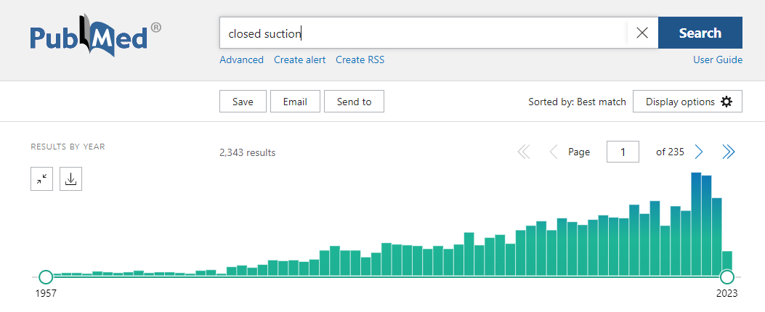
CSC Verso™
PubMed Research

Slide 3
Overview
Endotracheal suctioning
Intubated patients may be unable to adequately cough up secretions.
Endotracheal suctioning is therefore important in order to reduce the risk of consolidation and atelectasis that may lead to inadequate ventilation.
The suction procedure is associated with complications and risks including bleeding, infection, atelectasis, hypoxemia, cardiovascular instability, elevated intracranial pressure, and may also cause lesions in the tracheal mucosa.

Slide 4
Endotracheal suctioning
Indications
Cleaning the airway from mucuse
Mucuse is visible in ETT
Oxygen desaturation
Obtaining tracheal secretions for diagnostic purposes

Slide 5
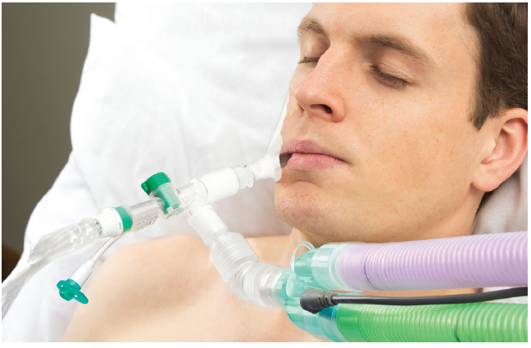
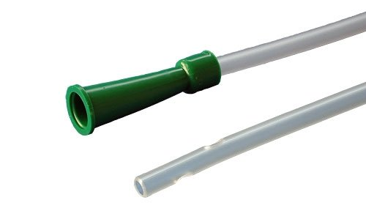
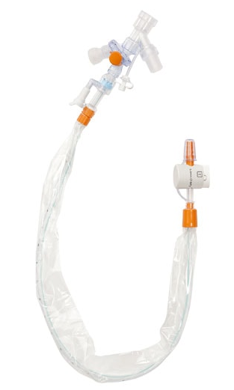
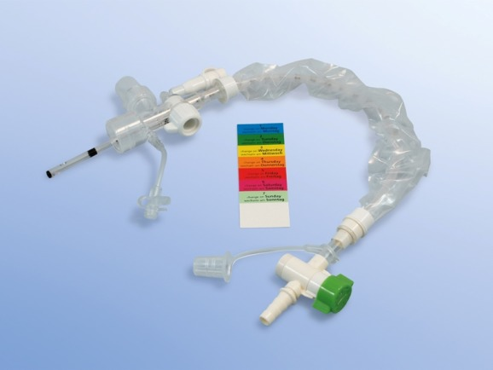
Endotracheal Suctioning
What is the right way?

Slide 6
Closed Endotracheal Suction
Today due to Covid-19
Closed Suction since Pandemic - Standard of care
Avoiding spreading of aerosols
Protect nursing staff
Avoiding derecruitment of lungs
Minimalising risk of Ventilator Associated Pneumonia (VAP)
Maintain Positive Pressure (PEEP)

Slide 7
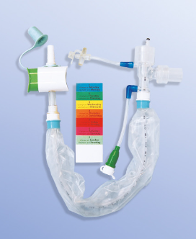
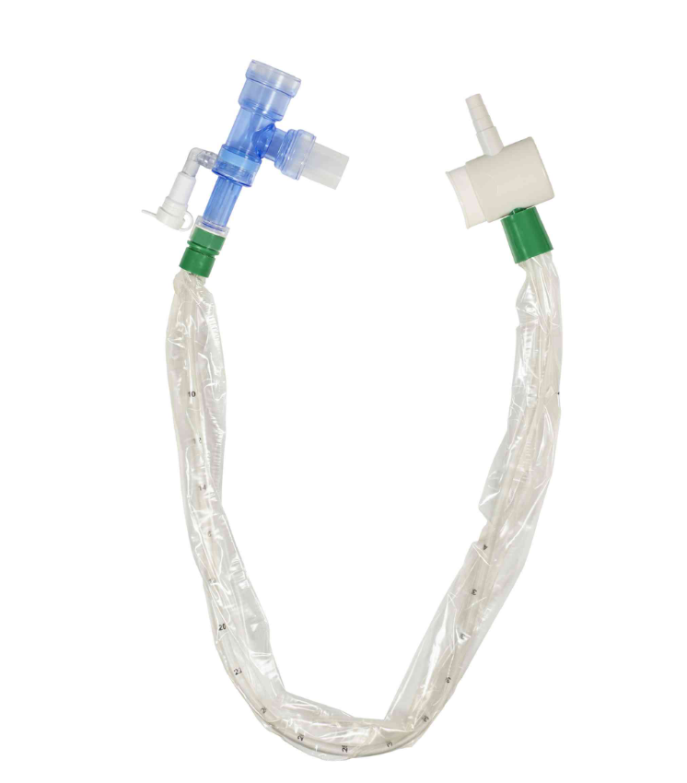
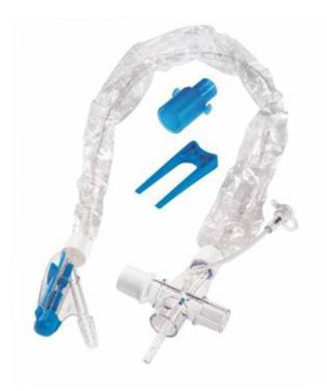
Closed Suction Systems
Competitors
BALLARD Closed Suction System, reusable up to 24h
AVANOS
Dahlhausen, Optiflow 48 h
Smiths, SuctionPro 72 h

Slide 8
Vyaire CSC Verso™
Modular System
CSC100 Airway Adapter
CSC116 Closed Suction Catheter

Slide 9
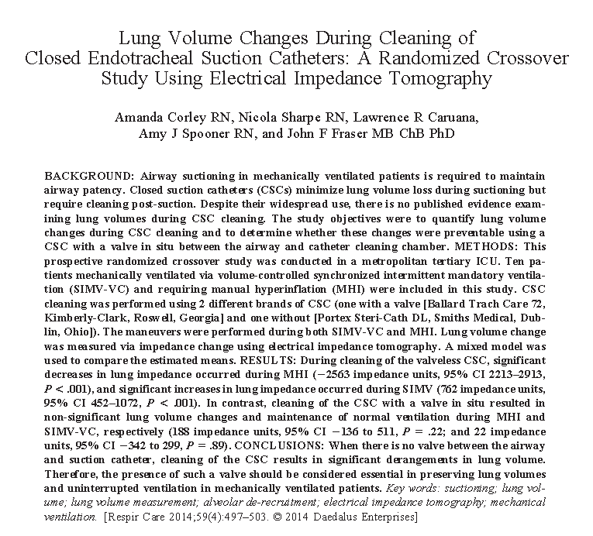
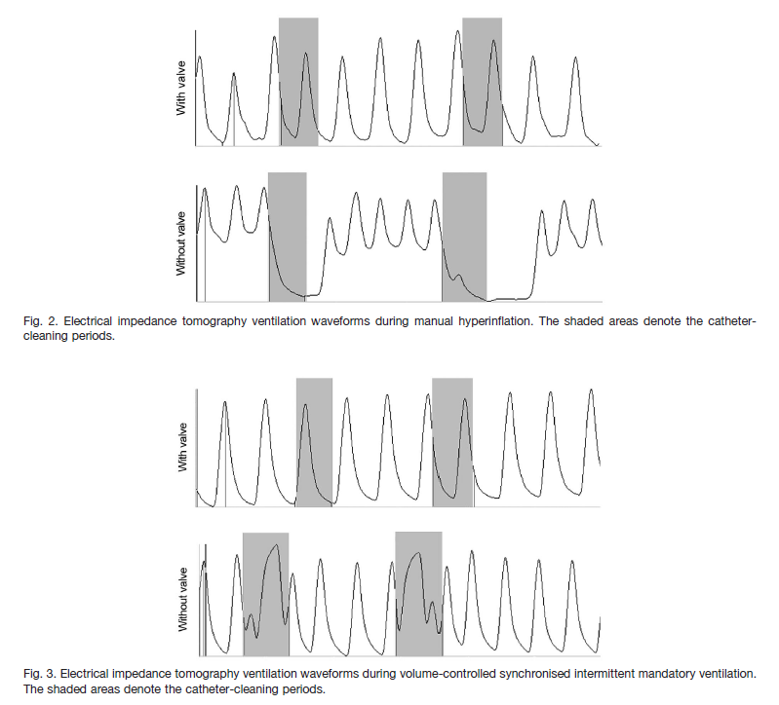
Closeds Suctioning

Slide 10
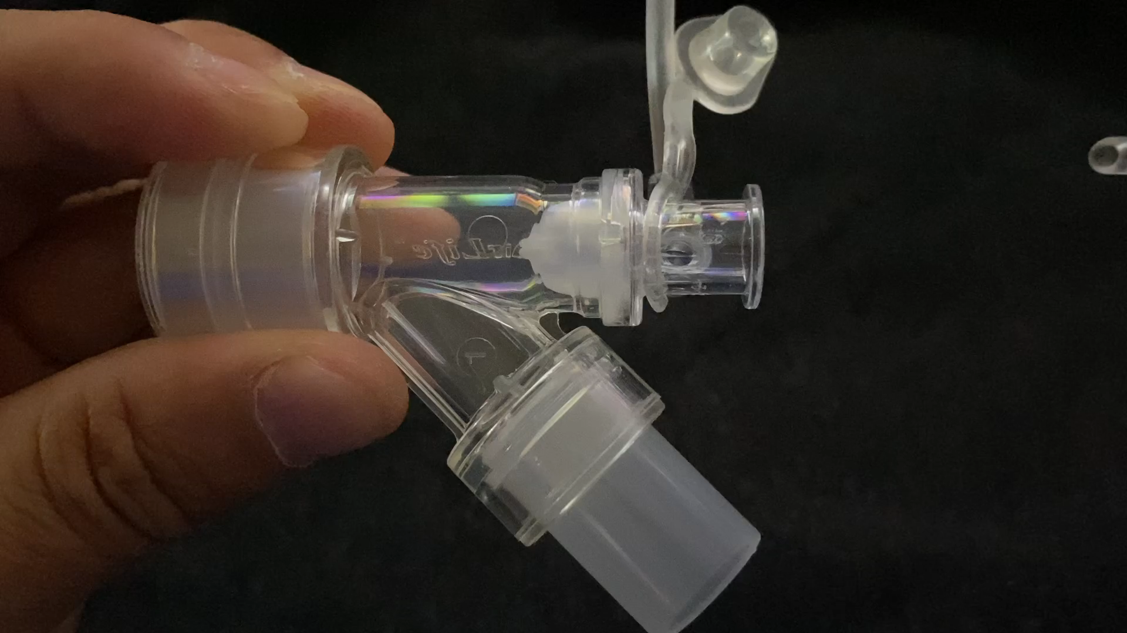
Vyaire CSC Verso™
CSC100 Airway Adapter
Pucker Valve Technology

Slide 11
Bronchoscopy in ICU
Mini-Broncho Alveolar Lavage (BAL)
Several times per day sample collection for identifying germs
Disconnection needed
Lost of PEEP
Contaminaton due aerosoles possible

Slide 12
Cost Calculator
Vyaire CSC Verso™

Slide 13
PPT TEMPLATE DO’S & DON’TS

