Slide 1
Air-Q3
Supraglottic Airway (SGA)

Slide 2
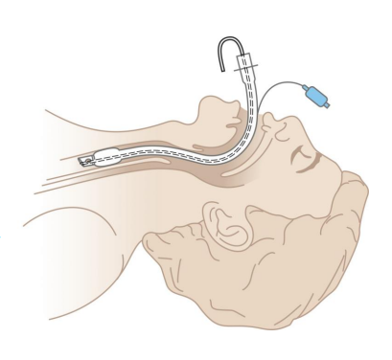
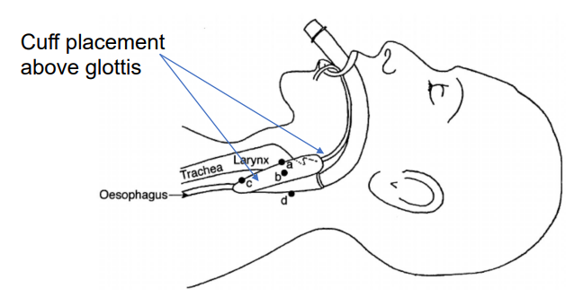
Laryngeal mask vs. Endotracheal Tube
Supraglottic
Supraglottic airways (known as SGA, or LMA™ Laryngeal Mask Airways) are placed above the glottis. These airways were a mainstay of the surgery suite, providing temporary airways for short procedures, rather than performing an invasive procedure like endotracheal intubation. Now, they are used in emergency management, in and out of the hospital and other healthcare environments.
Endotracheal
An endotracheal tube is a tube constructed of polyvinyl chloride
that is placed between the vocal cords through the trachea. It serves to provide oxygen and inhaled gases to the lungs and protects the lungs from contamination, such as gastric contents or blood.

Slide 3
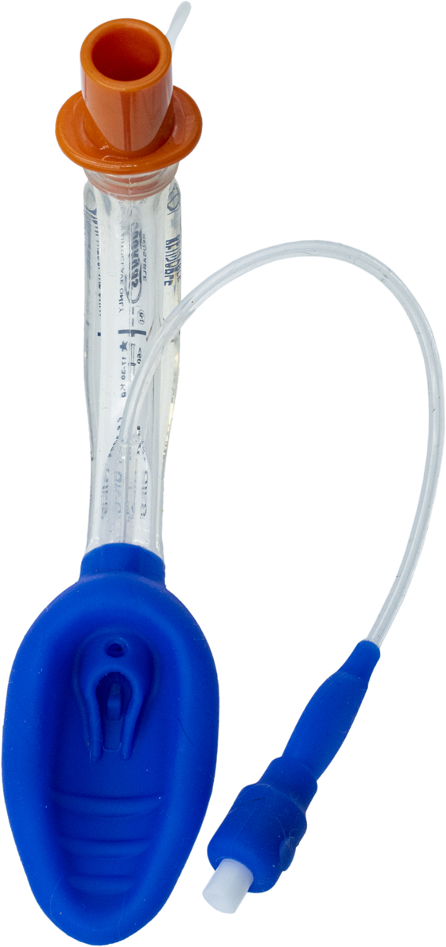
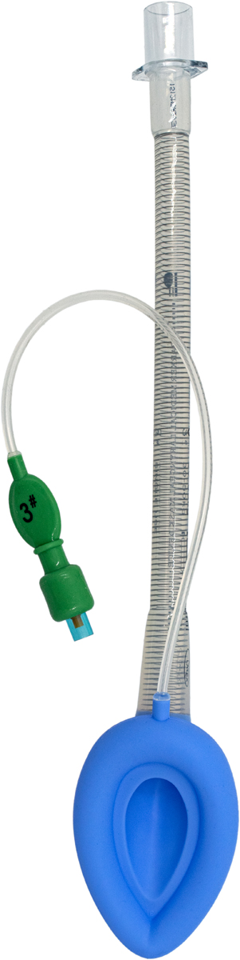
Classification SGA
SGA’s are classified by generation:
Gen 1:
Standard, with inflatable cuff.
Gen 2:
With inflatable and non-inflatable cuff (iGel), gastric access, ability to intubate, integrated bite block.
Gen 3:
Does AirQ3 take us there?

Slide 4

Air-Q3 G

Slide 5
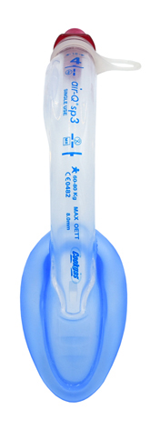
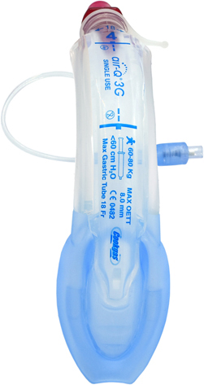
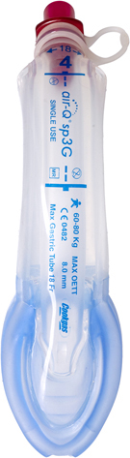
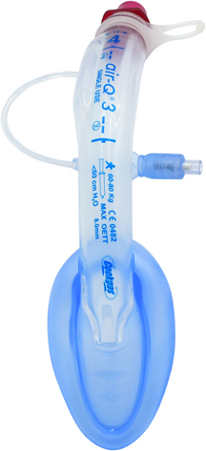
Air-Q3 Portfolio
Air-Q3 – Gen 2 | Air-Qsp3 – Gen 2 | Air-Q3G -Gen 2 | Air-Qsp3G - Gen 3
30005 | 40005 | 50005 | 60005
30055 | 40055 | 50055 | 60055
30105 | 40105 | 50105 | 60105
30155 | 40155 | 50155 | 60155
30205 | 40205 | 50205 | 60205
30305 | 40305 | 50305 | 60305
30405 | 40405 | 50405 | 60405
30505 | 40505 | 50505 | 60505
Single tube with integrated bite block
Manual inflation with pilot balloon
Single tube with integrated bite block
Self-pressurizing mask
Single tube with integrated bite block
Manual inflation with pilot balloon
Dual gastric channels with integrated bite block
Self-pressurizing mask
Focus Area:
Focus Area:
Focus Area:
Focus Area:
OR
ER
OR
ICU
ER
OR
ICU
ER
OR
ICU
ER

Slide 6
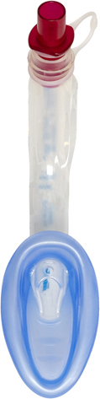
Air-Q3 Features
Color-coded connector for easy size identification. Removable tethered connector enables insertion of endotracheal tube through airway tube.
Color coded connector
All silicone
Anatomical Curve
Elevated Mask heel
Epiglottis Elevator
ETT Ramp
Dual Gastric Channels (G models)
Self Pressurizing Mask (SP models)
Anatomically curved, medical grade silicane airway tube with integrated bite block
Aperture enables transfer of air if the inlet becomes blocked
Exclusive epiglottis elevator lifts the epiglottis to maximize cuff placement
Soft medical grade silicone cuff
Self-pressurizing cuff inflation is controlled by inspiratory/expiratory pressure. No manual inflation needed
Air-Qsp3

Slide 7
Clinical Difference of Silicone
Selling the all-silicone feature. Silicone has been deemed body safe in a solid form, for implantation and use in invasive procedures. Silicone is unaffected by body heat and humidity, which means it will retain its shape.
Silicone also requires very little lubricant when inserting into an airway, which will allow it to slide in with little difficulty. This also applies to intubating with a PVC tube or placing a gastric tube. PVC and silicone do not ‘stick’ together, like PVC on PVC will. Thus, requiring very little, if any, lubricant to allow insertion of the ETT or gastric catheter into the AirQ3.

Slide 8
Clinical Relevant Selling Features
Anatomical Curve follows the anatomy for easier placement.
Larger Mask heel and epiglottis elevator allows epiglottis to rise further up, opening the glottis further.
ETT ramp directs the tip of the ETT towards the glottic opening for more chances of 1st pass success when intubating.
Larger gastric opening at the distal tip and large dual gastric channels allow for better flow (sump drain), removing more secretions and lessening the chance of blockage. It also allows for larger catheters to be placed if desired.
Equilibrium port that allows for the self-pressurizing mask to equilibrate with ventilating pressures to ‘seal’ the airway.

Slide 9
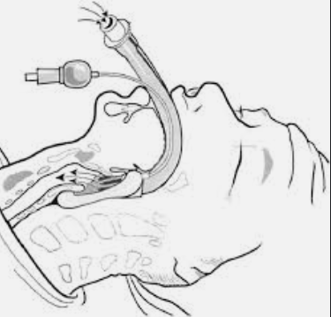
What is „Self-Pressurizing“?
When an SGA is inserted, the mask is inflated to create a seal above the glottis allowing for gas flow to the lungs. This has traditionally been done using a syringe and a pilot line to fill the mask.
i-gel launched a non-inflatable cuff device that uses a thermoplastic elastomer to ‘seal the airway’.
The AirQ3 self-pressurizing model allows for the mask to inflate based on the transpulmonary pressure that exists in the airways. When transpulmonary pressure is increased in the case of positive pressure ventilation with a ventilator, resuscitation device, or mouth-to-tube, there is an equilibrium port in the heel of the mask, that allows the mask to inflate proportional to the transpulmonary pressure increase, or ventilation pressure.
Mask seal
In spontaneously breathing patients, the mask itself creates a seal, and as transpulmonary pressure is minimal in spontaneous breathing, very little ‘seal’ is needed as the negative pressure from the dropping of the diaphragm and the chest wall expanding creates the gas flow and pressure needed to expand the lungs.

Slide 10


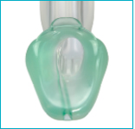
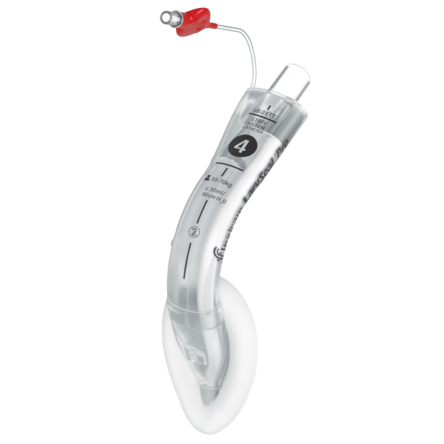


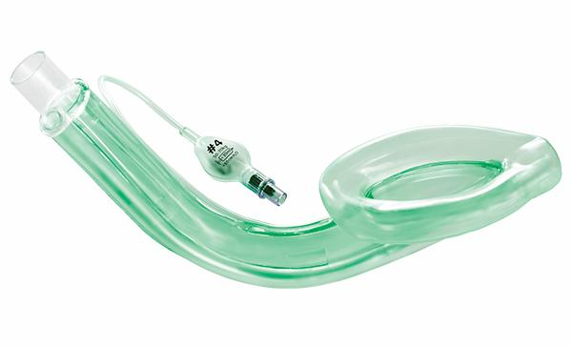
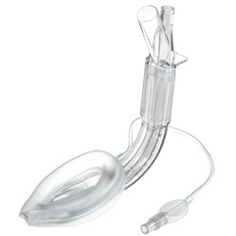
Competitor Landscape
Gen 1 | Gen 2 | Gen 3
Solus™ Standard Solus™ Satin Solus™ MRI Solus™ Curve Solus™ Flexible reinforced | i-gel® | i-gel® Plus
Gen 1 | Gen 2 | Gen 3
LarySeal Blue LarySeal Clear LarySeal Mutliple LarySeal MRI | LarySeal Pro
Gen 1 | Gen 2 | Gen 3
LME Unique LMA Classic LMW SureSeal | LMA Protector LMA Supreme LMA ProSeal LMA Guardian
Gen 1 | Gen 2 | Gen 3
Ambu® AuraStraight™ Ambu® AuraOnce™ Ambu® AuraFlex™ Disposable Laryngeal Mask Ambu®Aura-i™ | Ambu® AuraGain

Slide 11
Company | Product | Generation | Competitor Features | AirLife Strategy
Standard LMA/SGA |  | 1 | Low-Cost, available anywhere | SunMed LMA at comparable cost
AMBU | AuraGain | 2 | Low-cost with decent quality, Anatomically curved, gastric access, ability to intubate, MR safe | Air-Q3G
 | AuraStraight | 1 | Easy glide, extra soft, MR safe, phthalate free, use in OR and emergency medicine | Air-Q3 or SunMed LMA based on cost concerns
Teleflex | LMA Supreme | 2 | Gastric access, effective “First Seal™” and innovative Secon Seal (which minimizes gastric insufflation | Air-Q3G or Air-Qsp3G
 | LMA Unique | 1 | Versatile, single use, aperture bars, soft, flexible cuff | Air-Q3 or SunMed LMA based on cost concerns
Flexicare | LarySeal Pro | 2 | Integrated suction catheter port, ability to intubate, bite guard, epiglottic flap | Air-Q3 G
 | LarySeal Clear | 1 | Satin finish PVC, crush resistant, color-coded balloon, clear view | Air-Q3 or SunMed LMA based on cost concerns
Intersurgical | i-gel Plus | 3 | Non-inflating cuff (1st and only), gastric access, ability to intubate | Air-Qsp3G
 | Solus | 1 | Lower end line, 4 version, including Satin, MRI, curved & flex | Air-Q3 or SunMed LMA for flex models

Slide 12
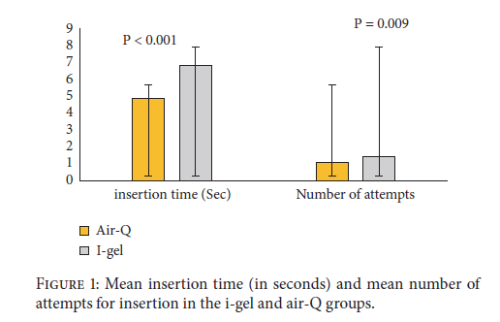
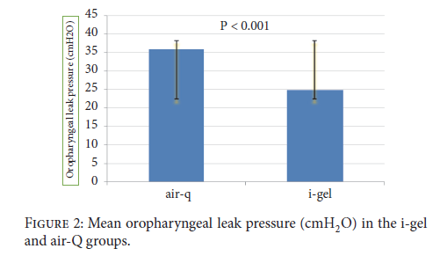
Air-Q® vs i-gel®
Insertion time & number of attempts
Oropharyngeal Leak Pressure (OLP)
Massoudi et al., BioMed Research International, Volume 2018

Slide 13
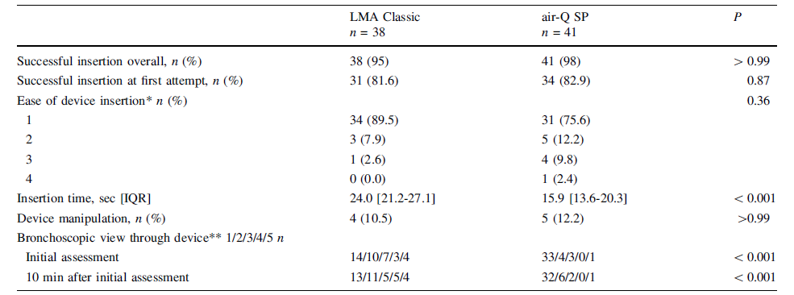
Air-Q® vs LMA Classic
Insertion time & number of attempts
Ha et al., Can J Anesth/J Can Anesth (2018) 65:543–550

Slide 14
Thank you

