Slide 1
Endotracheal Tubes

Slide 2
Intubation Risks
Aspiration: When a person is intubated, they may inhale vomit, blood or other fluids.
Endobronchial intubation: The tracheal tube may go down one of two bronchi, a pair of tubes that connect your trachea to your lung. This is also called mainstem intubation.
Esophageal intubation: If the tube enters your esophagus (food tube) instead of your trachea, it can result in brain damage or even death if not recognized soon enough.
Failure to secure the airway: When intubation doesn’t work, healthcare providers may not be able to treat the person.
Infections: People who’ve been intubated may develop infections, such as sinus infections.
Injury: The procedure can potentially injure your mouth, teeth, tongue, vocal cords or airway. The injury may lead to bleeding or swelling.
Problems coming out of anesthesia: Most people recover from anesthesia well, but some have trouble waking or have medical emergencies.
Tension pneumothorax: When air gets trapped in your chest cavity, this can cause your lungs to collapse.

Slide 3
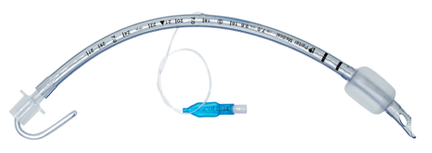
What is an Endotracheal Tube?
Definition: An endotracheal tube is a tube constructed of polyvinyl chloride that is placed between the vocal cords through the trachea. It serves to provide oxygen and inhaled gases to the lungs and protects the lungs from contamination, such as gastric contents or blood.
Care Areas:
OR
ICU
ED
Stylet
Pilot Balloon
Inflation Valve
15 mm Connector
Murphy Eye
Cuff
Vocal Cord Lines
Magill Curve

Slide 4
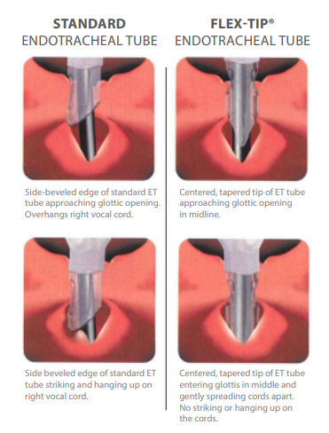
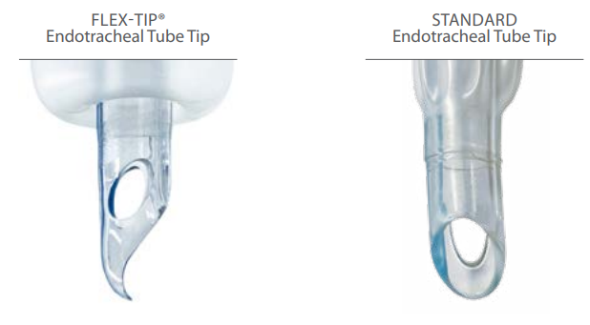
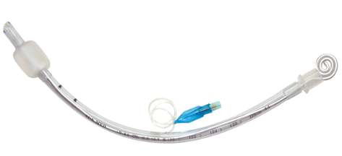
Endotracheal Tube Products

Slide 5
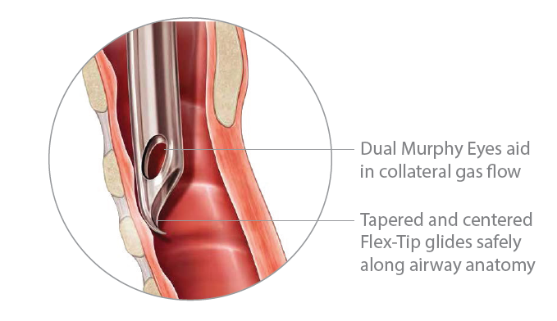
ET Tubes – Specialties – Flex Tip
Unique patented design helps avoid airway collisions, providing a smooth and easy intubation.

Slide 6
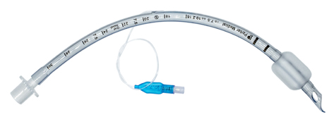
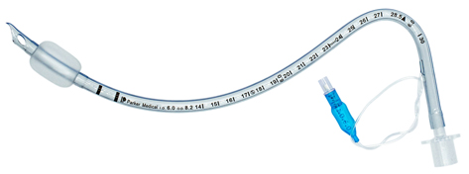
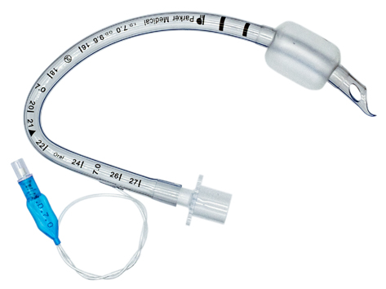
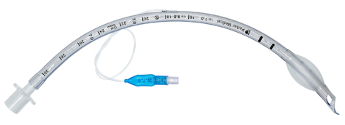
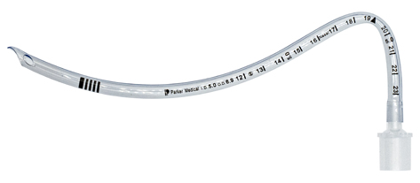
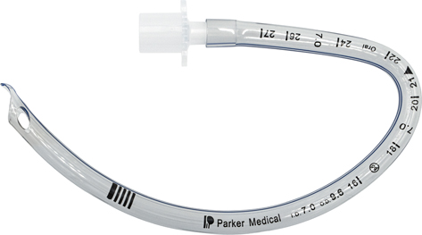
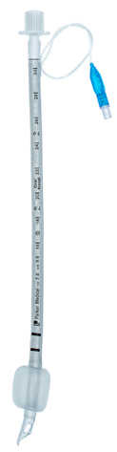

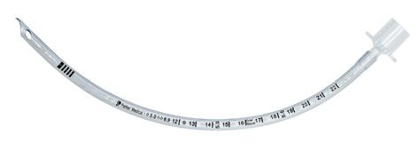
Flex-Tip Endotracheal Tubes
High Volume Low Pressure, Cuffed (PFHV)
4.0 mm – 9.5 mm
Prefomed, Nasal,Cuffed (PFNC)
4.0 mm – 9.0 mm
Prefomed, Oral,Cuffed (PFOC)
4.0 mm – 9.0 mm
Low Profile, Cuffed (PFLP)
4.0 mm – 9.5 mm
Preformed, Nasal, Uncuffed (PFNU)
3.0 mm – 7.0 mm
Preformed, Oral, Uncuffed (PFOU)
3.0 mm – 9.0 mm
Endotracheal Tube, Uncuffed (PFUO)
2.5 mm – 7.0 mm
Reinforced, Cuffed (PFRC)
5.5 mm – 9.5 mm
Reinforced, Uncuffed (PFRU)
3.0 mm – 5.0 mm

Slide 7
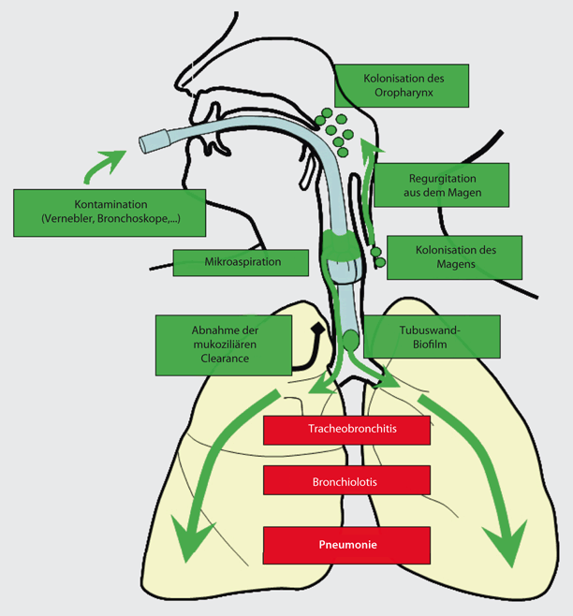
Ventilator Associated Pneumonia (VAP)
Ventilator-associated pneumonia (VAP) occurs in patients that have been on mechanical ventilation for more than 48 hours.
Artificial airways become colonized with pathogenic bacteria soon after intubation or tracheostomy
Development of ventilator-associated pneumonia: most commonly it is thought to be a progression from colonization of the upper airway, leading to tracheal colonization, then tracheitis, and finally pneumonia
Intubation compromises the integrity of the oropharynx and trachea and allows oral and gastric secretions to enter the lower airways
Colonization of
oropharynx
Regurgitation
from stomach
Contamination
(Nebulizer, Bronchoscopes,…)
Microaspiration
Colonalization of
stomach
Reduction of
mucociliar clearance
Tube wall biofilm
Tracheo bronchitis
Broncheolitis
Pneumonia
Dembinski, Roussaint, Der Anaesthesist volume 57, pages825–842 (2008)

Slide 8

Subglottic Suctioning

Slide 9
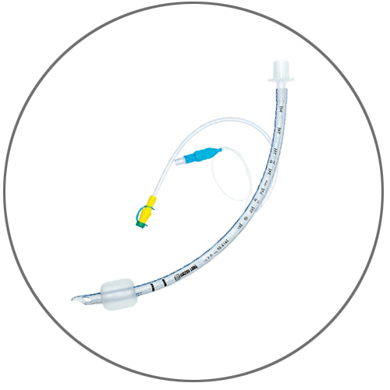
ET Tubes – Specialties
Subglottic Suctioning may reduce Ventilator Associated Pneumonia up to 50% ^{1,2,3,4}
Unique patented design helps avoid airway collisions, providing a smooth and easy intubation.
Trach-Vac Subglottic Suction Endotracheal Tube with Flex-Tip® and Polyurethane Cuff
Dezfulian C, Shojania K, Collard HR et al (2005) Subglottic secretion drainage for preventing ventilator-associated pneumonia: a meta-analysis. Am J Med 118:11–18
Lacherade JC, De Jonghe B, Guezennec P et al (2010) Intermittent subglottic secretion drainageand ventilator-associated pneumonia: a multicenter trial. Am J Respir Crit Care Med 182:910–917
Muscedere J, Rewa O, McKechnie K et al (2011) Subglottic secretion drainage for the prevention of ventilator-associated pneumonia: a systematic review and meta-analysis. Crit Care Med 39:1985–1991
Wang F, Bo L, Tang L et al (2012) Subglottic secretion drainage for preventing ventilator-associated pneumonia: an updated meta-analysis of randomized controlled trials. J Trauma Acute Care Surg 72:1276–1285

Slide 10
Thank you

