Slide 1
NIV
Marie-Louise Bluffield, Sr. Product Specialist
Holly Pattie-Belleli Account manager
EMEAC

Slide 2
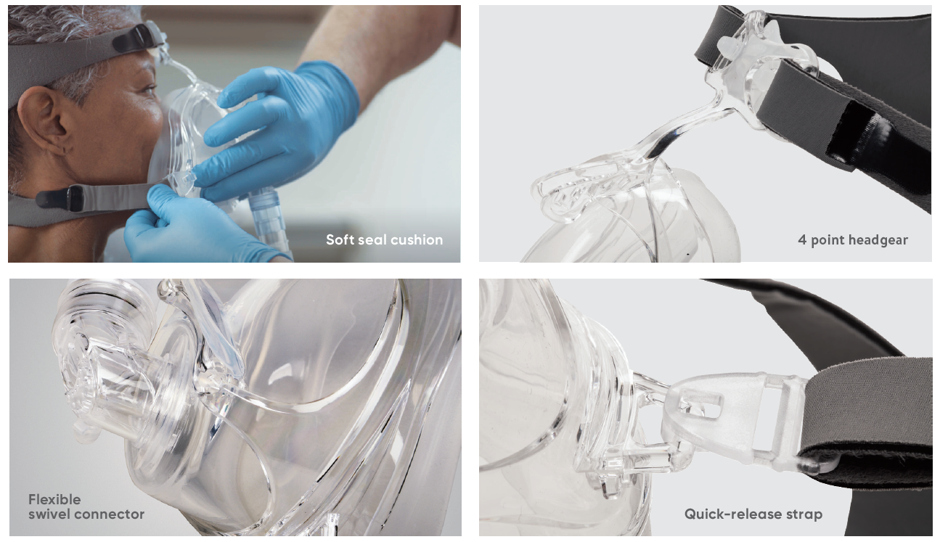
Strategy
Features and clinical benefits
Generate more business!
Target Areas: ICU, RESP WARDS, HDU, RESP Physios, procurement
Multiple means of communication, phone, email, sample packs, lunch meetings, audit/study days
Sales pitch – be aggressive
Focus on features and benefits
Price – we are extremely competitive compared to other brands in the field
Notes:
Explain novation from aquilant – massive op
Strategy moving forward
Refresher on F&B
Not just ICU use NIV – A/M ask procurement about cost saving exercises for niv
Don’t just email…
This will be ongoing

Slide 3

NIV feature and benefits https://www.youtube.com/watch?v=0hP-g4l4OKk
Notes:
Start at 3 min 21.

Slide 4
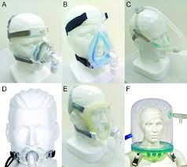
What is a NIV Mask?
Non-invasive ventilation (NIV) is a way of helping patients breathe more deeply by blowing extra air into their lungs via a mask when you breathe in.
This supports patients breathing, rests breathing muscles and gives patients time to recover.
By assisting patients breathing, NIV can increase the oxygen levels and decrease the carbon dioxide levels in the blood.

Slide 5
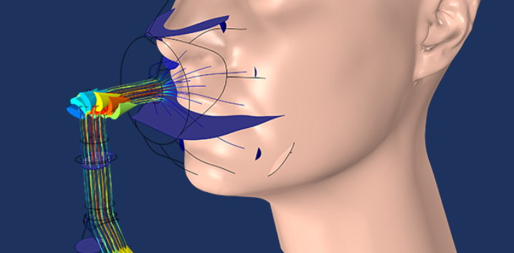
How does a NIV mask work?
Patients receiving NIV need to wear a cushioned mask which is connected to a machine. The mask either fits over the nose alone, or over both the nose and mouth.
As patients take a breath in they will feel a flow of air and oxygen into their lungs from the machine.
As patients breathe out there will be a small amount of air / resistance to help keep their lungs open.
This continual positive pressure helps to ‘splint’ the airways open, enabling patients to take bigger breaths with less effort therefore helping them rest tired respiratory muscles.

Slide 6
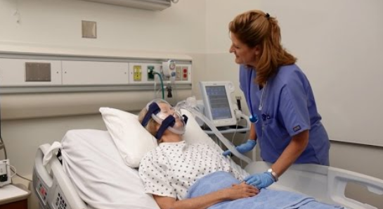
Why should a patient have a NIV mask?
When we breathe in, we take oxygen out of the air to keep us alive. Our bodies use oxygen to make energy and produce carbon dioxide as a waste product, which we breathe out.
When we experience a breathing problem, such as a chest infection, breathing becomes harder work and our muscles get tired.
Our body may not be able to take in enough oxygen and you might get a build up of the waste gas, carbon dioxide.

Slide 7
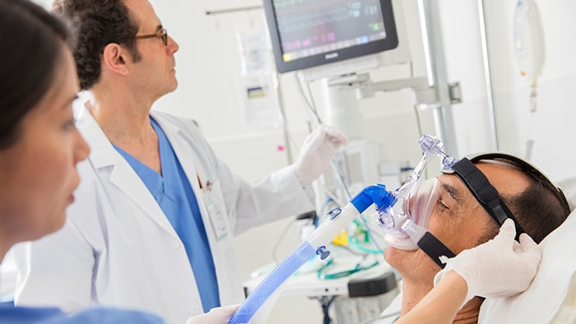
How to decide when a patient needs a NIV mask?
Patients will have a blood sample taken from an artery to accurately measure oxygen and carbon dioxide levels.
Whilst poor levels of oxygen can be treated by providing extra oxygen, (either by nasal cannula or a mask), high carbon dioxide levels require NIV to help get rid of the carbon dioxide and to rest the respiratory muscles.

Slide 8
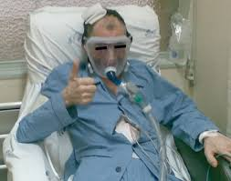
What happens during NIV?
NIV can feel strange at first, but most patients adjust quickly, and as it supports their breathing and therefore often allowing them to relax and get some sleep.
The mask has to be applied firmly to make sure enough air from the machine goes into a patients lungs without too much leaking from the mask.

Slide 9
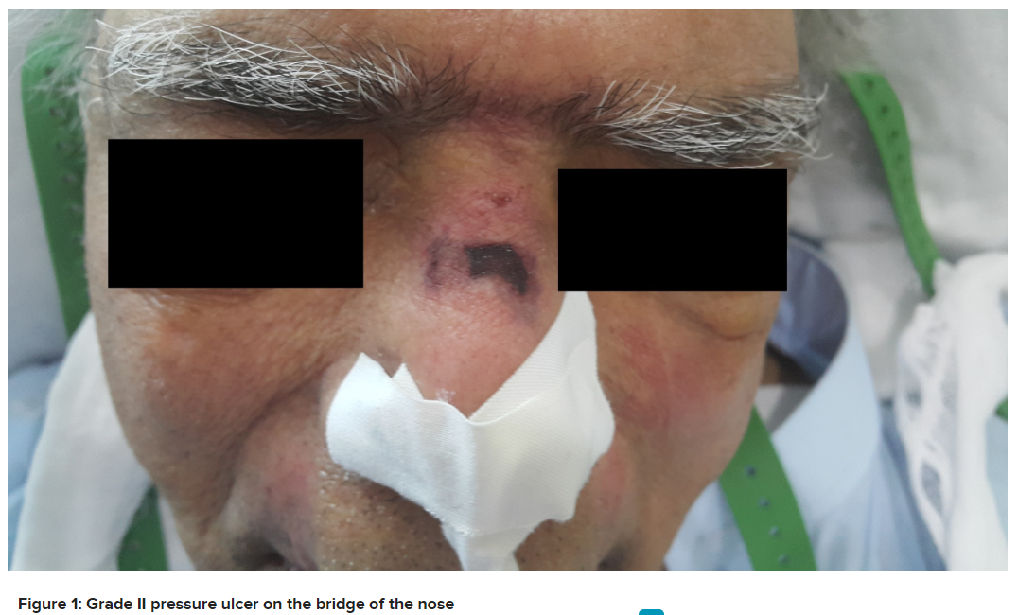
What problems are associated with NIV masks?
Skin ulceration - some patients get sore skin and complain of discomfort on the bridge of their nose.
Poor mask fit - some patients complain of the NIV machine alarming, this is due to too much air leaking from the sides of the mask.
Overtightening the head gear in an attempt to reduce leakage exacerbates skin damage resulting in poor compliance.
Mask fit is therefore very important for comfort and to ensure effective ventilatory support.
https://www.cureus.com/articles/5246-case-report-of-a-pressure-ulcer-occurring-over-the-nasal-bridge-due-to-a-non-invasive-ventilation-facial-mask
The authors present a case report of an unusual pressure ulcer developing on bridge of the nose due to the prolonged application of an NIV facial mask.

Slide 10
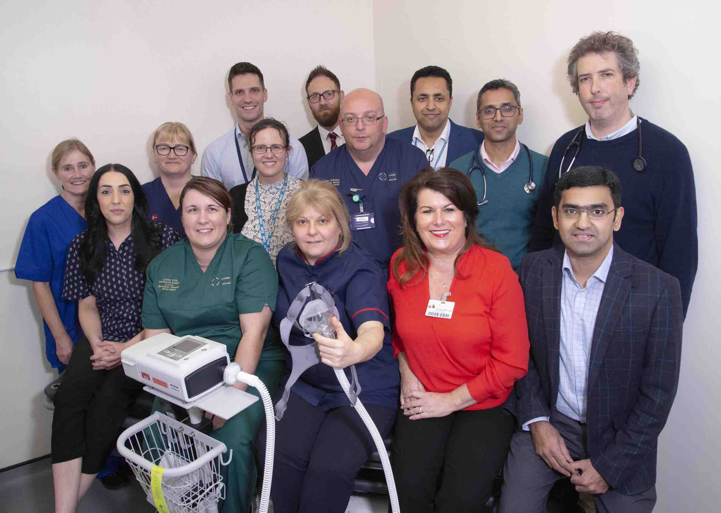
What hospital depts use NIV masks?
Respiratory Units
ICU
HDU
Notes:
Can anyone think of any more? – home care

Slide 11

Stakeholders
ICU – equipment leads, stores, resp physios, Matrons, Consultants
RESP Units – resp physios, nurses
HDU – matrons, sisters, resp physios, nurses
Procurement – clinical and buyers
Notes:
Working with all and not just one

Slide 12
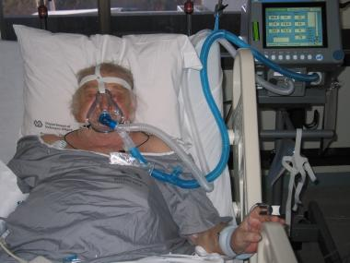
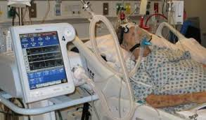
What types of patients require a NIV mask?
COPD – Chronic Obstructive Pulmonary Disease, lung condition that causes breathing difficulties
Hypercapnic respiratory failure - too much CO2 in the blood and not enough O2 in the blood
Cardiogenic pulmonary oedema - excess fluid in the lungs
Weaning from tracheal intubation

Slide 13

What types of patients don’t require a NIV mask?
Impaired consciousness – a state where consciousness has been affected by damage to the brain
Severe hypoxaemia – really low oxygen levels in the blood
Patients with copious respiratory secretions

Slide 14
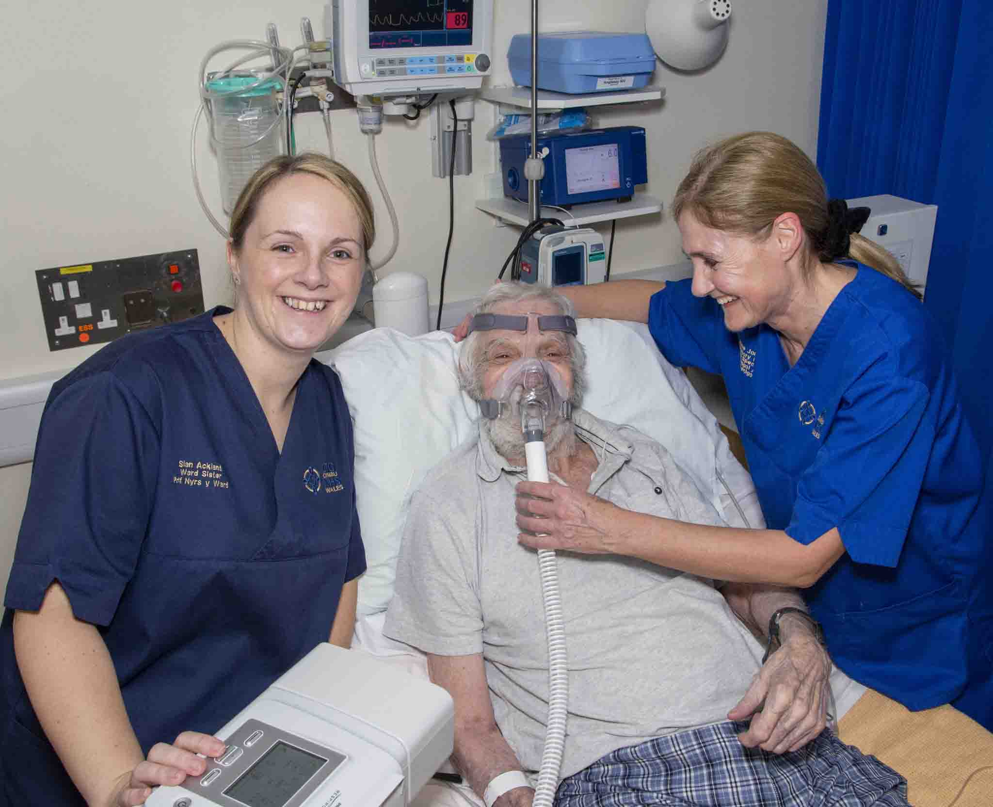
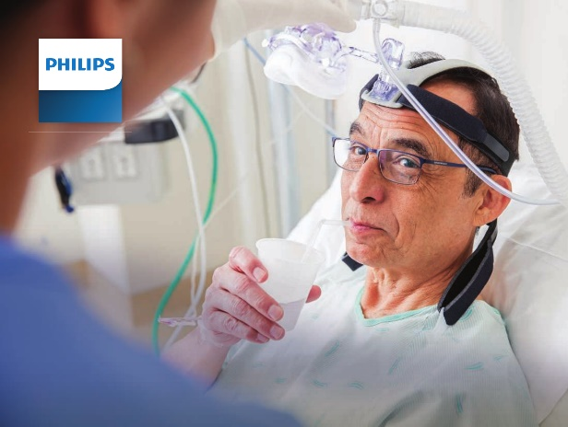
What are the benefits of using NIV to the NHS?
Fewer patients referred to intensive care for intubation
Shorter stays on intensive care
Fewer deaths of patients with acute respiratory failure

Slide 15
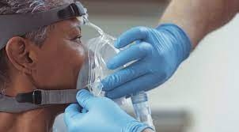
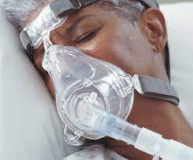
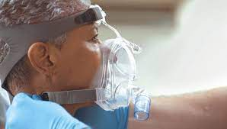
Vyaire NIV Masks

Slide 16
Features of the Vyaire NIV Mask
Soft seal
4-Point head gear
Quick clip
No added DEHP
Flexible, double swivel elbow
External frame
Large, soft forehead pad

Slide 17
External frame
External Frame
No part of the frame is directly connected with the inner mask, preventing pressure points by evenly distributing the pressure around the patients face.

Slide 18
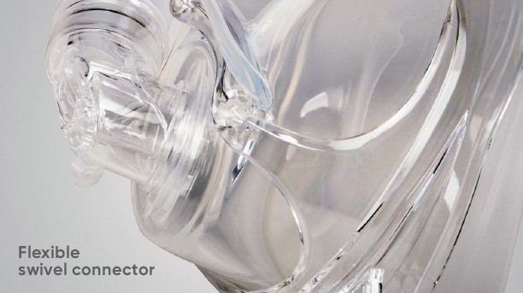
Flexible elbow
The flexible swivel elbow of the AirLife NIV mask reduces the torque applied to the seal between the mask and patient, helping to minimise pressure points.

Slide 19
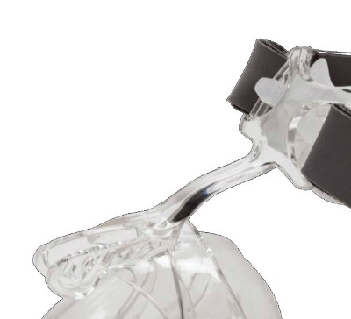
Large soft adjustable forehead pad
Large soft forehead pad
Adjustable pivot
Adjustable forehead rest helps achieve an optimum fit to the patients face.
Combined with the large soft forehead pad providing added comfort and stability.

Slide 20
Soft seal
Soft Silicone Cuff
The lightweight silicone design contours to the patient’s face, providing both a low pressure seal and a comfortable fit.

Slide 21
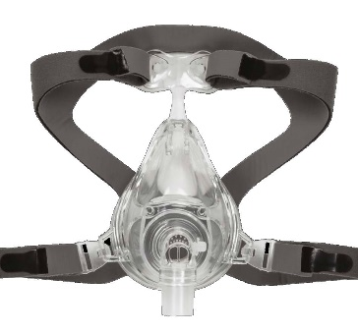
Four point head gear
4 point head gear
The four point head gear provides an even distribution of pressure around the back of the head aiding a good fit with low pressure on the patients face.

Slide 22
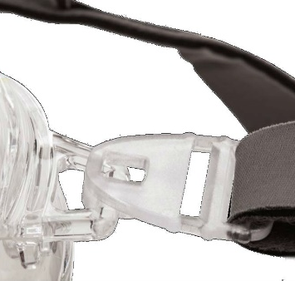
Quick clip
Quick Release Clip
After careful initial fitting of the mask the quick release clip eliminates the need to refit after removal, helping reduce the chance of overtightening.

Slide 23

No DEHP
DEHP has been shown to be a potential carcinogen with links to possible effects on reproductive health in animal studies. The AirLife NIV mask is not made with DEHP.
https://ec.europa.eu/health/scientific_committees/emerging/docs/scenihr_o_047.pdf

Slide 24
NIV Mask Decision Tree
Does the customer have a 2 tube Ventilator
Yes
No
Offer
NIV 041 Mask
Dark Blue
Does their 1 limb circuit have an exhalation port?
(No Valve in Mask as it is in the Vent)
Yes
No
Offer
NIV 040 Mask
Clear
Offer
NIV 043 Mask
Light Blue
(No holes in Mask as it is in the tube)
(Holes in Mask as it is not in the tube)

Slide 25
Which NIV mask to use?
© 2015 CareFusion Corporation or one of its subsidiaries. All rights reserved.

Slide 26
Part numbers
Code | Description | Elbow Colour | UOM | Pack Factor
NIV040L | MASK, NIV FULL FACE, VENTED, LARGE W/AAV | Clear | Case | 10
NIV040M | MASK, NIV FULL FACE, VENTED, MED W/AAV | Clear | Case | 10
NIV040S | MASK, NIV FULL FACE, VENTED, SMALL W/AAV | Clear | Case | 10
NIV043L | MASK, NIV FULL FACE, NONVENTED,LRG W/AAV | Light Blue | Case | 10
NIV043M | MASK, NIV FULL FACE,NONVENTED, MED W/AAV | Light Blue | Case | 10
NIV043S | MASK, NIV FULL FACE,NONVENTED, SM W/AAV | Light Blue | Case | 10
NIV041L | MASK, NIV FULL FACE, NONVENTED, LARGE | Dark Blue | Case | 10
NIV041M | MASK, NIV FULL FACE, NONVENTED, MEDIUM | Dark Blue | Case | 10
NIV041S | MASK, NIV FULL FACE, NONVENTED, SMALL | Dark Blue | Case | 10
NIV044L | MASK, NIV NASAL, NONVENTED, LARGE W/ AAV | Light Blue | Case | 10
NIV044M | MASK, NIV NASAL, NONVENTED, MEDIUM W/AAV | Light Blue | Case | 10
NIV044S | MASK, NIV NASAL, NONVENTED, SMALL W/AAV | Light Blue | Case | 10
NIV042L | MASK, NIV NASAL, VENTED, LARGE W/ AAV | Clear | Case | 10
NIV042M | MASK, NIV NASAL, VENTED, MEDIUM W/AAV | Clear | Case | 10
NIV042S | MASK, NIV NASAL, VENTED, SMALL W/AAV | Clear | Case | 10
© 2016 CareFusion Corporation or one of its subsidiaries. All rights reserved.

Slide 27
Competitors

Slide 28
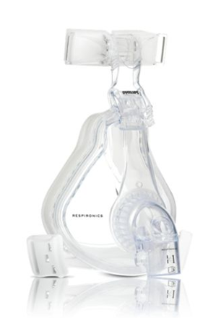
Philips Respironics - PerformaTrak
Market Leader in NIV
Elbows labeled 1, 2, 3, & 4
Dual-density foam forehead pads
3 sizes, clinicians can quickly fit a wide range of patients
Swivel clips simplify reapplication
© 2015 CareFusion Corporation or one of its subsidiaries. All rights reserved.

Slide 29
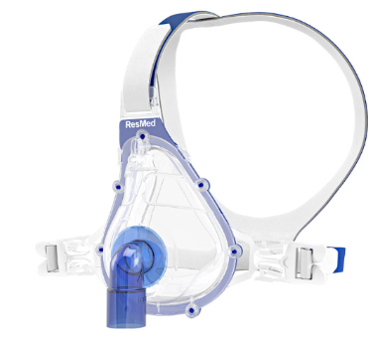
ResMed - AcuCare
    Patented dual-wall seal to provide unsurpassed comfort and a stable fit
    Resulting in the ability to reduce mask leak and alleviate skin breakdown
    Single patient use for up to 7 days
© 2015 CareFusion Corporation or one of its subsidiaries. All rights reserved.

Slide 30
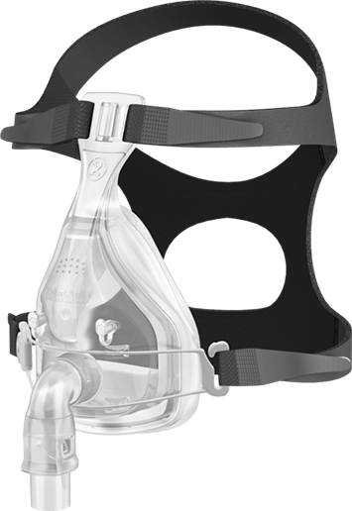
F&P FreeMotion
Under chin seal provides for a more comfortable and stable fit
Free Motion Glider with quick release clip enables freedom of movement with single motion refit
Available in 3 sizes: small; medium and large

Slide 31
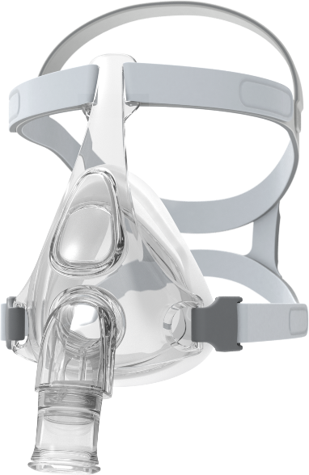
F&P Nivaro
RollFit seal to adapt to different face shapes and minimises pressure on the bridge of the nose
Easy clips on both sides for simple removal and refit
Breathable headgear fabric for enhanced comfort
2 sizes of headgear to accommodate different head shapes
Available in 4 sizes: Extra Small, Small, Medium and Large

Slide 32
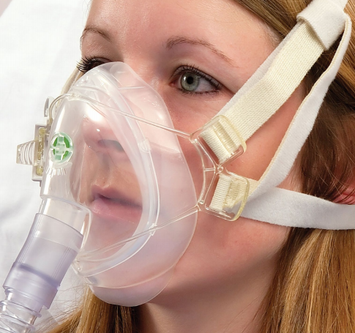
Intersurgical Face Fit
FaceFit is a range of lightweight and comfortable masks for use in non-invasive ventilation (NIV)
FaceFit NIV and FaceFit Ported NIV masks are available in 3 sizes with a size guide
Masks provide a lightweight comfortable interface for the patient with minimal dead space

Slide 33
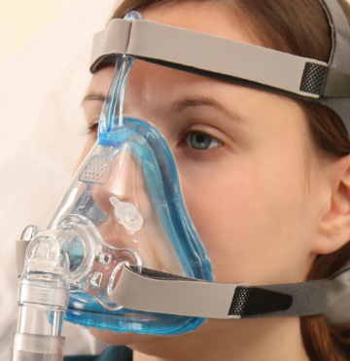
Intersurgical Vari Fit
The VariFit is a single patient use hospital NIV mask featuring a cushion with AIRgel technology for enhanced patient comfort
The breathable, quick release headgear is designed to fit easily to the patient and improve patient comfort
VariFit masks are available in 3 sizes with a size guide
VariFit NIV masks, vented with anti-asphyxiation valve, have a clear elbow and are suitable for use with single limb breathing systems that do not have a CO2 leak port

Slide 34
Tool box

Slide 35
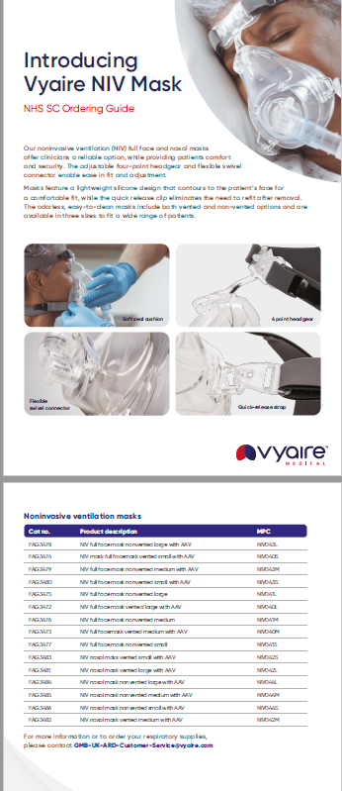
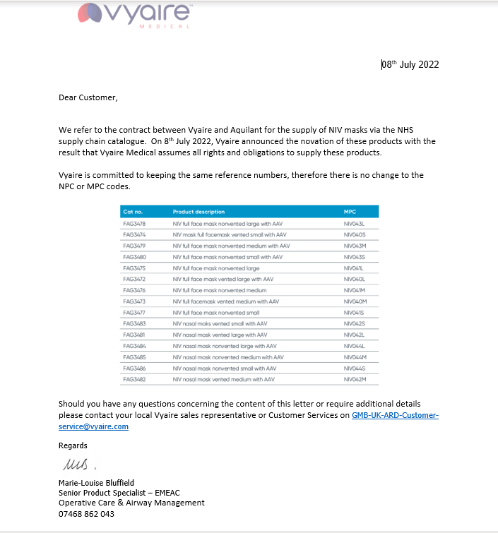
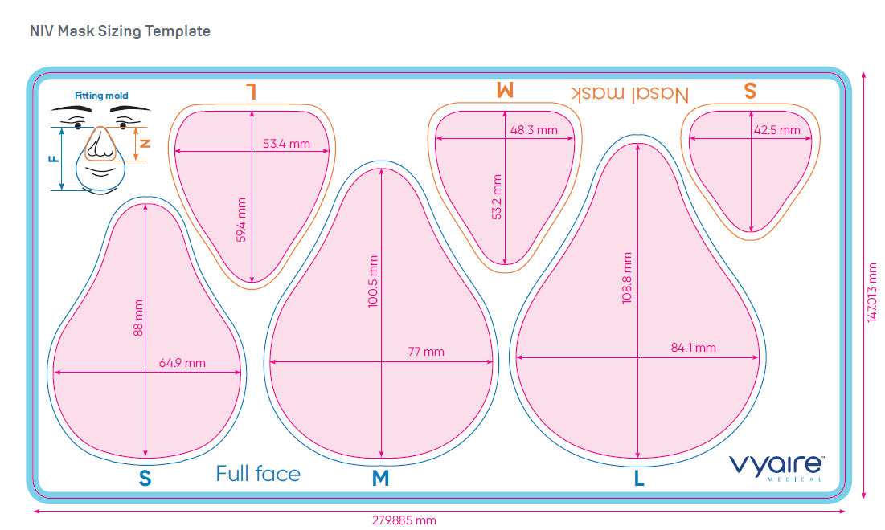
Notes:
NIV NOVATION LETTER
NHSSC Purchasing guide
Sizing template

Slide 36
Price
£240 EX VAT ON NHSSC
OPEN TO DICUSSIONS BASED ON USAGE FOR DIRECT CUSTOMERS!!

Slide 37
Questions

