Slide 1
DCAR/ECG Training
Marie-Louise Bluffield
EMEAC Senior Product Specialist - Sedation

Slide 2
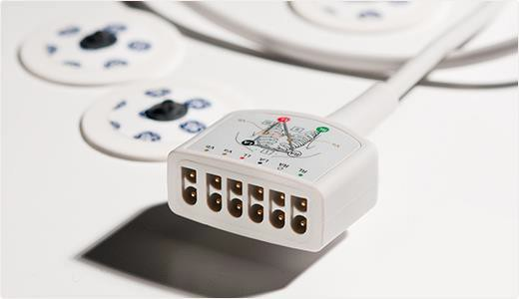
Cardiology
84 CONFIDENTIAL – for internal use only

Slide 3
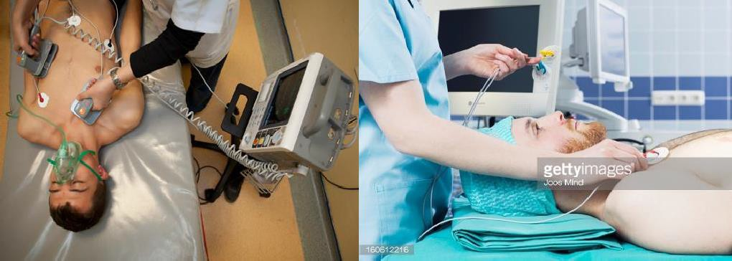
Cardiology
Cardiology is the branch of medicine that deals with the disorders of the heart.
The field includes medical diagnosis and treatment of heart defects, coronary artery disease and heart failure.

Slide 4
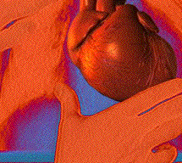
Cardiology divided into 2 areas:
Patient Monitoring ECG vs. Diagnostic Cardiology (DCAR) ECG
Patient monitoring ECG
Performed throughout the hospital or surgical centres to monitor a patient’s ECG rhythm and rate
Diagnostic cardiology (DCAR) ECG
Testing performed by medical professionals in hospital, clinic, or physician office setting to diagnose or evaluate cardiac condition

Slide 5
What is ECG
ECG is short for electrocardiogram
It is a test which measures the electrical activity of your heart to show whether or not it is working normally
Set up is: ECG device, ECG cable, ECG leadwire and ECG electrode
A number of electrodes (small sticky patches) are put on your arms, legs and chest. The electrodes are connected to a machine that records the electrical signals of each heartbeat and records them on to a paper or computer
85 CONFIDENTIAL – for internal use oCON_{nly} FIDENTIAL – Internal Use Only

Slide 6
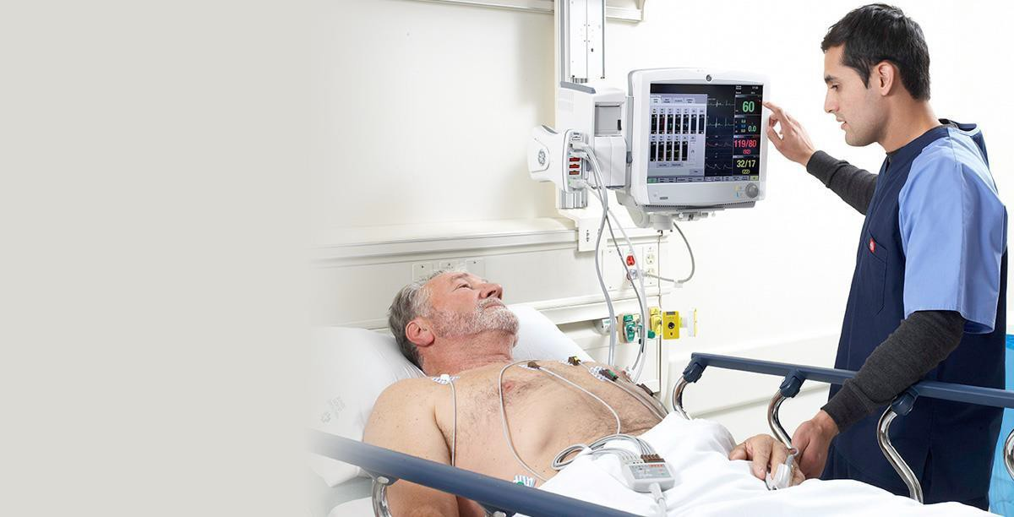
ECG Monitoring
Monitor a patient’s ECG rhythm and rate
87 CONFIDENTIAL – for internal use oCONnly FIDENTIAL – Internal Use Only

Slide 7
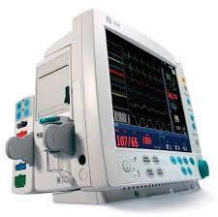
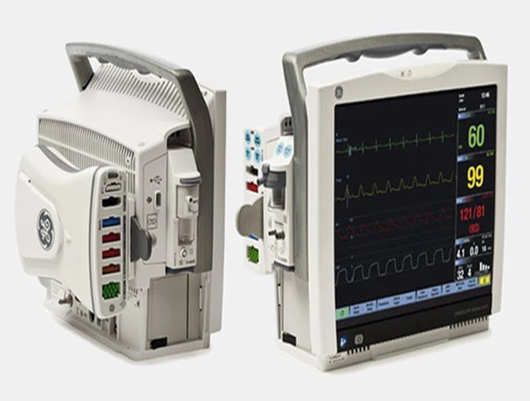
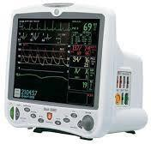
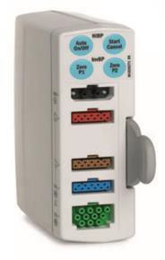
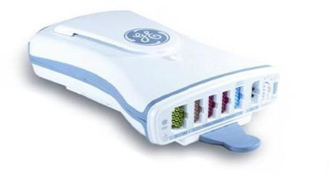
ECG monitoring
GE Healthcare Range of Monitors and modules:
86

Slide 8
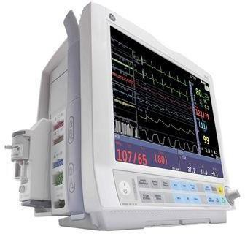
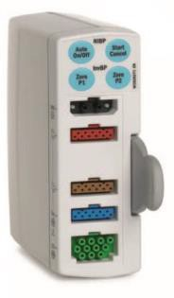
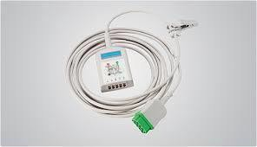
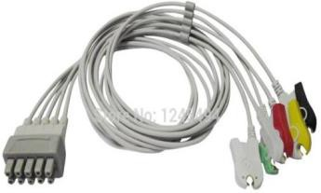
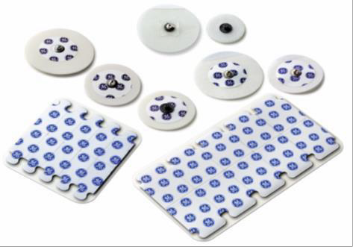
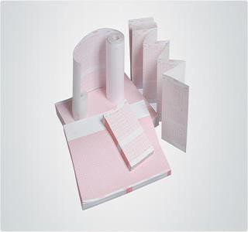
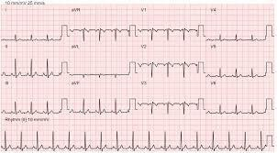
Set up for ECG on Monitors
+
+
+
+
+
=
88
CONFIDENTIAL – Internal Use Only

Slide 9
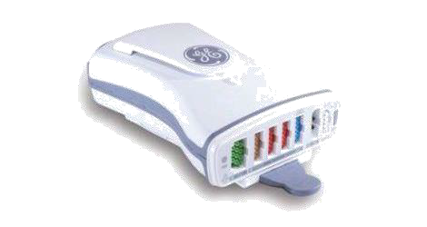
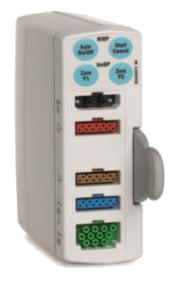
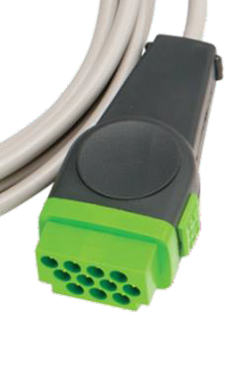

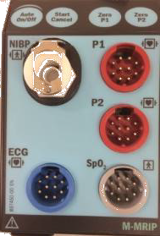
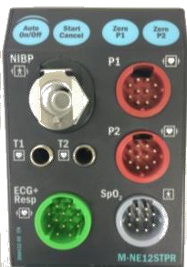

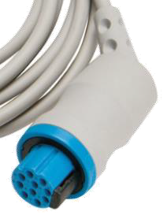
What’s the difference with the below?
Multi-Link®
300 series (Nicolay)
CONFIDENTIAL – Internal Use Only

Slide 10
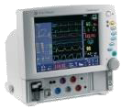




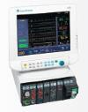
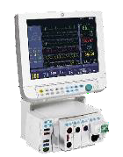
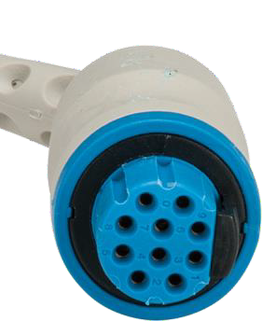
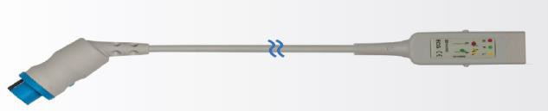
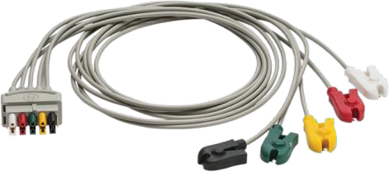

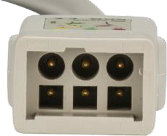
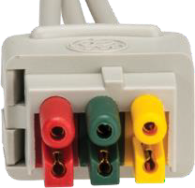

300 series cables and leadwires
300 series
Cardiocap
AS/3, CS/3,
S/5 Light
S/5® Monitor
Note: S/5 monitors have either 300 series or Multi-Link connection
Note: 300s individual leadwires are EOL (sets will be available)
CONFIDENTIAL – Internal Use Only

Slide 11
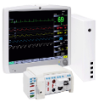


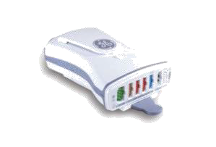


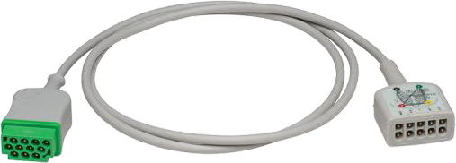
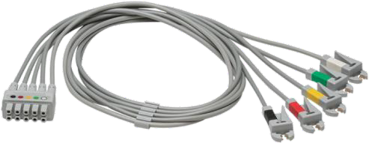
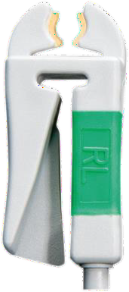
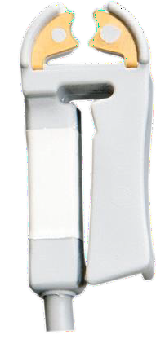
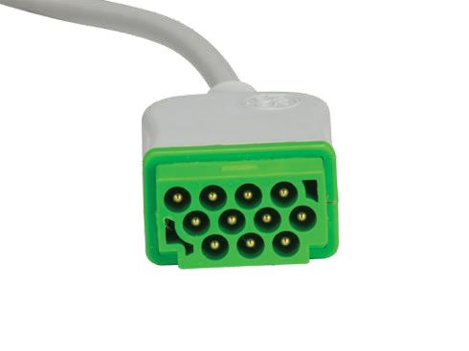
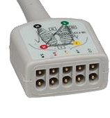
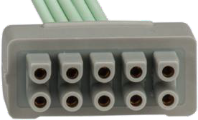
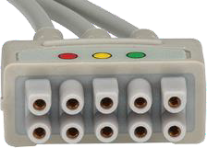
Multi-Link
Multi-Link®
PSM(P), PDM
CARESCAPE® Bx50
Procare Bx0
Dash, Solar
S/5® Monitor
Note: S/5 monitors have either 300 series or Multi-Link connection
CONFIDENTIAL – Internal Use Only

Slide 12
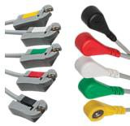
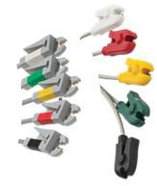
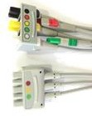
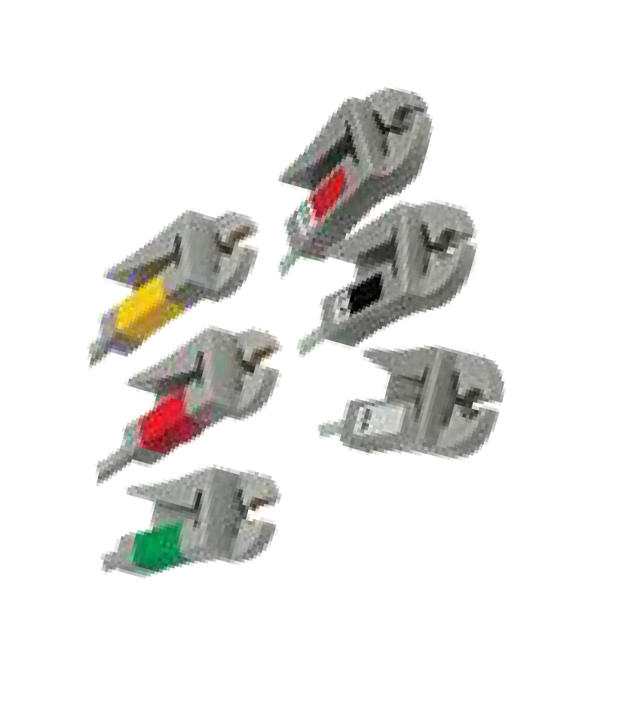

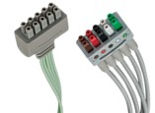


Variations on leadwires
Grabber vs. snap
Multi-Link vs. 300-series
Individually replaceable vs. grouped
IEC vs. AHA
SPU vs. reusable
Check customer preference!
2
3
CONFIDENTIAL – Internal Use Only

Slide 13

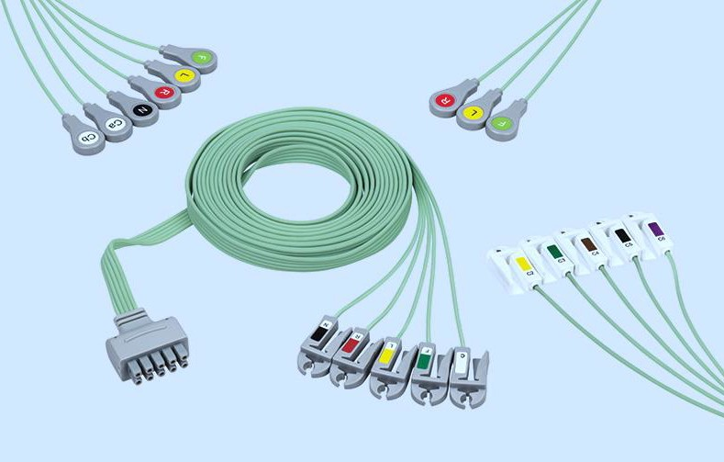



Single-patient-use leadwires

Slide 14
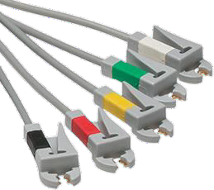


Reusable or SPU
How confident are you?
University of Wisconsin Study
The most frequently cited study promoting the use of single-patient-use leadwires
UW Madison swabbed and cultured 100 of their clean, reusable leadwires
77% of them came back with at least one form of antibiotic-resistant bacteria present, including MRSA
1. Jancin, B. Antibiotic resistant pathogens found on 77% of ECG lead wires. Cardiol News, March 2004, 2(3):14.
CONFIDENTIAL – Internal Use Only

Slide 15
Literature review (SPU)
St. Anthony’s Medical Center in St Petersburg, FL, reported a 70% decrease in combined MRSA, VRE, and other HAIs when disposable ECG wires were added to the hospital’s infection control bundle.¹
At Bon Secours St Francis in Virginia, a 23-month zero infection rate was achieved when use of disposable ECG leads was added to the infection control bundle in telemetry & ICU. Subsequently, surgical site infections decreased 40%.¹
To reduce wound infections, three hospitals began using disposable ECG lead wires in their ICUs. In all three hospitals, the frequency of infections decreased by 90+%.²
Recent study suggests there may be positive link between false alarm reduction and use of disposable leadwires.³
1. Brown, Donna Q. Disposable vs reusable electrocardiography leads in development of and cross-contamination by resistant bacteria. Crit Care Nurse. 2011 Jun;31(3):62-8.
2. 8 Barnett, T.E. (2007). “The Not-So-Hidden Costs of Surgical Infections.” AORN Journal: Vol. 86, No. 2; 249-258.
3. Albert, NM et al (2013). “Randomized Controlled Trial of Differences in Artifact/Noise Alarm Events in Disposable versus Reusable ECG Lead Wires.” AACN, NTI & Cricital Care Expo, Boston, MA 2013.

Slide 16
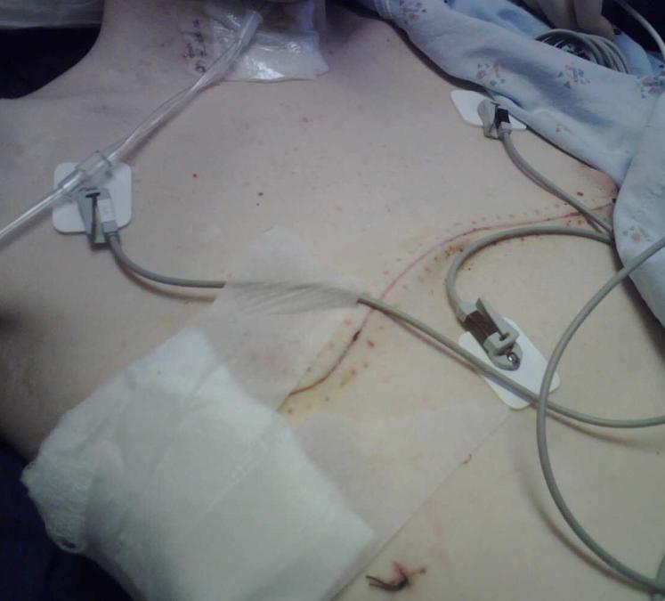
The contact environment of ECG wires:
Picture source: http://checkonjim.com/?p=386

Slide 17
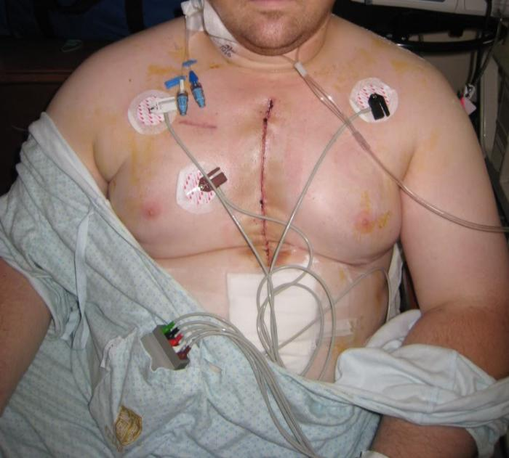
The contact environment of ECG wires:
Picture Source: http://forum.bodybuilding.com/showthread.php?t=126585773&page=1

Slide 18
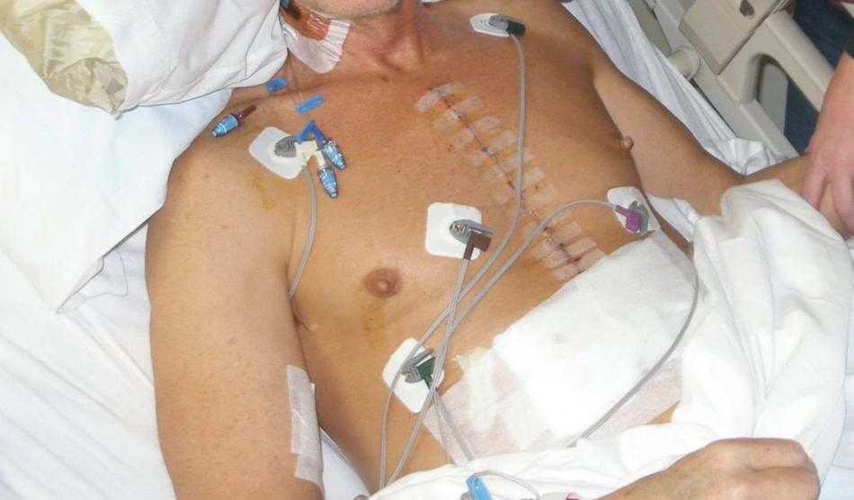
The contact environment of ECG wires:
Picture Source: http://kempkuties.blogspot.com/2009_01_01_archive.html

Slide 19

The contact environment of ECG wires:
Brown D, Disposable vs Reusable Electrocardiography Leads in Development of and Cross-contamination by Resistant Bacteria Critical Care Nurse June 2012

Slide 20

The Contact environment of ECG wires
Professional Organizations and Publications
Picture Source: http://lifeinthefastlane.com/trauma-tribulation-005/

Slide 21


ECG leads carrying bacteria coming in contact with open wounds constitute a cross-contamination pathway
Disinfectants need to come into contact with bacteria for sufficient time and in sufficient strength to eliminate the bacteria
Are ECG wires 100% disinfected, 100% of the time?
Picture Sources: http://www.plasticsurg.com/burn/pulmonary/page_18a.jpg
http://216.92.122.69/Modules/initial_mgmt/sec_3.htm http://pilldoctor.blogspot.com/2010/09/incredible-inflatable-man.html

Slide 22
Disposable vs. reusable
Reusable ECG Leadwires | Single Patient Use Leadwires
Cross-contamination challenge in inpatient and outpatient care areas (multiple patient use) | Disposable Product: Admission to discharge single patient use
Need to clean before re-use | No cleaning procedure Leadwire disposed at discharge
Significant factor contributing to HAIs incidences in care areas | Disposable ECG leadwires may help to reduce the risk of HAIs in healthcare settings
Costs: Reusable leadwires, cleaning agents, cleaning processes and staff time | Cost reductions in cleaning processes and staff time but added cost of SPU leads

Slide 23
Risks across care settings
Outpatient- Often have limited capacity for oversight and infection control compared to hospital-based settings.¹
ICU- ~30% of patients in ICUs develop at least one HAI, often linked to the prolonged use of invasive devices.²
Emergency Dept- Rapid treatment of a cross-section of patients makes the ER an area of risk.³
Surgery- A surgical wound infection occurs when microrganisms from the skin or the environment interferes with the incision site.⁴ 31% of total HAIs.
Burn Unit- Due to the nature of the burn injury itself, immuno-compromising effects of burn injury, prolonged hospital stays, and invasive diagnostic & therapeutic procedures.⁵
Healthcare-Associated Infections. Healthy People.gov. Accessed October 6, 2013. http://www.healthypeople.gov/2020/topicsobjectives2020/overview.aspx?topicid=17.
World Health Organization. Health care-associated infections, FACT SHEET. Accessed October 6, 2013. http://www.who.int/gpsc/country_work/gpsc_ccisc_fact_sheet_en.pdf.
5 Infectious Diseases You Might Get in the ER. Discovery Health. Accessed October 6, 2013. http://health.howstuffworks.com/medicine/5-infectious-diseases-you-might-get-in-er.htm.
Safe Car Campaign. SURGICAL SITE INFECTION: DEFINITION AND STATISTICS. Accessed October 5, 2013. http://www.safecarecampaign.org/SSI.html.
Wurtz R, Karajovic M, Dacumos E, Jovanovic B, Hanumadass M. Nosocomial infections in a burn intensive care unit. Burns. 1995 May;21(3):181-4. http://www.ncbi.nlm.nih.gov/pubmed/7794498.

Slide 24





SPU – is there demand?
There is a demand for special cases!
Open heart surgery
Burn patients
MRSA patients
Sepsis patients
Isolation rooms
Other at risk: elderly, very young, reduced immune system (e.g. cancer)
CONFIDENTIAL – Internal Use Only

Slide 25

Competitors

Slide 26
Vyaire SPU ECG Product Details
Fully shielded to reduce electromagnetic interference
Securely connect to electrodes to prevent accidental disconnection
Colour coded (light green) to enable easy identification and prevent loss of reusable accessories
Can be used for up to 2 weeks on the same patient
Feature | Advantages
Single-patient-use | Designed to reduce the risk of bacterial cross-contamination
Multi-Link® ECG cable compatibility | Designed and validated for use on GE® ECG Monitoring equipment and others
Fully shielded | Helps reduce electromagnetic interference in the acute care setting
Free of natural rubber latex | Helps improve patient comfort & safety
Light green colored ribbon wire | Helps for easy SPU leadwire identification
Available in 3/5/V lead configuration - grabbers | Provides optimal usage in ICU/CCU/OR/ER applications

Slide 27
Steps to generate SPU customer interest
Have a grabber leadwire with you – ask how confident they are it is cleaned properly and has no resistant bacteria?
Wipe test? Dirty? Ask if they would have it placed on their child with an open wound?
Recite Wisconsin study – 77% of leadwires came back with at least one form of antibiotic-resistant bacteria present, including MRSA
Ask which kind of patients they think should have SPU leadwires on them?
Would they personally promote SPU leadwires for these patients?
Who would need to be convinced to get SPU leadwires into the hospital – at least for certain at risk patients?

Slide 28

Leadwire Tactical Tips

Slide 29





Which solution to pitch and where?
If your customer …
Uses reusable accessories across the hospital
Has no SPU vendors calling on them nor having any success
Cares more about waste
management than HAI
If your customer …
Uses disposable accessories across the hospital
Uses disposable electrodes
Sees infection control as a priority
Has known infection control
issues
Uses disposable blood pressure cuffs in isolation units/ OR / ICU
•
•
•
•
•
Promote reusable lws:
OR
ICU
ER
Biomed
Promote SPU lws:
Burn / trauma units
Open heart unit / ICU
Too busy units (e.g. ER, OR)
Units with many lost leadwires
Units interested in HAI control
2
3
Notes:
Send x2 catalogue

Slide 30


Slide 31

Multi-Link X2

Slide 32









Multi-Link X2
With Multi-Link X2, you can offer a standardised connectivity (leadwire) option for the main monitor brands
Ability to compete in multi-system accessory tenders and offer true disposable solution
Potential to triple+ ECG cables and leadwire sales
CONFIDENTIAL – Internal Use Only

Slide 33


Simple
CONFIDENTIAL – Internal Use Only

Slide 34

Versatile
CONFIDENTIAL – Internal Use Only

Slide 35


Slide 36

And Remember!
CONFIDENTIAL – Internal Use Only

Slide 37

Diagnostic Cardiology (DCAR) ECG
Diagnose or evaluate cardiac conditions
Notes:
to diagnose or evaluate cardiac conditions.

Slide 38

Cardiology
Patient Care Areas
Pre-op testing
Hospital-inpatient rooms
ICU
Cardiology Depts

Slide 39



How is it done?
Electrodes are attached to the arms, legs, and chest
Lead wires are then attached to the electrodes
Recording is printed out, saved or sent

Slide 40





DCAR Systems
MAC 2000
MAC 800
MAC 1200
MAC 1600
MAC 5500
MAC 500 *EoL

Slide 41





Continued…
CardioSoft
KISS
SEER MC
SEER Light
CASE

Slide 42








CS Cardiology Key Accessories and supplies
Electrodes
ECG cables & leadwire
Chart paper
Holter Supplies

Slide 43


Resting ECG
What is it?
Resting ECG is a test records the heart's rate and rhythm while patient is at rest
The ECG cart will draw lines across a strip of paper, allowing the doctor to look for any changes in the heart's normal rhythm
Why is it done?
Evaluate symptoms associated with heart disease:
Chest pain
Shortness of breath
Dizziness or faintness
Irregular heart beats
Evaluate health if at risk
High Cholesterol
High Blood Pressure
Family history of heart disease
Monitor effects of medications
Notes:
The Resting ECG is a resting electrocardiogram or electrocardiograph – it is called EKG (Germany derivation) or ECG (American derivation).
It is a safe and painless test – the patient lies down on a comfortable exam table and continues to rest while the test is being performed
The system records the electrical impulses produced by the heart – On the right you can see a sample ECG Chart.
The wavy lines represent different view of the heart over a short period of time – 3 to 5 minutes.

Slide 44

Resting ECG Electrode Placement
Test uses 10 electrodes – most often
Limb leads on outer arms and lower legs
C (V)-Leads on chest

Slide 45



GE Resting ECG Systems
Current Resting ECG Systems
MAC 500
MAC 1200
MAC 5500
Older Resting ECG Systems
MAC PC
MAC 6, MAC 8, MAC 12, MAC 15
MAC 1000
Centra
MAX 1
MAX Personal
MAC VU
MAC 5000
MAC 1200
MAC 500
MAC 5500

Slide 46




Cables & Leadwires
MAC 500, MAC 1200 ST, CardioSys/Soft
Set of 10 with banana
Set of 10 with grabber
Set of 5 with long length
Electrode adapter
Universal adapter clips for use with banana-ends

Slide 47


Reusable ECG Electrodes – Cream and gel - EOL
Electrode Cream or Gel
Crème - Box of 10 tubes, flavoured
Crème, 250 ml bottle and 5 L canister
Gel – Box of 10 tubes, transparent
Prepping Cream
Crème Epicont, abrasive paste for skin, pack of 10
Electrode spray
Spray – Box of 10 bottle
Highly conductive, non-irritating,
Contain isopropyl Alcohol for cleaning and desinfection
Particularly suitable to KISS System

Slide 48

Exercise/Stress Testing
What is an Exercise/Stress Test?
Records the electrical activity of heart on an electrocardiogram while a patient is doing exercise on a treadmill
Electrocardiogram is watched constantly, and blood pressure measured at each speed increase
When is it used?
Exercise increases workload on heart
Evaluate potential of a heart disease
Notes:
An exercise test records the electrical activity of the heart on an electrocardiogram while a patient exercises on a treadmill or a stationary bicycle (ergonometer). Note: GE sells treadmills not ergonometers.
During the test, blood pressure measurements are recorded. The Critikon wall manometer and blood pressure cuffs are an excellent choice for exercise/stress testing. The blood pressure is taken manually – not automatically.

Slide 49

Exercise/Stress Testing
How is Stress Test Performed?
Skin is prepped to remove any dry skin cells, oil, perspiration to reduce artifact in the readings/signal
Foam or Vinyl Tape Electrodes placed on patient
Leadwire connected to electrode via grabber
Procedure lasts 20 – 30 minutes
What are the benefits of exercise/stress testing
Safest and most widely used tests for heart disease
Quick way to check heart arteries for narrowing or blockage – non-invasive
Determines whether or not more invasive procedures are needed such as cardiac catheterisation

Slide 50
Exercise/Stress Testing
Electrode Placement
10 electrodes
Skin Preparation
Skin prep important – during test patient moving, to obtain good results need to be sure to reduce as many barriers to good signal as possible – reduce artifact

Slide 51

Exercise/Stress Testing
GE Exercise/Stress Systems
CASE
Older Exercise/Stress Systems
CASE 8000,CASE 16, CASE 15, CASE 12
Centra
MAX-1
MAX Personal

Slide 52



Cables & Leadwires
CASE and MAC 5500ST
CAM 14 patient cables
MAC 5500ST 4,6 m cable
CASE 4,6 m cable
MultiLink type Leadwire Connectors
Set of 10 or 14 Lead wires
Individual Leads – EOL
Electrode Connectors
Connectors set of 10 or 14
Available in Banana, Grabber, Alligator clip

Slide 53

Holter Monitoring
When is it used?
Patient with symptoms related to cardiac problems. Patient after cardiac surgery
Patient Preparation and Monitoring
A technician will prepare the patient for the Holter recording in the hospital area
5, 7 or 10 electrodes are applied
Patient returns home and continues normal activities while maintaining a patient diary
Test lasts 24 or 48 hours
Patient returns to hospital to have electrodes and recorder removed
Technician downloads data into scanning device for interpretation
Cardiologist overreads data and highlight significant areas
History
Discovered by Dr. Norman Holter – 1940’s
Developed and marketed by Dr. Holter and Mr. Bruce Delmar – 1960

Slide 54

Holter ECG - EOL
5-Lead Monitoring
5 electrodes
7-Lead Monitoring
7 electrodes
10-Lead Monitoring
10 electrodes
Holter Supplies
Electrodes/Leadwires/Cables
Holter Kits
Batteries
Cassettes
Pouches – Straps - Belts
Skin Prep Products

Slide 55


Holter Monitoring - EOL
GE Holter Monitoring Recorders
8500 Holter Recorder
Cassettes used to record data
5 or 7 lead recording
SEER Recorder
Digital recording
5 leads only
SEER MC
Digital recording
5, 7 or 10 leads
SEER Light
Digital recording onto removable digital cards
5 or 7 lead
Down load data to Laser XP, SXP

Slide 56



Holter Cables and Leadwires - EOL
ECG Cables
Snap lock cable locks leadwires in place to ensure a good connection
Release button allows leadwires to be removed when pressed
Snap-Lock Leadwires
Improved snap design - easy to reconnect leadwire while on patient
Snap leadwires hold securely to electrode snap stud

Slide 57


Holter Hook-Up Kits & Pouches - EOL
Convenient
Everything in one place
Electrodes
Cassettes (if needed)
Prep pads
Patient Diary
Cardiology Departments
Pouches & Belt
SEER Light – Pouch, Belt and Strap

Slide 58

Electrodes
CONFIDENTIAL – Internal Use Only

Slide 59


What to compare
Material
Gel
Size
Shape
“Stickiness”
Radiolucency/MRI
Connection
Packaging
Patient population (neo vs. others)
Quality
CONFIDENTIAL – Internal Use Only

Slide 60


From us: two lines
SilverTrace/ Mactrode
High Quality
Better for Cardiology & demanding customers
More wet gel options
VitalSigns
Basic
Neonatal options
More solid gel options
CONFIDENTIAL – Internal Use Only

Slide 61




Materials
Customer preference & environment
Foam Cloth
Silvertrace & VitalSigns
Silvertrace & VitalSigns
Clear Tape
Microporous Tape
SilverTrace
Silvertrace & VitalSigns
CONFIDENTIAL – Internal Use Only

Slide 62



Gel
Customers generally prefer one gel or another
Solid gel: “Less mess”, easy to apply, needs “warm up” on skin for good trace
Wet gel: Quick trace more immediately, quality trace, “more mess”
Solid Gel Wet gel
sponge
CONFIDENTIAL – Internal Use Only

Slide 63

Size – need different size options
Small size – better for smaller adults & pediatrics
Larger size – better for larger adults and large pediatrics
Neonatal – neonatal is specific
CONFIDENTIAL – Internal Use Only

Slide 64




Connection
“Snap”
Tab
Pre-Wired
Banana
CONFIDENTIAL – Internal Use Only

Slide 65


Our pre-attached leadwires
Only for neonates
– IEC: 2009101-406
– AHA: 2009101-404
CONFIDENTIAL – Internal Use Only

Slide 66


Radiotranslucent ECG Electrodes
Used in Cath Lab and MRI
Conductive carbon snap – X-ray translucent and non-magnetic
Use with radiotranslucent leadwires
9408-401 – Oval Foam Radiotranslucent Electrode, Wet Gel – 5/strip, 300/case
2014786-001 – Rectangle Foam, Radiotranslucent Electrode, Wet Gel – 30/pouch, 300/case
2014787-001 – Rectangle Foam, Radiotranslucent Electrode, Wet Gel – 5/strip, 300/box

Slide 67



Radiolucency/MRI
Which electrode is radiolucent / MRI compatible?
CONFIDENTIAL – Internal Use Only

Slide 68

Disposable Resting ECG Electrodes
Adhesive gel that adheres to most patients’ skin without skin prep
Conductive gel provides clear signal

Slide 69

GE Disposable Resting ECG Electrodes
Silver Mactrode Plus, Adult Disposable Resting ECG Electrodes
BabyMAC, Neonatal/Pediatric Disposable Resting ECG Electrodes

Slide 70

Silver Mactrode Plus … Strong Adhesion
Traditional design provides wide silver tab for easy leadwire connection
Conductive, aggressive, adhesive gel provides adhesion to patient’s skin
Silver/Silver Chloride construction for quality signal

Slide 71

BabyMAC … Improved Design
Neonatal/paediatric
Disposable resting ECG electrode
Larger surface area to provide improved adhesion
Torque-resistant tab to minimise electrode lift

Slide 72

BabyMAC … for the Smallest Patient
Less aggressive gel designed for the fragile skin of an infant
Meets AAMI electrode standards

Slide 73




Disposable ECG Electrode Competition
Tyco/ Kendall Healthcare Products
Full line of Cardiology and Monitoring Electrodes
Q Trace
Ambu
Full line of Cardiology and Monitoring Electrodes
Innovative, high quality
Blue Sensor
3M
Electrode manufacturer
Red Dot brand name
Full line of Cardiology and Monitoring Electrodes
Medtronic
Fastrace 4
Conmed
Heartbeat

Slide 74







Electrodes – choose the right one!
Foam
Clear Tape
OR
General Ward
High volume – quick – cost pressure
Offer Vital Signs line
Material will depend on customer preference
Resting
Requires quick set-up for a quick test
Mostly tab
Price: Vital Signs line
Quality / Defib recoverable: Mactrode
Stress / Diaphoretic
Requires stay-on power
Offer aggressive adhesive – SilverTrace
Sensitive Skin
Marketing pitch!
Offer cloth - breathable
Clear tape for visualisation
Do not offer aggressive adhesive/stress test electrode!
2
6
© 2016 CareFusion Corporation or one of its affiliates. All rights reserved. Vital Signs, CarCeFuOsionNanFd thIeDCaEreFNusiTon IloAgo Lare – Internal Use Only
trademarks or registered trademarks of CareFusion Corporation or one of its affiliates. Medical devices class I according to
Medical Devices Directive 93/42/EC. Please read the complete Instructions For Use that come with the devices or follow the instructions on the product labeling. 0000MS07315 Issue 1

Slide 75








Two electrode product lines
Quality offering
Foam
Cloth
Clear Tape
Microporous tape Pre-wired
Wet gel Solid gel
Variety of shapes Banana connector
SilverTrace
Mactrode BabyMAC
Great solutions for
Stress & diaphoretic
Resting , cardiology
Diagnostic ECG
Shapes optimal for chest leads
✗
✓
✓
✓
✓
Value offering
Foam
Cloth
Clear Tape
✗ Microporous tape
Pre-wired
Wet gel
Solid gel
✗ Variety of shapes
✗ Banana connector
Vital Signs
Basic solution for
Resting, general
Short-term
General monitoring
Pre-wired for neonates
2
5
© 2016 CareFusion Corporation or one of its affiliates. All rights reserved. Vital Signs, CarCeFuOsionNanFd thIeDCaEreFNusiTon IloAgo Lare – Internal Use Only
trademarks or registered trademarks of CareFusion Corporation or one of its affiliates. Medical devices class I according to
Medical Devices Directive 93/42/EC. Please read the complete Instructions For Use that come with the devices or follow the instructions on the product labeling. 0000MS07315 Issue 1

Slide 76

ECG Recording Paper

Slide 77



Our paper portfolio is very complex but complete …
30+ individual product offerings
Letter and A4 format
Red grids, blank interpretation area
Guide holes
Z-fold, sheet, roll
Paper functionality – paper is not just paper!
Weight
Curl resistance
Heat sensitivity
Smoothness
Chemical composition
Brightness
Testing!
269

Slide 78



… but we have a paper brochure to help you!
Main purpose/function?
Monitoring ECG
Diagnostic cardiology ECG
OB monitoring
Which equipment?
Which archival life?
Which size?
2
7
CONFIDENTIAL – Internal Use Only

Slide 79

ECG Recording Papers
Proprietary products – designed specifically for equipment
50+ individual product offerings

Slide 80
Paper Properties
Weight
Measurement of both thickness and density of a sheet of paper
Curl Resistance
Keeps paper flat at exit site
Stiffness or curl ensures paper flows easily through paper rolls, across print head and lies flat on top of the cart
Heat Sensitivity
Paper tested to provide the clearest trace

Slide 81

Paper Properties
Smoothness
Rough paper can increase the potential for a distorted image
Chemical Composition
Special formula so thermal papers resist trace fading
Ensures traces remain on paper for an extended period of time
Examples: Archivist and Premium Thermal Papers
Brightness
Ensures optimal image readability
White tone of sheet, if paper gray/white, trace is difficult to read
Brightness of all GE papers selected to provide optimum in image readability

Slide 82

Recording Papers Marquette ECG Carts
Archivist Thermal Papers
Introduced in 1990
Thermal coating has colorless compounds
Heat creates a new permanent pigmented compound
The compound is black – will NOT return to previous colorless state
Lifetime warranty- 100 years against fading
Eliminates need for special storage precautions

Slide 83

Recording Papers Marquette ECG Carts
Premium Thermal Papers
Originally called Marquette “Standard” thermal paper
Exclusive chemical composition resists trace fading for 5-7 years
Available in wide variety of configurations for all GE systems using thermal papers
Chart z-fold
Rolls

Slide 84

Recording Papers Marquette ECG Carts
Universal Thermal Papers
Introduced in 1993
Low cost papers
Bright white paper offers excellent trace legibility
Resists trace fading for 2-3 years
Similar weight and density to premium paper

Slide 85
Key Cardiology Paper Competitor in EMEA
Tyco/Controlles Graphicos, Low to medium quality, OEM Manufacturer
Blumberg, Germany, OEM manufacturer, large Breadth of paper; Standard quality
Diagram Halbach, Germany, Standard to good quality
Pirrone, Italy, standard quality,
Ca.Mi.Na, Italy, low quality, export in EE
Chartrite, UK
Guyot Graphco, France
Diagramma, CH

Slide 86
Questions?

