Slide 1
2022 Sales Conference
Anesthesia CIRCUITs
& Circuit Accessories

Slide 2
Dedicated to improving quality of life.

Slide 3





Our Values
Customer First
Differentiate
with Our People
Bias for Action
Continuous Improvement
Accountability

Slide 4
Table of contents
Anesthesia Circuits Overview​
​Product Overview
Competitive Landscape
Getting To Know The Customer
Crossing a Circuit and Group Exercise

Slide 5
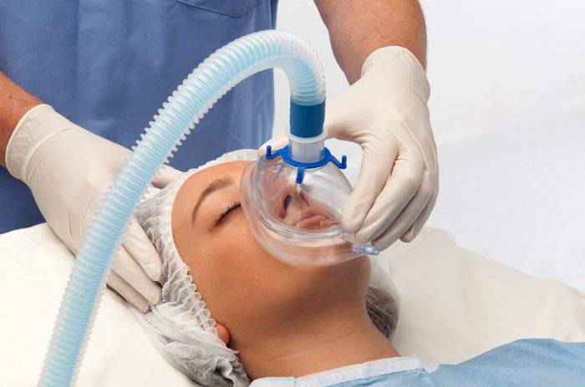
ANESTHESIA CIRCUITS
Overview
1

Slide 6
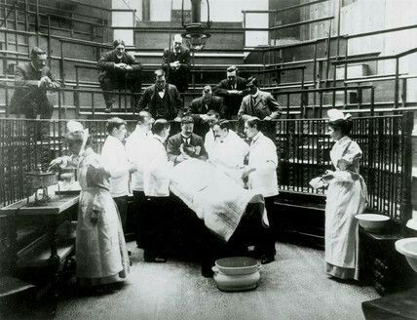
History of anesthesia
History has shown us that as far back as 4000 BC Opium was discovered and used for “pain control”. Then various other herbs and methods (acupuncture) were used. Inhalation of cannabis vapors, boiled wine, and other boiled herbs were used.
Fast forward to the mid-1600’s when the use of IV anesthetic was used (opium) and then to the late 1700’s when Joseph Priestly discovered isolation of gasses, specifically the “airs of oxygen” and he isolated nitrous oxide, and oxygen. Born from this was the currently used combination of inhaled anesthetic vapors and IV anesthetic.

Slide 7
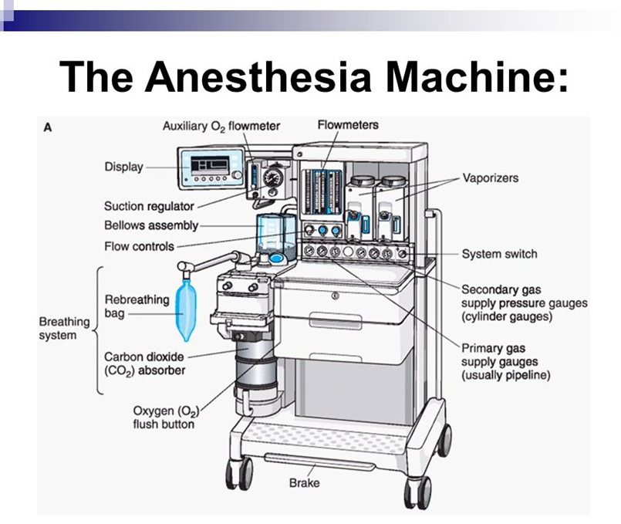
What does an Anesthesia machine do?
While seemingly complicated in today’s world, the anesthesia machine is a simple device to deliver anesthetic gasses to sedate patients.
Four key functions
Deliver anesthetic vapors to the patient’s airway, blended with oxygen.
Recovery of anesthetic vapors, so as not to anesthetize the caregivers.
Monitoring the patient’s vital signs, including depth of anesthesia.
To ventilate the patient.

Slide 8
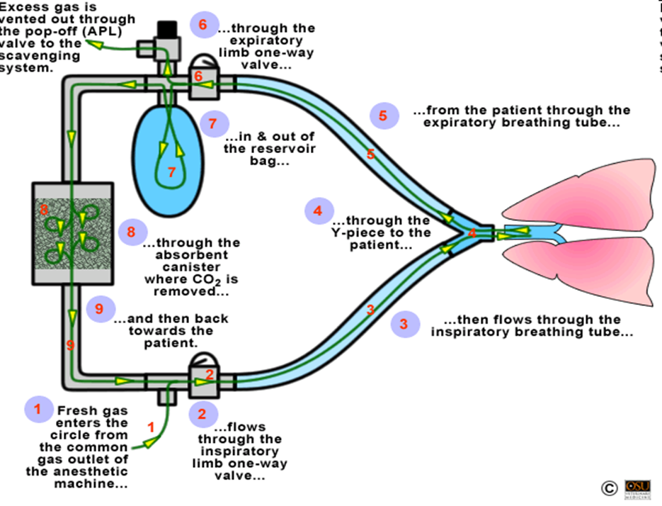
What is an anesthesia circuit?
An anesthesia circuit is an assembly of components which connects a patient’s airway to an anesthesia machine. The anesthesia circuit is used to deliver oxygen and anesthetic gases as well as eliminate carbon dioxide (CO2) to the patient.
There are several circuit accessories that connect to the circuit and work in conjunction to a circuit’s use when assembled to an anesthesia machine.
Circle System (Closed Circuit)
Notes:
The anesthesia circuit, it is best to look at as a closed, circle system. There is a blend of fresh gas introduced to the anesthetic vapors, that are delivered in a one-way direction (inspiratory valve) to the patient’s airway (mask, ILA/LMA, ETT). This gas is then recovered in the expiratory limb, again through a one-way valve to prevent re-breathing, and collected in a reservoir bag. The gas is then scrubbed in a CO2 absorbent to then be sent back to the patient with a combination of fresh gas and anesthetic vapors.

Slide 9
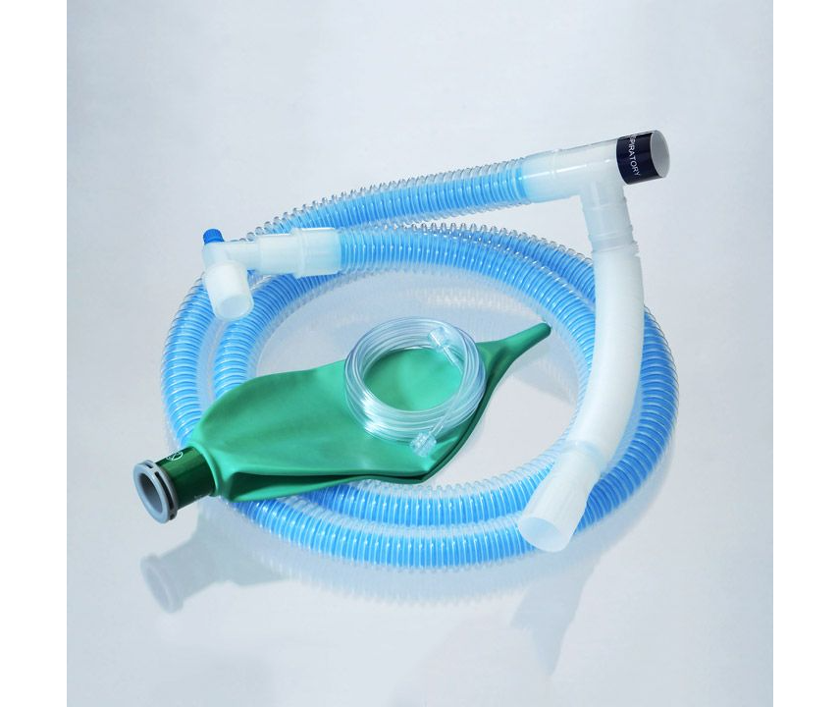
accessories & kit components
“A Circuit is the sum of its parts”
Common Accessories​
  Breathing Masks
  Breathing Bags
  Gas Sampling Lines
  Filters & Exchangers
Other Products Kitted with Circuits​
  Airway Management
  Fluid Management
  Patient Monitoring (Electrodes)

Slide 10
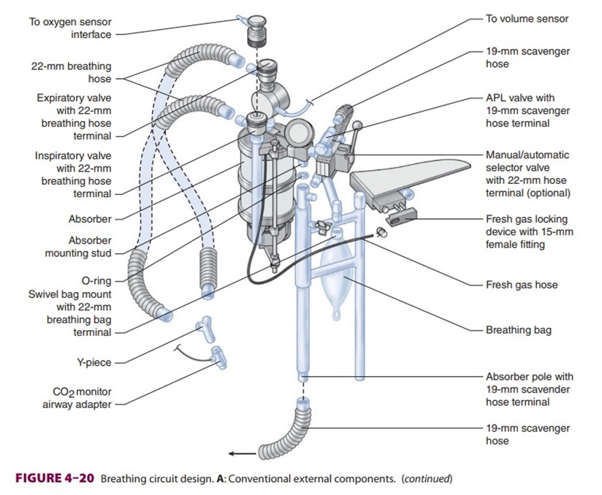
Simple complex
Speak with an aura of customization, but focus on standardization
A customer’s Want can be complex, the solutions you offer to solve their Need doesn’t have to be
Notes:
A more realistic picture and to add to the complexity, this shows the circuit with various sensors to monitor fresh gas and anesthetic vapors, as well as the scavenger system, and selector valve for manual versus automatic ventilation. This can help us understand the various circuits that would be needed that would include peripheral lines such as the ETCO2 monitoring line, the adapters, and Y pieces.

Slide 11



Sunmed circuits
SunMed offers a comprehensive line of circuits and circuit accessories that can meet the needs of the various anesthesia machines on the market, with the ability to customize for unique circumstances. We offer both pediatric and adult circuits to meet the various patient populations.
Our circuits are made of low-density polypropylene (LDPE) for the corrugated tubing, with the expandable tubing made of a combination of the LDPE and a polypropylene copolymer. The wye connectors are medium density polypropylene, and the gas sample lines are PVC. We are Phthalate free and DEHP free.
As we determine more of our sustainability position in the market, it is important to understand that we have some recycling options for circuits, more info to come as we work with our recycling partners.

Slide 12

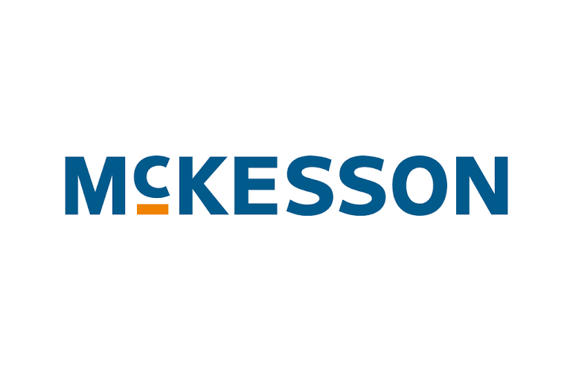
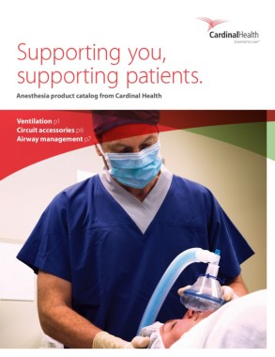
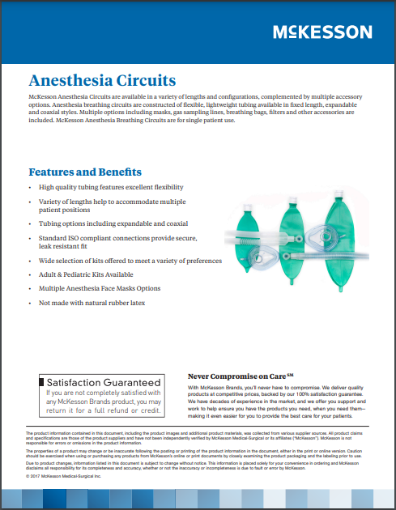
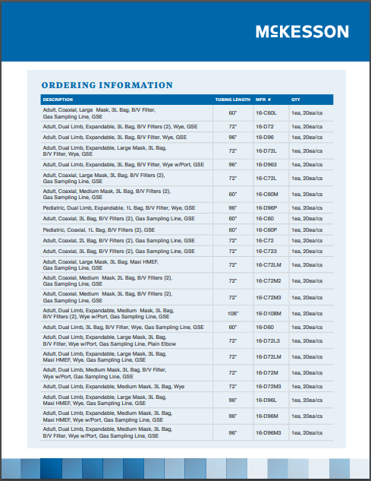
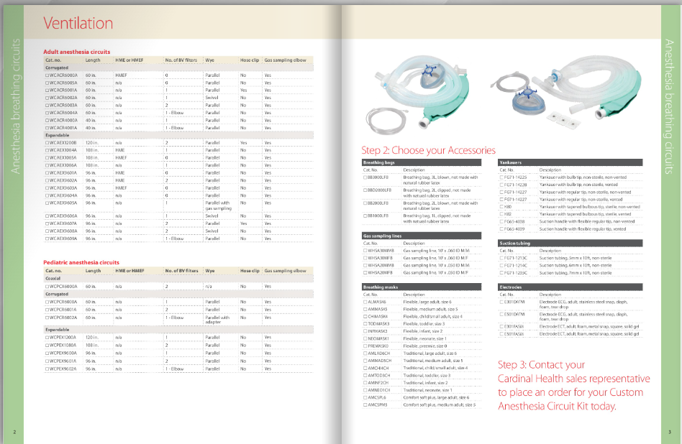
Sunmed: Private label customers

Slide 13
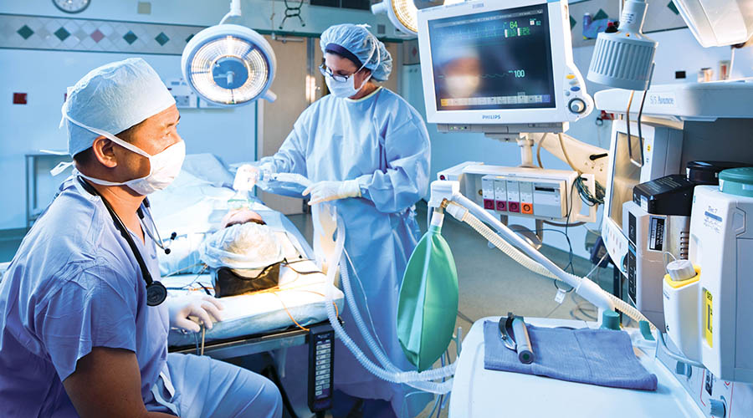
Product Overview
2

Slide 14
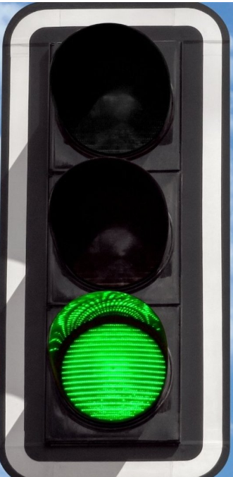
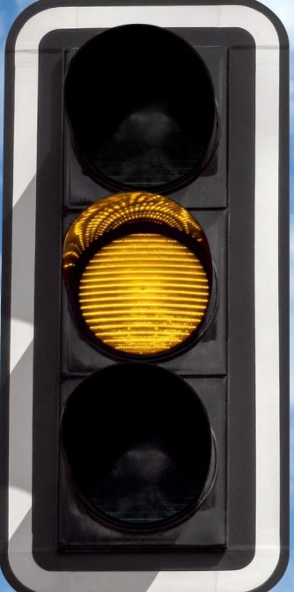
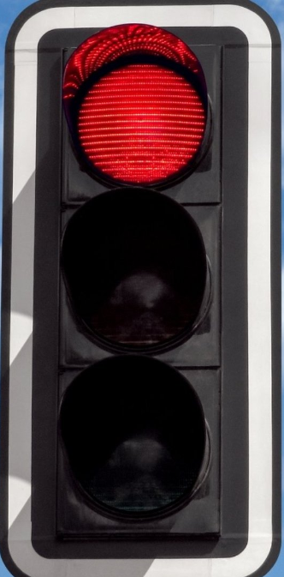
Circuit types – “clear as mud” breakdown
Anesthesia
Anesthesia circuits are circle systems and are closed circuits.
An anesthesia circuit is a breathing system consisting of an assembly of components, which connects the patient's airway to the anesthesia machine, creating an artificial atmosphere, from and into which the patient breathes.
Respiratory
Respiratory Circuits are also considered closed systems, but not referred to as circle systems like with single or dual limb anesthesia circuits. Single limb ventilator circuits are an open circuit as they vent to atmosphere when the exhalation valve is open. Dual limb ventilator circuits are a closed system with venting to atmosphere through the ventilator.
Respiratory circuits are used for 30 days and not changed unless visibly soiled with biomaterial.
Mapleson
Mapleson functions on the same premise as Respiratory circuits, the APL valve essentially leaks creating an open system.
Mapleson type circuits are primarily only used in veterinary medicine.
If we don’t have it DO NOT offer to build it.
Notes:
Stoplights represent complexity versus opportunity.

Slide 15
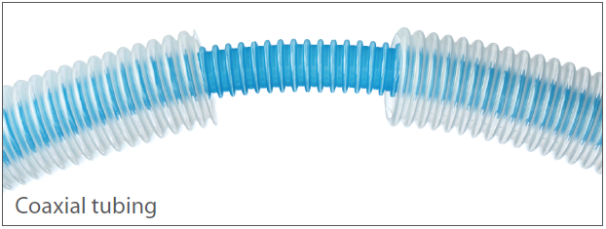
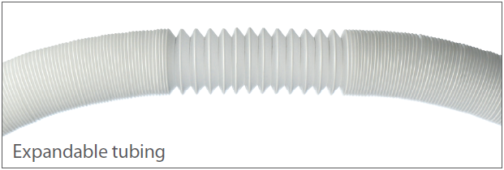
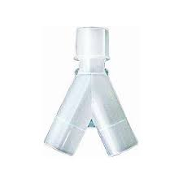
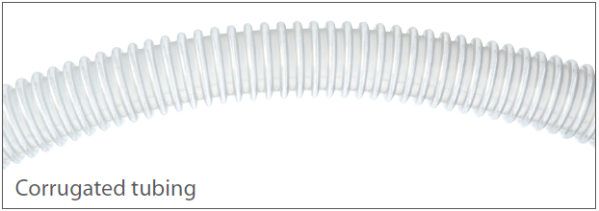
Tube types – adult to pediatric patients
Coaxial – Single Limb or UniLimb
Inspiratory tube is surrounded by exhalation tube
Less obstructive to provide clear visual of patient
Aids in heat conservation as exhalation tube surrounds inhalation tube
Expandable – Dual Limb
Stretches to variable lengths to accommodate each OR
Prevent dislodging of the ET tube
Allows for drapability
Corrugated – Dual Limb
Low-cost solution
Light weight and durable
Also referred to as “Y” Circuits
Notes:
Ambu’s King Flex circuits are trademarked as “F” circuits. Their Universal Flex2 circuits are both Expandable and Coaxial, as well as proprietary technology. When crossing a Flex circuit, a SunMed substitute is our Coaxial offering. It will not expand, but it will functionally perform like the single limb, Flex circuit.

Slide 16
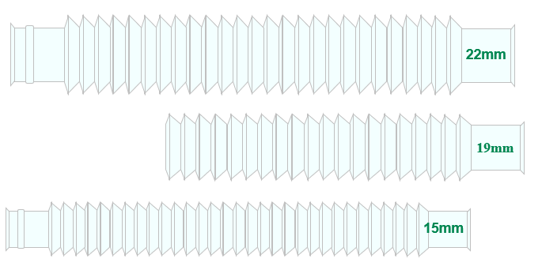
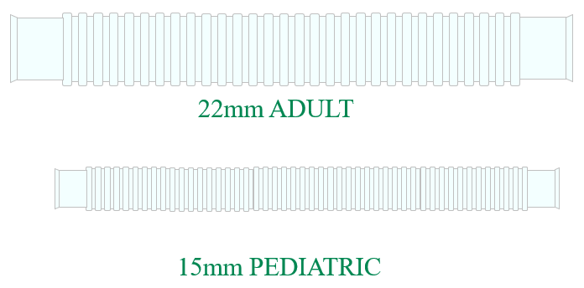
Tube sizes
Expandable
Corrugated or “Fixed”
Notes:
Reference page for range of tubing connection sizes, if the question comes up from a customer.

Slide 17
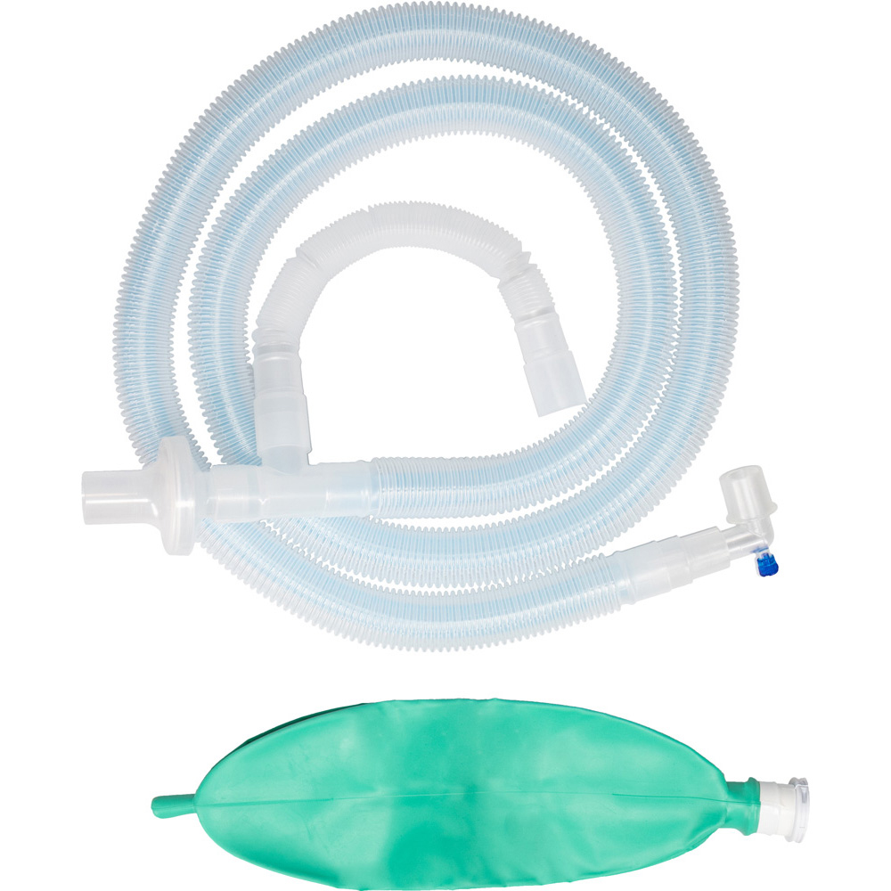
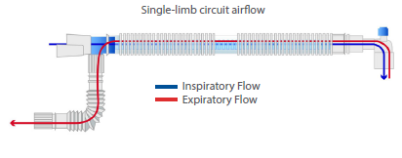
Single-limb tube type: corrugated
Expiratory line (outer tube)
Inspiratory line (inner tube)
The ‘circuit-within-a-circuit’ is known by many names in the industry. This circuit is unique as it generally has an inner circuit, shrouded by an outer circuit. The theory is that the inner inspiratory limb is heated and humidified by the expiratory limb that surrounds it. It looks like a single limb, but really is a 2-into-1 dual limb circuit, as noted by the connector end that directs either inspiratory or expiratory gas flow.
Competitors offer similar or differentiated versions:
  King (Ambu) has the Flex 2 family, Vyaire (Vital Signs) have the Limb-O, while Medline, Smiths, Flexicare all have a version, as does SunMed, which is pictured above.
  Tip: You can offer a substitutable cross to an Ambu/King System Universal Flex Circuit with SunMed’s Coaxial offering.

Slide 18
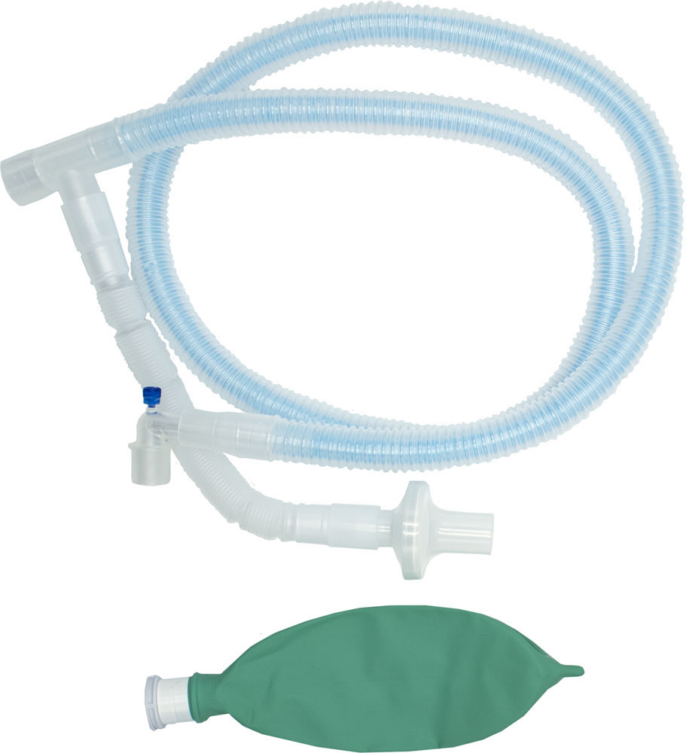
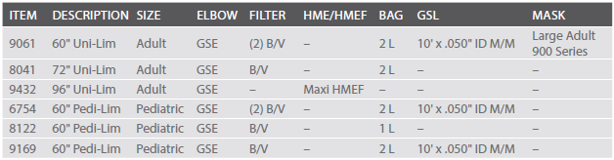
Single-limb tube type: sunmed offering
Uni-Lim™ and Pedi-Lim™ Single Limb Coaxial Anesthesia Circuit
Features a streamlined tube-within-a-tube design which eliminates twisting between the inspiratory and expiratory limbs
Provides natural heat and moisture conservation properties to that of a standard circle circuit
Engineered with a secure-t inspiratory limb to prevent patient end disconnects – no floating internal tubes
ISO-standard connections for secure, leak-resistant attachments
PROS
Provides natural heat and moisture conservation
Streamlined design, eliminates bulky connectors at patient interface
CONS
Heavier than Corrugated or Expandable
More expensive than Corrugated or Expandable
Notes:
Tube-within-a-tube
Helps eliminate twisting between limbs
Removes connectors from patient interface
Provides natural heat and moisture conservation properties
ISO Standard connections

Slide 19
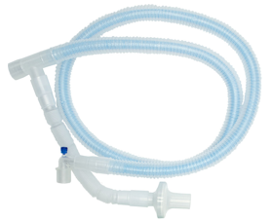
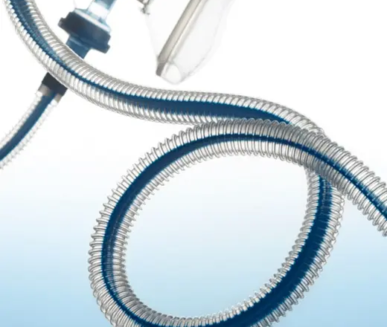
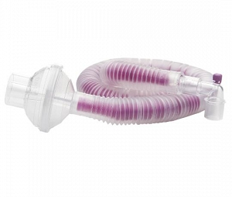
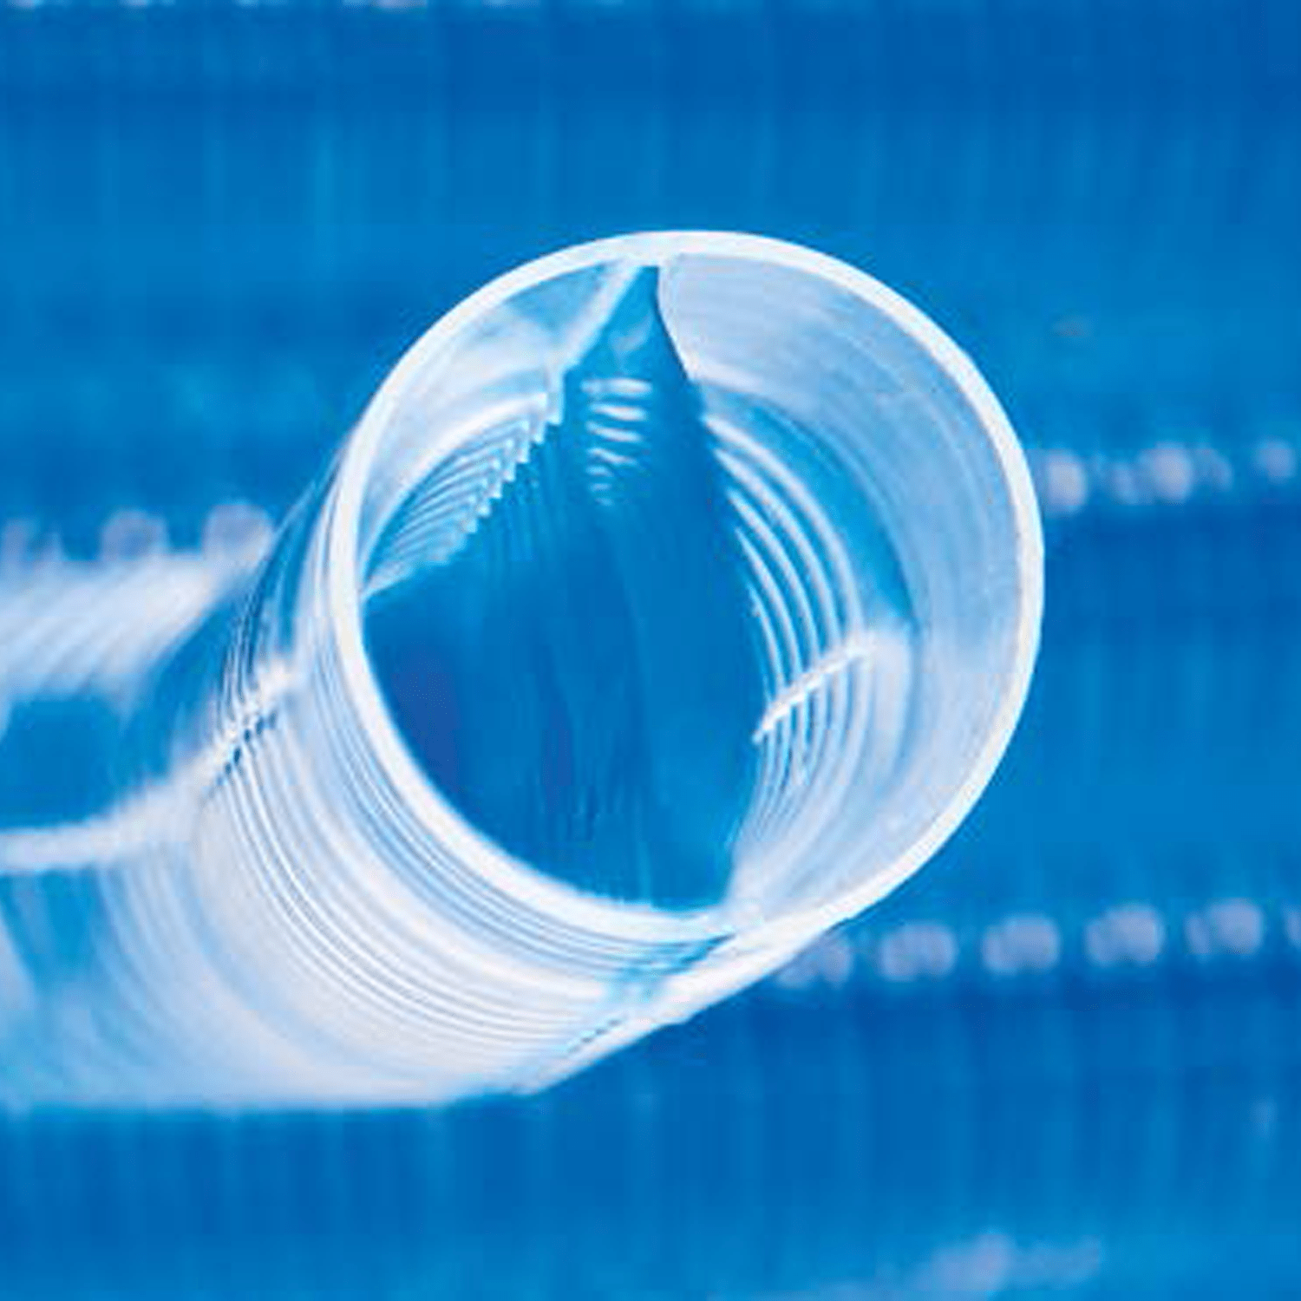
Single limb circuits: competitive comparison
Expandable Tubing
SunMed Coaxial
Vyaire “Limb-O”
Ambu “Universal Flex2” or “F” Circuit™
Tube-within-a-Tube
Inner-tube : Inspiratory
Outer-tube: Expiratory
Expiratory connection at machine end
The inspiratory and expiratory pathways are separated by a flexible septum or bifurcated, not a “tube-within-a-tube”
Not considered a true coaxial circuit, but reduces material and weight, while being able to market to coaxial benefits
Expiratory connection at machine end
Combination of a Single Limb Coaxial circuit and Expandable circuit all-in-one. Otherwise performs like SunMed option
Proprietary design
Requires customers to retrofit their machines with a special connector, which can be lost or damaged necessitating replacement
Corrugated Tubing
Notes:
Ambu’s King Flex circuits are trademarked as “F” circuits. These are both Expandable and Coaxial circuits. Can be crossed with SunMed’s Corrugated Coaxial circuits.

Slide 20

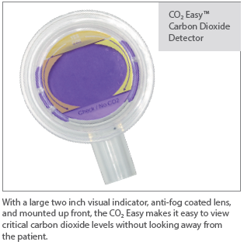
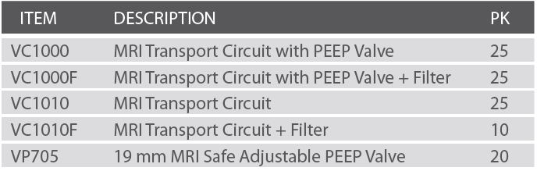
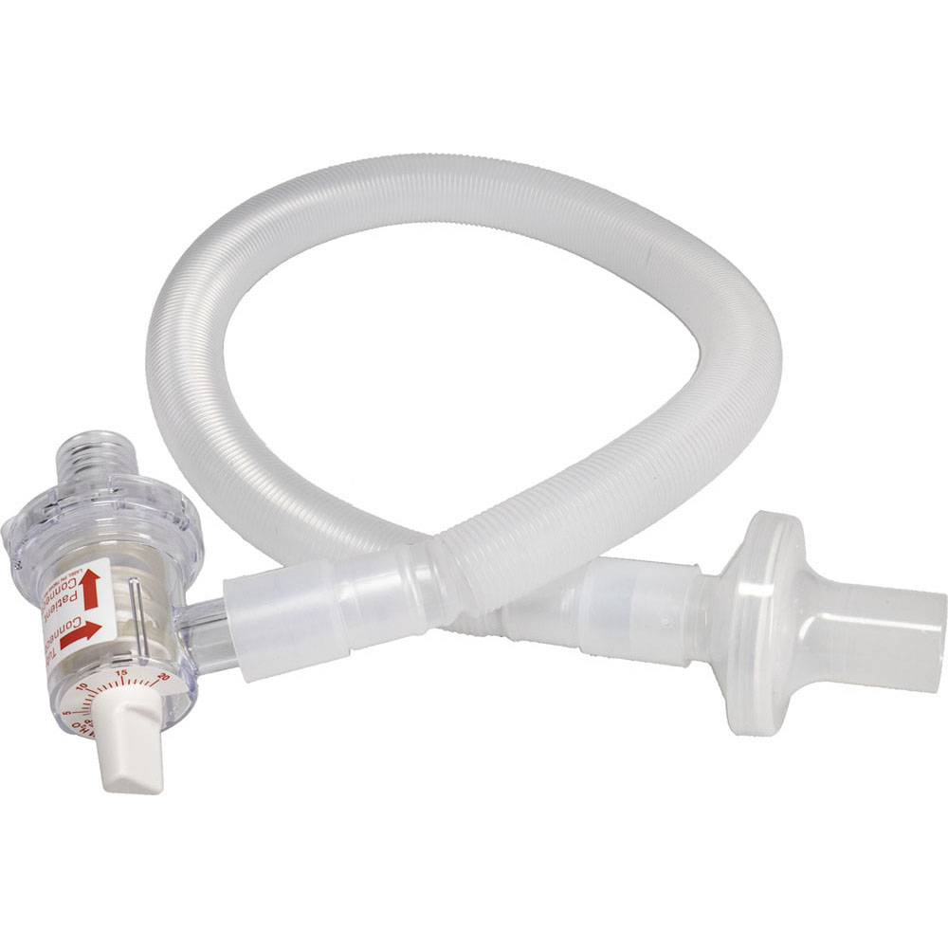
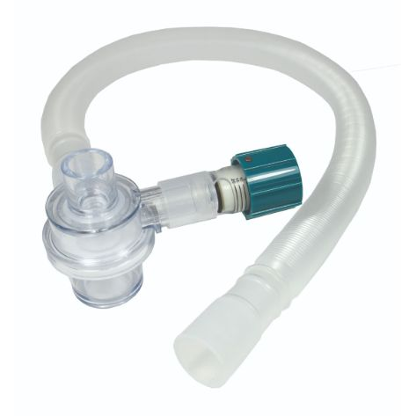
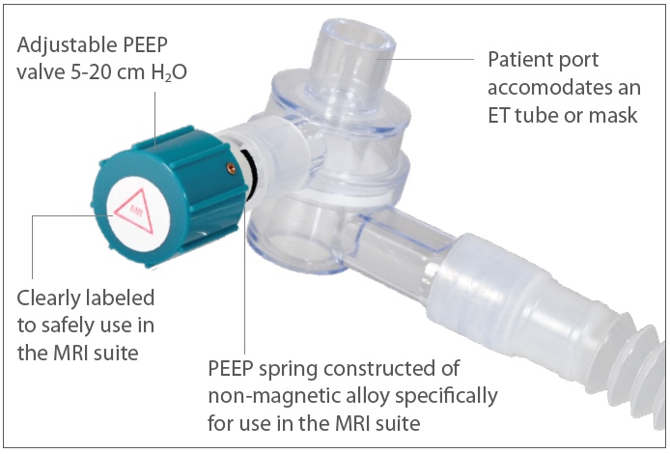
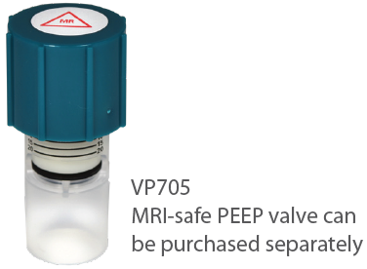
Single-limb tube type: MRI Safe transport
MR Conditional Transport Circuit
Westmed
MR Transport Circuit
Ventlab
LATEX FREE | SINGLE PATIENT USE | DISPOSABLE | CE MARK
A complete, lightweight, ready-to-use, non-metallic, non-electrically
conductive MRI transport circuit. Compatible with BagEasy™ and AirFlow™
Manual Resuscitators and with some portable transport ventilators that have a passive exhalation valve.
LATEX FREE | SINGLE PATIENT USE | DISPOSABLE
Patient valve, PEEP valve and oxygen tubing constructed of MRI-safe materials
3 o’clock position of PEEP keeps valve out of patient’s face
For use with Smiths Medical Pneupac and other ventilators (Consult ventilator manufacturer specifications prior to use)
Corrugating tubing expands generously to 9’
Circuit available with or without PEEP valve
Notes:
Reference slides for MRI Transport circuit options

Slide 21
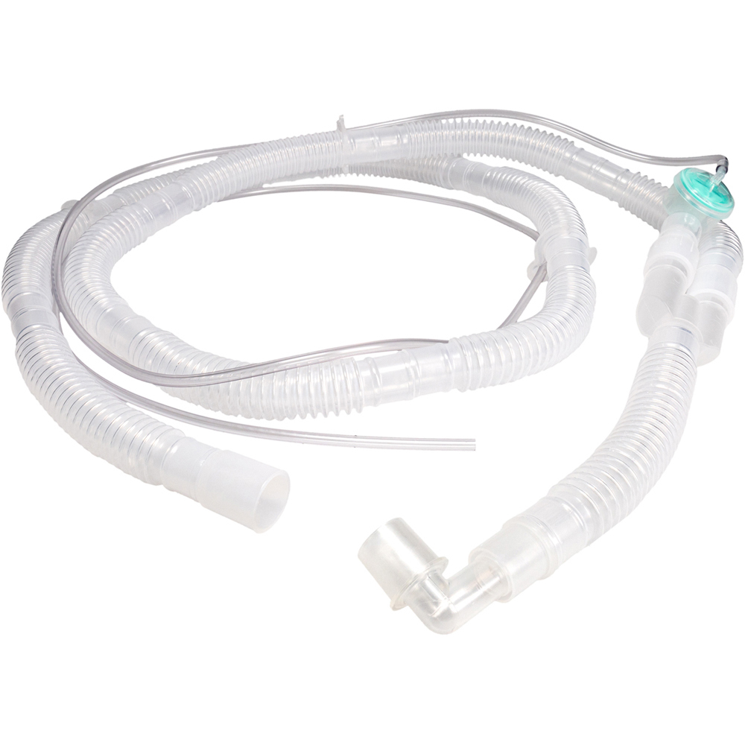
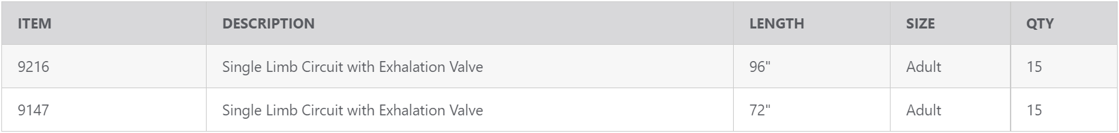
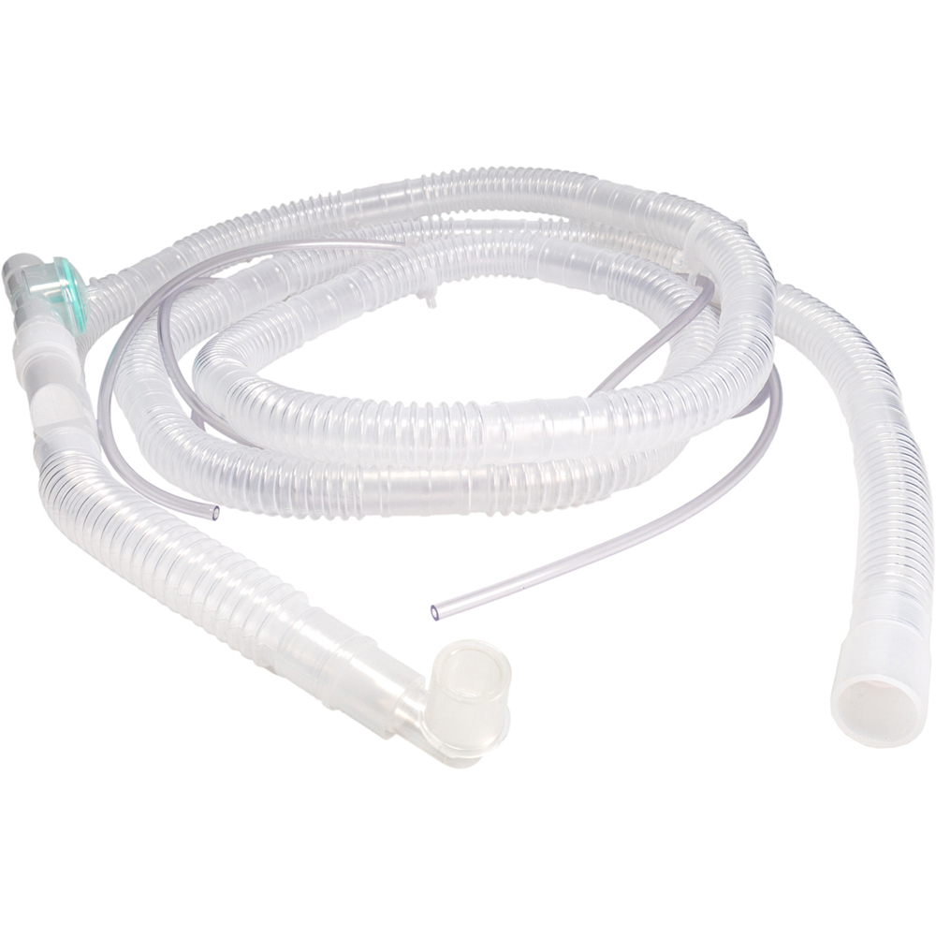
Single-limb tube type: mri safe w/ exhalation
Single Limb Coaxial Circuit with Exhalation Valve
Westmed
LATEX FREE | SINGLE PATIENT USE | DISPOSABLE
Patient valve, PEEP valve and oxygen tubing constructed of MRI-safe materials
3 o’clock position of PEEP keeps valve out of patient’s face
For use with Smiths Medical Pneupac and other ventilators (Consult ventilator manufacturer specifications prior to use)
Corrugating tubing expands generously to 9’
Circuit available with or without PEEP valve

Slide 22

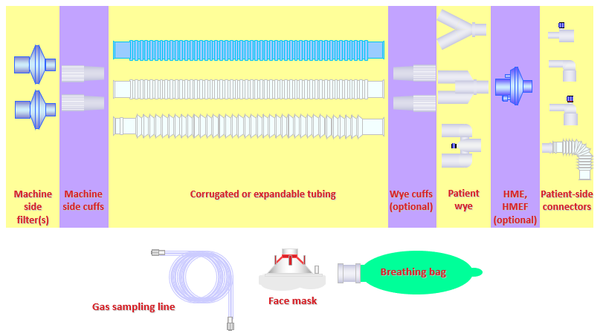
Dual-limb “y” tube type: circuit components
A Circuit is the sum of its components.
CIRCUIT
+
CIRCUIT ACCESSORIES

Slide 23

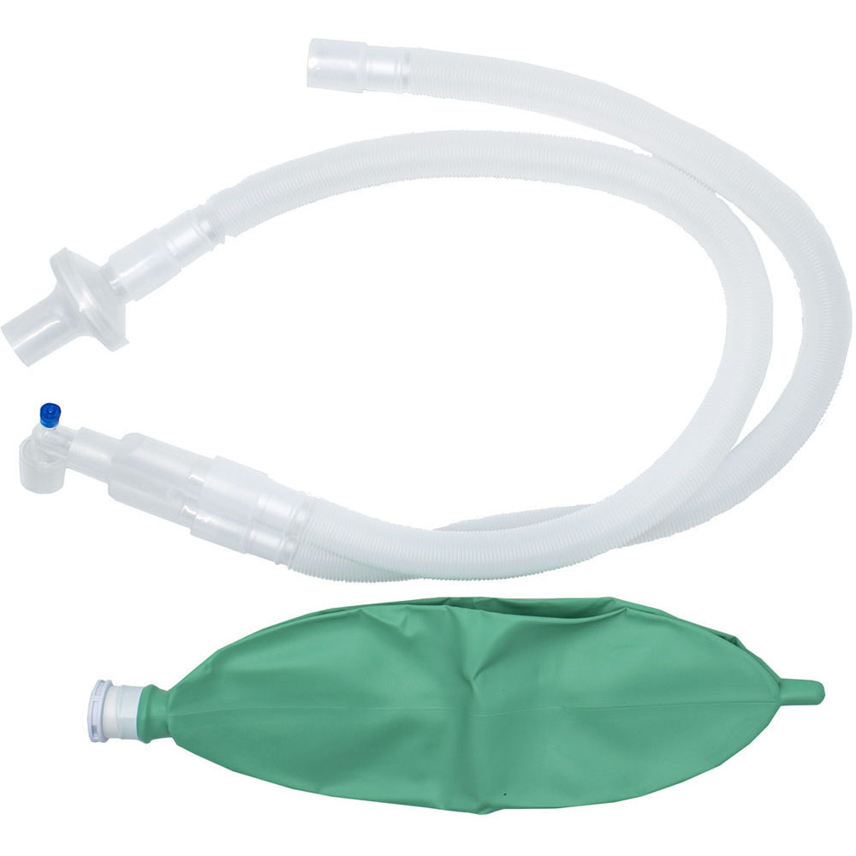
Dual-limb “y” tube type: expandable
SunMed Marketable Features
• High quality tubing with exceptional flexibility and drapability
• ISO connections for secure leak resistant connections
• Custom configurations are available to meet your need
Expandable circuits are the top selling option used by customers across the disposable circuit market
PROS
Takes up less space
Can expand or contract to desired length
Flexibility and Drapability
CONS
Heavier than Corrugated tubing
Opportunity for and detecting leaks

Slide 24
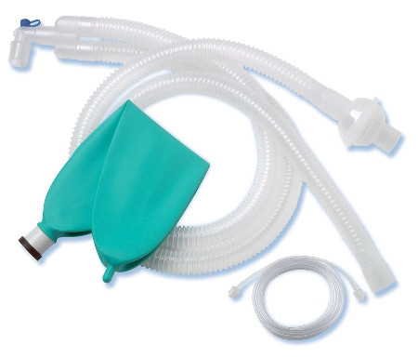
Dual-limb “y” tube type: corrugated
SunMed Marketable Features
• ISO connections for secure leak resistant connections
• Custom configurations are available to meet customer needs
PROS
Simple
  Non-expandable, basic tubing
Economic
Light Weight
  Important for PED patients
CONS
Bulky, Takes Up Space
Lacks Feature Benefits

Slide 25
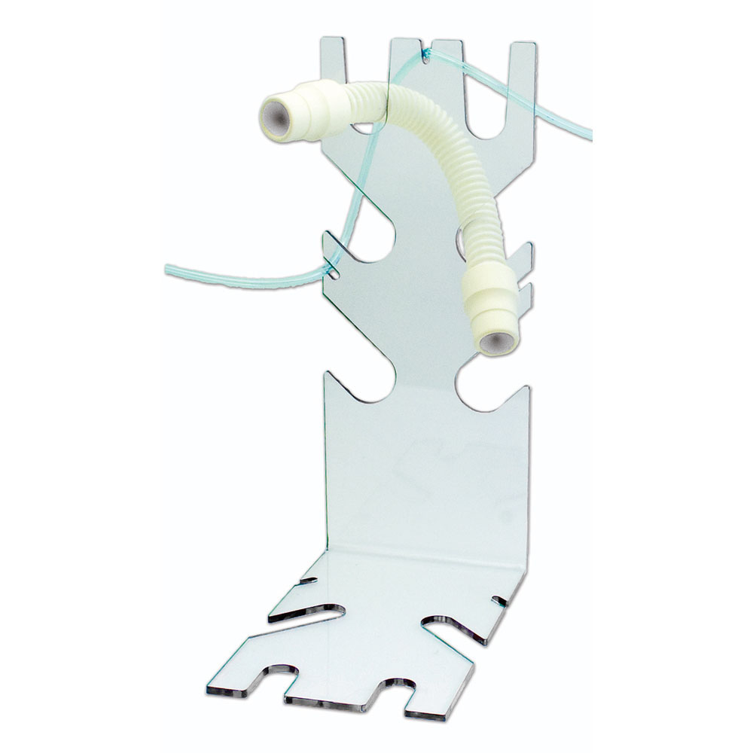
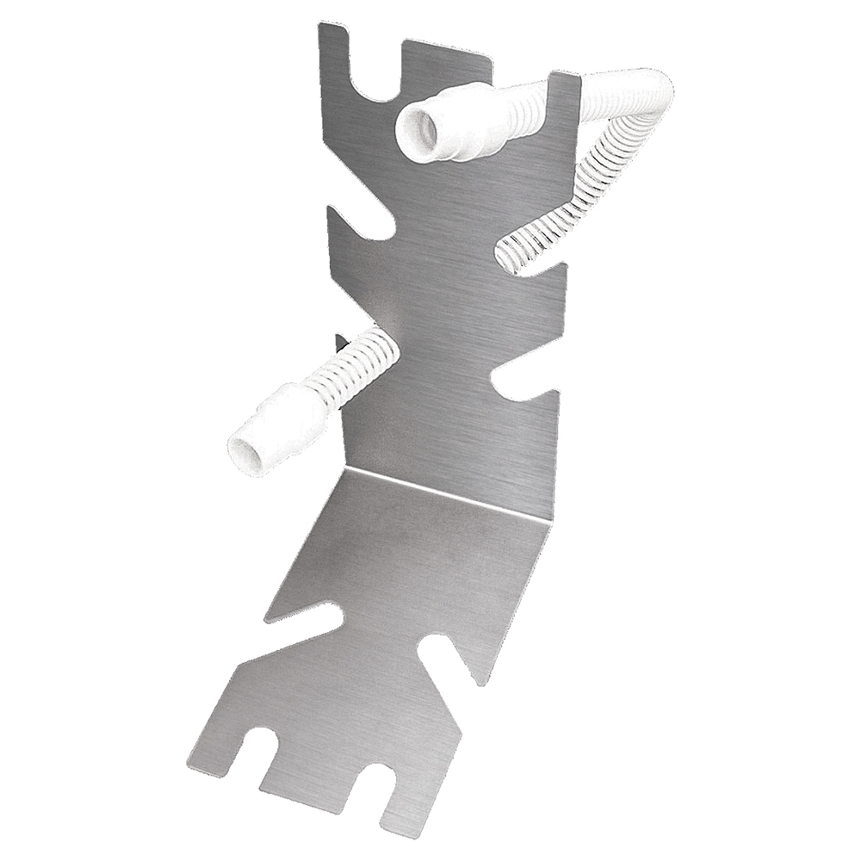
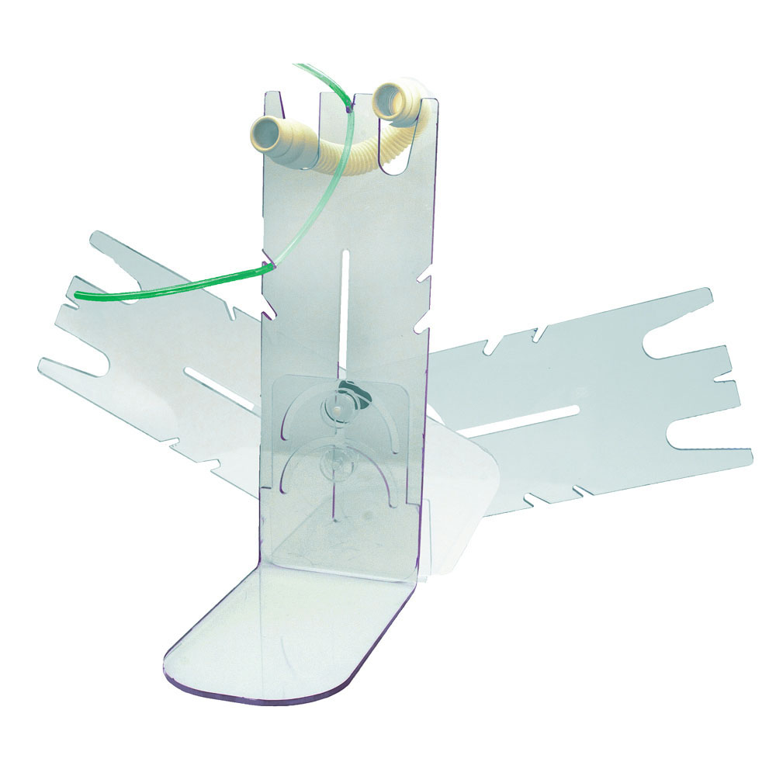
Sunmed Tube tree
Easily restrain oxygen and suction tubing gas sampling lines
Effectively manage all three diameter breathing hoses: small disposable plastic, medium reusable rubber, and plastic large king hoses
Available in stainless steel or clear polycarbonate (PC) for long life
PC models are more durable than acrylic and can be safely cleaned with alcohol
PC models accommodate gas sampling tubes
PC models safe for MRI use
Each model measures 12.125″H x 5″W x 8.5″D
8-0038-01
Stainless Steel
8-0038-03
Polycarbonate
8-0038-04
Adjustable Polycarbonate

Slide 26
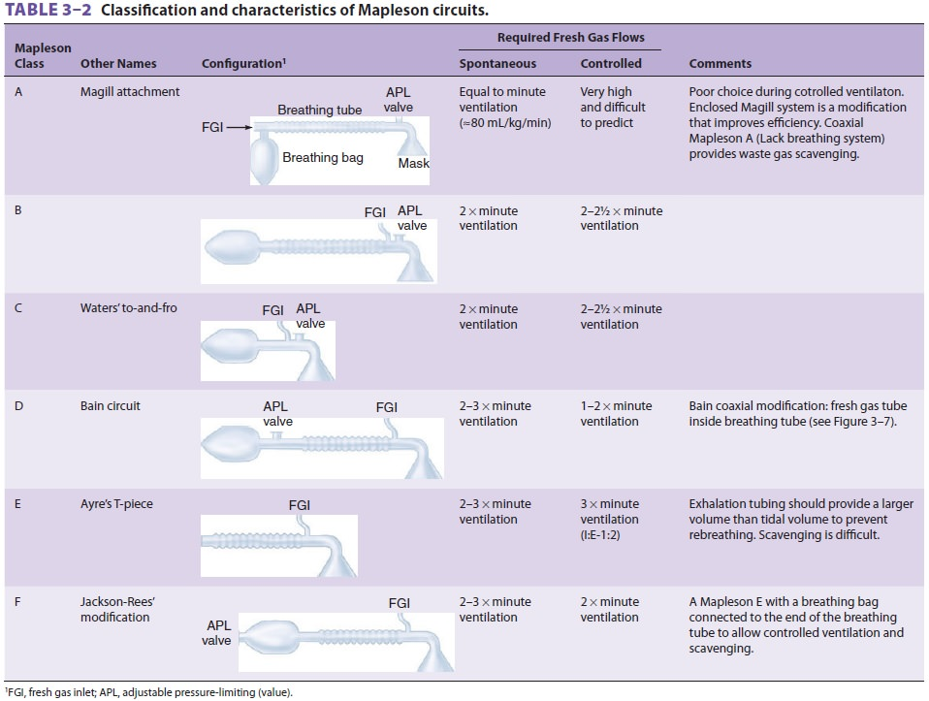
Circuit Types: Mapleson Non-rebreathing
Mapleson circuits come in many varieties, Bain (Class D) being the most popular. They can be used when the patient is under light anesthesia and still spontaneously breathing or in need of minimal support.
The other benefit of this setup is it can be used post anesthesia as a transport circuit/ventilation circuit in recovery. The use of the APL valve and the fresh gas flow can accommodate many breathing patterns and support levels.
These circuits are not widely used anymore in human anesthesia delivery but are popular in
veterinary anesthesia.
Source: https://www.brainkart.com/article/Performance-Characteristics-of-Mapleson-Circuits_26772/
Notes:
The non-rebreathing circuit, as the name implies, is a system where the patient receives fresh gas and anesthetics vapors combined in a single limb circuit. Exhaled gas is pushed to the reservoir bag where is collects. The amount of fresh gas flow helps to control any CO2 rebreathing and the pop-off or APL valve where the anesthetic gases can be scavenged and not vented into the operating theater. The advantages of this system is that it is lightweight and easy for the clinician to control the fresh gas intake. The disadvantage is that there is a lot of waste of anesthetic vapors that could be recycled as in the circle system.
The Bain and Jackson Rees circuits fall into a gray area between Anesthesia circuits and Hyperinflation Bags. For any Mapleson circuit types not aligned under “D” or “F” it falls out of the Circuit category and into Hyperinflation.
Mapleson Table Source: https://www.brainkart.com/article/Performance-Characteristics-of-Mapleson-Circuits_26772/

Slide 27
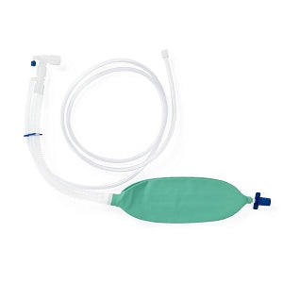
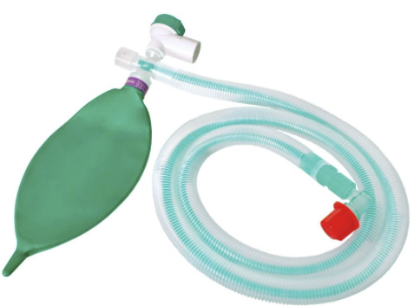
Mapleson circuits: bain & Jackson rees
We offer two types of Mapleson circuits
Bain or Mapleson “D”
Jackson-Rees or Mapleson “F”
If we don’t have it DO NOT make it. Low volume opportunities with human patients, primarily used in veterinary medicine.
Notes:
If we don’t have it, don’t make it. Low volume opportunity with human patients, primarily used for veterinary medicine. Outside of the Bain and Jackson Rees, Mapleson options dive directly into the hyperinflation/resuscitation offering, removing it from being what we consider a “Circuit.”

Slide 28
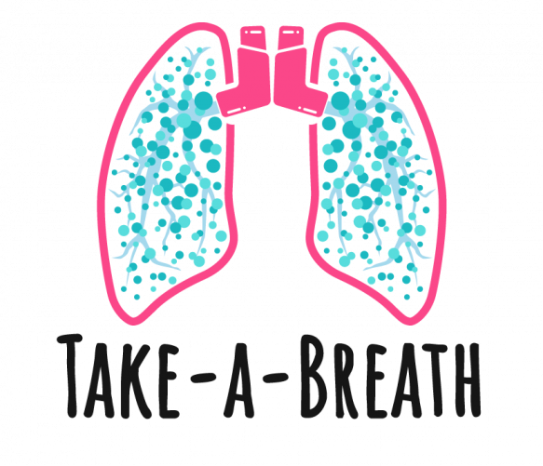
Before we continue… let’s review
What is a circle system?
What are the three main types of Anesthesia circuits?
Red Light/Green Light: Where do we want to focus our efforts?
Questions?

Slide 29
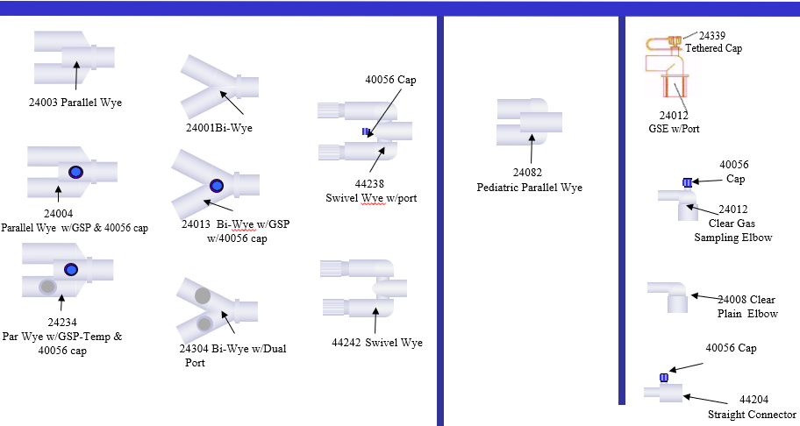
Circuit components: Wyes & Connectors
The GSP (Gas Sampling Port) is the connection point for a GSL (Gas Sampling Line)
Lead with GSP options, when available
Wye and Elbow options that feature a GSP will eliminate unnecessary objections from an anesthesiologist who may have a preference-based want for GSP options

Slide 30
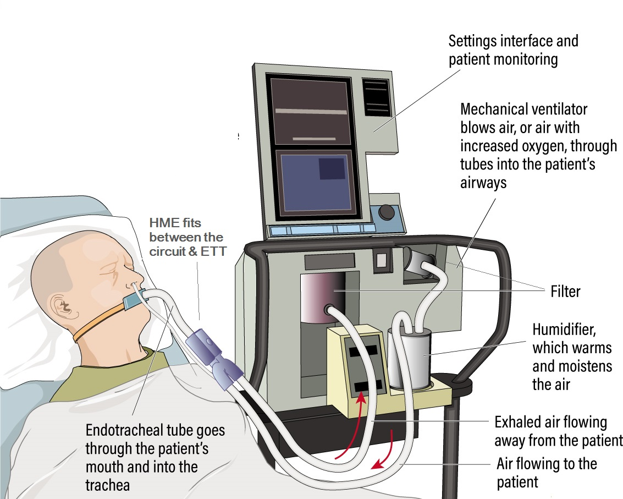
Circuit components: filters & exchangers
Bacterial/Viral (BV)
  Electrostatic
    Offered on circuits, also sold separately, by the case
  Mechanical (HEPA)
    Not offered on circuits, are sold separate, by the case
Heat & Moister Exchanger (HME)
  Also referred to as Hydroscopic Condenser Humidifiers (HCH)
Heat & Moister Exchanger + Filter (HMEF)
  HMEF = HME + BV
  Also referred to as Hygroscopic Condenser Humidifier + Filter (HCHF)
Notes:
Bacterial viral filters are essential for mechanical ventilation to filter the source gas delivered to the patient and to filter the patient’s exhaled breath. Electrostatic and mechanical filter media are used in the breathing circuit. If you look at the illustration, the filters are often placed between the ventilator and inspiratory limb prior to the heated humidifier. This is used to filter out any particulates that may be in the compressed gas source. The clinician may also place a filter at the end of the expiratory circuit prior to the ventilator exhalation valve. Some ventilators have their own heated HEPA filtration system on the exhalation port; therefore, an additional filter would not be required. Instead of a heated humidifier, the RT may use an HME/HCH between the endotracheal tube and the circuit wye.
Filter efficiency can be established through several means, the most stringent being the High Efficiency Particulate Air (HEPA) test. While a variety of HEPA-grade filters are available, single-layer media and electrostatic filters are those most used in breathing circuits and heat and moisture exchange filters. Filters are generally used in equipment where bacterial contamination can occur, such as breathing tubes, mechanical ventilators and anesthesia circuits, resuscitation bags and nebulizers. Use of these filters can potentially minimize the risk of infection and cross-contamination to patients, caregivers and visitors in the critical care setting.

Slide 31

bacterial/viral filters
Bacterial/Viral (BV)
High Efficiency Particulate Air (HEPA)

Slide 32

Heat and moisture exchangers (hme)
Placed between the Wye and ETT
  Between the tube and ETT for Coaxial circuits
  Options come with or without gas sampling port
Captures heat and water vapor from a patient’s exhaled air. It then adds that heat and moisture to the patient’s inspired air, providing humidification.
  Also called Hygroscopic Condenser Humidifier (HCH)
HMEF adds a BV filter layer to the HME
  The bigger the surface area,
  the more moisture provided
    “Maxi” sized HME used for Respiratory

Slide 33


breathing masks: Marketable features
Cone
Grip – dictates comfort and ease of use
Transparency of crown to allow patient monitoring
Hook Ring – connects harness, doubles as extra grip
Inflation Valve – location, tail or fixed
Cushion
Secure seating and sealing is important
Flexibility and patient comfort
Minimal pressure to create a seal

Slide 34




Breathing masks: Sunmed Examples
Westmed – Inflatable
Westmed – 900 Series
Ventlab – Vent Mask
Ventlab - Inflatable Flexible
Features clear, flexible faceplates and soft elastomeric cushions for maximum patient comfort
Medium and large adult sizes
Includes hook ring
Features a thumb ridge for an easier grasp
Unique ergonomic shape fits all facial configurations for improved sealing capabilities
• Soft pliable air-filled cushion with inflation valve
• Includes six standard sizes to properly fit all your patients needs
Superior ergonomic cushion design for an optimal seal with minimum pressure
• Flexible body allows gentle deep seating of cushion to face
• Inflation valve adjusts cuff pressure for optimal seal
• Ample nose bridge room for proper fit
Inflatable cuff helps ensure patient comfort
• Reduces wasted anesthetic gas pollution
• Transparent housing for immediate detection of regurgitation or silent aspiration
• Removable color-coded hook ring
Notes:
Right to left:
Westmed 900 Series – Large Adult to Neonate

Slide 35







Circuit accessories: breathing bags (BB)
Breathing bags in an anesthetic system are collapsible ellipsoid containers that serve as a reservoir for anesthetic gases and as a means for manual ventilation. The reservoir bags, also known as counter lungs, allow visual assessment of the presence and estimation of the volume of ventilation. These bags form a crucial part of most anesthetic systems, since, during normal spontaneous inspiration, anesthetic machines are incapable of providing the needed peak inspiratory gas flow.
Size Range:
Types: Blow-Molded (thicker, w/ seam) and Dip-Molded (thinner, seamless)

Slide 36

Circuit accessories: gas sampling lines (GSL)
or EtCO2 End Tidal Gas Sampling Lines
The level of carbon dioxide that is released at the end of an exhaled breath is called End Tidal CO2 (EtCO2) and it reflects the patient’s ventilatory status.
Gas sampling lines are used to deliver gas samples to a monitoring device for the measurement of respiratory gases.
Focused Features For Cross Referencing
  Tube Length
  Inside Diameter
  Luer Lock
“Gold Standard” Options:
Male/Male
or
Male/Female
Luer?
Material# | Description
0600-04 | 10’ x .050 ID M/M
0600-03 | 10’ x .050 ID M/F
Notes:
.050ID seen as an all-around standard fit
.050ID – Can be substituted for .047ID through 0.60ID
The connection point is always .050ID, even if the GSL’s ID is .060ID
.040, .030 or below only exceptions to the .050ID standard
Luer – Need to match M/M, M/F
F/F (uncommon, generally only applies to older machines)
0600-03 10’ x .050 ID M/M
0600-04 10 x .050 ID M/F

Slide 37






Circuit accessories: what’s in your bag?
Circuit
Complimentary products kitted with Circuit and Circuit Accessories:
Patient Monitoring
  Electrodes (ECG)
Fluid Management
  Yankauers
  Suction Tubing
Airway Management
  Endotracheal Tubes
  Intubating Stylets
  Oral & Nasopharyngeal Airways
GSL
Mask
Breathing Bag
Electrodes
Distributors, such as Cardinal Health and Medline, have custom kitting capabilities coupled with a wholistic mix of branded and sourced catalog options.
Developing customized procedural kits to their customers focus on branded mix incentives by delivering on cost and labor savings, along with supply chain and inventory management efficiencies.

Slide 38
Before we continue… let’s review
What are the three most common accessories included in an Anesthesia Circuit kit?
What is the difference between an HME and an HMEF?
What are the two main parts of a breathing mask?
What are the two standard GSL options to offer?
Questions?
ANOTHER

Slide 39

Competitive landscape
3

Slide 40






Market overview
Great opportunity to grow market share!
(31%)
(20%)
(20%)
(10%)
(5%)
(4%)

Slide 41
Competitors
Marketing Strategies of Major Competitors
Low-price, limited offering
Broad product range, highly customized offering sold at a premium
+
= 36% of Disposable Anesthesia Market
+
= 40% of Disposable Anesthesia Market

Slide 42


Competitors: medline
Own 31% of the overall disposable circuits and kits market (2021 Clarivate)
Offer a full suite of circuit components and options, along with manufacturing and custom kitting capabilities to match customer wants
Focus customers on a limited, low-price offering
Like Cardinal Health, Medline sells customers on branded product mix incentivization, overall supply chain capabilities, and inventory management tools

Slide 43


Competitor: ambu (King)
Ambu owns 20% of the overall disposable circuits and kits market (2021 Clarivate)
Offer a broad range of products with a focus on quality and innovative technology
Differentiate circuits based off their “F” connector
Ambu “Universal Flex2”
Only Expandable Coaxial circuit in the market. Proprietary technology.
King Masks
Highly preferred by customers. Well designed, ergonomic, high quality.

Slide 44


Competitor: vyaire
Own 20% of the overall disposable circuits and kits market (2021 Clarivate)
Offer a full suite of circuit components and complimentary options
Commonly see backorder opportunities based on their focus on BTO solutions and can substitute SunMed solutions as an alternative
Vyaire “Limb-O”
Bifurcated version of a coaxial circuit, not tube-in-tube

Slide 45



Competitor: smiths medical / icu medical
Own 5% of the overall disposable circuits and kits market (2021 Clarivate)
Smiths Medical and their Portex® brand is now part of ICU Medical
Focus customers on a limited, low-price offering
Great opportunity to offer similar SunMed options to match their customer solutions

Slide 46

Getting to know the customer
4

Slide 47
Gpo contracts
We are not on any GPO contracts for Circuits
Little to no GPO compliance or brand loyalty by customers
Supply chain disruptions are common
  Backorders often result in lost and gained business

Slide 48
Customer segmentation
Economic Buyers
Ambulatory care and small acute care facilities
Tend to be profit driven and receptive to low cost
More accepting of standardized (BTS) solutions
Value Buyers
Will be open to the fact that additional suppliers are entering the market
Seek a pragmatic balance between the benefits of clinical features and cost
Have buying power to demand custom (BTO) solutions

Slide 49
Custom vs standardization: Want vs need
Stock Circuits – BTS
In general, it is a standard item that we would carry on the shelf for anyone to buy.
Some customers could ask us to stock a certain amount of product for them, and it could be private labeled or not. (i.e., McKesson)
Custom Circuits – BTO
This is a custom circuit, with a lead time of 6-8 weeks. Most all are SunMed branded circuits. Historically there was a MOQ of either a dollar amount or a case amount.
With so many options, why would a customer want a standard solution?
Highly customized solutions result in longer turnaround times, higher costs due to low volumes, along with increased opportunity for supply chain disruptions, which causes Materials Management to scramble for alternative substitutes to ensure procedures go uninterrupted. Bottom line: business is won and lost based on the deliverable.
Notes:
Focus on reducing complexity and improving supply chain efficiencies. Highly customized solutions result in longer turnaround times, higher costs due to low volumes, along with increased opportunity for supply chain disruptions, which will cause Materials Management to scramble for alternative substitutes to ensure procedures go uninterrupted

Slide 50

Decision makers & stakeholders
RELIABILITY | COST SAVINGS | QUALITY SUBSTITUIONS | REDUCED COMPLEXITY
Rationalization Challenge
There’s a dynamic of Want vs Need between Anesthesiologists and Materials Management in high volume hospitals. An anesthesiologist can sway a sale due to preferences and a competitive landscape of suppliers willing to sell custom (BTO) solutions to match their Want. Health Systems accounts, for bidding purposes, demand a high level of options before ultimately settling on only a handful of SKUs.
Notes:
Focus on reducing complexity and improving supply chain efficiencies. Highly customized solutions result in longer turnaround times, higher costs due to low volumes, along with increased opportunity for supply chain disruptions, which will cause Materials Management to scramble for alternative substitutes to ensure procedures go uninterrupted.
The key pieces that match what’s valued and will help the pain points of the customer are: Supply Chain Reliability, Cost Savings, and Simplified Solutions to Reduce Complexity.

Slide 51

crossing a circuit
&
Group Exercise
5

Slide 52

How to cross a circuit
Getting Started
A Circuit will fall under one of two categories
  Cataloged: Descriptions available and published on a manufacturer's website or catalog
  Custom: Non-cataloged material numbers are more difficult to find
Identify what the competitive product code is
  The code can be found on the product label or ask your customer for the material number they order
  This code will either be part of a catalog offering or a custom-built (BTO) solution for the customer
Search the competitive product code online
  Search the manufacturer website for the product code or use a search engine like Google or Bing to find results
  If you can’t find any information online then work with your customer to get a physical sample, a description of circuit features and accessories, or pictures of the circuit kit
Still unable to determine what the circuit is? Refer to Questions to Ask in order to get the necessary information from your customer

Slide 53

Questions to ask
Is it an Adult, Pediatric, or Neonatal Circuit?
  Caution: the SunMed catalog offering is geared primarily toward Adult and Pediatric patients NOT Neonate
What is the Type of Circuit?
  Dual Limb
    Corrugate (non-expandable, basic tubing)
    Expandable
  Single Limb (Unilimb, Limb-O)
  Coaxial
  Expandable + Coaxial (Only offered by King/Ambu)
    Tip: Can be crossed to our Coaxial options. If it is a 72” Expandable Coaxial, then cross to our 72” Coaxial
What is the Circuit Length?
  Common lengths are 40”, 60”, 72”, 96”, 108”, and 102” – When in doubt, round up!
What types of Filters & Exchangers are on the circuit tubing?
  BV (Bacterial/Viral) filter
    If BV filter How Many and Where on the circuit are they located (inspiratory, expiratory, or patient end)
  HME/HMEF: Heat Moisture Exchanger / Heat Moisture Exchanger + Bacterial/Viral Filter. HME also referred to as HCH.
  HEPA – HEPA filters are sold separately by the case, due to low demand and high cost. Allows a customer to place the HEPA filter on themselves, when needed.
What accessories are in the kit with the circuit?
  Is there a breathing mask and if so what size?
    Breadth of sizes range from Large Adult (Size 6) through Preemie (Size 0)
  Is there a breathing bag (typically green) and if so what size (1L, 2L, or 3L?)
    If no information is available, but a bag is needed – PED circuits commonly feature 1L bags, while adult circuits feature 3L bags
  Is there a Gas Sampling Line?
    What is the inside diameter of the connection (.050 ID or .060 ID), and is it a M/M or M/F connection?
Sales Pad will allow you to find SunMed circuit options with inventory
  Marketing Specialists will support you with navigating Sales Pad, cross referencing and sample orders
If you need to create a custom kit work with Zoyla Herrera through the New Project Request process
  Quotes, Drawings, and Samples

Slide 54


cross reference example: Cataloged Circuits
Circuit Type?
Adult or Pediatric?
Tube Type?
Length?
Filters and/or Exchangers?
Accessories?
Mask?
Breathing Bag?
Gas Sampling Line?
Material Number:
DYNJAA0110
*BOM info found on Medline.com*

Slide 55





cross reference example: custom circuits
Google search resulted in information on it through McKesson.com, along with BOM details!
Circuit Type?
Adult or Pediatric?
Tube Type?
Length?
Filters and/or Exchangers?
Accessories?
Mask?
Breathing Bag?
Gas Sampling Line?
Material Number:
DF475-6121Z
No info found on Ambu website, what do you do?
Notes:
Product information on custom circuits can sometimes be found on non-manufacturer websites, such as distributors selling the product through their channels.

Slide 56
Questions to ask
What ventilators are you using?​
When do you use heated and non-heated wire circuits?​
How do you humidify your patients with a non-heated circuit?​
Where do you place your filters on a dual limb circuit?​
Where do you tee in a nebulizer?​
What resus bag is at the bedside?​
What ventilators are you using to transport?​
How many internal transports do you do with ventilated patients in a week/month/year?
Notes:
In order to understand your customer’s needs, here are some sample questions that can direct the conversation.
Many institutions use more than one brand and have some ICU and some transport ventilators.
The potential answer is that they only use heated wire, but some may have a protocol that uses non-heated for up to 3 days before moving to heated. Worthy of a discussion on their practice and it may present an opportunity for our solution.
Asking how they humidify should net an answer of HME or HMEF. Do not be surprised if the clinician says HME, but you observe HMEF. This would be a good opportunity to educate the difference.
Some will filter both Insp and Exp sides, some only exp sides. There are many possibilities as well. If an HMEF is used at the patient, they may only use an Exp filter. If they use an Insp filter as well, this could lead to a lot of resistance in the circuit and would be a worthwhile discussion as to why they do this.
Asking about the nebulizer tee will open a conversation about nebulization or are they using MDI or Aerogen.
Resus bag question opens the door to discuss our portfolio. Every patient on a ventilator should have a resus bag at bedside in case of equipment failure.
Transport question could open up an opportunity, however we have limited options, but if we have a solution, we are MRI Safe.
It is always good to get some data on patients and vents for forecasting info.

Slide 57

Other resources
Ventilator Sales Tool
We have created a flip book that covers most all the ventilators on the market, including some that are discontinued, just in case you encounter them.​
The book will detail what circuits will work with what machine, and let you know what machines are not compatible with our circuits.

Slide 58


