Slide 1
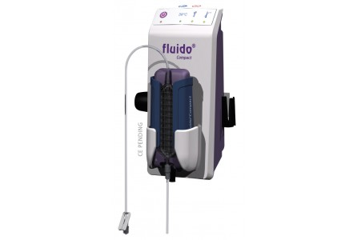
Fluido Compact
Marie-Louise Allen
Ben Green
Alberto Guzzetti

Slide 2
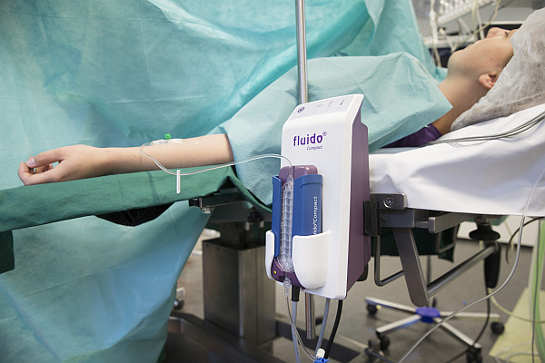
What they claim…
https://www.youtube.com/watch?v=zBi5hp5PAmc
One button operation.
Easy to use.
Disposable set consists of a cassette and patient line of 40 cm and has a priming volume of only 3 ml.
Independent control system and multiple temperature sensors.
Device requires no maintenance.
Disposable set is interchangeable and moves easily with the patient between

Slide 3
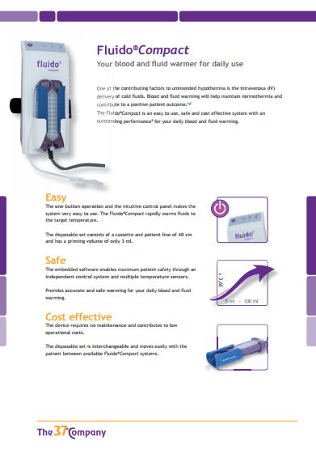
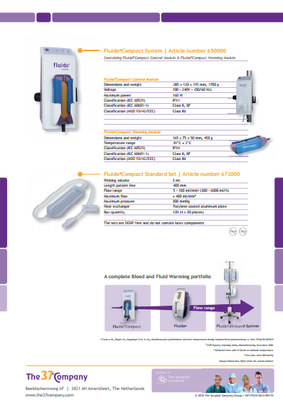
Brochure

Slide 4
Competitor Matrix

Slide 5
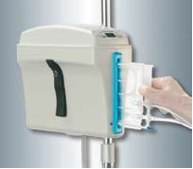
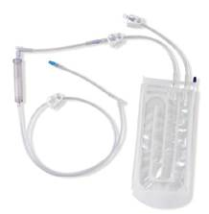
Fluido Compact Loss!
Facts:
2 Key persons identified–very difficult to get appointments
>1,5 year of work and waiting…
35 Units – OR-ICU & Recovery
Gaymar EQ. It is EOL on the market and no cartridges are no longer available.
Benefits:
IB (4 units) on ER
IB on sister site in Lund (22 units)
IB in Kristianstad (same county)(20 units)
Challenge:
Fluido Compact needs to get into the market –low price

Slide 6
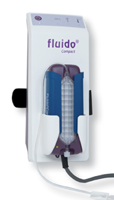
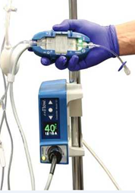
Continued…
Trial:
Fluido Compact first in, enFlow second. Trials in OR, ICU & Recovery.
Evaluation:
They liked both Fluido Compact & enFlow
Fluido Compact price: 736$, cassette 1$. enFlow price: 736$ cartridge 12$
They liked that the Fluido Compact cassette had preattached extension.
Benefits for enFlow:
enFlow have been longer in market – good references
Lighter in weight
IPX7 – both usefull regarding cleaning & protection for risk of current leakages when used in central venous catheter
Flow Capacity
enCheck
Bubble trap
Warmer holder
E-learning

Slide 7
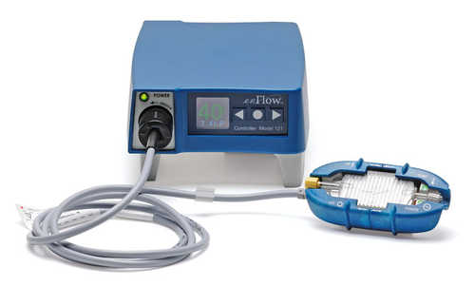
Winner is enFlow!
Business won at $12 cartridge price.
Installation/training started.
New challenge – convert from Bronze to Silver.
Introduce standards for when to use warm fluid –Nice Guidelines.

