Slide 1
Anatomy & Physiology of the Respiratory System

Slide 2
Anatomy & Physiology of the Respiratory System
Luc Van Audenhove Head of Marketing
Reworked version from Tommy Lynch
Zaventem, October 2023;

Slide 3


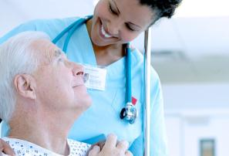
The information provided in the AirLife Training Academy for the Sales and Marketing teams of AirLife and its distributors is not intended for further distribution.
The enclosed information can only be used for educational purposes for our sales teams.
This information can under no circumstances be used as advertising or for distribution to end users.
Confidential: Not for further distribution

Slide 4
Anatomy & Physiology of the Respiratory System
Objectives:
Identify the anatomical structures,
Understand the physiology,
Recognize common disorders of the Respiratory System

Slide 5
I. ANATOMY

Slide 6
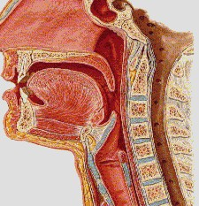
The upper respiratory tract – Pharynx
Nasopharynx
Oropharynx
Laryngopharynx
Larynx
Esophagus

Slide 7
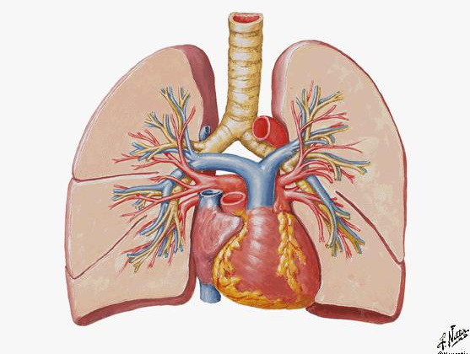
Pulmonary Arteries and Veins

Slide 8
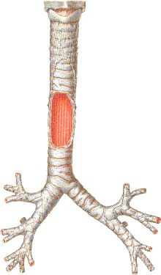
The lower respiratory tract
Trachea & Primary Bronchi
trachea
right mainstem bronchus
left mainstem bronchus
segmental bronchi
lobar bronchi
carina

Slide 9
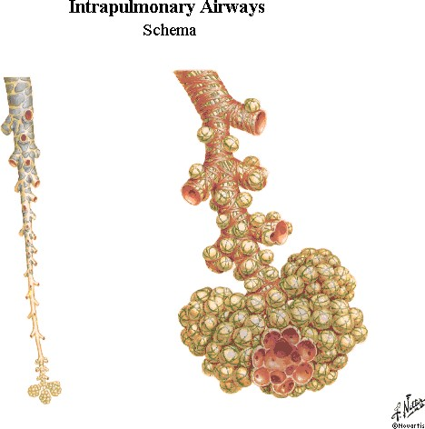
The lower respiratory tract
Bronchioles
Bronchi Bronchioles Alveolus Alveolar sacs

Slide 10
The diaphragm
The diaphragm is a sheet of muscle extending across the bottom of the ribcage.
The diaphragm separates the thoracic cavity from the abdominal cavity.
It is crucial in respiration: in order to draw air into the lungs, the diaphragm contracts, thus enlarging the thoracic cavity and reducing intra-thoracic pressure
When the diaphragm relaxes, air is exhaled by elastic recoil of the lung and the tissues lining the thoracic cavity

Slide 11
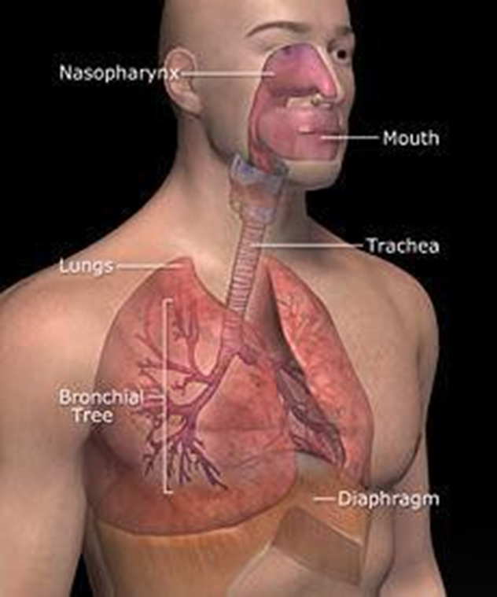
II. PHYSIOLOGY

Slide 12
Physiology – Ventilation
Ventilation occurs under the control of the autonomic nervous system from the brain stem, the medulla oblongata and the pons.
Inhalation is initiated by the diaphragm and supported by the external intercostal muscles. Normal resting respirations are 10 to 18 breaths per minute.
Exhalation is generally a passive process, however active or forced exhalation is achieved by the abdominal and the internal intercostal muscles.

Slide 13
Physiology – Gas exchange
Upon inhalation, gas exchange occurs at the alveoli: The alveolar walls are extremely thin (approx. 0.2 micrometers) and are permeable to gases.
The alveoli are lined with pulmonary capillaries, the walls of which are also thin enough to permit gas exchange.
All gases diffuse from the alveolar air to the blood in the pulmonary capillaries, as carbon dioxide diffuses in the opposite direction, from capillary blood to alveolar air.
At this point, the pulmonary blood is oxygen-rich and the lungs are holding carbon dioxide.
Exhalation follows, thereby ridding the body of the carbon dioxide and completing the cycle of respiration.

Slide 14
Physiology – Gas exchange
Cycle consists of 3 phases:
Inspiration
Expiration
Rest
Frequency in rest: 12 - 15 x / minute
Pressure
Expiration
0
Inspiration
Rest

Slide 15
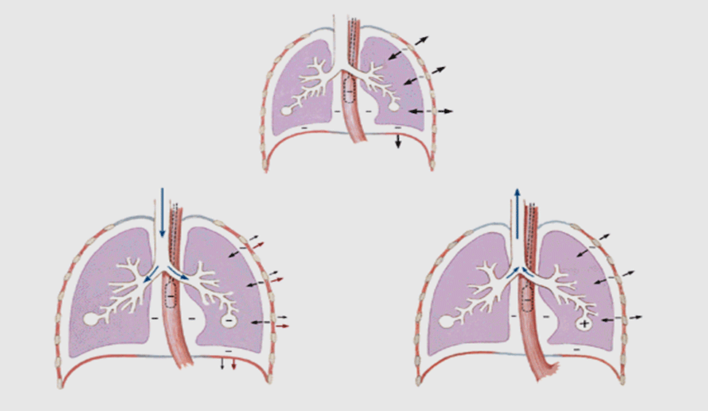
Physiology – Gas exchange
Inspiration:
Rib cage expands and diaphragm pulls downwards
Air is drawn into lungs
Expiration: air is expelled from lungs

Slide 16
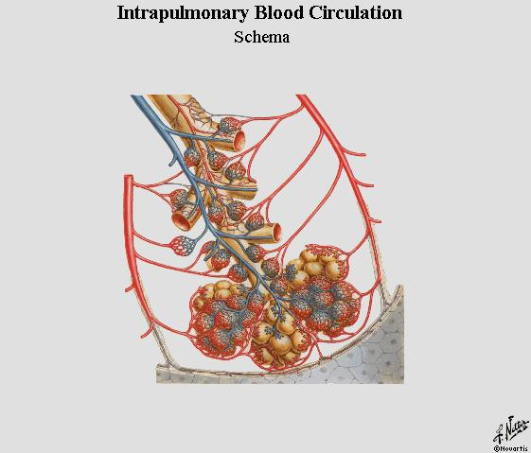
Intrapulmonary Blood Circulation
Arterioles: O₂ poor
Venules: O₂ rich
Alveolar sac: 0₂ / C0₂ exchange

Slide 17
III. COMMON DISORDERS

Slide 18
Common disorders
Obstructive Conditions:
Emphysema: Alveoli become overstretched, rupture and merge reducing the surface area for oxygen absorption.
Chronic Bronchitis: The Bronchi become inflamed, congested and narrowed. The inflamed airway begins to produce too much mucus.
COPD: Long-term disorder with progressive damage to lung tissue and increasing shortness of breath.

Slide 19
Common disorders
Restrictive Conditions:
Fibrosis: Gradual thickening of the lung tissue causing irreversible scarring.
Sarcoidosis: A disease that results from inflammation causing granulomas. When the granulomas do not heal, the tissues remains inflamed and fibrotic.
ARDS: (Acute Respiratory Distress Syndrome) Sudden failure of the respiratory system that occurs when fluid builds in the alveolar sacs.
Pleural Effusion: Excessive fluid in the two-layered membrane surrounding the lung. Common causes are pneumonia, tuberculosis heart failure and cancer.

Slide 20
Common disorders
Vascular Diseases:
Pulmonary Edema: Fluid accumulation in the lungs which leads to impaired gas exchange as a result of inadequate unctioning of the heart or circulatory system.
Pulmonary Embolism: A condition that occurs when one of more arteries in your lungs become blocked.
Pulmonary Hypertension: A type of high blood pressure that affects only the arteries in the lungs and the right side of the heart. The pulmonary arteries and capillaries become narrowed , blocked or destroyed which raises pressure within the arteries in the lung.

Slide 21
Common disorders
Infectious, environmental and other "diseases“:
Pneumonia: Inflammation of the bronchioles and alveolar sacs due to infections with bacteria, viruses or other pathogenic organisms.
Tuberculosis: Infectious disease caused by the tubercle bacillus. It is characterized by the formation of tubercles on the lungs often developing long after the initial infection.
Asbestosis: A breathing disorder caused by inhaling asbestos fibers/Prolonged accumulation of these fibers in your lung causes scarring of the lung tissue and shortness of breath.

Slide 22
THAN K Y OU
29

