Slide 1
MICROCUFF* Endotracheal Tubes
September 2022

Slide 2
MICROCUFF* Endotracheal Tubes
Luc Van Audenhove Head of Marketing
Reworked version from Tommy Lynch
Zaventem, October 2023

Slide 3



The information provided in the AirLife Training Academy for the Sales and Marketing teams of AirLife and its distributors is not intended for further distribution.
The enclosed information can only be used for educational purposes for our sales teams.
This information can under no circumstances be used as advertising or for distribution to end users.
Confidential: Not for further distribution

Slide 4
Adult MICROCUFF*
Objectives:
Identify current practices
Discuss Adult MICROCUFF Value Proposition
Product Portfolio and Competition
In-service and Role Play Scenarios – What Sales Resources Do I Use?
Notes:
For In-services and Role Plays, these will be video taped. Can utilize, clinical reprints, visual aids, for the role plays. In-services, can also utilize these but must complete a tip-to-tail product demo and can utilize leakage demo.

Slide 5
What is an Endotracheal Tube(ETT)?
A type of catheter that is inserted into the trachea for the primary purpose of establishing and maintaining a patent airway and to ensure the adequate exchange of oxygen and carbon dioxide.
Anesthesia can be passed through the ETT to sedate and paralyze the patient.
Used in surgery/OR and the ICU environment.
Main call point is Anesthesiologist
Notes:
Wikipedia

Slide 6
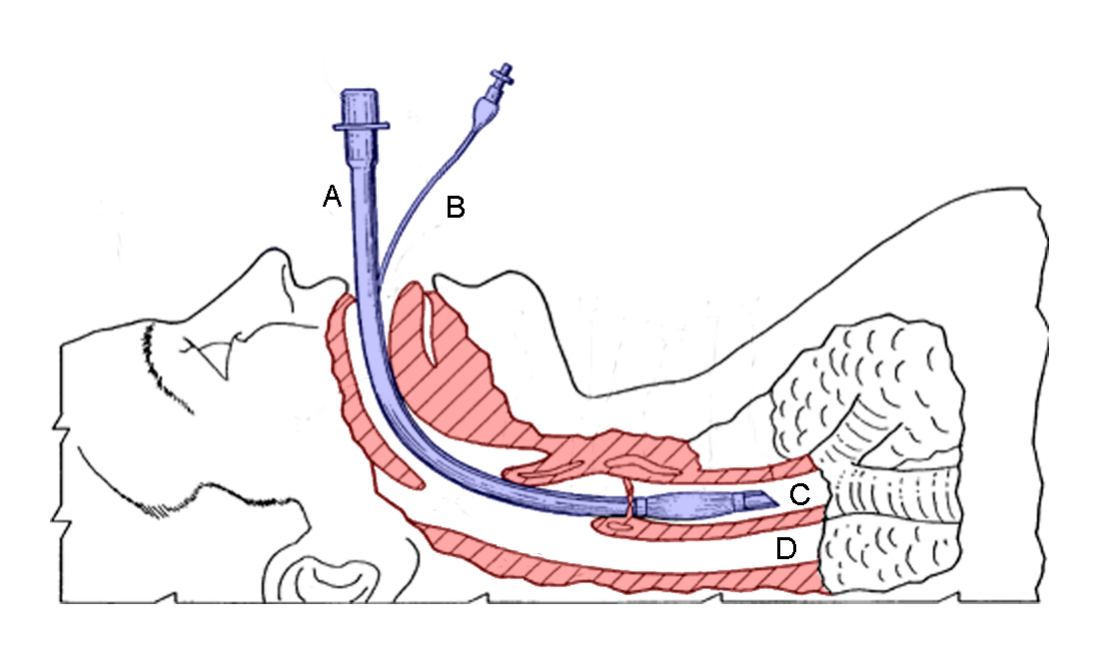
A- Endotracheal Tube
B- Pilot Line to inflate/deflate the cuff
C- Trachea
D- Oesophagus

Slide 7
Why would a patient need to be intubated??
Inadequate oxygenation and ventilation
Altered mental status
Anticipated airway obstruction
Upper airway obstruction
Apnea
Ineffective clearance of secretions
High risk of aspirations
Respiratory distress/ Respiratory failure

Slide 8
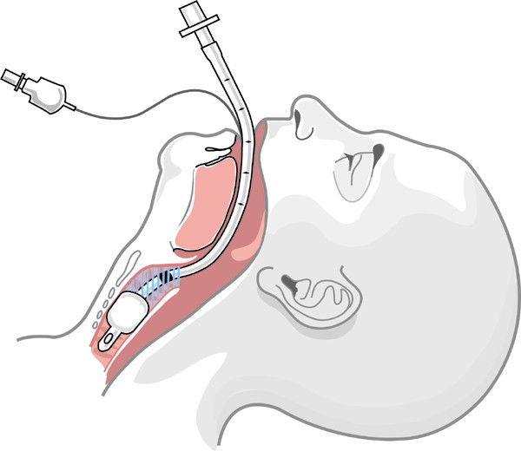
What is Micro-aspiration?
Endotracheal Tube
Endotracheal Tube (ETT)
In patients on a ventilator > 48 hours, aspiration of infected secretions past the cuff are a known cause of VAP.
The subglottic space is the space between the vocal cords and the ETT cuff. Secretions from the oral cavity, pharynx, and gastric reflux all contribute to secretions collecting in the pharynx and pooling above the ETT cuff.
These are called subglottic secretions. This is a great environment for bacteria to breed – stagnant water, dark, moist, etc.
Secretions
Cuff
Epiglottis
Subglottic space
Notes:
Let’s take a closer look at micro-aspiration.
[Background on the indications and use of an ET tube.]
To seal the airway, each endotracheal tube has a cuff, or balloon which inflates, seals the airway, and allow for the lungs to be ventilated.
The subglottic space is the space between the vocal cords and the ETT cuff. Secretions from the oral cavity, pharynx, and gastric reflux all contribute to secretions collecting in the pharynx and pooling above the ETT cuff. These are called subglottic secretions. This is a great environment for bacteria to breed – stagnant water, dark, moist, etc.
Current ET tubes on the market do not provide sufficient fluid seal of the airway and these subglottic secretions leak past the cuff and into the lung. If the subglottic secretions become colonized with bacteria, the bacteria travel into the lung with the subglottic secretions, increasing the risk of infection.
Current ET tubes, therefore, do not effectively address micro-aspiration.

Slide 9
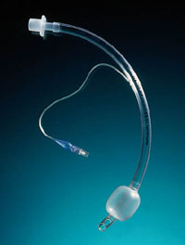
Endotracheal Tube: Head-to-Toe Review
Standard Features:
15mm adapter
Standard connection to ventilator tubing or airway devices
“Magill Curve”
Standard curvature of the whole ET tube
Full length radiopaque line
Assure correct tube placement if necessary
Pilot balloon and line
To fill the cuff with air
Mechanical self-sealing valve
Standard syringe/luer fitting
Cuff (balloon)
Conventionally made of PVC material
Seals the airway for ventilation

Slide 10
What is the Cuff Design Trade-off?
OUT OF BALANCE!
In a cuff design balancing act, current high-volume low pressure (HVLP) tubes seal at relatively low cuff pressures (25-30 cm H₂O) at the expense of leakage!
Low cuff pressure
(Reduce tracheal
trauma)
Superior tracheal seal
(Reduce micro-aspiration
& prevent VAP)
The ideal cuff would provide both an air seal (allow ventilation) and fluid seal (prevent microaspiration) at very low cuff pressure to avoid pressure on airway tissues.
Notes:
If too much pressure is exerted by the cuff on the tracheal tissue, patient complications can occur.
The ideal cuff would provide both an air seal (allow ventilation) and fluid seal (prevent microaspiration) at very low cuff pressure (avoid pressure on airway tissues).
There a two ways the cuff can seal the trachea – with pressure or volume. Early cuff designs (1970’s) were with cuff materials that stretched under pressure to create a seal. These cuffs exerted higher pressures on the trachea and increased the patients risk to complications.
Most cuff designs on the market today are “High-Volume Low-Pressure” cuffs. This means they are oversized to the trachea so that the volume in the cuff seals the trachea instead of the cuff stretching. While they seal at lower cuff pressures than before, they are very poor at creating and maintaining a fluid seal.
In short, conventional cuffs are designed for low cuff pressure, but at the expense of fluid leakage.

Slide 11
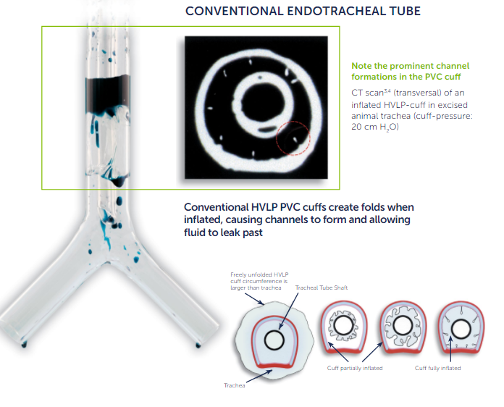
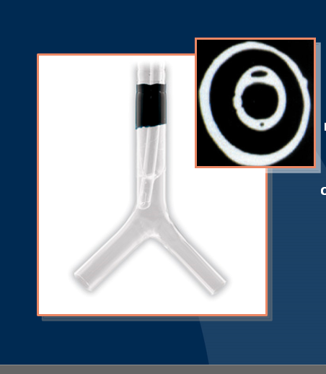
Side by side ETT

Slide 12
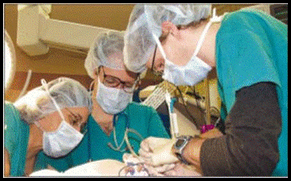

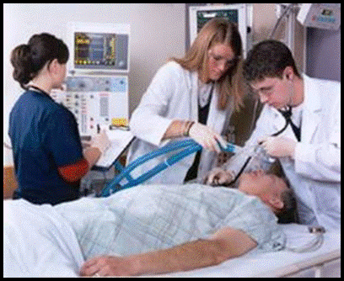
Review
What are Adult 3 Value Propositions for
Adult MICROCUFF*

Slide 13
Adult MICROCUFF* - Value Proposition
1. Reduced Micro-aspiration
MICROCUFF* provides a superior tracheal seal designed to reduce the aspiration of potentially infectious secretions
2. Reduced risk of tracheal trauma
MICROCUFF* can seal the airway at low cuff pressures, reducing the risk of tracheal trauma
3. Strong Clinical Solution
Airlife is committed to providing clinicians with a range of innovative, effective clinical solutions to prevent, diagnose and manage VAP
Notes:
There are three key messages which you should walk away knowing by heart. These three messages will be reinforced in our sales tools, and in our sales calls. You should know these by the time you leave this training.
They are:
1. MICROCUFF* reduces Micro-aspiration by providing a superior tracheal seal designed to reduce the aspiration of potentially infectious secretions.
2. MICROCUFF* reduces the risk of tracheal trauma by sealing the airway at low cuff pressures, which reduces the risk of tracheal trauma.
3.Halyard Health is a partner for VAP solutions. We are committed to providing clinicians with a range of innovative, effective clinical solutions to prevent, diagnose and manage VAP.
Let’s go into each of these in much more detail.

Slide 14
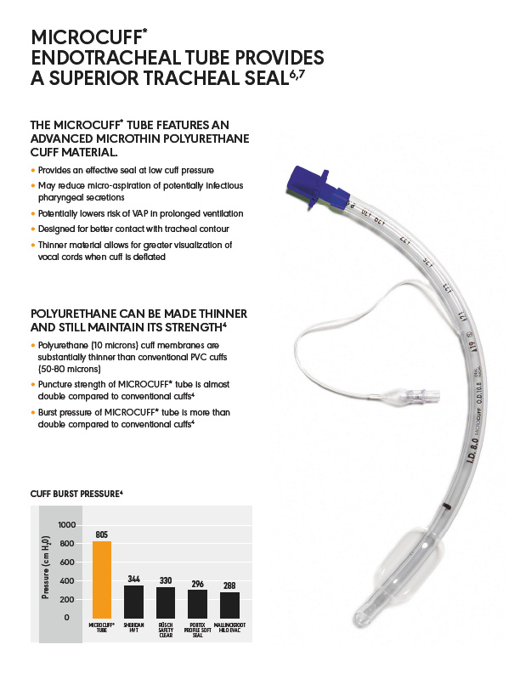

Slide 15
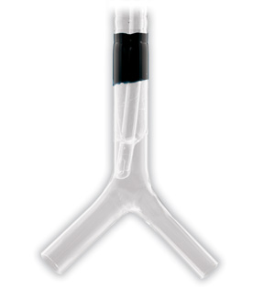
Reduced Micro-aspiration – High Volume, Low Cuff Pressure Design
MICROCUFF* “seals” channels and reduces leakage
MICROCUFF* Averages 10 microns thick. PVC cuffs are 50 -80 microns thick
Cuff length and shape are optimized for better contact with tracheal contours
Very thin polyurethane cuff: minimizes fluid that can pass through
Shape of the cuff around the tube and clear cuff eases visualization during intubation
Notes:
How does MICROCUFF* create a better seal?
MICROCUFF* is also a high-volume low-cuff pressure design so channels form in it like conventional PVC cuffs. The breakthrough technology for MICROCUFF* is an advanced micro-thin (avg 10 microns thick, PVC cuffs are 50-80 microns thick) polyurethane cuff. Because the material is so thin these channels are very small and minimize the fluid that can pass through.
Here is that same glass trachea with MICROCUFF*. MICROCUFF* seals those channels better and minimizes leakage past the cuff and into the lung.
Furthermore, the Long cuff length, lengthens the “channels” which improves seal. The Cylindrical or barrel shape maximizes surface contact with the trachea.

Slide 16
Clinical Studies: refer to MICROCUFF* Clinical Compendium
Pitts, Renee
“Variables affecting leakage past endotracheal tube cuffs: a bench study”
2009 Resp Care Dept Mass General Hospital Boston, MA
Intensive Care Med
Cuff leakage varied among all tubes tested which depended upon cuff pressure
MC performed the best with little to no leakage; only other that performed well was polyurethane cuff
Miller, Melissa
“A polyurethane cuffed endotracheal tube is associated with decreased rates of ventilator-associated pneumonia”
2011 Resp Care Dept Univ of Michigan Ann Arbor, MI
Journal of Critical Care
Comparison of a polyurethane cuffed tubes vs PVC cuffed tubes
VAP rates decreases from 5.3 to 2.8 per 1000 vent days
Sponsored by KCC

Slide 17
Reduced Risk of Tracheal Trauma
Dullenkopf, et al. Air leakage around endotracheal tube cuffs. EU J of Anesth 2004; 21:448-453.
Notes:
A study on cuff pressure was conducted in 50 patients using size 7.0mm adult MICROCUFF* tubes in adolescent patients. This study compared cuff pressure required to seal the trachea for ventilation. MICROCUFF* was found to require almost half the pressure of comparison tubes in the study.
Air seal (to allow ventilation in the lungs) without leakage = around 10 cm H2O cuff pressure.
Fluid seal (to reduce microaspiration) = around 15 cm H20 cuff pressure.
Two clinical articles to support these results.

Slide 18
Reduced Micro-aspiration
Cuff Pressure Matters!
Three inflation techniques:
Manometer (cmH₂0): 20-30 CmH₂0 based on protocol
Minimal occlusion: Inflate the cuff just barely until no leak is detected.
Minimal leak: Inflate until no leak is detected, then deflate until just a slight leak is detected.
Best practice:
Monitor and maintain the cuff pressure
Check at least every Q12 or PRN
Notes:
Minimal occlusion: Inflate the cuff just barely until no leak is detected.
Minimal leak: Inflate until no leak is detected, then deflate until just a slight leak is detected.
Maintaining cuff pressure is another key ingredient in reducing micro-aspiration, even with MICROCUFF*.

Slide 19
Complications of the ET tube following placement
Daily Care of the ET tube includes monitoring cuff pressure, oral and endotracheal suctioning of secretions, and proper position is maintained.
The cuff provides the seal between the ETT and the tracheal wall to ensure accurate Tidal Volumes during mechanical ventilation.
Over Inflation can cause tissue ischemia (restrict blood supply) , ulceration, and necrosis of the tracheal wall.
Underinflation can result in leaks of air and secretions around cuff which can cause inadequate ventilation, de-recruitment, and aspiration.
Tracheal Trauma is a term for damage to the trachea (crushed trachea, injury via stab to neck, or Overinflated ETTube)
Laryngeal Injury is the most common complication with ETT placement. This includes laryngeal inflammation, edema and vocal cord ulceration, granulomas, and stenosis. This causes the hoarseness following extubation.
Tracheal Stenosis is the narrowing of the trachea/airway due to formation of scar tissue in the trachea which is caused by long term placement of an ET tube and high cuff pressures.
Risk factors for injury to the trachea include: prolonged use of ET tube, difficult intubation, too large of ET tube, displacement of tubes, unplanned extubations, and infection
Exchanging of the ET tube is risky for patients but necessary when a cuff leak is found or size of tube is incorrect.

Slide 20
MICROCUFF* Sales & Marketing Tools

Slide 21


MICROCUFF*
HC658-04
HC609-01

Slide 22
Thank You

