Slide 1
MICROCUFF* Paediatrics Endotracheal tubes

Slide 2
MICROCUFF* Paediatrics Endotracheal Tubes
Luc Van Audenhove Head of Marketing
Reworked version from Tommy Lynch
Zaventem, October 2023.

Slide 3



The information provided in the AirLife Training Academy for the Sales and Marketing teams of AirLife and its distributors is not intended for further distribution.
The enclosed information can only be used for educational purposes for our sales teams.
This information can under no circumstances be used as advertising or for distribution to end users.
Confidential: Not for further distribution

Slide 4

Pediatric MICROCUFF*
Objectives:
Describe the history and current product offerings.
State traditional teachings in comparing Cuffed versus Un-cuffed Tubes.
Discuss the AirLife Value Proposition (3 Key Messages).
Notes:
Here is the agenda for this section. We will cover:
History and Current Product Offering
Traditional Teachings: Comparing Cuffed versus Un-cuffed Tubes
Introducing the HH Solution Value Proposition (3 Key Messages)
Events and Sales Tools
Customer Oriented Selling, Objection Handling

Slide 5
Three Pediatric Groups
Pediatric patients are not all the same, so physicians refer to them into three groups:
Neonate: Less then 30 days of age
Infant: 1-12 months old
Child: 1-12 years old
Different considerations must be made when performing intubations in each group

Slide 6
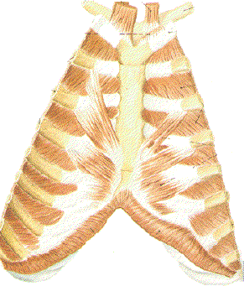
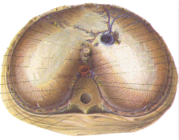
Anatomical Differences with Infants
The infants’ respiratory system (which includes the diaphragm and intercostal muscles - muscles between the ribs) will not fully develop until the child is about 2yrs old.
This means that the infants’ respiratory system fatigues early with anything that causes an increase in breath… And fatigue then leads to apnea or CO₂ build up leading to respiratory failure.
Intercostal
Diaphragm
Notes:
Intercostal Muscles: These muscles are found between the ribs, and there are two kinds: the internal and external intercostals. The internal intercostal muscles (in the inside of the ribcage) extend from the front of the ribs, and go around back, past the bend in the ribs. The external intercostal muscles (on the outside of the ribcage) wrap around from the back of the rib almost to the end of the bony part of the rib in front.
The diaphragm, viewed from above at left with the front of the body on top, is a sheet of muscle and tendon the divides that torso in two. Above is the thorax with the lungs and heart, below is the abdomen, featuring the intestines, stomach, liver, kidneys... It is dome shaped, slightly higher on the right side and it curves up toward the center.

Slide 7
Pediatrics
The diameter of the airways increases the resistance to flow.
The infants’ airway is highly compliant (more elastic) and poorly supported by surrounding structures.
The chest wall is highly compliant providing little support for the lungs, so each breath allows the functional airway closure.

Slide 8

Anatomical Differences with Infants
Oxygen consumption is 2 to 3 times higher in infants:
Newborn to 1 month of age: 40-60 breaths for minute
1 month to 6 months of age: 18-26 breath per minutes
7 to 12 years of age: 12-24 breaths per minute
Adults: 12-18 breaths per minute (BPM)

Slide 9
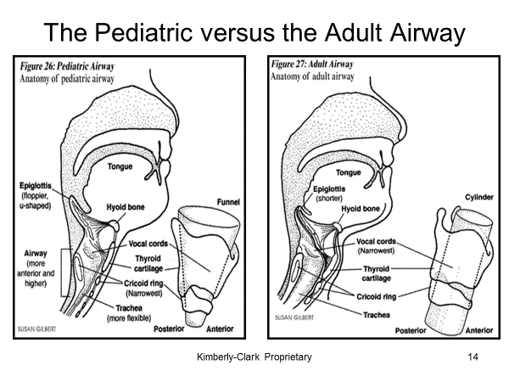
Pediatrics vs. Adults
Larynx is located higher in the neck. Cricoid cartilage by 4th cervical vertebra rather than the 6th in adults.
Larynx is funnel-shaped, narrowest part at cricoid cartilage. In adults

Slide 10
Pediatrics vs. Adults
Tongue in larger
Epiglottis is shaped differently; floppier and U shaped. Adults is shorter
Pediatric airway is smaller in diameter and shorter in length than the adults.
Notes:
https://www.pediatrics.wisc.edu/education/sedation-program/sedation-education/pediatric-airway

Slide 11
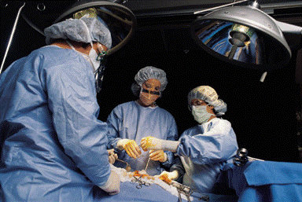
Pediatric Intubation
While intubations is used in medical emergencies, the majority are performed to establish an airway prior to surgery.

Slide 12
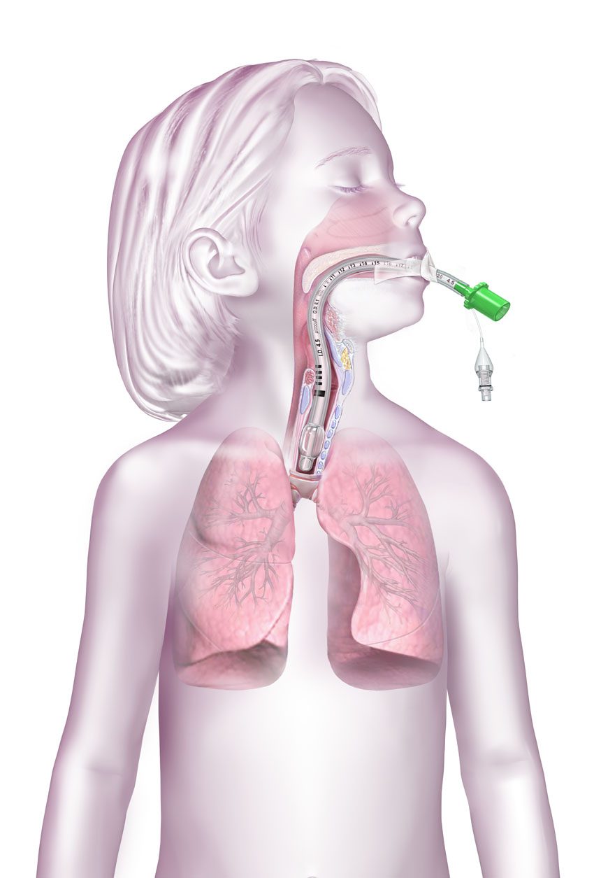
Value Proposition - Designed for Pediatric Anatomy
Cricoid
Cuff-free subglottic zone
Carina
Notes:
The unique attributes of the MICROCUFF* ET tube make accurate tube placement much easier than other tubes. Again, the intubation depth mark is placed based on anatomical data. The cuff is short and cylindrical and placed near the tip.
MICROCUFF* maximizes the cuff-free subglottic zone to reduce risk to tissues. The cuff is designed to be lower in the airway:
Short, cylindrical cuff shape
Cuff placed near tip
Cuff centers the tube in the trachea, no need for Murphy eye

Slide 13


Pediatric MICROCUFF* - History
Dr. Andreas Gerber
Pediatric Anesthesiologist, Intensivist & Pediatrician
Former Director of Anesthesiology, Children’s Hospital of Zurich
Dr. Markus Weiss
Pediatric Anesthesiologist
Director of Anesthesiology
Notes:
Pediatric MICROCUFF* is truly a device DESIGNED BY DOCTORS FOR DOCTORS.
There are two doctors who brought this product to life. The first is Dr. Andreas Gerber, a board certified pediatric anesthesiologist, intensivist, and pediatrician. He has since stepped down as Director of Anesthesiology at the Children’s Hospital of Zurich Switzerland. Dr. Markus Weiss assumed Dr. Gerber’s responsibilities.
Both doctors believed in the benefits of cuffed ET tubes for pediatrics and did not feel that current commercial ET tube designs were well suited for pediatrics.

Slide 14
Traditional Teaching: Cuffed versus Un-cuffed ET Tubes
Notes:
Now I’d like to talk about how cuffed and uncuffed tubes compare and the traditional teaching in Pediatrics that emphasizes uncuffed tubes.

Slide 15

Cuffed vs. Un-cuffed – The Issue
Cuffed tubes are standard of care for adults and adolescents, but most pediatric patients under 8 years old are intubated with un-cuffed tubes.
Un-cuffed tubes are not an ideal solution. Clinicians are left to compensate for deficiencies with current ET tube options.
Notes:
Cuffed ET tubes are the standard of care in adult patients. Uncuffed tubes are not used. But with Pediatric patients, this scenario changes.
Clinicians perceive cuffed tubes to be dangerous for patients under 8, so they typically use uncuffed tubes. But this means that these patients and clinicians are not receiving the benefits of a cuffed tube. We’ll get into the details of this later in the presentation.

Slide 16
Un-cuffed ET Tubes
Undersized = Excessive Leakage
Oversized =
Tube Exchange
Difficult to control ventilation
Less accurate monitoring and pulmonary function testing
Higher risk of aspiration
Higher anesthesia gas flow rate
May necessitate reintubation
Results in repeated tube exchange, up to 23%*
Increases risk to patient with each exchange
High pressure inside the cricoid
May lead to airway trauma
Tube OD varies widely among brands
Clinicians must deal with the leakage!
Clinicians may need to re-intubate!
* Khine. Anesthesiology 1997; 86:627-631
Notes:
Uncuffed tubes may not always fit the cricoid which means clinicians are left to compensate!
First of all, if they are Undersized, you get Excessive Leakage (click mouse for animation)
Difficult to control ventilation
Less accurate monitoring and pulmonary function testing
Higher risk of aspiration
Higher anesthesia gas flow rate
May necessitate re-intubation
(click mouse for animation)
Clinicians must deal with the leakage!
Second of all, if the tube is overized you can get tube exchange. (click mouse for animation)
Results in repeated tube exchange, up to 23%*
Increases risk to patient with each exchange
High pressure inside the cricoid
May lead to airway trauma
Tube OD varies widely among brands
(click mouse for animation)
Clinicians may need to reintubate!

Slide 17
Why are un-cuffed tubes used?
Use cricoid ring to ‘seal’ the airway without a cuff.
This practice dates back several decades from safety concerns using these older cuffed tubes.
Even current cuffed tubes may be inadequately designed for pediatrics.
Un-cuffed tube are not ideal!
The cricoid diameter varies widely among pediatric patients.
Un-cuffed tubes may not always fit the cricoid, leading to excessive leakage, re-intubation, or even complications;
Clinicians are left to compensate for ill-fitting tubes without many options.
Notes:
Here is a summary of the current status of pediatric tubes.
(click mouse for animation) Why are uncuffed tubes used?
(click mouse for animation) Uncuffed tubes are not ideal!

Slide 18
With a Safe, Cuffed ET Tube…
Accurate pulmonary function tests & ventilation management,
Reduced tube replacement,
Reduced use of oversized tubes and associated complications,
Reduced gas leakage,
Improved efficiency of ventilation,
Reduced environmental pollution
Notes:
Reduced gas leakage
Improved efficiency of ventilation
Reduced environmental pollution
More reliable end-tidal gas monitoring
Less aspiration
Ability to use low-flow anesthesia
Reduced need to replace ill-fitting tubes
Reduced use of oversized tubes and associated complications

Slide 19
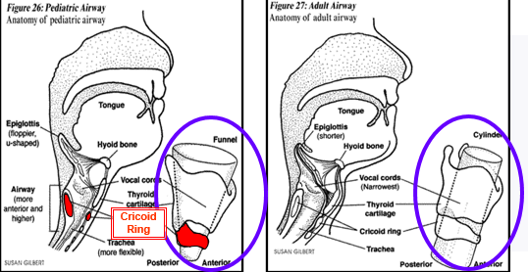
Pediatric vs. Adult Anatomy
Notes:
These pictures point out the main differences between the pediatric and adult airway. The Epiglottis in a pediatric patient is floppier and u-shaped, while an adult’s is shorter. Additionally, the airway of a pediatric is more anterior and higher. But probably the most importance difference between a pediatric and an adult patient is the placement of the Cricoid ring. The Cricoid ring is the narrowest place in the pediatric patient, while the vocal cords are the narrowest place in the adult patient.
Because the trachea is cylindrical in adults, it is much easier to place the cuff of the ET tube below the vocal cords and obtain a seal. In the pediatric patient, because the Cricoid ring is the narrowest part of the airway, clinicians will often place an uncuffed tube and use the mucosal tissue inside the Cricoid to form a “seal” around the tube shaft.
If a cuffed tube is used, incorrect placement of the cuff can result in tracheal trauma. It is important that the cuff not be placed on the vocal cords or the Cricoid ring but because of the short pediatric airway, this can be difficult to do.

Slide 20
Value Proposition - Three Key Messages
Provides the benefits of a cuffed ET Tube
2. Designed for the pediatric anatomy
3. Reduced risk of tracheal trauma
Notes:
These are the three key messages we want to you walk away from this meeting committed to memory. 1 – Provides the benefits of a cuffed ET tube; 2 – Designed for the pediatric anatomy; and 3 – reduced risk of tracheal trauma. We will get into the details and support for these messages in the following slides.

Slide 21
Value Proposition – Provides the Benefits of a Cuffed ET Tube
Benefits of a completely sealed airway include:
Less gas leak around tube
Improved efficacy of ventilation due to reduced air leak
Reliable end-tidal CO₂ and anesthesia gas monitoring
Reduced risk of aspiration
Lower flow rates of anesthesia
Notes:
What is confidence in a sealed airway? As we discussed, cuffed ET tubes are the standard of care for adults. This is because having a seal in the trachea has benefits for the patient and the clinician. These benefits are:
- Improved efficacy of ventilation due to reduced air leak. When an uncuffed tube is used, there is a leak that the clinician has to compensate for when ventilating the patient. When a seal is present, the clinician can use the optimal settings on the ventilator to provide air to the patient, without having to increase pressures to compensate for a leak.
- Reliable end-tidal CO₂ and anesthesia gas monitoring. Again when there is a leak, the clinician has to compensate for that leak…when monitoring patients…
- Less gas leak around the tube provides two benefits to clinicians. First of all, the staff, particularly the anesthesiologist, will not breath in the gases and anethesthetics that are leaking from around the tube. Second, these gases are not wasted resulting in a cost savings.

Slide 22
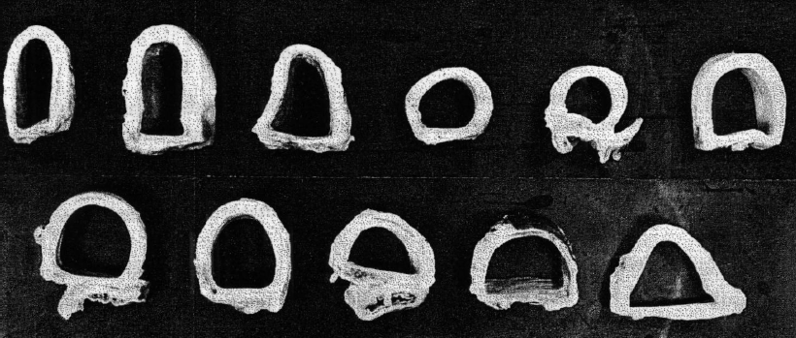
Value Proposition – Provides the Benefits of a Cuffed ET Tube
Reduces the risk of using oversized un-cuffed tubes
Reduces re-intubation due to ill-fitting or undersized tubes
Compensates for different sizes and shapes of airways
Seals with a cuff, not a rigid tube shaft!
Variety of trachea cross-sections
Notes:
Another benefit of a cuffed tube is sealing with the balloon – not the tube shaft.
Key benefits of this include:
- Oversized uncuffed tubes are a primary cause of subglottic stenosis. Using the MICROCUFF* tube ensures pressure is not placed on the sensitive areas of the trachea (including the cricoid where uncuffed tubes place pressure), reducing the chance of tracheal trauma.
- Because it is easier to size cuffed ET tubes, reintubation is reduced. This results in less costs (OR time and material costs, less waste, less trauma to patient) and less trauma to the patient.
- The cuff also compensates for the differences in the anatomy of the trachea.

Slide 23
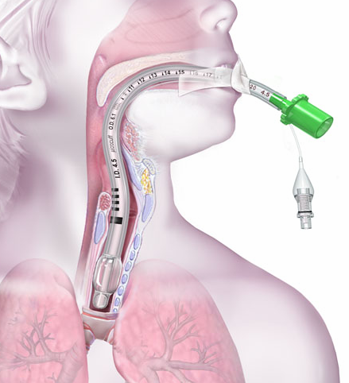
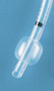
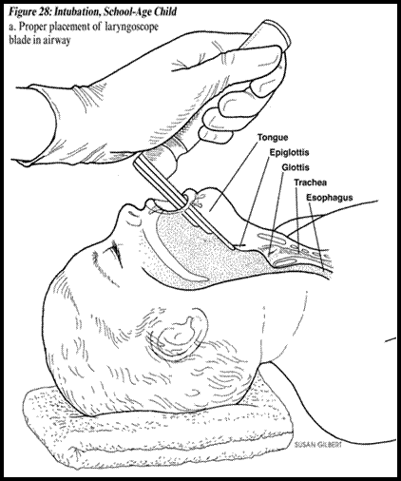
High Volume, Low Pressure (HVLP) Cuffs
Cuff is oversized 150% of tracheal diameter
Volume rather than pressure creates seal
Notes:
Let’s start by making sure we understand what a cuff is.

Slide 24
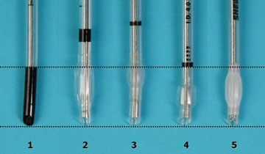
Value Proposition - Designed for Pediatric Anatomy
MICROCUFF’s* markings - correct to the pediatric anatomy
MICROCUFF*
Cricoid
Vocal Cords
Carina
Tube Tip
Examples of Conventional Tubes
Notes:
Only MICROCUFF* is designed for the pediatric anatomy. If you look at these tubes you will notice significant differences.
- First, not all tubes have an intubation depth mark. You can see the bottom of the tubes are aligned where they should be placed in the trachea – looking at this you will see there is significant differences in the placement of the intubation depth marks. Imagine where the end of the tube would be if you placed the intubation depth mark of tubes #2 and #3 between the vocal cords.
- You can also see major differences in the cuffs – where they are placed on the tube as well as the length. The length of some of these tubes could easily result in them being inflated in the wrong area of the trachea.

Slide 25
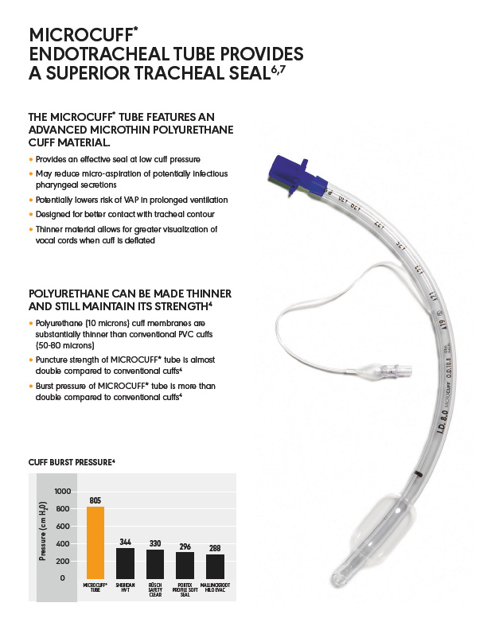

Slide 26
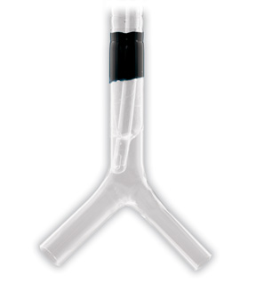
Reduced Micro-aspiration – High Volume, Low Cuff Pressure Design
MICROCUFF* “seals” channels and reduces leakage
MICROCUFF* averages 10 microns thick. PVC cuffs are 50 -80 microns thick
Cuff length and shape are optimized for better contact with tracheal contours
Microthin polyurethane cuff: Minimizes fluid that can pass through
Notes:
How does MICROCUFF* create a better seal?
MICROCUFF* is also a high-volume low-cuff pressure design so channels form in it like conventional PVC cuffs. The breakthrough technology for MICROCUFF* is an advanced micro-thin (avg 10 microns thick, PVC cuffs are 50-80 microns thick) polyurethane cuff. Because the material is so thin these channels are very small and minimize the fluid that can pass through.
Here is that same glass trachea with MICROCUFF*. MICROCUFF* seals those channels better and minimizes leakage past the cuff and into the lung.
Furthermore, the Long cuff length, lengthens the “channels” which improves seal. The Cylindrical or barrel shape maximizes surface contact with the trachea.

Slide 27
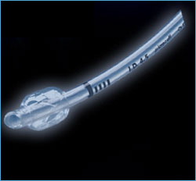
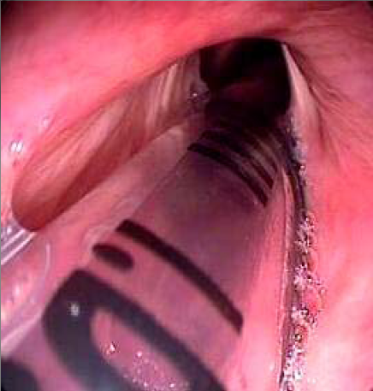
*Depth Markers assist for Tube Placement**
DeAnatomy
Four precision bars to facilitate and confirm optimal tube placement
USP for MICROCUFF* Paediatrics No other pediatric ET tube has this.
Clinician can know the tube depth even if intubation depth mark is past the vocal cords
Notes:
Again the precision bars are unique to MICROCUFF* - allowing optimal tube placement.

Slide 28
Value Proposition - Designed for Pediatric Anatomy
Size Selection Chart allows easy, accurate tube selection
Dullenkopf, et al. Fit and seal characteristics of a new pediatric tracheal tube with a high volume, low pressure polyurethane
Proven 98.4% accurate in 500 patient study¹
(3 kg = 6.6 lbs)
(1) Dullenkopf, et al. Fit and seal characteristics of a new pediatric tracheal tube with a high volume, low pressure polyurethane.
Notes:
MICROCUFF* has a size selection chart that is based on a 500 patient study and has been proven to be 98.4% accurate. Physicians should refer to this sizing chart before placing a tube – eliminating the need for complicating formulas.

Slide 29
Value Proposition - Reduced Risk of Tracheal Trauma
MICROCUFF* average sealing pressure in pediatric patients = 10 cm H₂O*
Adult capillary perfusion pressure = 27 to 40 cm H₂O*
Pediatric perfusion pressure agreed by clinicians to be lower than adults
By sealing well below capillary perfusion pressure, blood flow is maintained, preventing tissue damage
Seals airway below the capillary perfusion pressure reducing the risk to mucosal tissue
* Dullenkopf, et al. Tracheal sealing characteristics of pediatric cuffed tracheal tubes. Ped Anesth 2004; 14:825-830
** Seegobin, et al. Endotracheal tube pressure and tracheal mucosal blood flow. BMJ 1984; 228:965-968.
Notes:
By sealing well below capillary perfusion pressure, blood flow is maintained, preventing tissue damage

Slide 30
Value Proposition - Reduced Risk of Tracheal Trauma
MICROCUFF* seals at ultra-low pressure
Cuff Pressure (cm H₂O) |  | No. Patients | Year | Reference
9.7 | Mean | 500 | 2005 | Dullenkopf, et al. Acta Anesthesiol Scand 2005; 49:232-237
10 | Median | 250 | 2005 | Weiss, et al. Brit J Anesth 2005; 94 (1):80-7
10 | Median | 145 | 2006 | Dullenkopf, et al. Acta Anesthesiol Scand 2006; 50:201-205
10 | Median | 30 | 2004 | Dullenkopf, et al. Can J Anesth 2004; 51 (10): 997-1001
Notes:
MICROCUFF* consistently seals around 10 cm H20 cuff pressure, in almost 900 patients.

Slide 31
Polyurethane Cuffs are Thin But Strong
Almost double puncture strength compared to conventional PVC cuffs:
Cuff is 10 microns thick
Conventional PVC cuffs are 50-80 microns thick
In addition, MICROCUFF* can withstand over 800 cm H₂O burst pressure.
Notes:
MICROCUFF* is 10 micron, while conventional cuff thickness is 50-80 microns.
Polyurethane is a stronger material than PVC and even though it is thin, the puncture strength is better than PVC, and the burst pressure is equal to or better (the pilot line burst before the cuff did in several samples).
In addition, MICROCUFF* can withstand over 800 cm H2O burst pressure.

Slide 32
Value Proposition - Reduced Risk of Tracheal Trauma
Key to safety: Continuous cuff pressure monitoring
Avoid high cuff pressures which increase risk to airway
Benefit from low cuff pressure of MICROCUFF*
20 cm H₂O is upper limit for cuff pressure – cuff pressure must be monitored during procedures.
Nitrous Oxide permeates all cuffs and increases pressure
Manometers are used to measure cuff pressure
Notes:
Cuff pressure must be monitored during procedures.
Usually checked Q12h (once per shift) or prn as per protocol

Slide 33
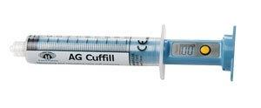
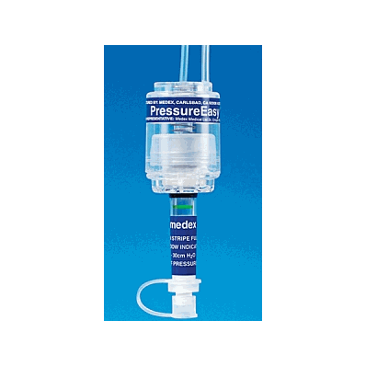
Ways to Monitor Cuff Pressure
AG Cuffill: Simple, easy way to check cuff pressures. Pocket size and reusable up to 100 times per single patient use. No cleaning in between uses. Made by Hospitech Respiration.
Pressure Easy Cuff Monitor: Continuously monitors tracheal cuff pressure; single patient use. Made by Smiths Medical

Slide 34
Clinical Evidence

Slide 35
Clinical Article – 2005
Conclusion: “In the in-hospital setting, a cuffed endotracheal tube is as safe as an un-cuffed tube for infants (except the newborn) and children.”
Notes:
Clinical Article:
Published 2005
American Heart Association Guidelines for Cardiopulmonary Resuscitation and Emergency Cardiovascular Care

Slide 36
Clinical Article - 2005
Conclusion: “MICROCUFF* pediatric tracheal tubes provided tracheal sealing with cuff pressures considerably lower than usually accepted.”
Notes:
Clinical Article:
Scandinavian Anesthesia
Dr. Dullinkof
Fit and Seal Characteristics of a new Pediatric Tracheal Tube with HVLP PU Cuff
500 patients

Slide 37
Clinical Article - 2005
Dr. Weiss:
Appropriate placement of intubation depth marks in a new cuffed pediatric tracheal tube
250 patient study
Conclusion: “The insertion depth marks on the new MICROCUFF* pediatric tracheal tube allows adequate placing of the tracheal tube with a cuff-free subglottic zone.”
Notes:
Clinical Article:
Dr. Weiss
Appropriate placement of intubation depth marks in a new cuffed pediatric tracheal tube
250 patients

Slide 38
MICROCUFF* Paediatrics Sales & Marketing tools

Slide 39

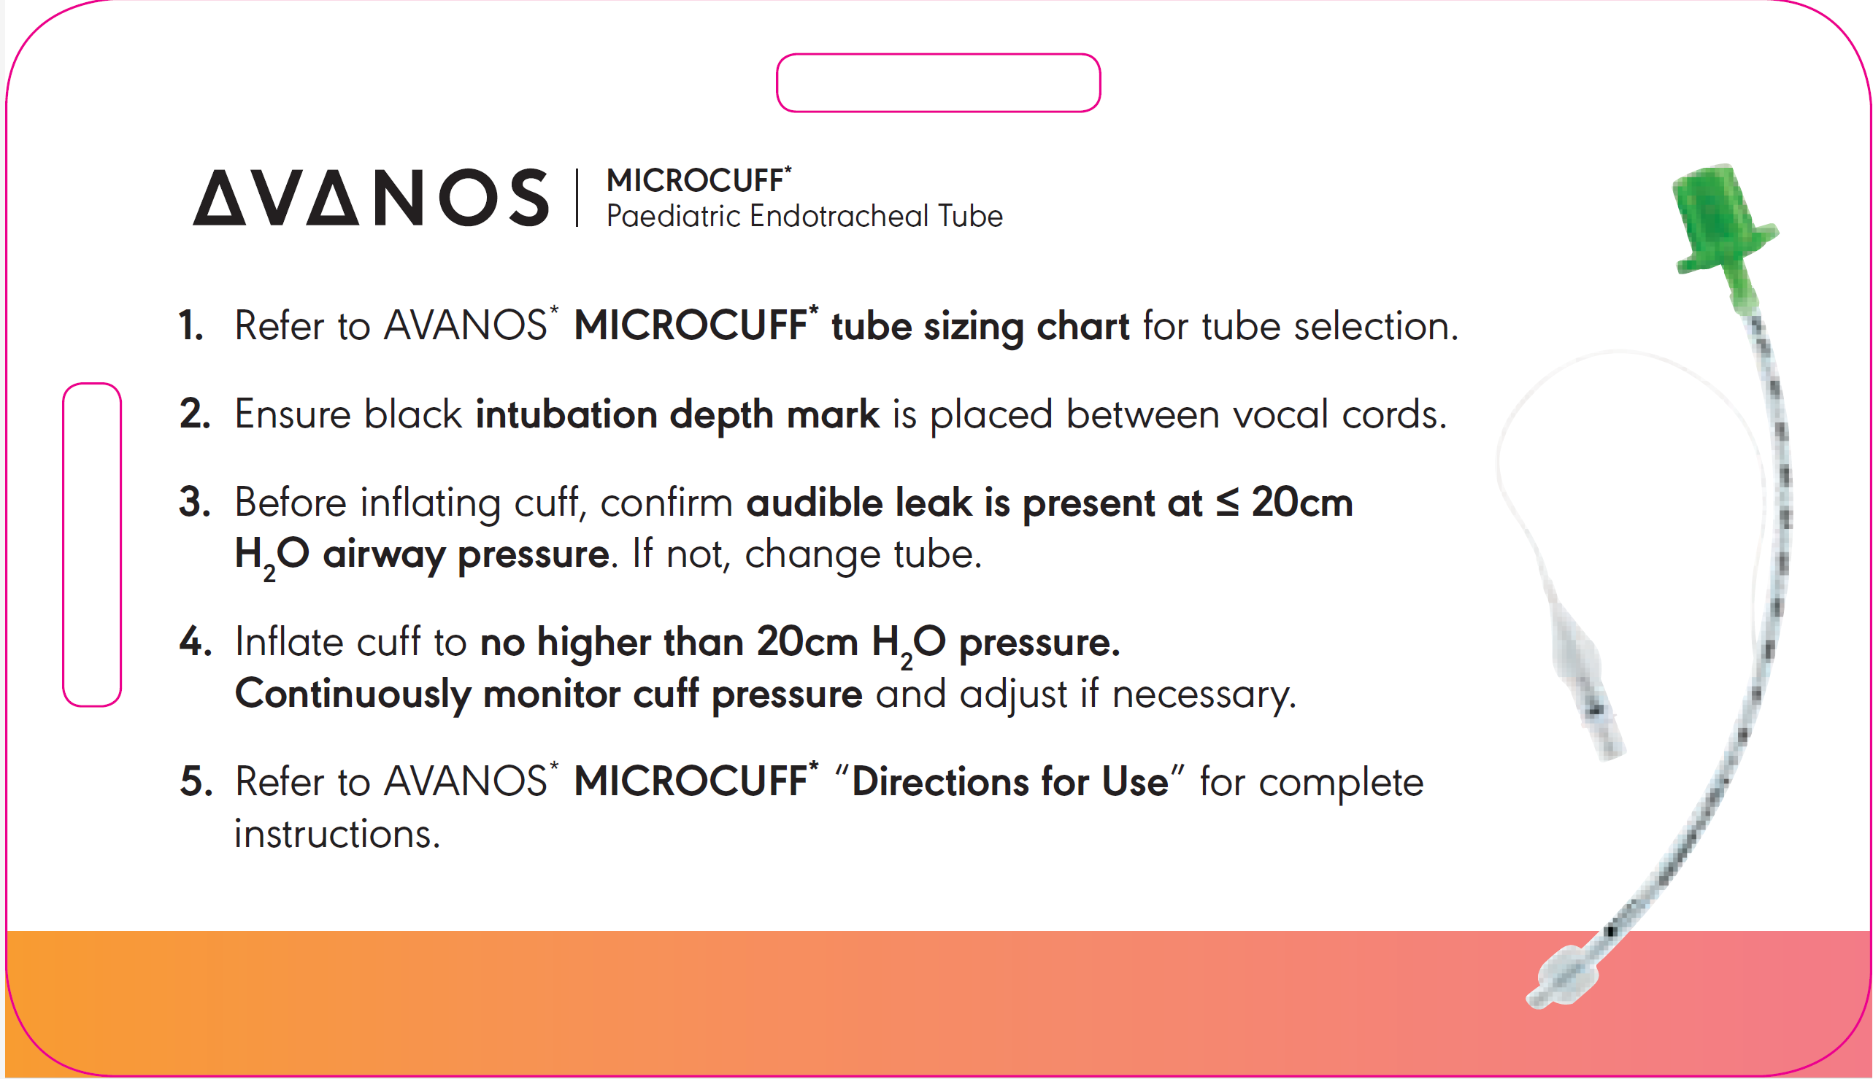
MICROCUFF* Paediatrics
HC659-04
HC623-04

Slide 40
Thank You

