Slide 1
BALLARD* Closed Suction Systems

Slide 2
BALLARD*
Closed Suction Systems
Luc Van Audenhove
Head of Marketing
Reworked version from Tommy Lynch
Zaventem, October 2023;

Slide 3



The information provided in the AirLife Training Academy
for the Sales and Marketing teams of AirLife and its distributors is not intended for further distribution.
The enclosed information can only be used for educational purposes for our sales teams.
This information can under no circumstances be used as advertising or
for distribution to end users.
Confidential: Not for further distribution

Slide 4
BALLARD* Closed Suction Systems:
Objectives:
Discuss the differences between open and closed suction procedures.
Convey the AirLife solution for Closed Suction Catheters.
Identify the key features and benefits of AirLife CSS.
Practice role paying using our insight messaging for Turbo Cleaning.
Demonstrate in-service techniques for our closed suction systems.
Tip to tail demonstrations of closed suction catheters.

Slide 5
Closed Suction Catheters: Adults
Target Audience/Call Points:
  Infection Control Departments
  Director of Respiratory Therapy/RN
  Intensivists/Hospitalist
  Pulmonologist
  Materials Manager
Products:
  BALLARD* Standard CSS (24hrs)
  BALLARD* Turbo CSS (72hrs)
  May include: Double Swivel Elbow, T-Piece, MDI Port, Dual lumen, wet packs, or directional tip.
  Comes in endotracheal and tracheostomy lengths

Slide 6
What is endotracheal suctioning?
Purpose:
Endotracheal or tracheostomy tube suctioning is performed
to maintain the patency of the artificial airway and
to improve gas exchange,
decrease airway resistance and
reduce infection risk by removing secretions from the trachea and main-stem bronchi.
Suctioning also may be performed to obtain samples of tracheal secretions for laboratory analysis.
*AACN Procedure Manual for High Acuity, Progressive, and Critical Care. 7th Edition.

Slide 7
Purpose of Suctioning (cont.)
Maintain a patent airway by removing retained tracheobroncheal secretions.
To prevent lower respiratory tract infection from retained secretions.
Provide effective ventilation.
Stimulate coughing.

Slide 8
When should it be performed?
Suctioning of airways should be performed
only for a clinical indication and
not as a routine fixed-schedule treatment.

Slide 9
Indications for suction include the following:
Secretions in the artificial airway,
Suspected aspiration of gastric or upper-airway secretions,
Auscultation of adventitious lung sounds,
Increase in peak airway pressure,
Increase in respiratory rate, frequent coughing, or both,
Gradual or sudden decrease in blood oxygen saturations,
Sudden onset of respiratory distress.

Slide 10
Complications associated with suctioning of artificial airway:
Hypoxemia
Respiratory/ Cardiac arrest
Cardiac dysrhythmias(arrhythmia) irregular heartbeat
Hyper/Hypo tension
Decreases in O2 saturations
Increase ICP
Bronchospasms
Pulmonary hemorrhage
Pain & anxiety
Barotrauma (tissue damage caused by pressure changes)
Bradycardia

Slide 11
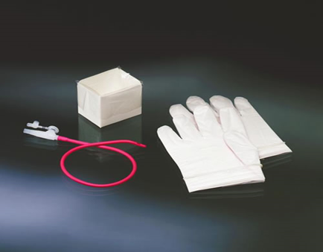

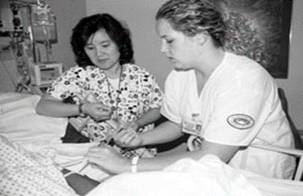
History:
In the 1970’s airway suction was a two, sometimes three person procedure.
For each suction episode, gloves, catheters, wrapper, water cup and other waste was generated.
By today’s standards, eye protection and in some cases gowns would be added to the waste.

Slide 12
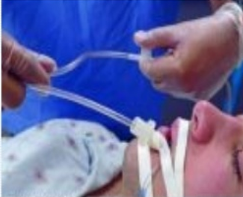
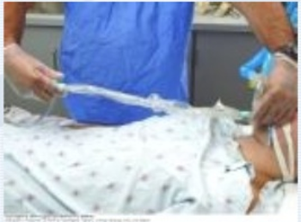
Types of Suctioning
Open Suction
Closed Suction Inline

Slide 13
Closed Suction | Open Suction
Patient remains connected to the ventilator. | Patient is disconnected from the ventilator.
No aerosolizing of secretions. | Aerosolizing of secretions up to 60 cm.
1 person “clean” technique. | 2 person sterile technique.
Multi-use catheter. | Single-use catheter.
Decreases risk of cross-contamination to patient, care-giver, and surfaces. | Increase risk through aerosolizing of secretions, open thumb port, and breaking the circuit.

Slide 14
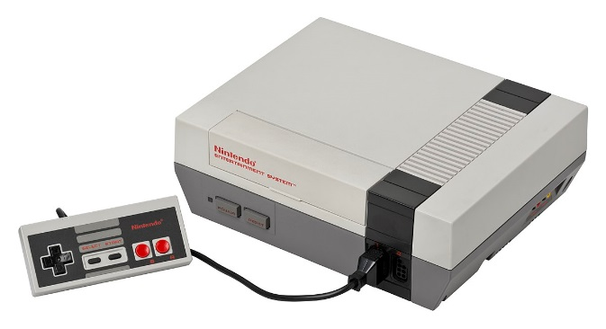
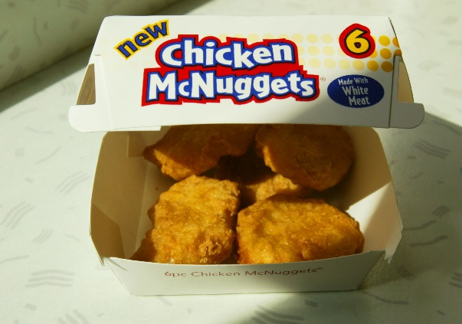
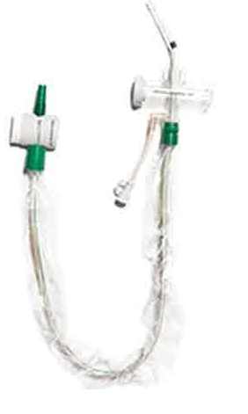
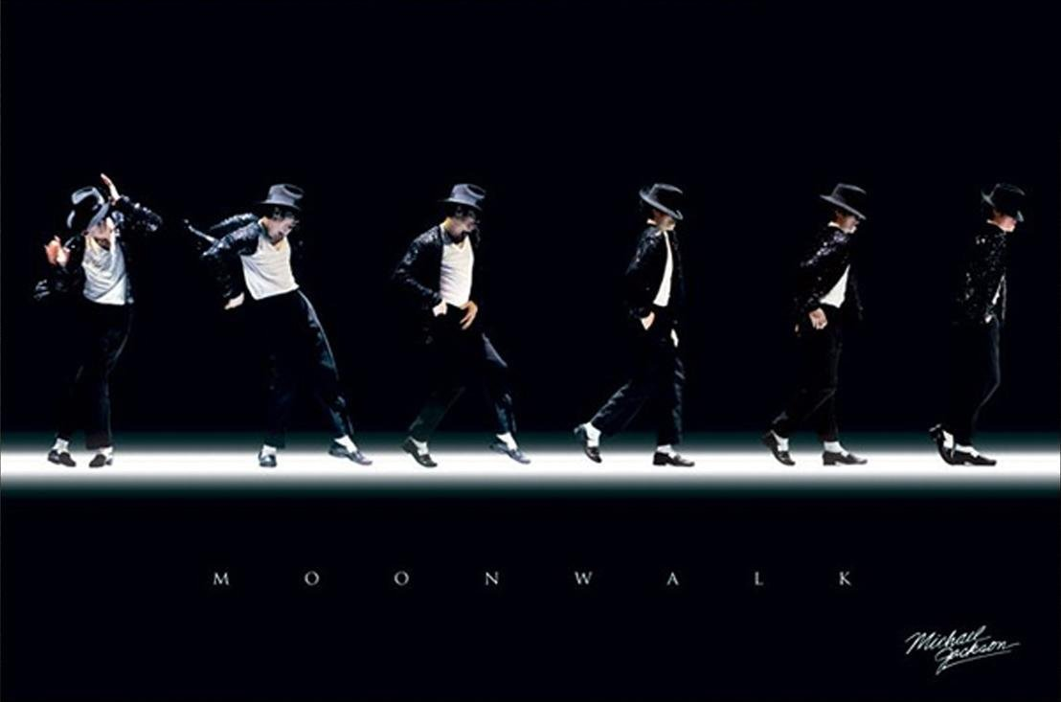
1985

Slide 15
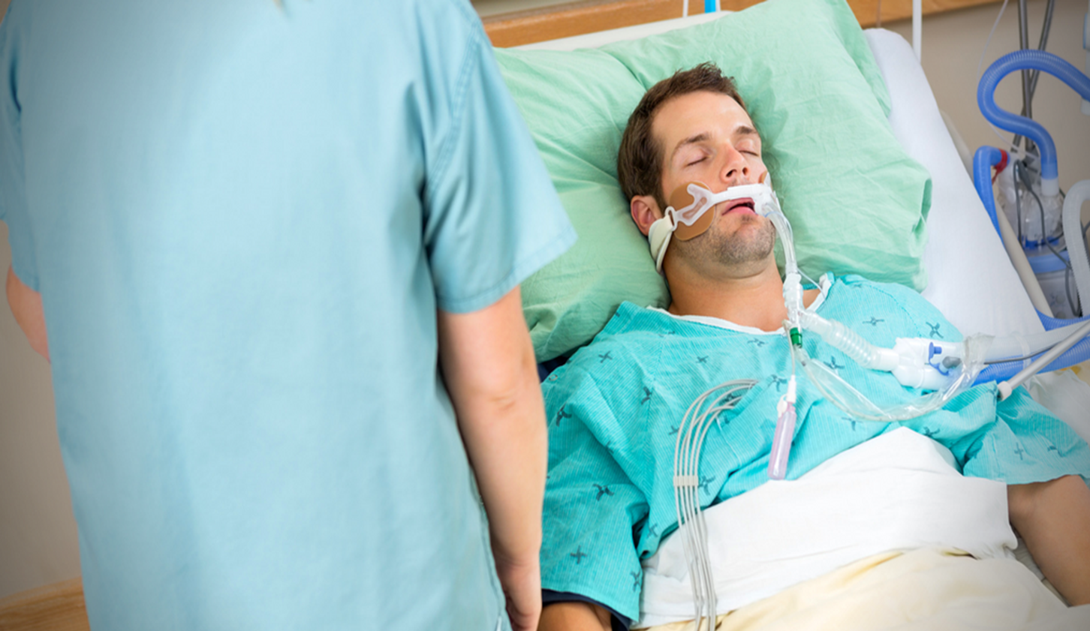
Steps for Closed Suctioning:
Washing your hands, no need of gloves.
Determining the correct catheter sizing and configuration.
Removal of CSC from its package and connection of the flex tube
Attachment of the day change sticker.
Connection of the wall suction line to the CSC and
setting the vacuum level.
Attach Catheter to the ventilation circuit/ET tube.
Observation of ventilator parameters and
assessing the patient’s need of suctioning.
Advance catheter through ET Tube; apply suction by pressing thumb valve;
retract catheter completely out of ET Tube(15 seconds).
Confirm catheter tip is out of airway; wash catheter tip via saline in the side port and apply suction for removal.
Check the ventilator and observe the patient.

Slide 16
Open Suction Procedure- Clinical Concerns
Patient Complications:
Increase heart rate, increase blood pressure and decrease PEEP
Patients Safety and well being
Clinician Protection
Efficiency:
    Time
    Ease of Use
    Cost Effective

Slide 17
Clinical Guidelines: CDC and AARC
Centers for Disease Control
(CDC)
Evidence Based Clinical Practice (AARC)
Suctioning of respiratory tract secretions:
“No recommendation can be made about the frequency of routinely changing the in-line suction catheter of a closed-suction system in use on one patient (Unresolved issue) (103).”
Recommendation #5
“
“The use of closed suction catheters should be considered part of a VAP prevention strategy, and they do not need to be changed daily for infection control purposes. The maximum duration of time that closed suction catheters can be used safely is unknown.”
“One observational study reported no change in VAP rate when in-line suction catheters were changed on a weekly rather than daily basis.67”

Slide 18
AirLife Closed Suction Catheters for Adults Portfolio
ALL the AirLife Closed suction systems are available for
  Endotracheal and tracheostomy lengths (except Liberator)
  Wet packs: 3 years shelf life (15ml sterile saline bullets) Dry Packs: 5 years shelf life
  (no saline included)
24 HRS Closed Suction systems
  T Piece
  Double Swivel Elbow
  MDI port, Directional Tip, double Lumen catheter
Turbo Clean 72 Hrs. Closed Suction Systems
  T Piece
  DSE
  MDI port

Slide 19
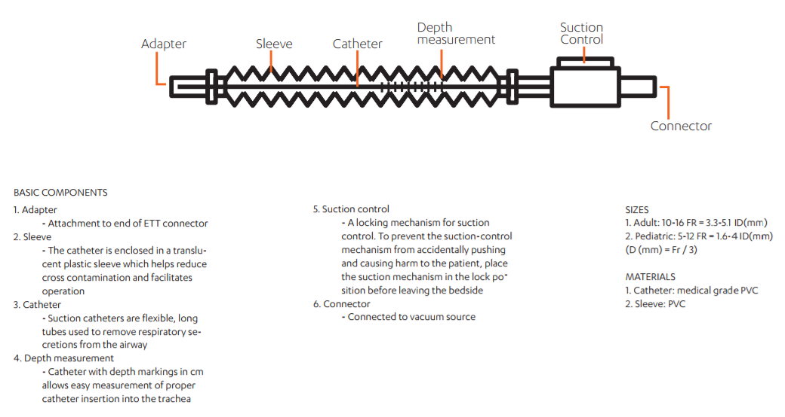

Slide 20
Reduces opportunity for contamination to/from caregivers
Protects the patient and caregiver from cross contamination. It reduces the risk of contamination from outside pathogens, reduces colonization with in the circuit, and it designed to protect caregivers from exposure to body fluids.
  Showpad - Turbo-Cleaning
  Showpad - A NEW standard in clean
  Microbiology Report, Nelson Laboratories Final Report, (89% Reduction in Bacterial Colonization vs TC24)
  Freytag study: "Prolonged Application of Closed In-Line Suction Catheters Increases Microbial Colonization of the Lower Respiratory Tract and Bacterial Growth on Catheter Surface”
Freytag study: Prolonged Application of Closed in-line suction catheters Increases Microbial Colonization of the Lower Respiratory Tract and Bacterial Growth on Catheter Surface. The Freytag study showed a standard close suction catheter used 1 day vs 3 days…The off label use of 3 days demonstrated a significant increase in microbial colonization of the catheter tip and adjacent sequent (over 10 times more colonization in most cases). Additional the study discusses that using saline instillation with a standard closed suction catheter can result in dispersion of microbial material into the lower respiratory tract. This is supported by the AARC guidelines which recommend not using a saline instillation with closed suctioning

Slide 21
2. May reduce risk of VAP
The closed suction maintains PEEP and avoids decruitment, TC has a 89% cleaner tip and removes tracheal secretions that could fall back into the lungs.
  Showpad - Turbo-Cleaning
  Showpad - A NEW standard in clean
  Decreases psychological stress to patient
  Turbo Clean 72 hr. cleaner tip
  Fraser Study-Lung volume changes during cleaning of closed endotracheal suction catheters: A randomized crossover study using electrical impedance tomography.

Slide 22
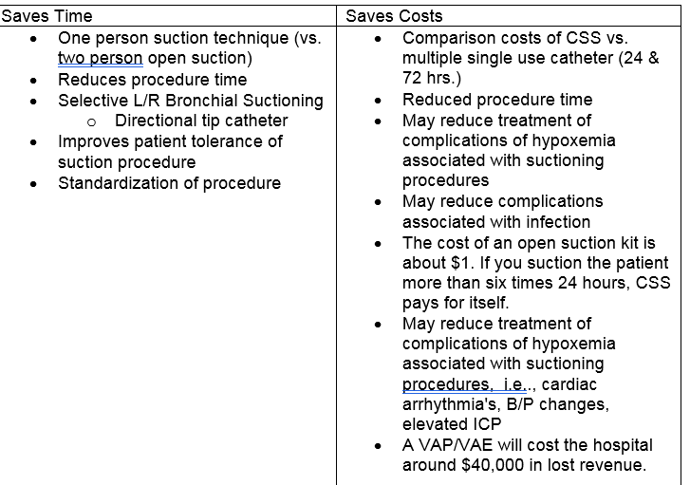
3. Increase adherence to “Standard or Universal Precautions”
Freytag study: Prolonged Application of Closed In-Line suction Catheters Increases Microbial Colonization of the Lower Respiratory Tract and Bacterial Growth on Catheter Surface

Slide 23
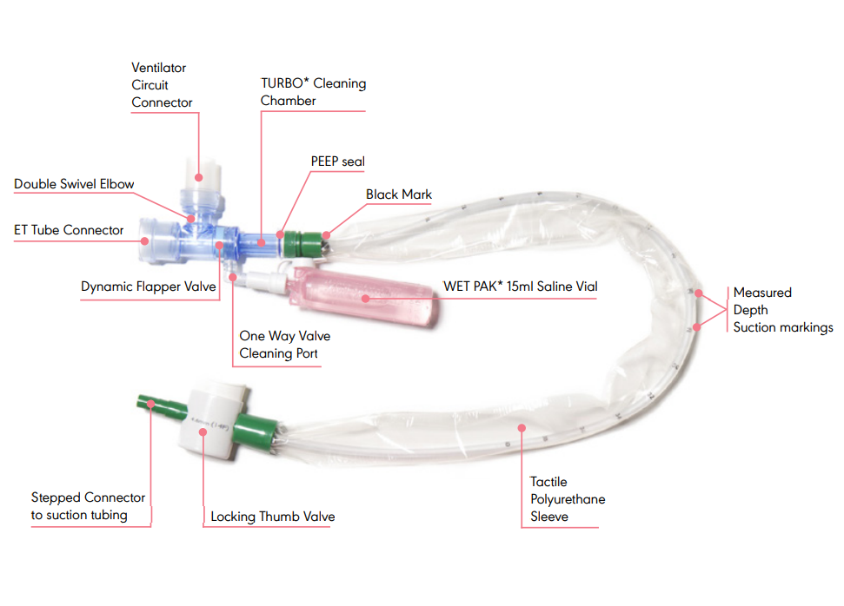
BALLARD* Turbo Closed Suction System

Slide 24
Turbo Closed Suction System
Value Propositions:
Reduce the bacterial colonization of the catheter tip.
    -Nelson Microbiology Report
    -Freytag study
Maintains lung volume during cleaning of the catheter tip.
    -Corley Study
    -Spooner Video
    -ARDSNet
Maintains a closed circuit for 72 hours(3 days).
    -DFU
    -AARC

Slide 25
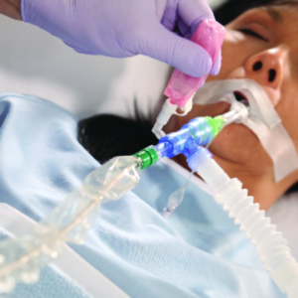
Turbo Closed Suction System
Competitors vs. Claims:
AirLife has clinical data to validate 72-hour claim
Other companies may indicate “72 hours” without submission of clinical testing to the FDA to justify that usage claim.
TRACH CARE* 72 catheters, at 72 hours, show 89% reduction in mean catheter tip colonization vs. the control catheters at 24 hours (p<0.001)

Slide 26
Features | Turbo Catheter | Standard Catheter
Contained Turbulent Cleaning Chamber | ✓ | -
Protects HME by Containing Saline | ✓ | -
Reduces In-Advertent Lavage | ✓ | -
Reduces Volume Loss | ✓ | -
Prevents Splash Back-One Way Lavage Port | ✓ | -
Clinical Study on Reduced Tip Colonization | ✓ | -
Approved Clinical 3-day Indication | ✓ | -
(2) PEEP Seals | ✓ | -
Wedge Plug | ✓ | -
Notes:
*PEEP-Positive End Expiratory Pressure
Pressure in the lungs (alveolar pressure) above atmospheric pressure (the pressure outside of the body) that exists at the end of expiration.^{[1]} The two types of PEEP are extrinsic PEEP (PEEP applied by a ventilator) and intrinsic PEEP (PEEP caused by an incomplete exhalation). Pressure that is applied or increased during an inspiration is termed pressure support.

Slide 27
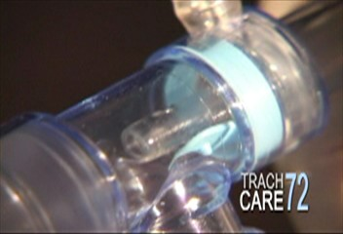
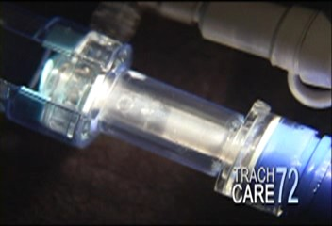
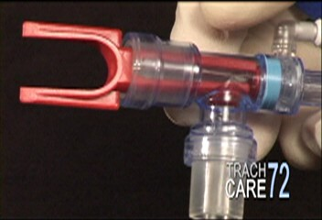
Turbo Closed Suction System
Flapper Valve- Preserves lung volumes,(PEEP) reduces risk of inadvertent lavage
Two PEEP seals- Maintains PEEP and cleans the catheter tip by reducing colonization on the catheter
Disconnection Wedge- holds the valve in place during shipping and is used to disconnect the suction from the ETT
Flapper Valve
Two PEEP Seals
Disconnection Wedge

Slide 28
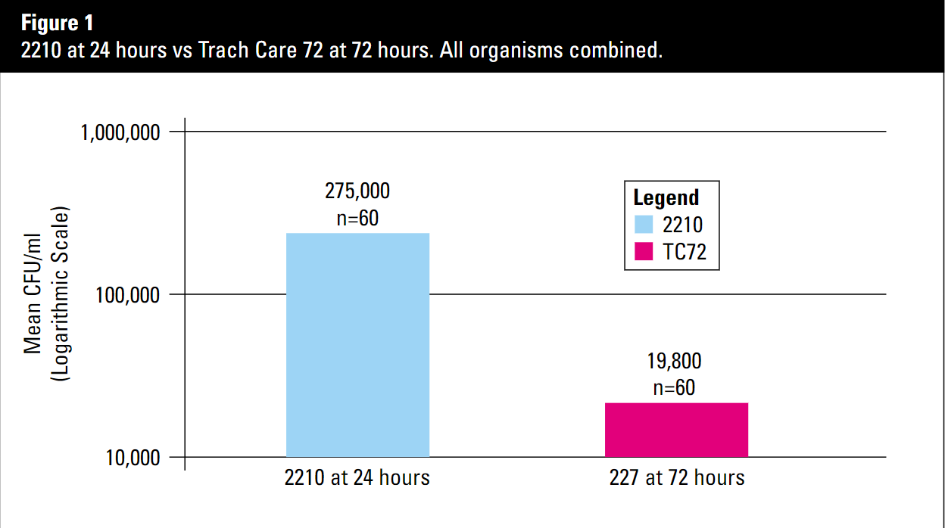
Critical Care Products CSC 72 Microbiology Report.
Nelson Laboratories final Reports, Laboratory Numbers 184343, 163901.1
Turbo Closed Suction System
Results: Avanos’s CSC 72 catheters at 72 hours show over an 89% reduction in the mean catheter tip colonization compared to the control CSC 24 catheters at 24 hours.
Notes:
This graph is taken from an article published by Nelson Laboratories. The EPI listing is: Z0403-Ballard Critical Care Products Trach
Nelson laboratories is an independent lab that performs non biased testing for companies. Nelson studied bacterial contamination colonization on TRACH CARE* 72 and the standard TRACH CARE* product line. The results are shown in this graph.
The green bars represents TRACH CARE* 24 and the blue bars represent TRACH CARE* 72. A simulated mucus solution was prepared containing the each of the bacteria listed in the graph. The level of colonization approximated normal respiratory secretions.
TRACH CARE* 24 catheters were challenged by simulating the suctioning procedure twelve times in a 24 hour period. The catheters were cleaned according to the DFU after every suctioning event. Catheter tip bacterial colonization was measured at the end of 24 hours is represented in the brown bars in the chart above.
TRACH CARE* 72 catheters were challenged using the same procedure above, twelve times in a 24 hour period times three days. Catheter tab bacterial colonization was measured at the end of 72 hours and is represented in the blue bars in the chart above
Results: TRACH CARE* 72 catheters at 72 hours show over an 89% reduction in the mean catheter tip colonization compared to the control TRACH CARE* 24 catheters at 24 hours.

Slide 29
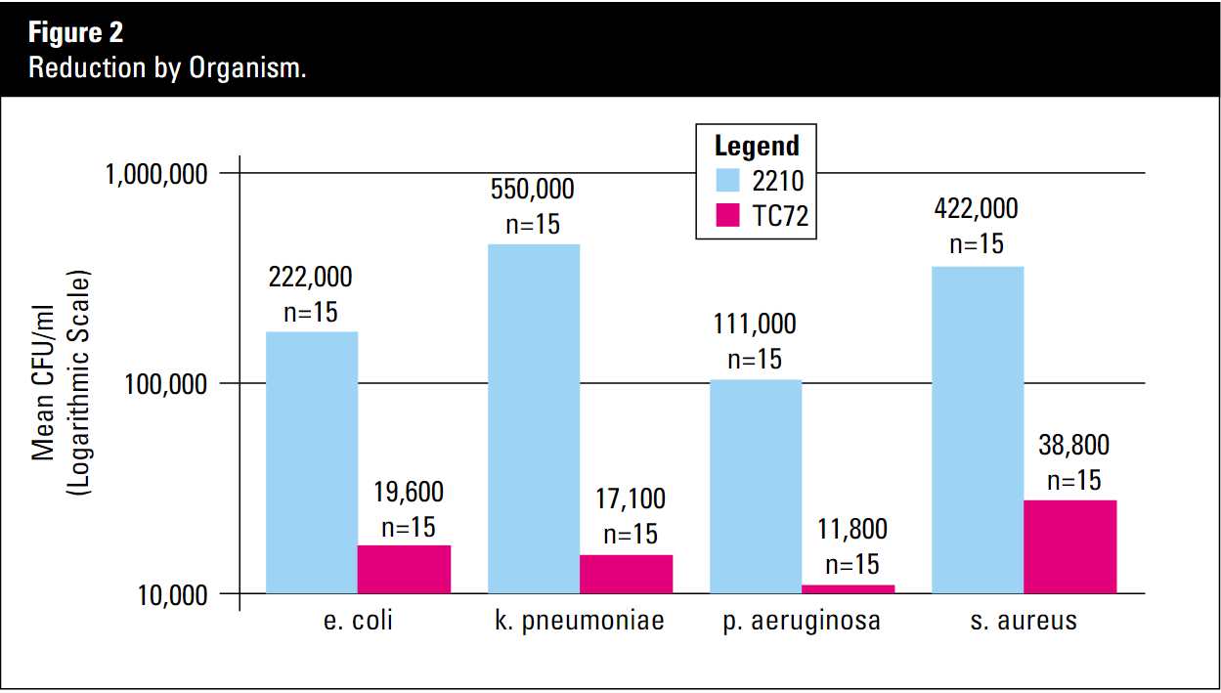
Turbo Closed Suction System
Nelson Microbiology Report:
4 bacteria tested to represent the common respiratory pathogens approximately 47% of VAP
Staphylococcus aureus
Pseudomonas aeruginosa
Klebsiella pneumonia
Escherichia coli

Slide 30
Tips & Tricks

Slide 31
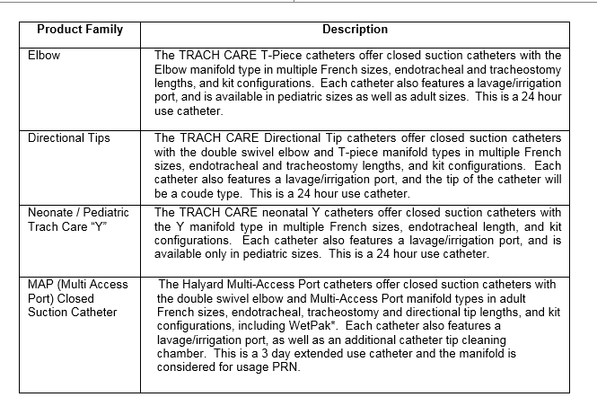

Slide 32
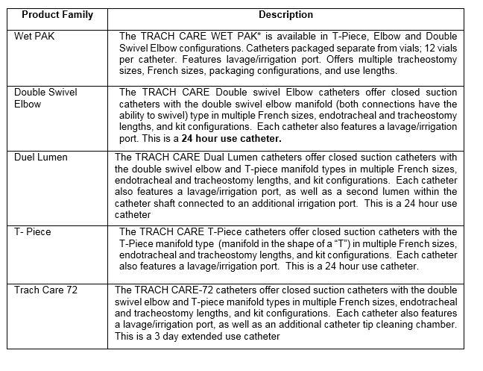

Slide 33

Tips & Tricks
The suction catheter should not be any larger than 50% of the internal diameter of the tube!
Closed Suction Catheter too large => Massive atelectasis may occur.
Closed Suction Catheter too small => May not clear secretions and lead to multiple passes
A good rule of thumb is:
(ETT(mm) -1) X 2 = Fr
(8,0 mm – 1) x 2= 14 Fr Closed Suction Catheter

Slide 34
Tips & Tricks
Patient Age | ETT size (mm) | CSC (Fr)
Premature | 2.5 - 3.5 | 6
Newborn | 3.0 | 6
6 months | 3.5 | 6
18 months | 4.0 | 8
3 year old | 4.5 | 8
5 year old | 5.0 | 10
6 year old | 5.5 | 10
8 year old | 6.0 | 10
12 year old | 6.5 | 10
16 year old/small adult | 7.0 | 12
Adult female | 8.0 | 14
Adult male | 9.0 | 14

Slide 35
Tips & Tricks
Suction Pressure:
Adults 80-120 mmHg
Children 80-100 mmHg
Infants 40-60 mmHg

Slide 36
Tips & Tricks
Color Coded French Size:
= 5 French
= 6 French
= 7 French
= 8 French
= 10 French
= 12 French
=14 French
=16 French
= 18 French

Slide 37
BALLARD* CSS
Sales & Marketing tools

Slide 38
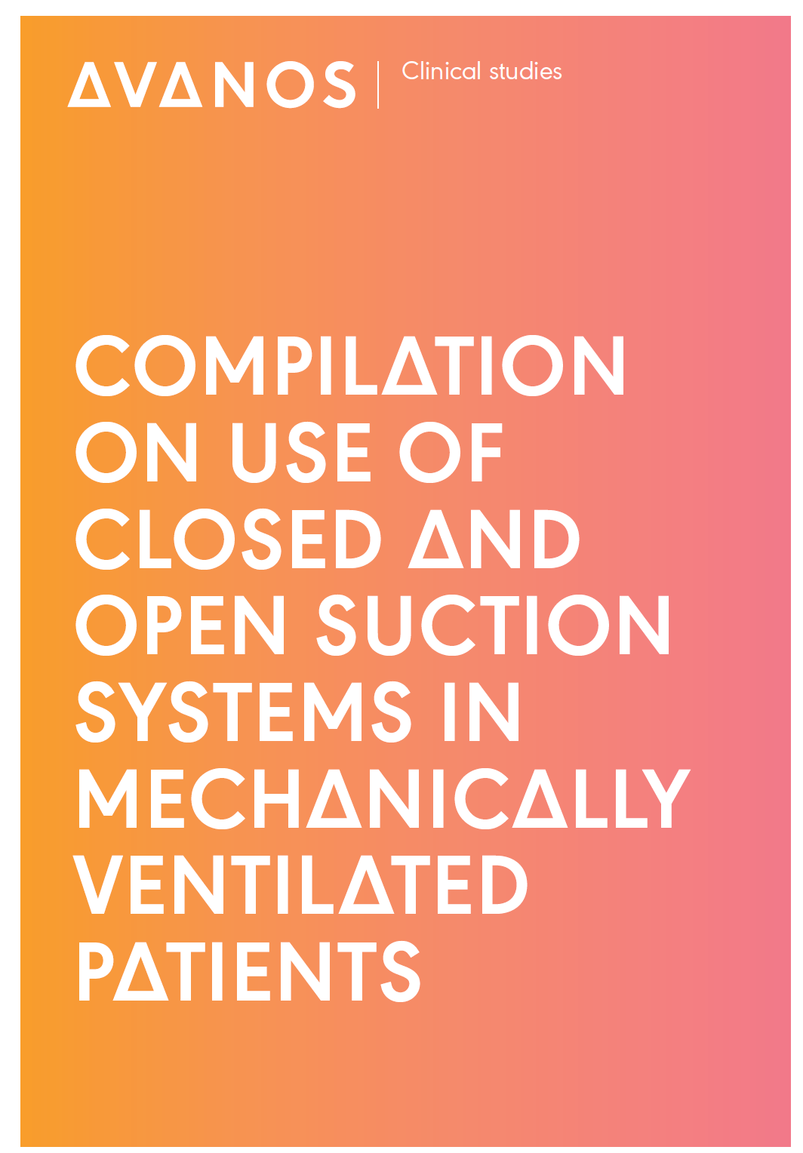
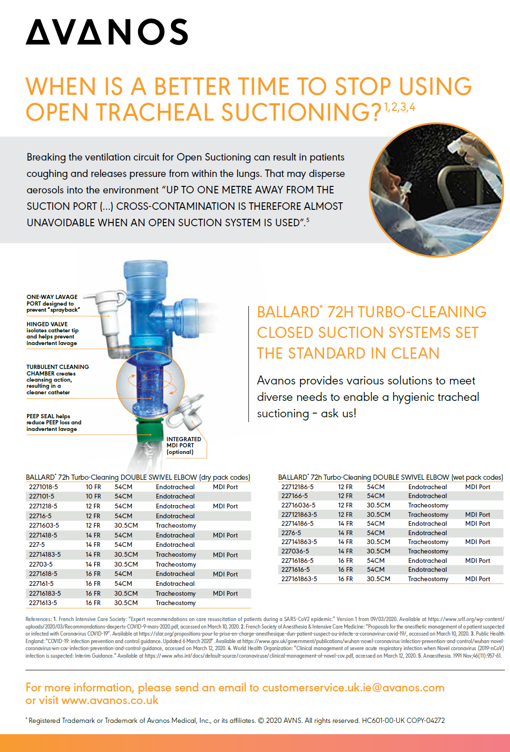
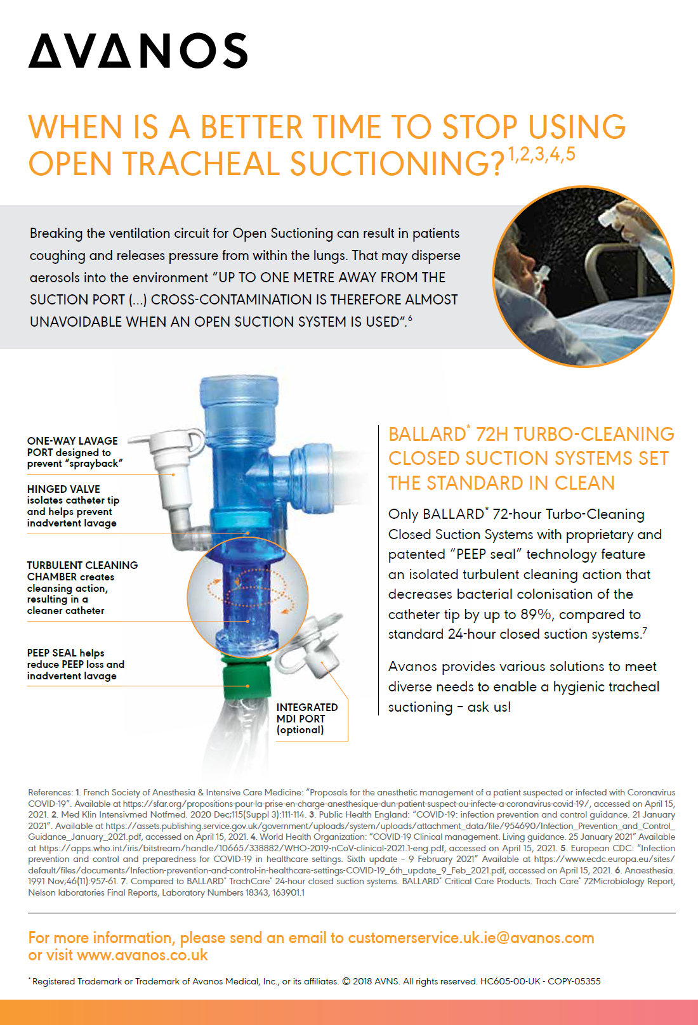
BALLARD* Closed Suction System: Open vs. Closed Suction
HC692-00
HC601-00
HC605-00

Slide 39
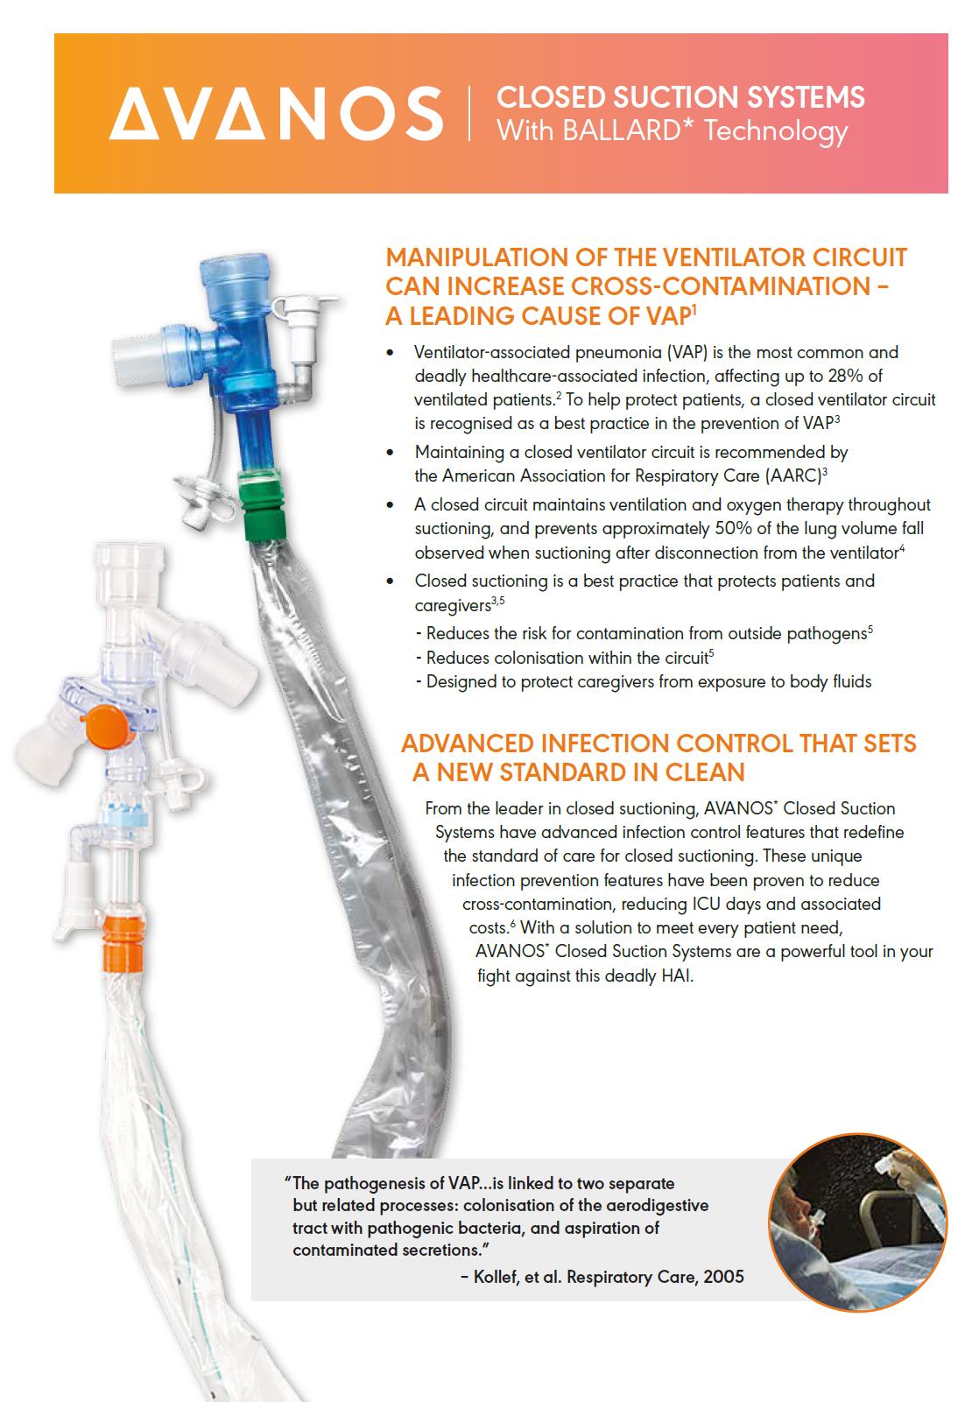
BALLARD* Closed Suction System: General
HC691-03

Slide 40
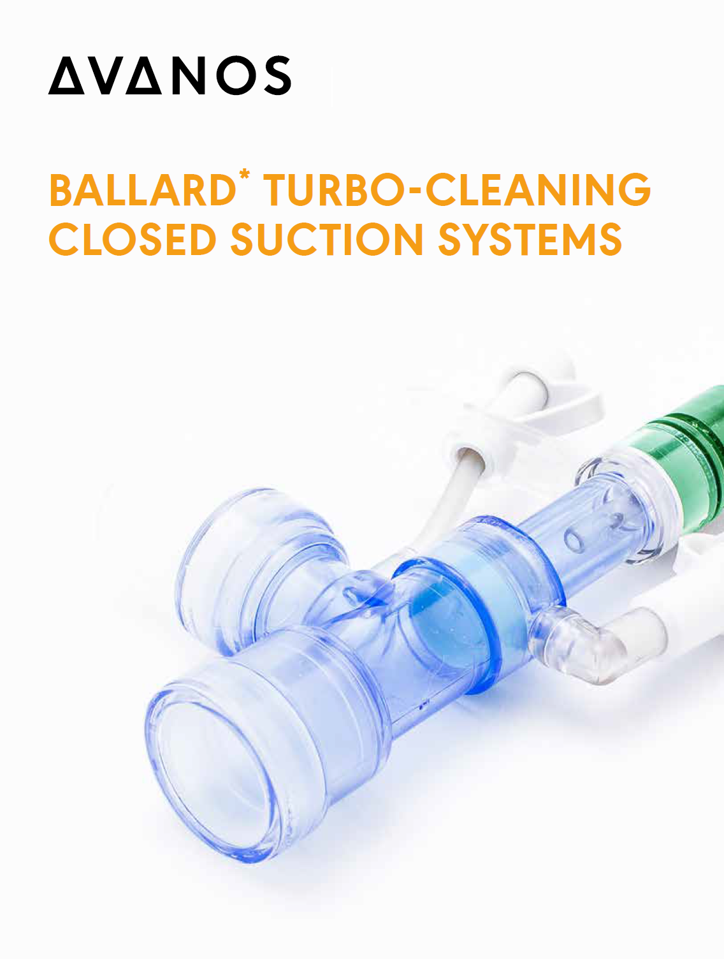
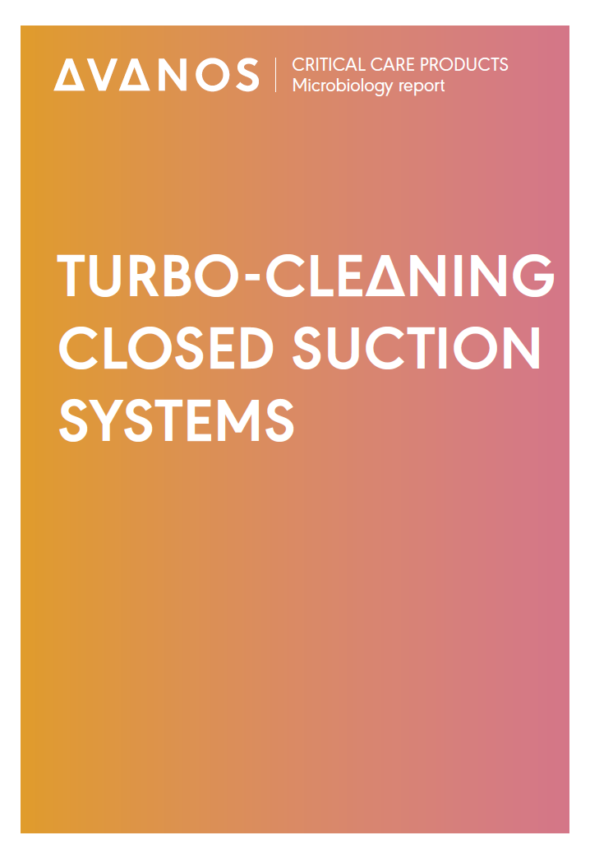
BALLARD* Closed Suction Turbo Cleaning
HC608-00
HC63369

Slide 41
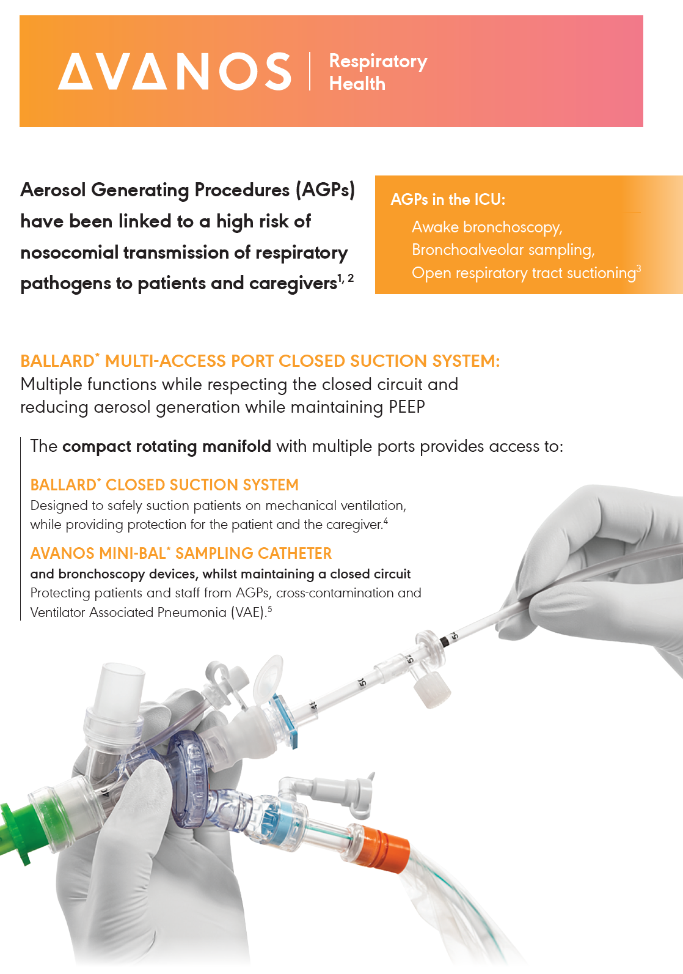

BALLARD* Closed Suction System: AGPs
HC615-00
HC658-04

Slide 42
Thank You

