Slide 1
BALLARD* Closed Suction Systems Paediatrics

Slide 2
BALLARD* Closed Suction Systems Paediatrics
Luc Van Audenhove Head of Marketing
Reworked version from Tommy Lynch
Zaventem, October 2023;

Slide 3



The information provided in the AirLife Training Academy for the Sales and Marketing teams of AirLife and its distributors is not intended for further distribution.
The enclosed information can only be used for educational purposes for our sales teams.
This information can under no circumstances be used as advertising or for distribution to end users.
Confidential: Not for further distribution

Slide 4
BALLARD* Closed Suction System for Pediatric & Neonate
Objectives:
Describe the special needs of neonates that are on Mechanical Ventilation.
Understand the AirLife solution for closed suction catheters for neonates.
State the features of Neonatal CSS.

Slide 5
Neonate Population
An infant less than a month old
Special Considerations:
Mechanical Ventilation is different
Suctioning is markedly different
Vital signs are much more likely to change
Notes:
Neonates
Premature Infants
Premature infants often require ballot or a support because their lungs are not fully functional and may lack surfactant, a chemical produced by the body that keeps the lungs inflated.
High Pregnancy/labor/delivery complications
Delivery complications place a huge amount of stress on the neonate and the stress often leads to respiratory failure and the need for ventilation
Fetal stress
Labor complications
Delivery
Meconium aspiration
Meconium aspiration occurs when the neonate takes a breath during the delivery process when the airway is filled with the baby’s first bowel movement. In general terms, it is aspiration of fecal material. Fecal material is caustic to the lungs and causes respiratory failure. Mechanical ventilation and suctioning will resolve this aspiration.

Slide 6
NICU and PICU
Nursing Staff:
One on One nursing
Extremely protective
Rarely float nurses
Highly motivated and educated
Critically evaluate new techniques and products
Notes:
Same as the pervious slide in regards characteristics of the NICU & PICU environment you will need to be aware of and follow.

Slide 7
NICU
Population - Neonatal Issues:
Immature lungs
Decreased or no surfactant
Increased work of breathing
Ventilator complications
Barotrauma/Volutrauma
Infection
Low body temperature
Notes:
The slide describes more information about the patient population
Neonatal Symptoms
Immature lungs
Decreased / no surfactant
Discussed on previous slide
Increased work of breathing
This comes from the lack of surfactant. Surfactant makes it easy to breathe and neonates without surfactant struggle to survive.
Ventilator complications
Barotrauma / lung damage
Discussed during adult ventilation. Barotrauma is pressured trauma from a high ventilating pressures which leads to lung damage.
Infection
Ventilation and intubation often lead to VAP, even in neonates
Body temperature
Neonates have very thin skin and lose body heat quickly. They are kept warm with special lights and incubators.

Slide 8
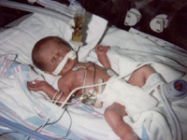
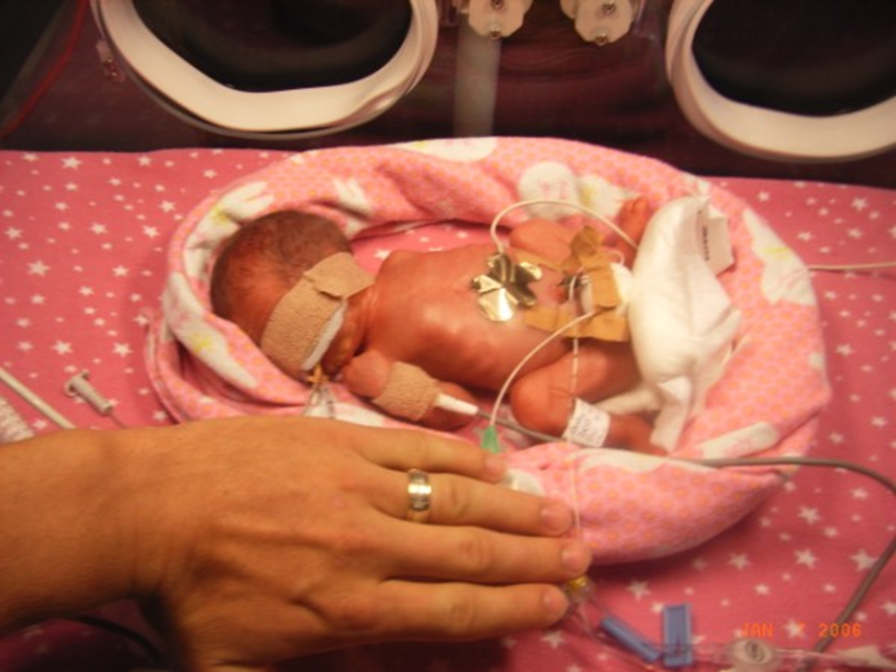
NICU
Premature Infants:
Under gestational age (full term is 40 weeks)
Organ Systems are not completely developed
Lungs begin producing surfactant at 26 weeks
Immune System develops at 32 weeks
Lungs increase production of surfactant at 38 weeks
GI System is still immature at 34 weeks
Immunosuppressed
Notes:
This is a photograph of a neonate.
The neonate is not just a miniature adult
It is a premature infant
Its body organs including lungs, heart, brain, GI tract, kidneys, liver and skin are not completely developed. Clinicians are where of these development issues and care for the patient accordingly.

Slide 9
NICU and PICU
Ventilation Strategies:
Continuous Positive Airway Pressure (CPAP) – may minimize ventilator associated lung injury.
Conventional Mechanical Ventilation – complex interrelationship among the ventilator, blood gas values, mechanical characteristics of the respiratory system and the infant’s spontaneous respiratory efforts.
Manipulating Peak Inspiratory Pressure (PIP), Positive End Expiratory Pressure (PEEP), Rate, Flow and others.
Notes:
Take a brief moment and think back to the review we had on Mechanical Ventilation…remember all of the different types of ventilators and strategies associated with this patient population?

Slide 10
NICU and PICU
Strategies to prevent lung injury:
Immature and developing lungs are particularly susceptible to acquired lung injuries
Emphasis is being placed on evidence that suggests lung injury partially depends on the particular ventilator strategies used.
Prevent Volutrauma caused by too high volumes,
Prevent repeated collapse (Atelectasis) and reopening of the alveoli.

Slide 11
NICU and PICU
Alternative modes of ventilation: Technologic advances have resulted in better ventilators:
Patient-Triggered Ventilation
Synchronized Intermittent Mandatory Ventilation (SIMV)
Proportional Assist Ventilation
Volume Targeted Ventilation
Tracheal Gas In-sufflation
High Frequency Ventilation (HFV)
High frequency jet ventilation (HFJV)
High frequency flow interruption (HFFI)
High frequency oscillatory ventilation (HFOV)
The Modes of Ventilation for the NICU and PICU are different for that of the Adult Patient Population
Notes:
The Modes of Ventilation for the NICU and PICU are different for that of the Adult Patient Population

Slide 12
Why is suctioning necessary in this patient population?
Like the adult, the neonate is not able to spontaneously remove secretions from the airways.
Mechanical Suctioning is required to:
Remove secretions from the (artificial) airway; including mucous plugs
Improve gas exchange
Notes:
Why is suctioning necessary and neonates?
The patient cannot spontaneously remove secretions from the airways.
Mechanical Suctioning:
Removes secretions from the (artificial) airway
Improves gas exchange
Reduces opportunity of pneumonia

Slide 13
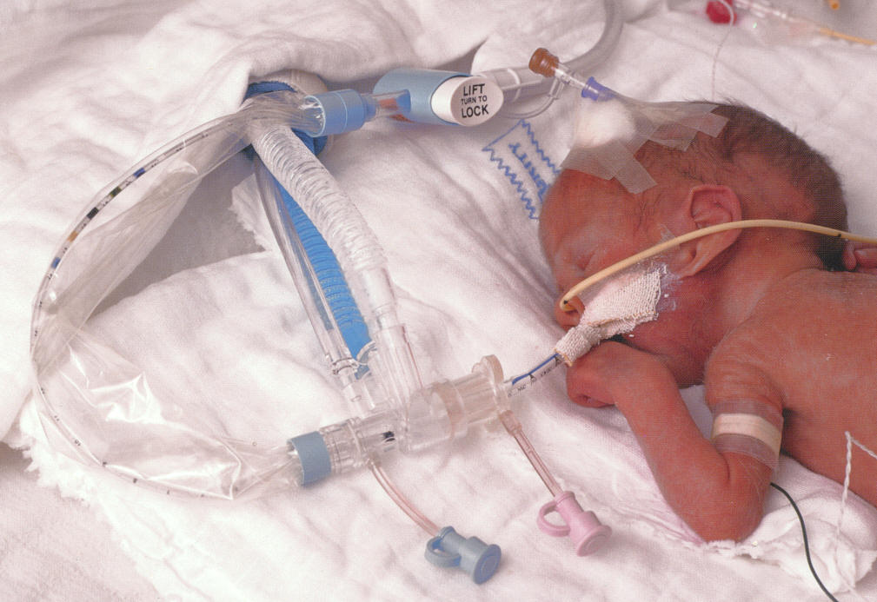
BALLARD* Closed Suction System Pediatric & Neonatal
Clinical Concerns:
Desaturation: - Hypoxia - Cardiac Arrythmias
Infection: - Death - Risk is higher with intubation and ventilation = VAP
Airway trauma: - Potential is increased without measured depth suctioning and excessive vacuum pressures
Psychological trauma: - Neonates stress very easily
Efficacy: - Time
Cost: - Less focus on cost in the NICU
Notes:
review clinical concerns relative to the neonate:
Desaturation
Hypoxia
Cardiac arrhythmias
Death
Infection
Risk is higher with intubation and ventilation = VAP
Airway trauma
Potential is increased without measured depth suctioning and excessive vacuum pressures
Psychological trauma
Neonates stress very easily
Efficacy of TRACH CARE*
Does it work
Time
Cost
Less focus on cost in the NICU in the past however that is changing

Slide 14
BALLARD* Closed Suction System Pediatric & Neonatal
Suctioning Complications:
Desaturation leading to Hypoxia:
Cardiac Arrhythmia
Hemodynamic change
Neurological impairment
Loss of lung recruitment therapy:
Barotrauma
Extended ventilator/ICU time
Notes:
Complications of Suctioning
Desaturation > Hypoxia
Cardiac Arrhythmia's
Hemodynamic changes
Neurological impairment
Loss of lung recruitment therapy
Barotrauma
Extended ventilator/ICU time
Infection
Antibiotic regime
Extended ventilator/ICU time leads to VAP
Airway Trauma
Hemorrhage
Pneumothorax
Psychological stress on baby
Death- rare but can happen.

Slide 15
BALLARD* Closed Suction System for Pediatric & Neonatal
Suctioning Complications:
Infection
Antibiotic regime
Extended time on ventilator/ICU time
Airway Trauma
Hemorrhage
Pneumothorax
Psychological Stress
Death

Slide 16
Value Propositions - Three Key Messages
1. Reduced Infections
2. Improve Patient Care
3. Efficient and Effective Procedure

Slide 17
Value Proposition:
Reduced Infections:
Reduce opportunity for procedure related infections: VAP,
Protect care-giver from contamination,
Reduce patient to patient cross contamination,
Maintain a closed vent circuit.
Notes:
Infection Control
Reduce opportunity for procedure related infections -VAP
Protect care-giver from contamination
Reduce pt-pt cross contamination
Maintain closed vent circuit
These are the same issues that we discussed for the adult TRACH CARE* market and they are the same for the neonatal market as well.

Slide 18
Value Proposition:
Improve Patient Care: Physiologic
Maintains O2 delivery: Reduces desaturation (Hypoxemia)
Maintains PEEP (positive airway pressure): Reduces alveolar de-recruitment
Reduces cardiac arrhythmias
< O₂ consumption
Intra-cranial pressures ICP
Notes:
This is a list of the physiological advantages of using neonatal TRACH CARE* (cont’d).
Maintains O2 delivery
Reduces desaturation (Hypoxemia)
Maintains PEEP (positive airway pressure)
Reduces alveolar de-recruitment
Reduces cardiac arrhythmias
< O2 consumption
Intra-cranial pressures ICP

Slide 19
Value Proposition:
Improve Patient Care: Psychological
Ventilator breathing maintained
Shortened procedure time
More gentle catheter insertion – less traumatic
Less stress for the patient
Notes:
This is a list of the psychological advantages of using neonatal TRACH CARE*. Discuss each briefly.
Ventilator breathing maintained
Shortened procedure time
More gentle catheter insertion – less traumatic
Less stress for the patient

Slide 20
Value Proposition:
Efficient and Effective Procedure: Time
One person suction technique
Reduces procedure time
Less stress patient
Standardization of procedure
Notes:
This is a list of the time advantages of using neonatal TRACH CARE*. Discuss each briefly.
One person suction technique
Reduces procedure time.
Less stress patient
Standardization of procedure

Slide 21
Value Proposition:
Efficient and Effective Procedure: Cost
Reduce cost of treating complications associated with ventilated high-risk babies
Hypoxemia
Cardiac
Infection
Comparison costs of TRACH CARE* vs. multiple single use catheters
Reduced procedure time
Notes:
This is a list of the cost advantages of using neonatal TRACH CARE*. Discuss each briefly.
Reduce cost of treating complications associated with ventilated high risk babies
Hypoxemia
Cardiac
Infection
Comparison costs of TRACH CARE* vs. multiple single use catheters
Reduced procedure time

Slide 22
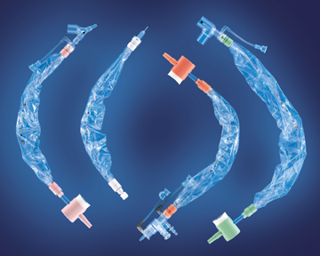
Closed Suction System for Pediatric and Neonatal Products
Neonatal CSC
Neonatal Y (195, 196, 197,198)
Neonatal Elbow (202, 206, 207, 208)
Neonatal Manifold (201, 200, 205)
Notes:
Now let’s review neonatal TRACH CARE* products. The neonatal product line includes three major categories including neonatal Trached Care, pediatric TRACH CARE*, and MAC catheters.
Point to the photograph with a laser pointer and ask the class to identify the TRACH CARE* products.
From left to right:
Neonatal TRACH CARE* “Y” configuration
MAC Catheter
Neonatal TRACH CARE* Manifold configuration
Neonatal TRACH CARE* Elbow configuration

Slide 23
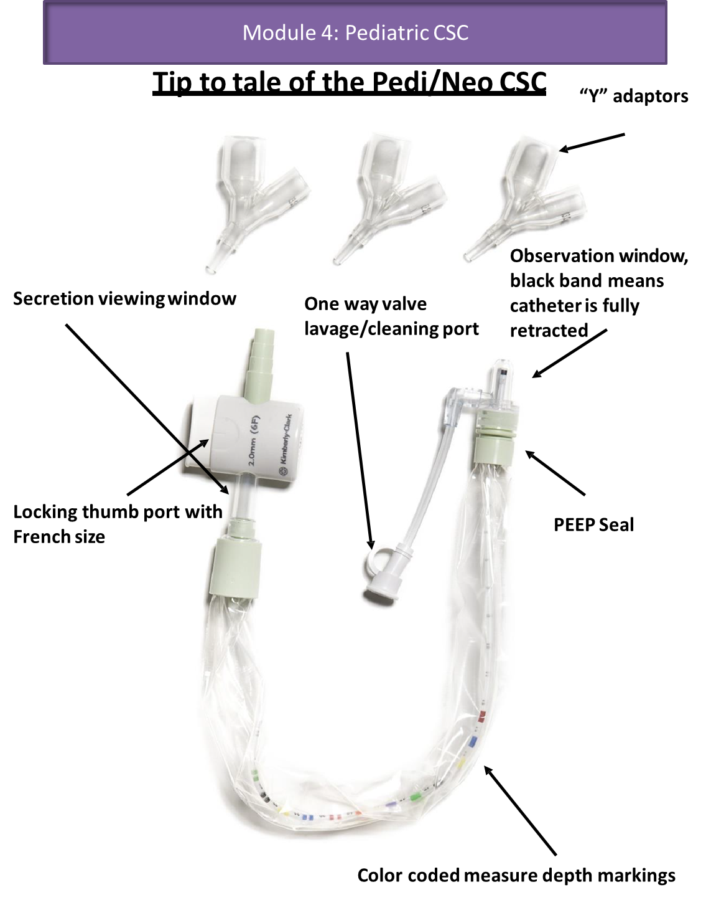
BALLARD* Closed Suction System for Pediatric & Neonate
Tip to tale:

Slide 24
BALLARD* Closed Suction System for Pediatric & Neonate
Features:
24-hour use.
Low dead-space adapters: Manifold & Y adapter designed with low dead space and direct the catheter down the ETT.
PEEP Seal prevents ventilator gases from entering the soft suction sleeve.
Soft tactile sleeve allows for a precise touch and feel of the suction catheter for gentle measured depth suctioning.
All BALLARD* Paediatric & Neonate CSC include numeric and color striped markings for precise measured depth suctioning.
Isolated suction valve: The thumb control well prevents secretions and bacteria from migrating back into the suction catheter and endotracheal tube.
Notes:
The older Manifold had an issue with dead space that may have derailed conversions several years ago. All adapters are now designed with low dead space adapters and they direct the catheter down the ETT.
A 6 Fr CSS includes 2.5, 3.0 and 3.5 adapters.
A 3.0 ETT requires a 6Fr suction Catheter. Twice the ETT value to determine Fr. Size.
We always include the exact adapter (based on Fr. Size) and 0.5 mm below and 0.5 mm above the exact adapter.
PEEP Seal
Same as adult TRACH CARE*. Prevents ventilator gases from entering the soft suction sleeve
Soft tactile sleeve
Allows for a precise touch and feel of the suction catheter for gentle measured depth suctioning
Measured Suction
All neonatal and pediatric TRACH CARE* catheters include numeric and color striped markings for precise measured depth suctioning
Isolated suction valve
The thumb control well prevents secretions and bacteria from migrating back into the suction catheter and endotracheal tube.

Slide 25
Directions for Use
Notes:
Hands-on product demos. Make sure that the each group of two to three people have the following items:
Clear head
TRACH CARE** (DSE or T-Piece)
Saline bullets
Exam gloves

Slide 26
Tips & Tricks

Slide 27
BALLARD* Closed Suction System for Pediatric & Neonate
Tips & Tricks
Inspect
Do not flood HME
Stop withdrawal when black mark on tip of catheter is visible in the dome.
Do not re-sterilize
Single use
Time usage
Inspect saline vial
Rx Only
Select appropriate size
Don’t block airway
Appropriate vacuum
Use appropriate suction times
Use caution in every vent mode

Slide 28
Tips & Tricks
Choosing the Appropriate Size Catheter:
Directions for Use (DFU):
Select the appropriate size CSC catheter. Most experts suggest that the catheter selected should occupy no more than one half of the internal diameter of the artificial airway.
Rule of thumb choosing catheter size:
2 X ETT size mm
Example:
3,0 mm ETT x 2 = 6 Fr Closed Suction Catheter
Notes:
Choosing the appropriate size catheter
The relationship of suction catheter (OD) to the ET tube
Rule of thumb cath size:
2 times ET size mm, 8.0mm tube (x2) = 16F
Choose next lowest size catheter or 14 French
14 French is the most common
Most respiratory therapists know this rule of thumb and sometimes will deviate from it. It’s their call.
This is a safety rule of thumb that prevents use of oversized suction catheters.
A suction catheter should never exceed 50% of the endotracheal tube diameter. This allows the patient to be ventilated during the suctioning procedure.

Slide 29
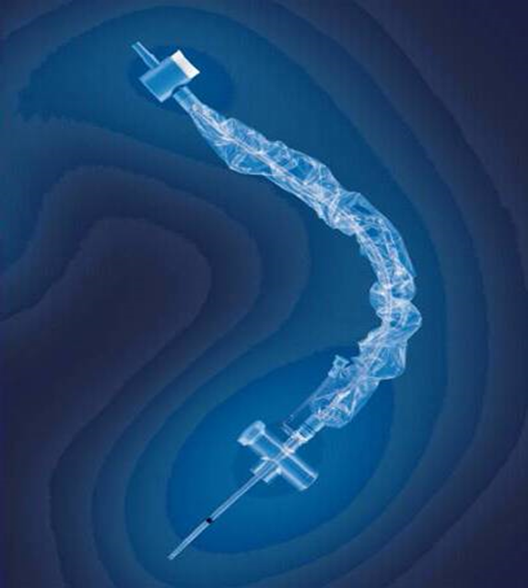
Tips & Tricks
Warning:
Fully withdraw the CSC catheter before cutting endotracheal tube, otherwise, the catheter may also be cut.
Notes:
Warnings
Continuous flow therapy and T-Piece.
Great care should be taken when cutting the endotracheal tube. Many hospitals trim the endotracheal tube to reduce kinking and lower the inspiratory pressures. ** they should always make certain that the TRACH CARE** catheter is fully withdrawn into the sleeve before cutting the endotracheal tube. This can be confirmed by visualization of the black stripe on the catheter within the clear suction sleeve. Noted with arrow in photograph.

Slide 30
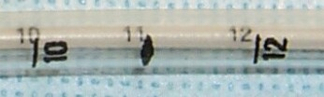
Tips & Tricks
Measured Depth Technique:
E.T Tube Markings
Catheter Markings
Notes:
Measured Depth Suction
The reason for measured suction in neonates is to prevent inadvertent damage to the carina. The neonates carina is thin and easily punctured with a suction catheter. Measured suctioning prevents the suction catheter from being introduced to far into the trachea.
Measured depth suctioning includes aligning the numbers marked on the endotracheal tube with the numbers or colors marked on the suction catheter. This ensures that the suction catheter does not extend beyond the endotracheal tube tip. The hospital we’ll have a policy and procedure that dictates the distance the catheter can extend beyond the endotracheal tube. The common distances are 0.0, 0.5 and 1.0 cm relative to the endotracheal tube.
Point out alignment of numbers on ET tube and catheter as one method for positioning catheter tip at ET tube tip.]

Slide 31
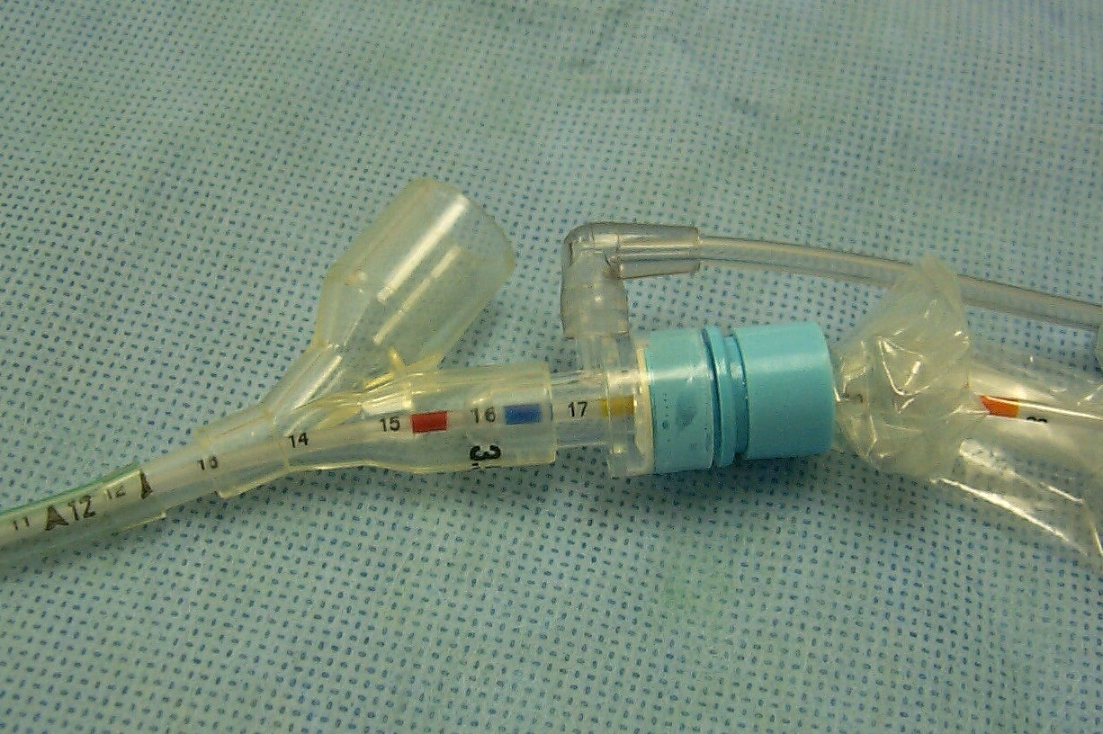
Tips & Tricks:
Measured Depth Suctioning
Note where tip of ET tube adapter is in relation to ET tube:
# at adapter tip + 5 = # at window
“Window”
Notes:
This is a photograph of the neonatal TRACH CARE* “Y” adapter highlighting the features that allow the clinician to perform precise measured depth suctioning.
Can be used to point out how numbers align during safe suction procedure.
Measure 5mm back from the adapter tip. Practice with a CSS before going into presentation or in-service. Tell the clinicians to do the same!
Pass a catheter and adapter around for visualization by everyone.
The lavage port is directly over the PEEP Seal.

Slide 32
Closed Suction – Measured Depth Suction – Special Ventilators – NICU
Examples are based on different sizes of ET tubes:
CMV Ventilator – Drager
3.0 ET Tube x 2 = 6 FR Catheter
Add on 5 for Adapter
HFO Vent – Oscillator
3.0 ET Tube x 2 = 6 FR Catheter
Add on 8 for Adapter
“Jet” Vent
2.5 ET Tube x 2 = 5.0 FR Catheter
Add on 6 for Adapter
Most facilities will practice the numbers matching on CSC to ETTube.
Notes:
Data from
Northwestern Memorial Hospital – NICU
These are very popular vents that you will often see utilized in the NICU/PICU in your facilities.
You will need to know these formulations not only while maintaining business for Pediatric TRACH CARE* but for educational in-services. It is not always just adding on 5 for the adapter, it is based on what vent they are using to determine the best measured depth suctioning.

Slide 33
Clinical Evidence

Slide 34
Clinical Evidence

Slide 35
Decreasing the adverse effect (AE) of endotracheal suctioning (ES) during mechanical ventilation (MV) by changing practice
Prospective open 4-month study:
229 consecutive pediatric ICU patients
Alternate months format
BALLARD* CSS versus open suction
Local Policy required 2 nurses for open suction
Data collected for:
ES event, staff, duration, saline use, HR, MP, SpO₂, AEs
6691 ES events
Open vs closed ES
583 vs 441 patient-days
6.0 vs 7.2 ES events/day (p < 0.01)
Mean ES duration 2.6 min vs 3.2 min
ES time/day per nurse 38 min vs 23 min (p < 0.01)
↓SpO₂ 6.3% vs 4.8% (p = 0.01)
↑HR 4.6% vs 1.6%, (p < 0.01)
↑MAP 9.2% vs 3.4% (p < 0.01)
Conclusions:
Compared with open ES, ES by CSS caused less physiologic disturbances, similar AE frequency, and required less staff time and fewer nurses.
This evidence supported change of ICU practice to CSS as standard
Evans J et al. Aust Crit Care 2014;27:70–74.

Slide 36
BALLARD* CSS Paediatric & Neonate Sales & Marketing tools

Slide 37

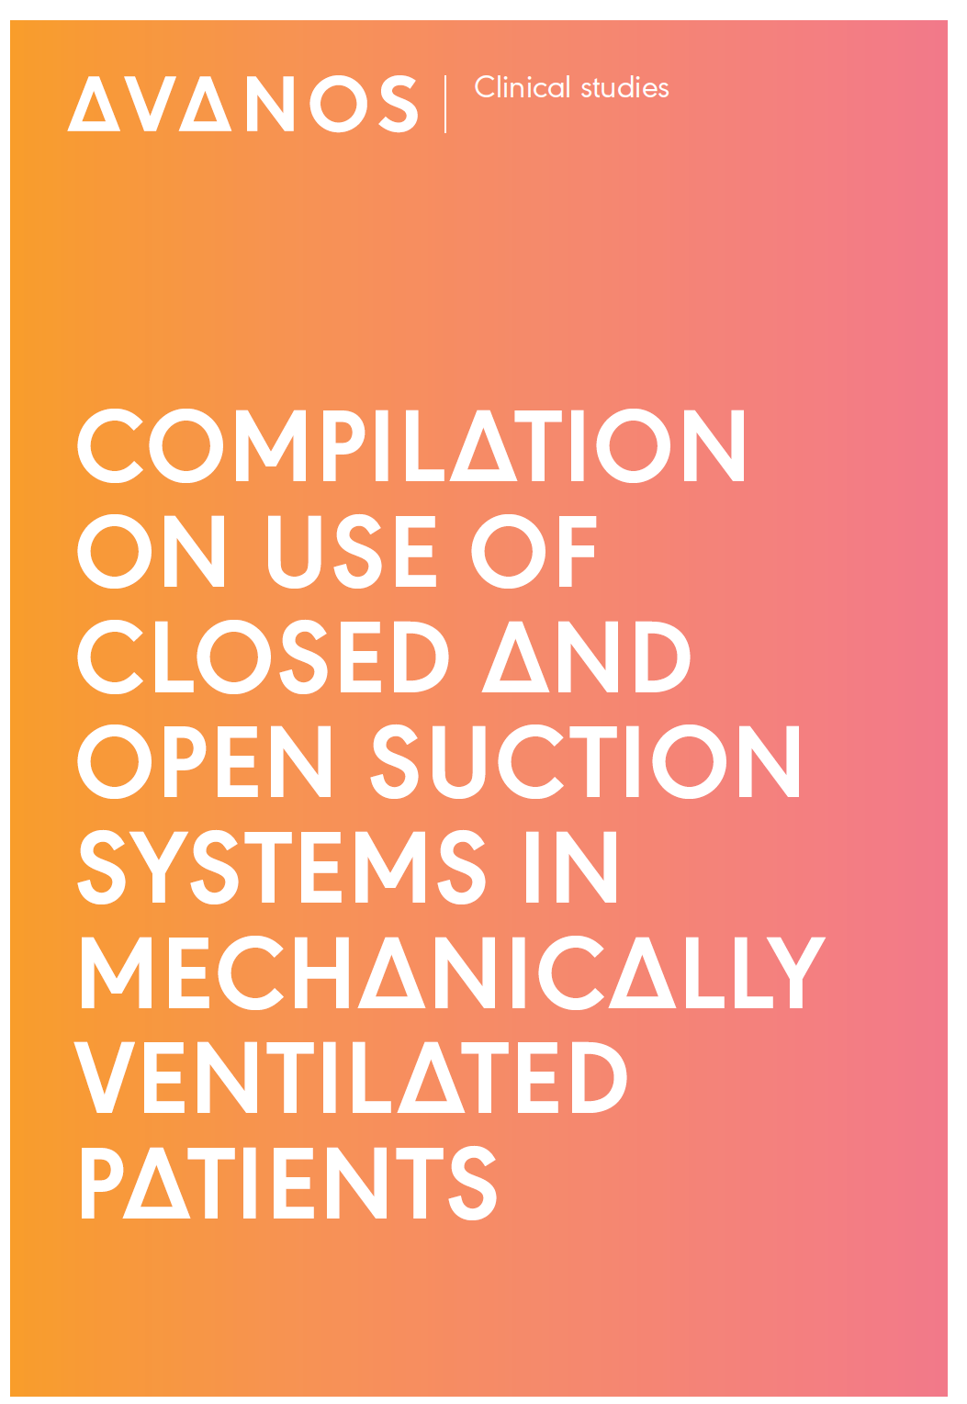
BALLARD* Closed Suction System for Pediatric & Neonate
HC659-04
HC692-01

Slide 38
Thank You

