Slide 1
Laryngoscopes & Blades

Slide 2
Agenda
Anatomy
Laryngoscopy
Laryngoscopes & Blades
GreenLine™/D® System
IntuBrite™
IntuBrite™ GreenLine System

Slide 3
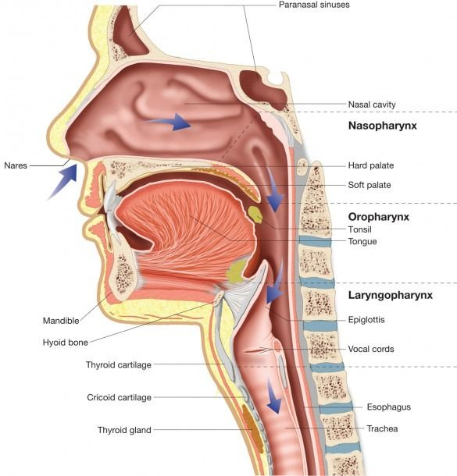
Anatomy – Upper Airway
Oral cavity:
Mouth, tongue, soft palate
Nasal cavity:
Nostrils, nasal mucosa
Pharnyx:
Nasopharynx: connects nasal cavity to pharynx
Oropharynx: connects oral cavity to pharynx
Laryngopharynx/Hypopharynx connects larynx to pharynx
Larynx: an organ that divides the upper and
lower airways and contains the vocal cords

Slide 4
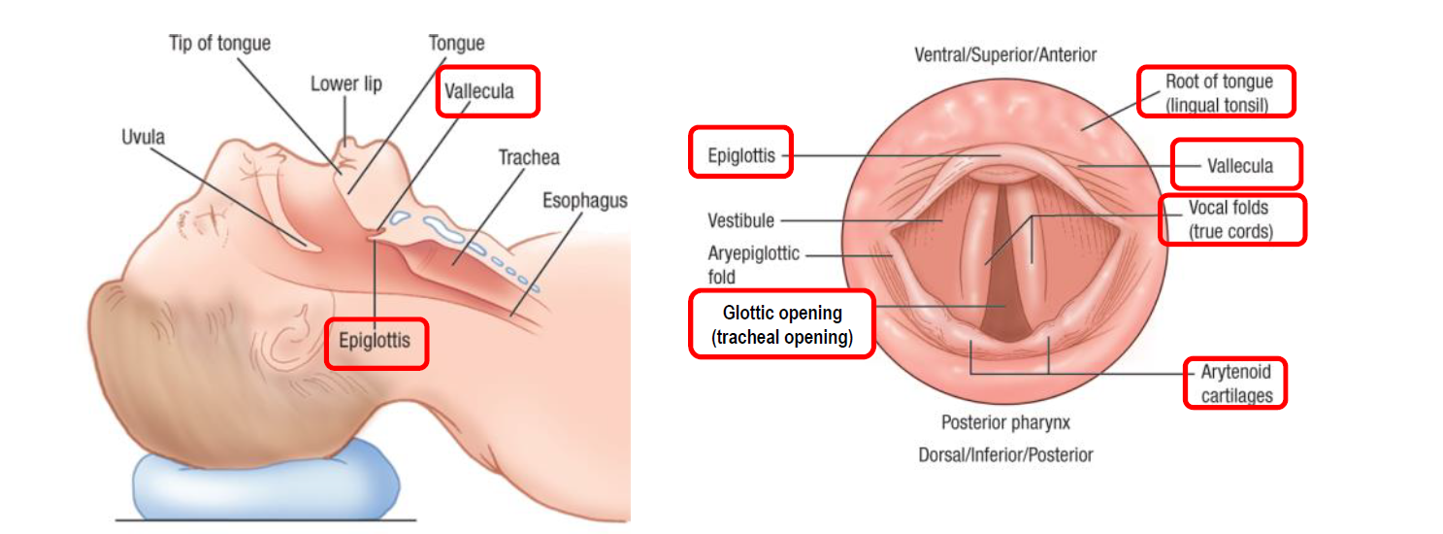
Anatomy for Laryngoscopy
Glottic opening:
the opening between the vocal cords. This is the target for tracheal intubation.
Vallecula (val·lec·u·la ):
the space between the base of the tongue and the epiglottis
Arytenoid cartilages (ar·y·te·noid ):
a pair of small triangular cartilages in the larynx thathelp to move the vocal cords

Slide 5
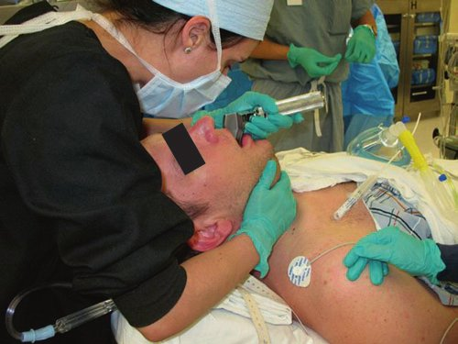
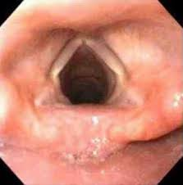
Laryngoscopy
Laryngoscopy (la·ryn·go·sco·pi):
Laryngoscopy is a term describing the visualization or examination of the larynx by distraction of the upper airway structures.
It is typically used to enable intubation and airway management in anesthesia, critical care, and trauma scenarios.
(2) (PDF) Airway Management (researchgate.net)
emedicine.Medscape.com/article/80222

Slide 6
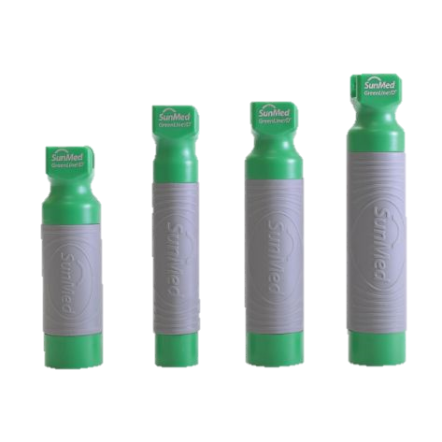
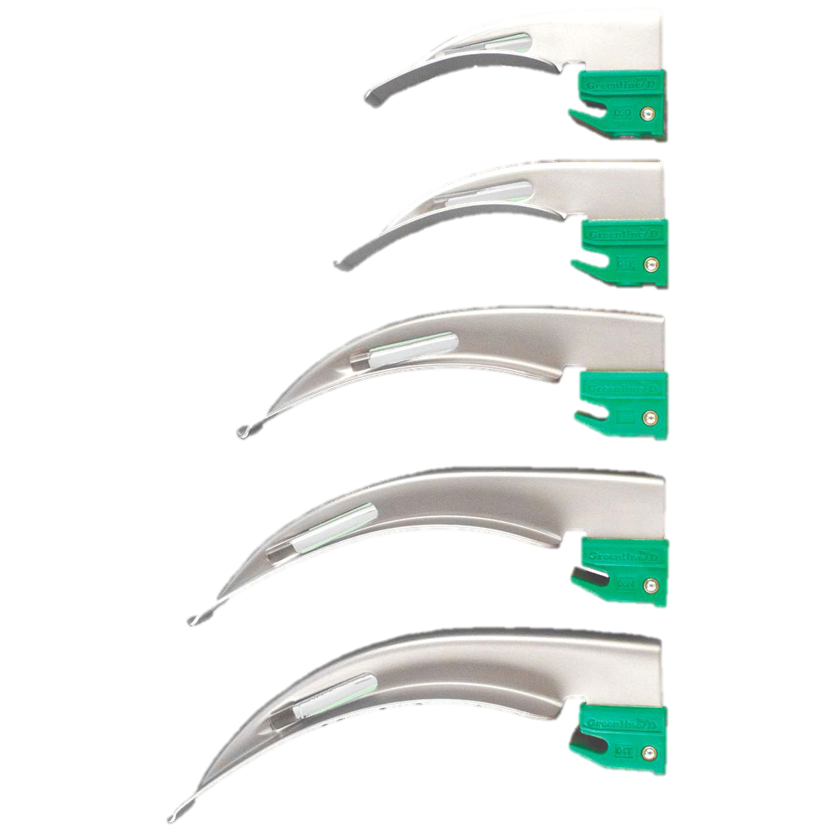
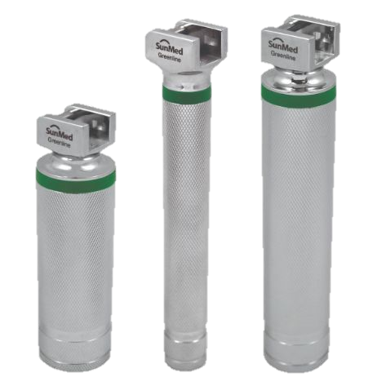
Laryngoscopes & Blades

Slide 7
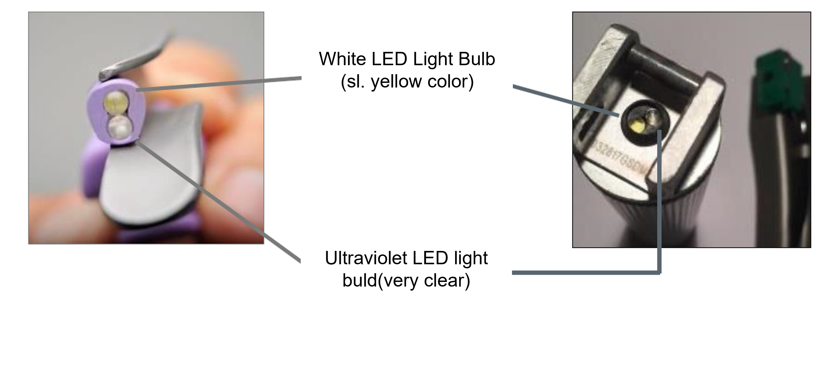
Classification of Laryngoscopes
Standard Laryngoscopes
has a light bulb incorporated into the blade, approximately 1/3 of the distance from the tip.
The light bulb screws into position and is powered via an integral line that transfers power from the batteries located within the handle.
Fiber Optic Laryngoscopes
The bulb in a Fibre Optic Laryngoscope is located in the handle and the light is transferred to the proximal tip of the blade via a fibre optic bundle, so the light is transmitted without heat, eliminating the risk of thermal damage to the patient's tissues within the patient’s oral cavity.
Two bulbs provide the blended ultraviolet/white LED light
When on, only the white LED light bulb appears to be working.
The UV light is not visible to the naked eye.
IntuBrite® Dual LED
(Standard LED)
Two bulbs in blade
IntuBrite® Greenline
(Fiberoptic) LED
Two bulbs in handle

Slide 8
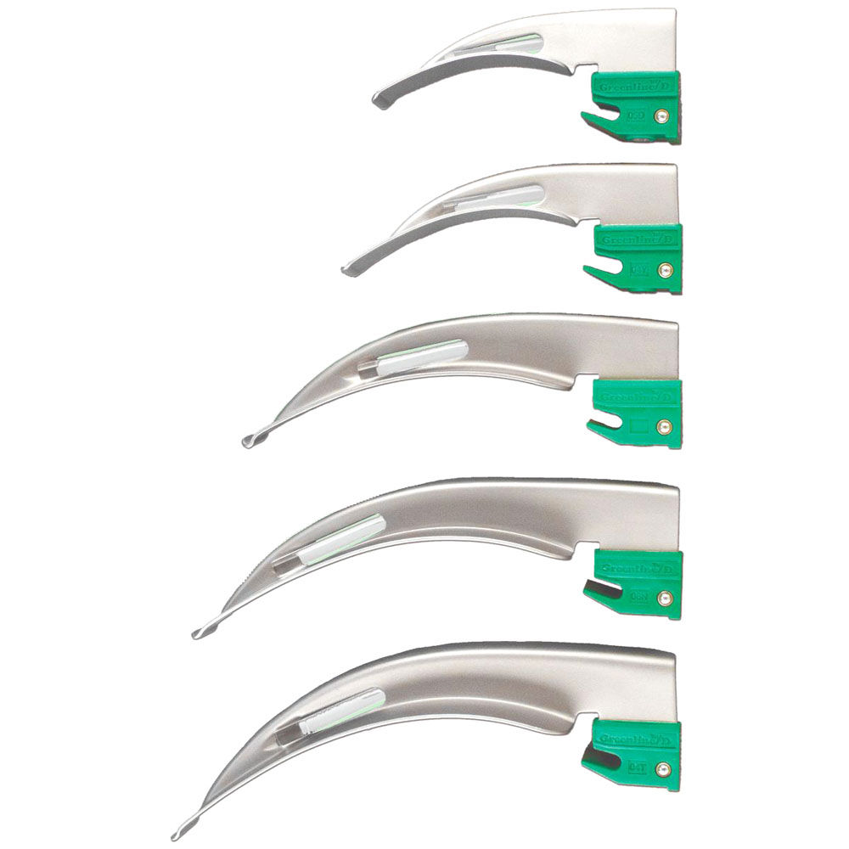
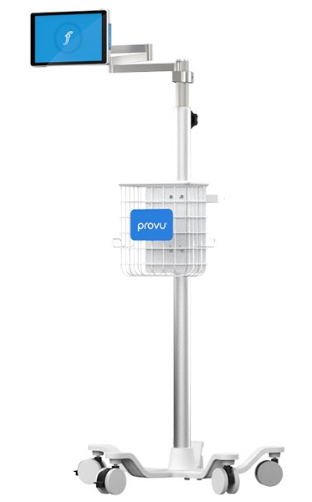
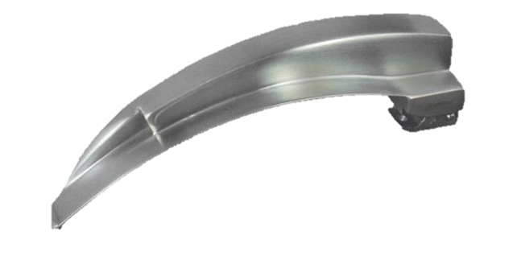
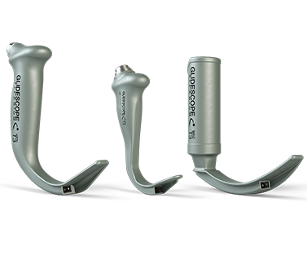
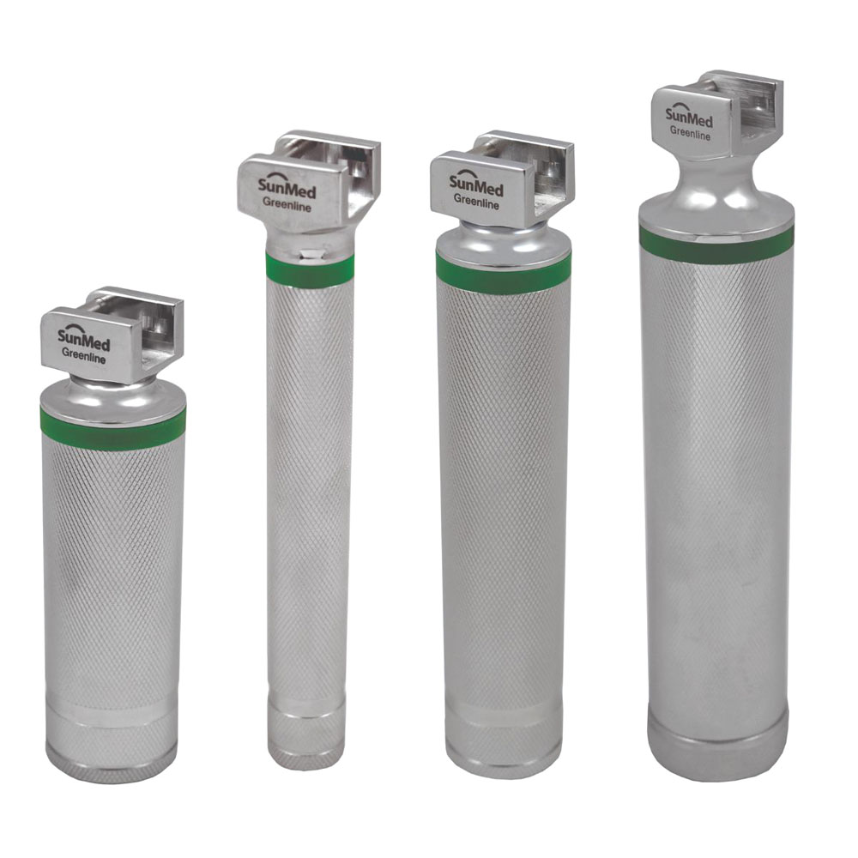
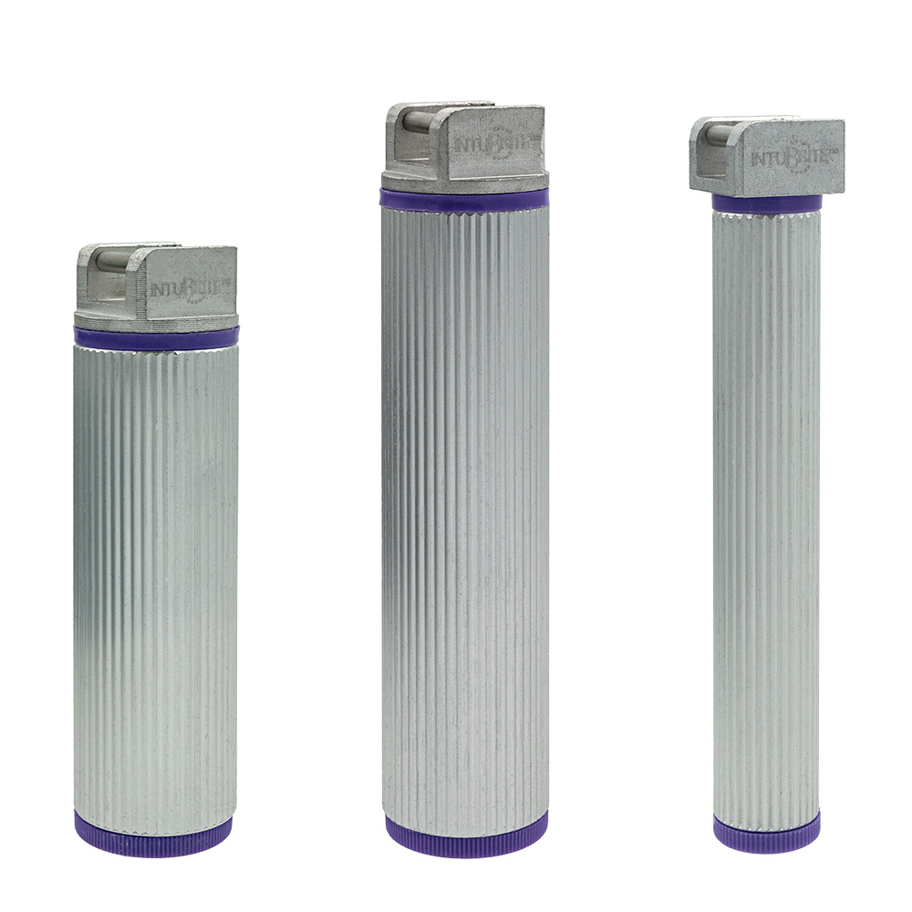
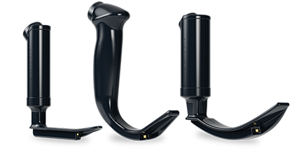
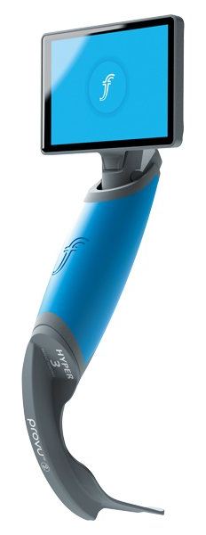
Types of Laryngoscopes
Disposable
Resuable
Videolaryngoscopes

Slide 9
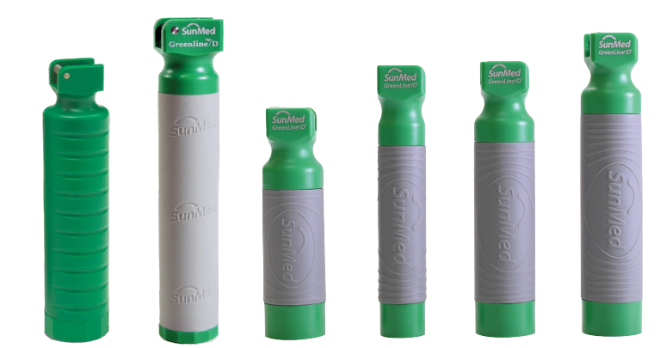
GreenLine ®/D™ Handle
Fiber Optic GreenLine®/D™ Handle
GreenLine®/D™ disposable LED laryngsocope handles are ideal for use with GreenLine® Fiber Obtic Laryngoscope blades.
This single patient use handle helps address secondary infection concerns and costs associated with reprocessing.
Fiber Optic GreenLine®/D™ Handle
Latex free
Sterile
Single Patient Use
Disposable
CE Mark
One complete, fully-contained unit
Ideal for use with GreenLine®/D™ disposable blades
LED illumination provides exceptional, clear viewing
Complies with ISO 7376 Standard
Batteries included
5-0236-69 | 5-0236-70 | 5-5338-11 | 5-5338-10 | 5-5338-09 | 5-5338-12
Ribbed Grip | Smooth Grip | Textured Grip Stubby | Textured Grip Penlite | Textured Grip Medium | Textured Grip Standard

Slide 10
GreenLine ® Premium Chrome Handle
GreenLine® Premium Chrome Plated Laryngoscope Handle
Surgical stainless steel handles are compatible with all Green System fiber optic blades
Bright Halogenated Xenon lamp
Batteries not included
Resuable
5-0236-11 | 5-5338-11 | 5-0236-09 | 5-0236-15
Stubby | Penlite | Medium | Large

Slide 11
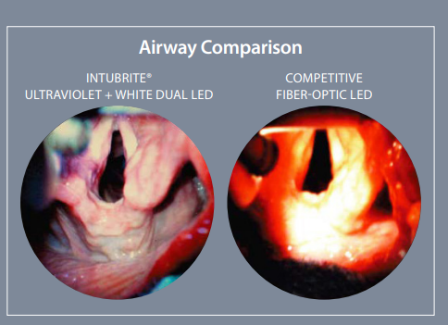
IntuBrite® Dual LED Disposable Handle
IntuBrite® Green System Disposable handle
IntuBrite® disposable fiber optic blades and handles are built to ISO Green Standard System specification.
The innovative greenline compatible dual LED lights combine white and ultraviolet wavelengths to illuminate airway structures Its now possible to go disposable and improve the intubation experience.
Blended ultraviolet and white LED lights
Improved clarity and definition, without glare
Anatomy glows
UV light provides unique bright detail
Fiber Optic GreenLine®/D™ Handle
Latex free
Sterile
Single Patient Use
Disposable
CE Mark
One complete, fully-contained unit
Ideal for use with GreenLine®/D™ disposable blades
LED illumination provides exceptional, clear viewing
Complies with ISO 7376 Standard
Batteries included
2017.C | 2015.C | 2016.C
Stubby | Medium | Pediatric

Slide 12
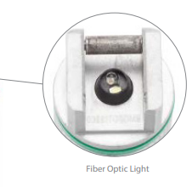
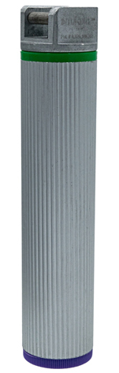
IntuBrite® Green System Laryngoscope
IntuBrite® Green System Laryngoscope
IntuBrite® disposable fiber optic blades and handles are built to ISO Green Standard System specification.
The innovative greenline compatible dual LED lights combine white and ultraviolet wavelengths to illuminate airway structures Its now possible to go disposable and improve the intubation experience.
IntuBrite® Green System Laryngoscope
Green System Compatible
Blended Ultraviolet + White LED lights
UV light provides unique bright detail
Improved clarity and definition without glare
Lightweight, disposable aircraft aluminum handle
Broad range of combinations
6017.C | 6015.C | 6016.C
Stubby | Medium | Pediatric

Slide 13
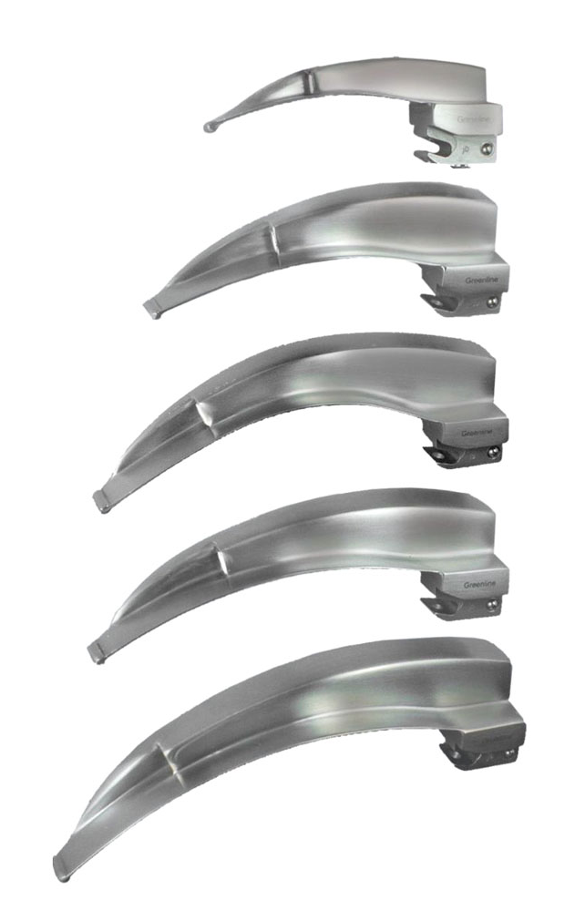
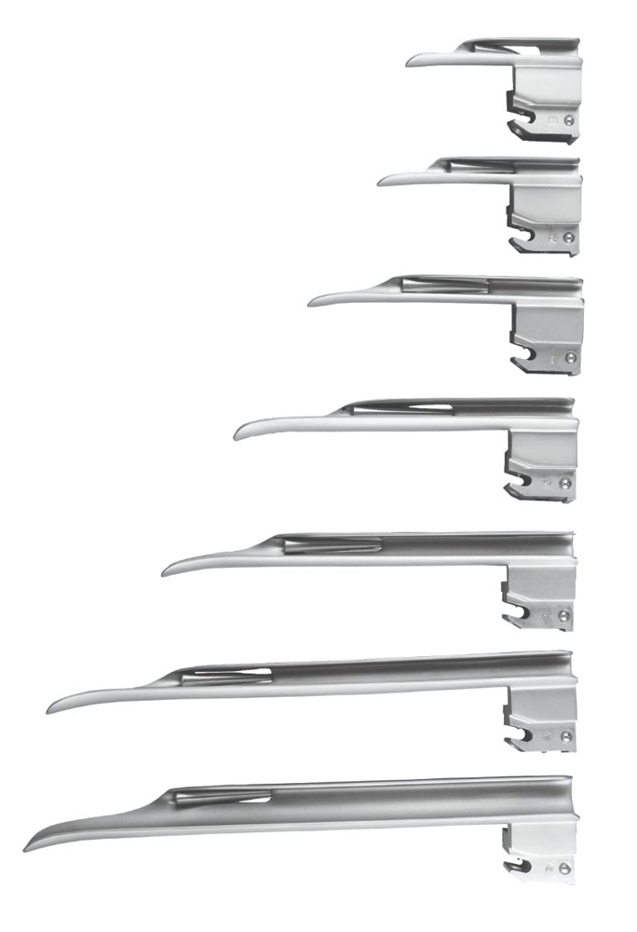
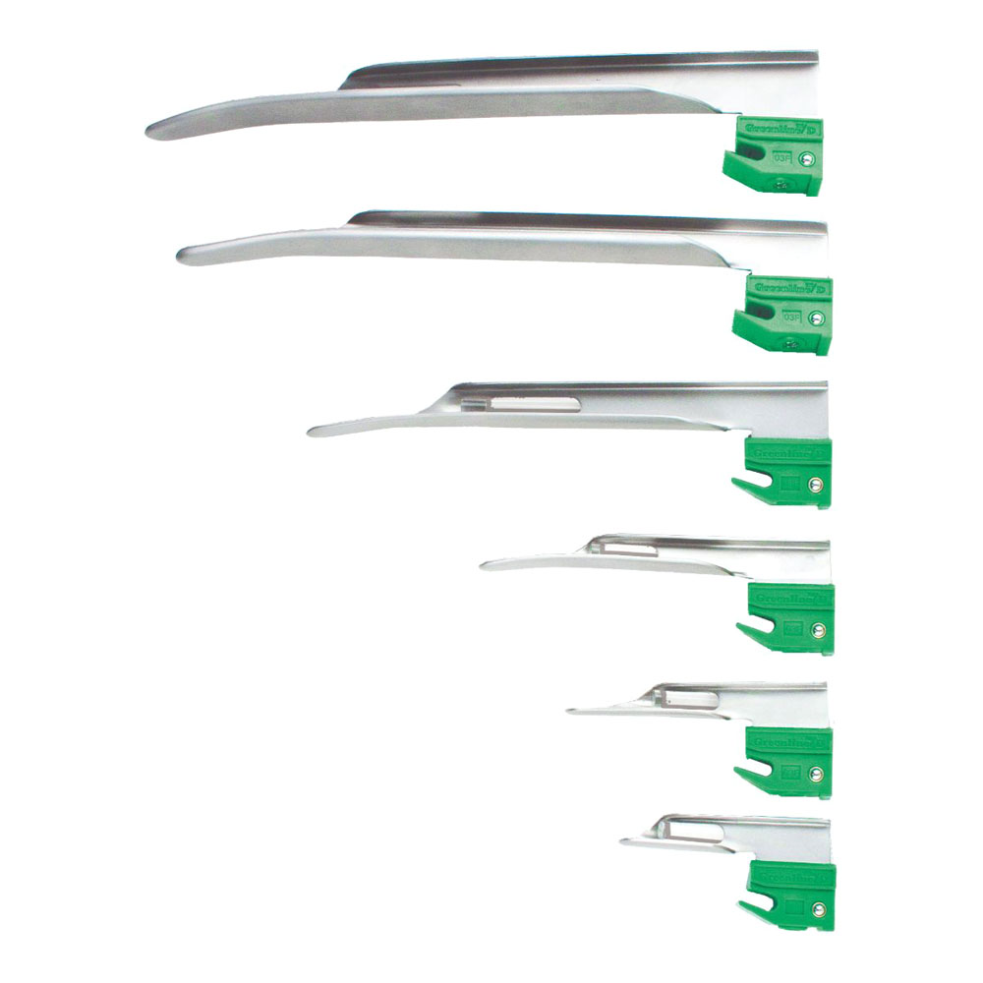
GreenLine ® Blades
GreenLine® Blades
Latex free
Resuable
Built with an integral, extra large fiber optic bundle delivering a cool, white light
Design eliminates cracks and crevices allowing superior cleaning and the prevention of cross contamination
Not chrome plated
Compliant with ISO standard 7376
Green System compatible
Constructed of 303/304 surgical stainless steel
GreenLine®/D™ Blades
Disposable blade solves contamination problems and eliminates the cost and time spent cleaning blades and returning them for use
Answers the professional’s request for a non-plastic single-use blade suitable for everyday hospital use
Polished acrylic stem produces exceptional illumination
Compliant with ISO standard 7376
Green System compatible
Constructed of surgical stainless steel

Slide 14
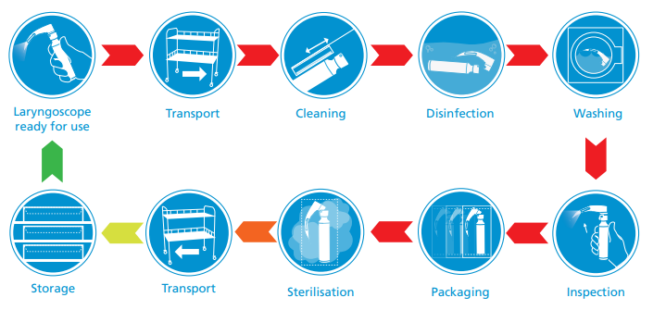
Why Single Patient Use?
Reusable Laryngoscopes are classified as high risk, and handles are a known source of cross-contamination. Studies have shown
that decontamination using impregnated germicidal wipes is ineffective - with between 75%¹ and 86%² of “patient ready” handles remaining positive for bacterial contamination.
The AAGBI Safety Guideline on Infection Control ³ recommends that reusable laryngoscope handles be “sterilised by SSDs after every use”, and concludes “single-use disposable equipment will remove the difficulties of reuse and decontamination procedures. The use of such equipment is to be encouraged”.
flexicare.com
Call T, Auerbach F, Riddell S, Kiska D, Thongrod S, Tham S, Nussmeier N. Nosocomial Contamination of Laryngoscope Handles: Challenging Current Guidelines. International Anesthesia Research Society (2009) Vol. 109, No. 2
Williams D, Dingley J, Jones C, Berry N. Contamination of Laryngoscope Handles. Journal of Hospital Infection (2010) 74, 123-128
AAGBI Safety Guideline: Infection Control in Anaesthesia (2008)

Slide 15
Thank you

