Slide 1
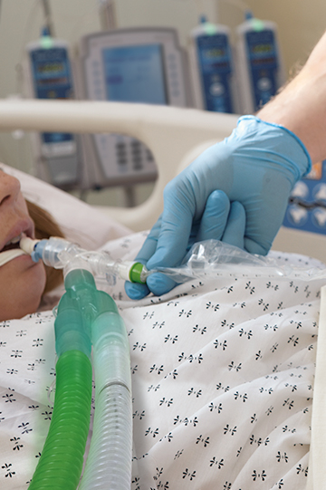
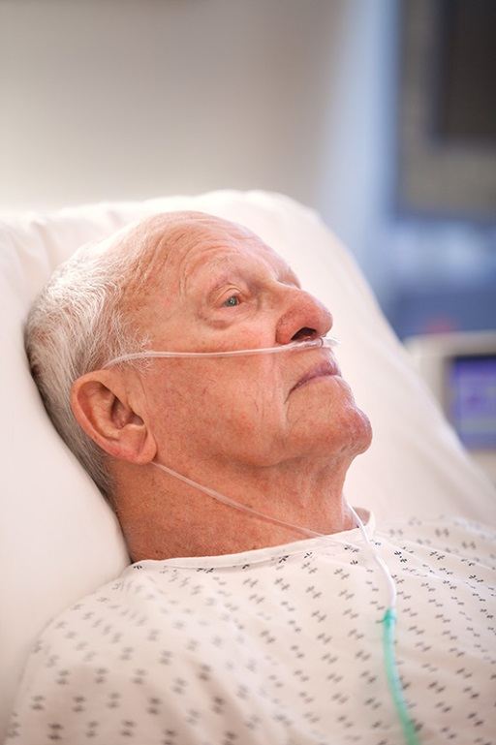

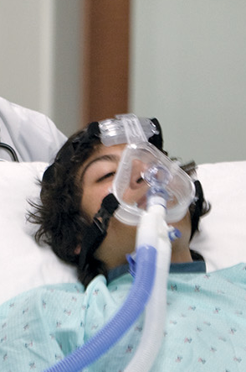
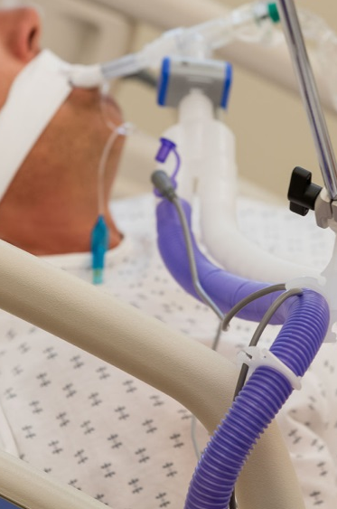
Medication Delivery

Slide 2
Agenda
Nebulizer overview
Where used
Small Volume Nebulizers
  Nebulizer Setup and Components
  Key Components and Terms
  CareFusion SVN Brands
  High Efficiency Nebulizers
  Competitive Landscape
Continuous Nebulizers

Slide 3
Medication Nebulizer Overview

Slide 4
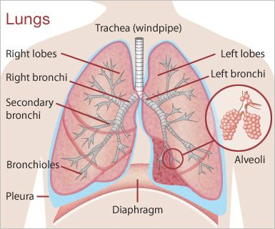
What is a medication nebulizer?
A device used to administer medication in the form of an aerosol (mist) inhaled into the lungs.
Used for the treatment of asthma, COPD and other respiratory diseases
Notes:
Micron = micrometer = one-millionth of a meter = one-thousandth of a millimeter (0.001 mm or 0.000039 inches)

Slide 5
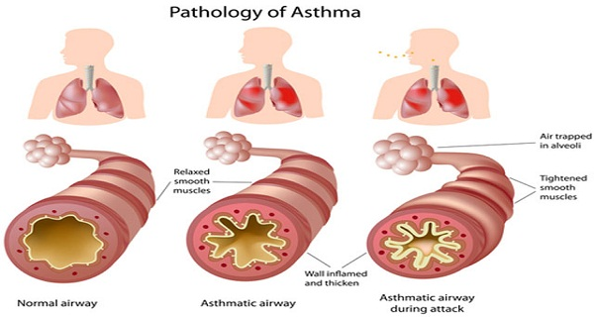
Why would somebody need medication delivered via nebulizer?

Slide 6
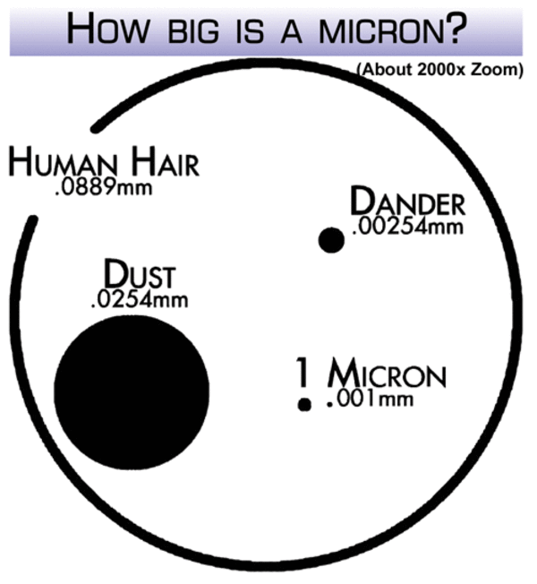
How does a nebulizer work?
Uses oxygen, compressed air or ultrasonic power to break up medical solutions/suspensions into small aerosol droplets that can be inhaled directly from the device.
Particle size is important too
  Desired range is between 1 and 5 microns
Micron = micrometer
= one-millionth of a meter
= one-thousandth of a millimeter
= 0.001 mm or .000039 in
Notes:
Micron = micrometer = one-millionth of a meter = one-thousandth of a millimeter (0.001 mm or 0.000039 inches)

Slide 7
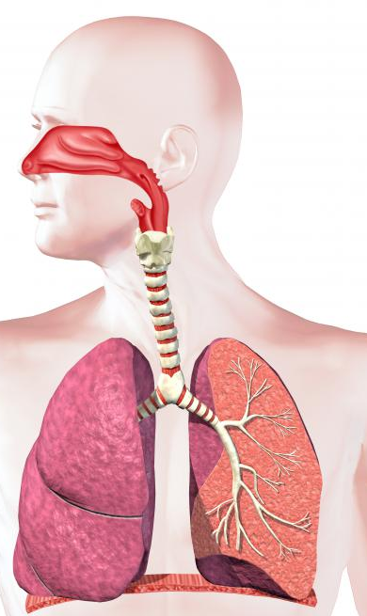
A Word on Particle Size
> 5μm impaction
Deposited into oropharynx and swallowed
Nasal Cavity
5.8μm – 9.0μm
Pharynx
4.7μm – 5.8μm
Trachea & Primary Bronchi
1 - 5μm sedimentation
Optimal for delivery to the lower airways
4.7μm – 5.8μm
Secondary Bronchi
2.1μm – 3.3μm
Terminal Bronchi
1.1μm – 2.1μm
<0.8 μm
Likely to be exhaled by tidal breathing
Alveoli
0.43μm – 0.65μm
Pharmacotherapy 2010;30(6): 562-584

Slide 8
Commonly Used Medications
Albuterol Sulfate
  Bronchodilator – Relaxes muscles and opens breathing passages in the lungs
  Used to treat ongoing Asthma attacks
Budesonide
  Steroid - works to prevent and minimize the severity of asthma attacks
Cromolyn Sodium
  Mast Cell Stabilizer – prevents the release of histamine when patients come in contact with irritants
  Prevents asthma attacks and bronchospasms that are caused by exercise, pollutants, etc.

Slide 9

Nebuliser – Type of Nebulizer
Small Volume Nebuliser
Uses air to pressurize the drugs in the
Medication cup into small, consistent size.
MMD – mass median density is usually
Between 1.5microns to 2.0microns
Benefits : Micron size improves the
drug delivery
Jet Nebulisers
Acts like a piston forcing air through the
Medication cup and forcing the drugs out into
The mouthpiece like a fine mist.
Benefits : size of particles delivered.
Large Volume Nebulisers
Used to nebulise water into fine mist
Not used for drug delivery, but aerosolized
Water supports mild breathing distress for
Some patients.
Benefits: simple, drug free support for
non-acute conditions.
Ultrasonic Nebulisers
Sometimes use water to conduct high Frequency vibrations into medication Cup which forces drug into a “fog”
Benefits: considered to have more
Consistent particle size….

Slide 10
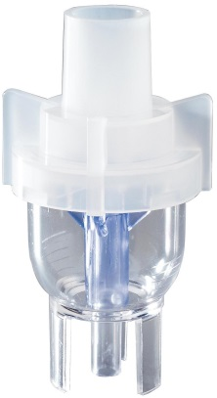
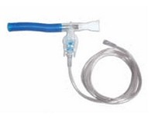
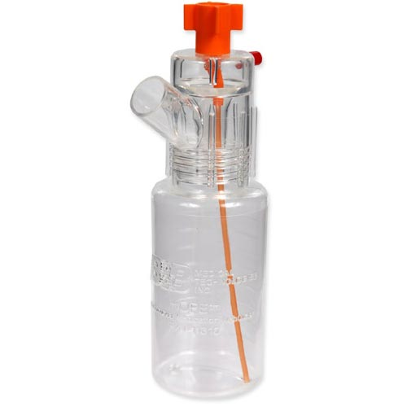
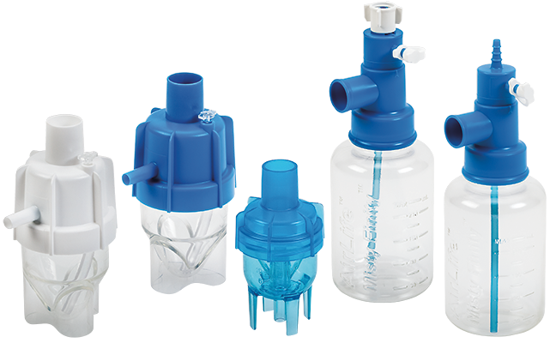
Vyaire - 3 Types of Medication Nebulizers
Small Volume Nebulizers Jet Small Volume Nebuliszer
Continuous Nebulizers

Slide 11
Misty Finity® Continuous Nebulizer
US Annual Sales: $2.65M
Small Volume: 1-2 hours of treatment time
Medium Volume: 2-4 hours of treatment time
Large Volume: Up to 8 hours of treatment time
Medium Volume
Small Volume
Large Volume

Slide 12
Where are Nebulisers used ?
Pre-hospital areas & Homecare
Home to treat; Chronic Asthma & Chronic pulmonary disease
Ambulances / Paramedics
to support breathing & deliver aerosolized drugs
Intra-hospital areas
Emergency
To support patient’s Respiratory distress
Stepdown units
Continue drug delivery
Maintenance of disease
ICU
Deliver Sufactant to maintain Alveola integrity
Respiratory wards
Support Cystic fibrosis
Control & stabilize asthma

Slide 13
Medication Nebulizers
Small Volume Nebulizers

Slide 14
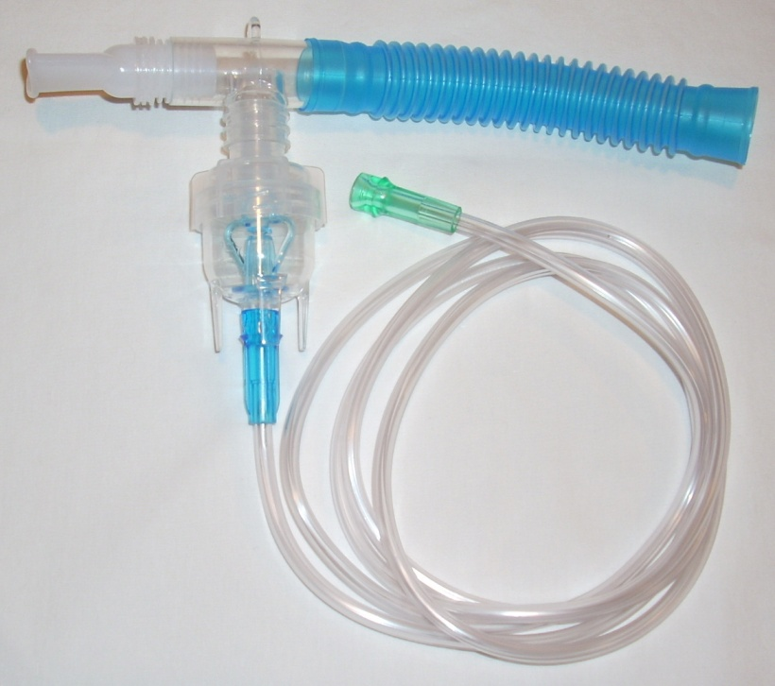
Small Volume Nebulizer Setup
Connect oxygen tube to the gas source and to the bottom of the SVN
Connect the top of the SVN to a T-piece
Connect the 6” flex tube to one end of the T-piece, and the mouthpiece attached to the other end
If the patient is unable to use a mouthpiece, the SVN can be attached to an aerosol mask
Notes:
Hand out a MM10 to everyone an have them put it together; explain each of the components they see; sketch out how the neb works

Slide 15
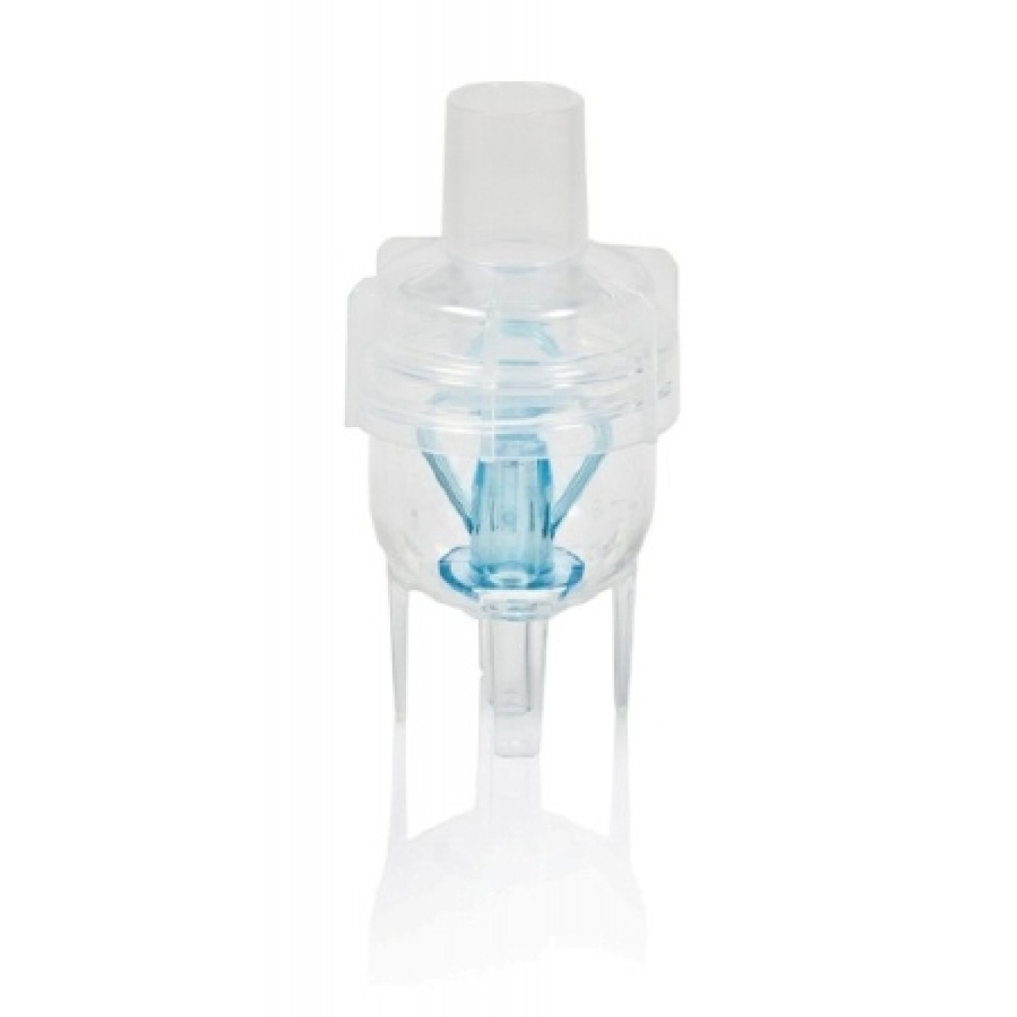
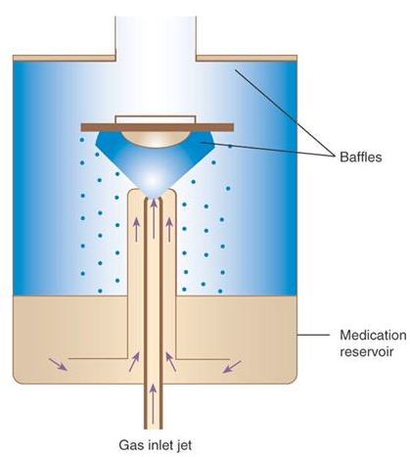
How does a nebulizer work?
Notes:
Micron = micrometer = one-millionth of a meter = one-thousandth of a millimeter (0.001 mm or 0.000039 inches)

Slide 16
Medication Nebulizer Key Terms
Mass Median Aerodynamic Diameter (MMAD) = Considered to be the average particle diameter by mass
Respirable Fraction = The fraction of the inhaled particles that penetrates into the alveolar region of the lung (1-5 microns)
Residual/Remaining Drug Volume = Medication that remains in a small volume nebulizer after the device is no longer producing mist
Treatment Time = Refers to how long it took to administer the dose of medication

Slide 17
MMAD – Mass Median Aerodynamic Diameter
Not all averages are equal.
Mode = most frequent
Median = in the centre of the distribution
Mean = total sum / sample size
1,1,1,1,2,2,2,2,3,3,3,3,4,4,4,4,5,5,5,5,6,6,6,6,7,7,7,7,7,8,8,8,8
Mode
Median
50% below
50% Above
Mean
Sum = 151
Count = 33
151 / 33 = 4.58

Slide 18
AirLife Medication Delivery Products
Quiz 1
What is MMAD?
Mass Median Aerodynamic Diameter
What is the desired particle size range?
1 - 5μm
What is “respirable fraction?”
inhaled particles that penetrates into the alveoli
What are the three types of medications most often used in a nebulizer (not the three generic names)
Albuterol Sulfate, Budesonide, Cromolyn Sodium

Slide 19
Misty Max 10 Details
Launched in 2004
18 million units sold each year in US
  Largest selling small volume nebulizer in the United States
Performance Specifications
  MMAD = 1.6 µ
  % particles 1µ>5µ: 85%
  Treatment time: 8 to 10 minutes in a non-controlled clinical setting

Slide 20
Misty Max 10 Codes
Now with 15 languages!
P/N | MM10 | Tee adapter | O2 tubing | Mouth piece | Flex tube | Filter | Ped Mask | Adult Mask
002430 | X
002431 | X | M/M
002434 | X | M/M | 7 | X
002435 | X | M/F | 7 | X | X
002437 | X | M/M |  | X
002438 | X | M/M | 7 | X | X
002439 | X | M/M | 14 | X | X
002442 | X | M/M
002445 | X | M/M | 7-UC | X
002446 | X | M/M | 7-UC | X | X
002447 | X | VLVDTEE | 7
002450 | X | “Y” | 7 | X | X | X
002443 | X |  |  |  |  |  | X
002444 | X |  | 7 |  |  |  | X
002440 | X |  |  |  |  |  | Elephant
002455 | X |  | 7 |  |  |  | Elephant
002432 | X |  |  |  |  |  |  | X
002433 | X |  | 7 |  |  |  |  | X
15% units
57% units
8% units
11% units
Notes:
Explain that anything without a tee adaptor is attaching into a mask; that one comes with a Y tee adaptor and filter to limit harmful medication from going into the ambient air, the difference in the 7 foot tubing and the you-connect-it tubing, that some come with the flex tube, and that we have two peds masks and one adult mask
BREAK after this slide

Slide 21
Misty Fast

Slide 22
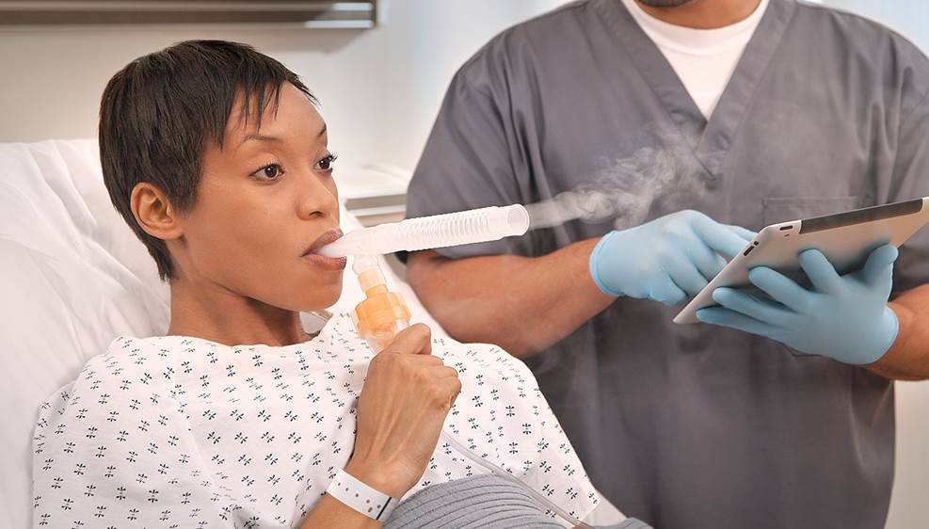
AirLife Misty Fast Small volume nebulizer

Slide 23
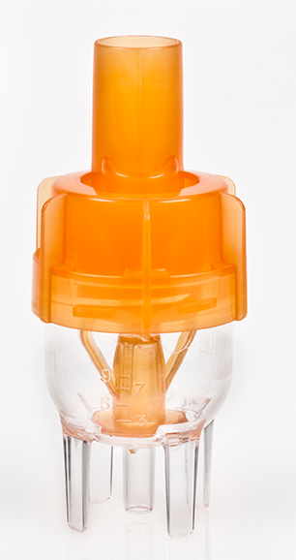
Misty Fast Details
Launched in 2013
Key Focus Product for AirLife
Performance Specifications
  MMAD = 2.4 µ
  % particles 1µ>5µ: 72%
  Treatment time: Nebulizes a standard 3ml dose in under 4 minutes

Slide 24
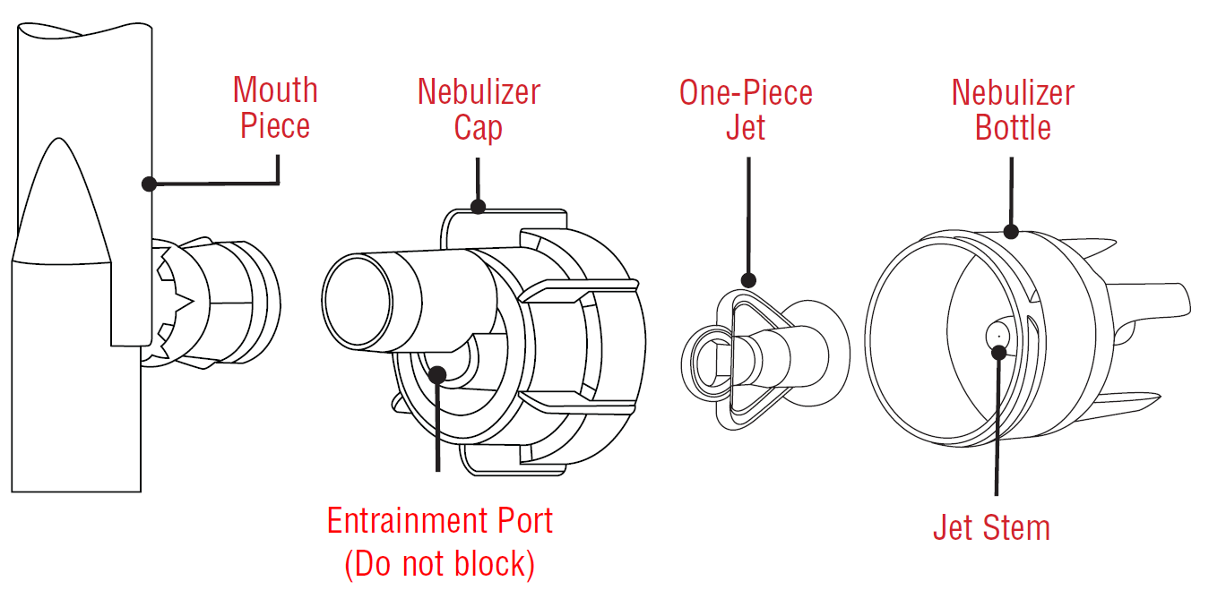
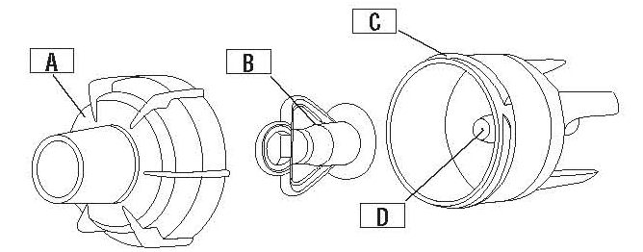
What Differences & Similarities do you notice?
Air entrainment port on Misty Fast cap
Swivel mouthpiece with built-in Tee adaptor
Modified Jet Design
Flextube is the same
Reservoir holds the same volume of medication
Jet stems have different sized openings, although they may look the same
Misty Fast
MM10
A-Nebulizer Cap, B-Jet, C-Neb bottle, D-Jet stem
Notes:
Pass out sample to each and have them break out into teams. Assemble them and write down every difference/similarity they see when compared to Misty Max 10

Slide 25
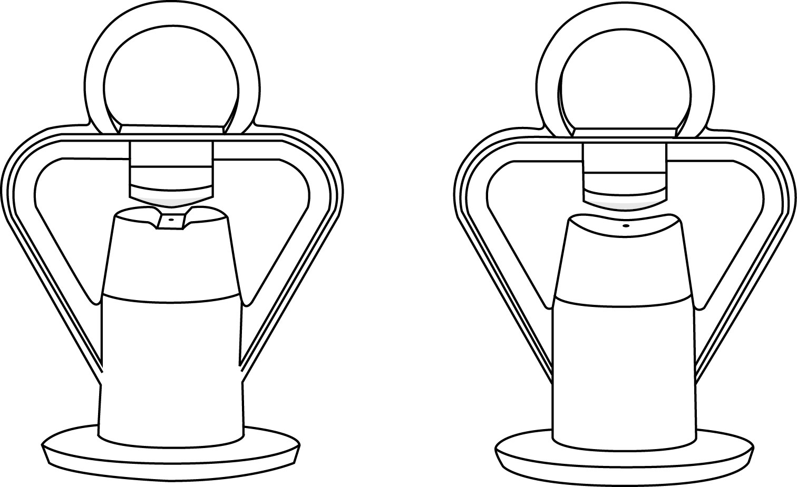
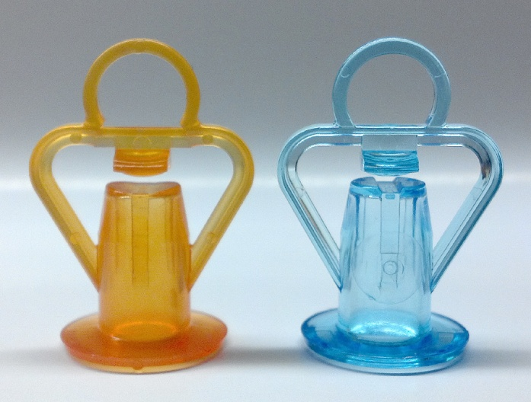
Misty Fast Jet Detail
Misty Fast
MM10
Jet has been modified for Misty Fast – improves output
Recommended 8 Lpm flow rate for optimal performance
Misty Fast jet is orange; Misty Max 10 jet is blue
Notes:
Have them split into teams and write down all the differences they see. This is not part of the quiz totals, but designed

Slide 26
What the differences mean
Ability to use the Misty Fast while lying in the beach chair position
Swivel Mouthpiece
Reduction in treatment time
Air Entrainment Port
Modified Jet Design

Slide 27
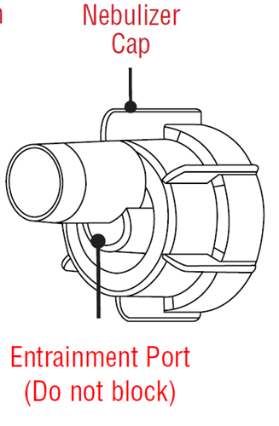
What the differences mean
Not intended for use:
In line with a circuit
Outside of the hospital
In conjunction with high flow treatment

Slide 28
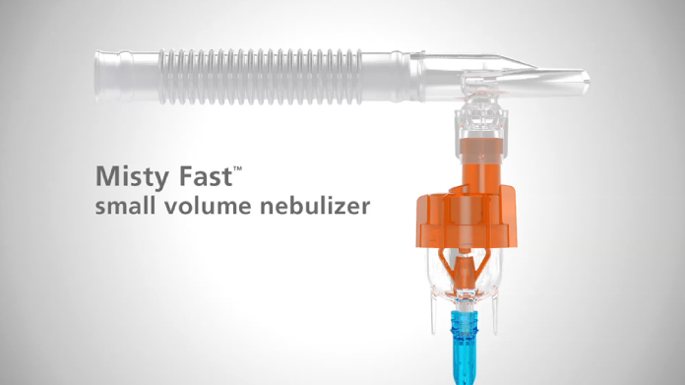
Watch the Misty Fast in Action
www.carefusion.com/mistyfast
Notes:
What will the audience be able to do after this training is complete? Briefly describe each objective how the audience will benefit from this presentation.

Slide 29
AirLife Misty Fast small volume nebulizer
Now with 15 languages!
M Max PN | M Fast PN | Neb | Tee adapter | O2 tubing | Mouth piece | Flex tube | Filter | Ped Mask | Adult Mask
2430 |  | X
2431 | FN2431 | X | M/M
2434 | FN2434 | X | M/M | 7 | X
2435 |  | X | M/F | 7 | X | X
2437 |  | X | M/M |  | X
2438 | FN2438 | X | M/M | 7 | X | X
2439 | FN2439 | X | M/M | 14 | X | X
2442 |  | X | M/M
2445 | FN2445 | X | M/M | 7-UC | X
2446 | FN2446 | X | M/M | 7-UC | X | X
2447 |  | X | VLVDTEE | 7
2450 |  | X | “Y” | 7 | X | X | X
2443 |  | X |  |  |  |  |  | X
2444 | FN2444 | X |  | 7 |  |  |  | X
2440 |  | X |  |  |  |  |  | Elephant
2455 | FN2455 | X |  | 7 |  |  |  | Elephant
2432 |  | X |  |  |  |  |  |  | X
2433 | FN2433 | X |  | 7 |  |  |  |  | X

Slide 30
AirLife Medication Delivery Products
Quiz 2
Name two of the physical differences between Misty Max 10 and Misty Fast
Air entrainment port, Swivel mouthpiece with built-in Tee, Modified Jet Design, Jet stems - different sized openings
How does Misty Fast work, compared to Misty Max ?
Entrainment port increases pressure & amount of drug nebulised
When can Misty Fast not be used? Name 2 scenarios
With vent circuit & at home
A customer wants to convert Misty Max cat#s 002438, 002439 and 002445 to Misty Fast. What Misty Fast codes should they order?
same with FN at start

Slide 31
Activity hands on set up neb flow meter, saline open kits use them

Slide 32
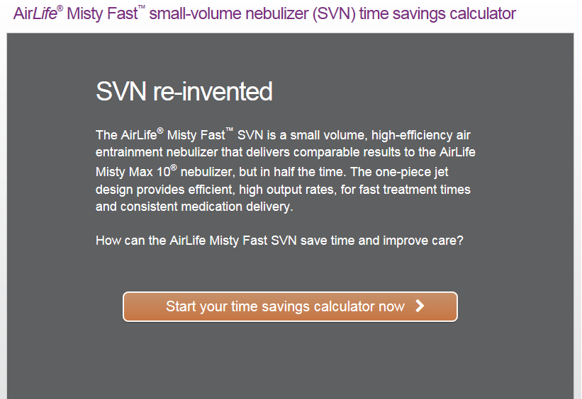
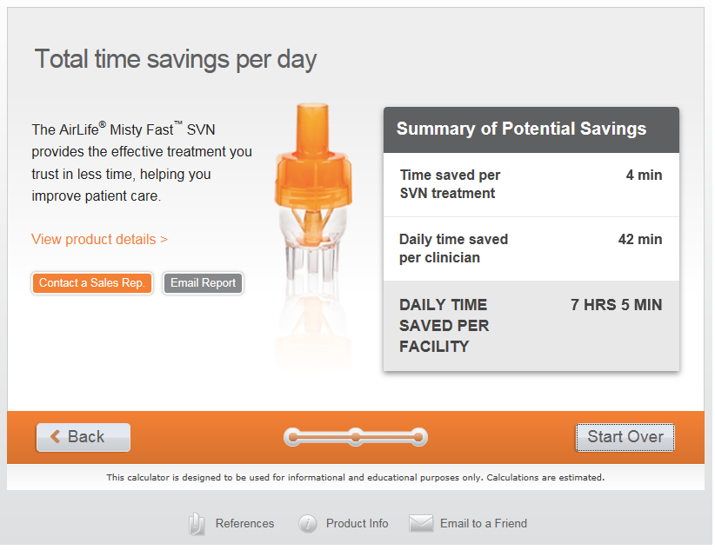
Why should a customer convert to Misty Fast?
Time Savings = Cost Savings
www.carefusion.com/mistyfast

Slide 33
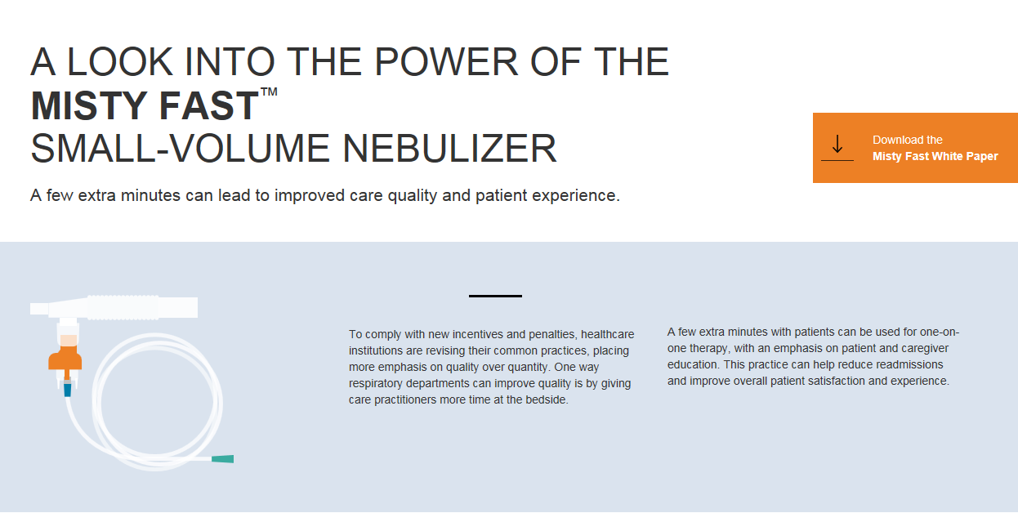
Misty Fast Landing Page
http://staging.interactive.columnfivemedia.com/carefusion/misty-fast/

Slide 34
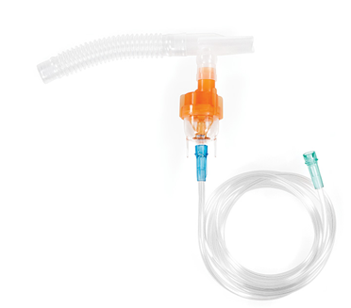
Misty Fast Sales Tools
Sales Tools Available
Brochure
Time savings calculator
Animation Video
Customer Messaging Presentation (Whitepaper executive summary)
Additional Resources
Tech bulletins
Whitepaper

Slide 35
AirLife Medication Delivery Products
Quiz 3
What is the primary benefit of Misty Fast to a customer?
  reduced treatment time
Name at least 3 ways converting to Misty Fast has benefited customers? Don’t need specific numbers?
more time back, improved workflows, reduced AFM (cost )
What is the most important resource you can use to help with conversions?
Whitepaper?... Int = Cost calc

Slide 36
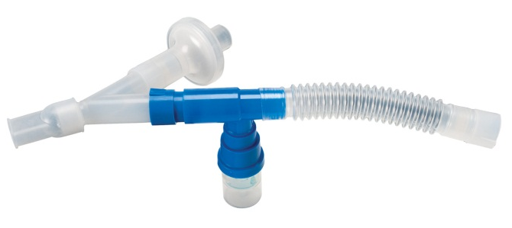
Medication Delivery Products
AirLife filtered nebulizer system*
Only product available that has been tested with tested with the drug, Pentamidine
Pentamidine is used to treat PCP, a very serious form of pneumonia commonly found in patients with AIDS
Target Price: $5.80 / unit
P/N | Description | Packaging
124030EU | AirLife filtered nebulizer system | 20 / Case
* Formerly known as Respirgard II neb system

Slide 37
Appendix

Slide 38
Medication Nebulizers
Small Volume Nebulizers Competitive Overview

Slide 39
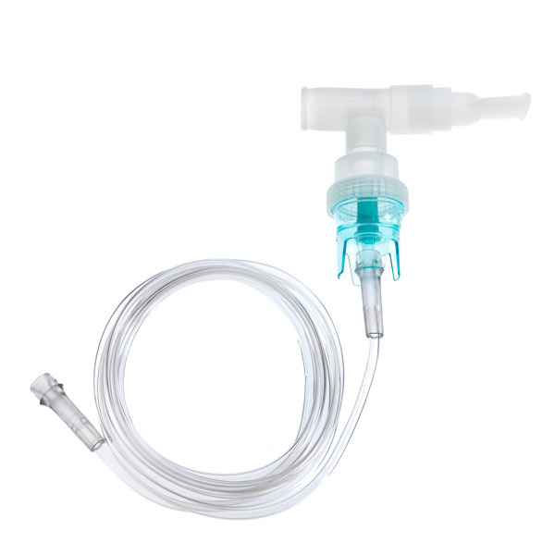
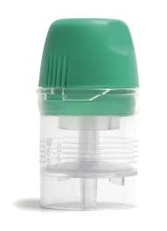
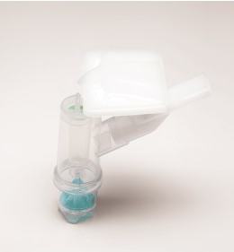
Standard SVN Competition
Hudson
Micromist
Intersurgical
Cirrus 2
Salter
Nebutech

Slide 40
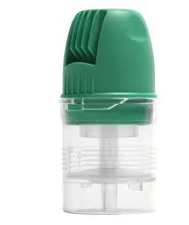
Small Volume Nebulizer - Competition
Intersurgical
Cirrus 2
  Basic SVN
  ASP: $0.74 chamber only
  ASP: $1.17 with Mask
  Strong on Contract
  Multiple kit configurations
    High-Efficiency Option (Hot top)
    ASP: $1.50
  Handheld use
  Inline use
  Various accessories

Slide 41
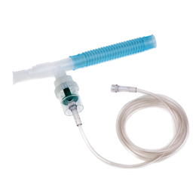
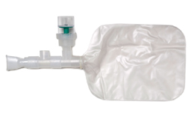
Small Volume Nebulizer - Competition
Teleflex Micro Mist
Micro-Mist SVN (Teleflex)
  Basic SVN
  ASP: $0.78 chamber only
  ASP: $1.22 with Mask
  Strong on Contract
  Multiple kit configurations
    High-Efficiency Option (Aero-Tee)
    ASP: $2.36
  Handheld use
  Inline use
  Various accessories
Aero-Tee

Slide 42
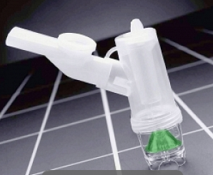
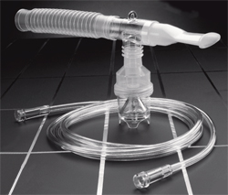
Small Volume Nebulizer - Competition
Salter
Nebutech (Salter)
  Basic SVN
  ASP: $0.61 chamber only
  ASP: $1.10 with mask
  Some contract positions
8900-Series (Salter)
  Basic SVN
  ASP: $0.94 (expensive)
  Minimal GPO contract positions
  Salter focuses on homecare market
NebuTech
8900-series

Slide 43
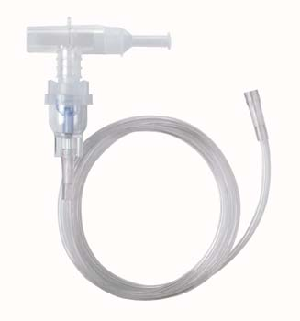
Small Volume Nebulizer - Competition
West Med – Vix One
Vix-One (Westmed)
  Basic SVN
  ASP: $1.00
  Minimal contract positions
Vix-One

Slide 44
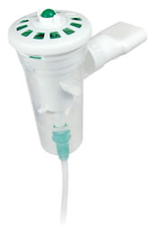
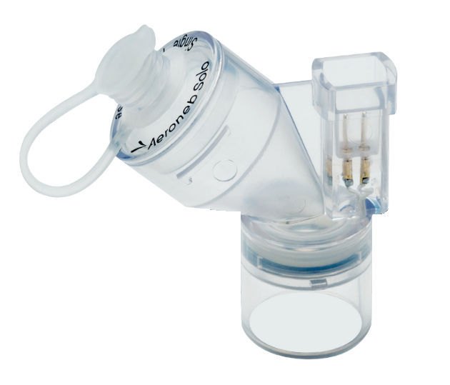
High Efficiency Nebulizers
AeroEclipse
Breath Actuated Nebulizer (BAN)
AeroNeb Nebulizer

Slide 45
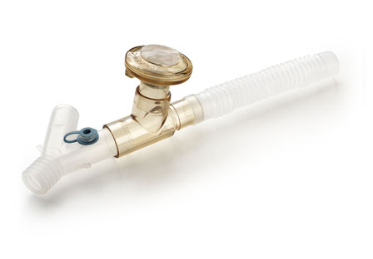
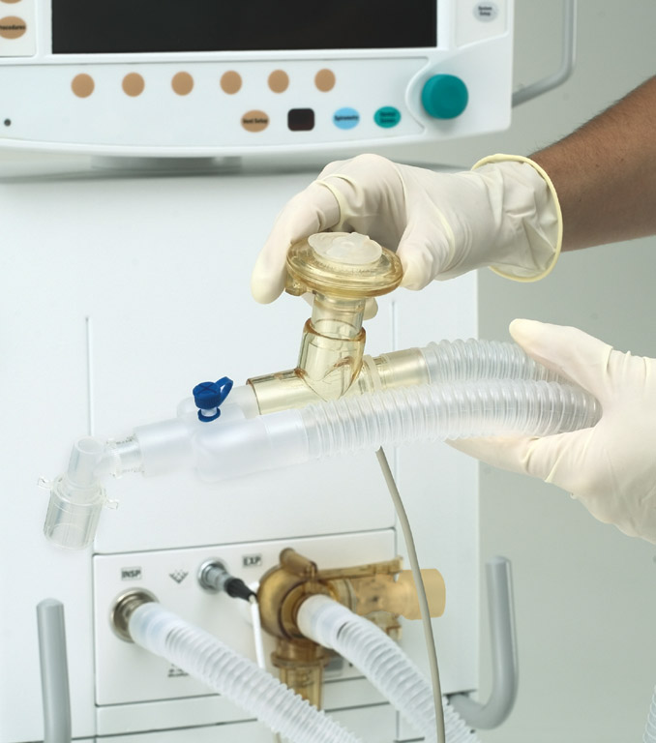
Aeroneb®
Advanced medication delivery
  Built intoventilator
  Reusable & autoclavable
  Efficient delivery
    2.4 micron size (MMAD)
    >80% drug less than 5 microns
  Connects directly into the ventilator
  Controlled via the ventilator
    Gas Module is turned off during nebulizer treatment
Tidy up

Slide 46

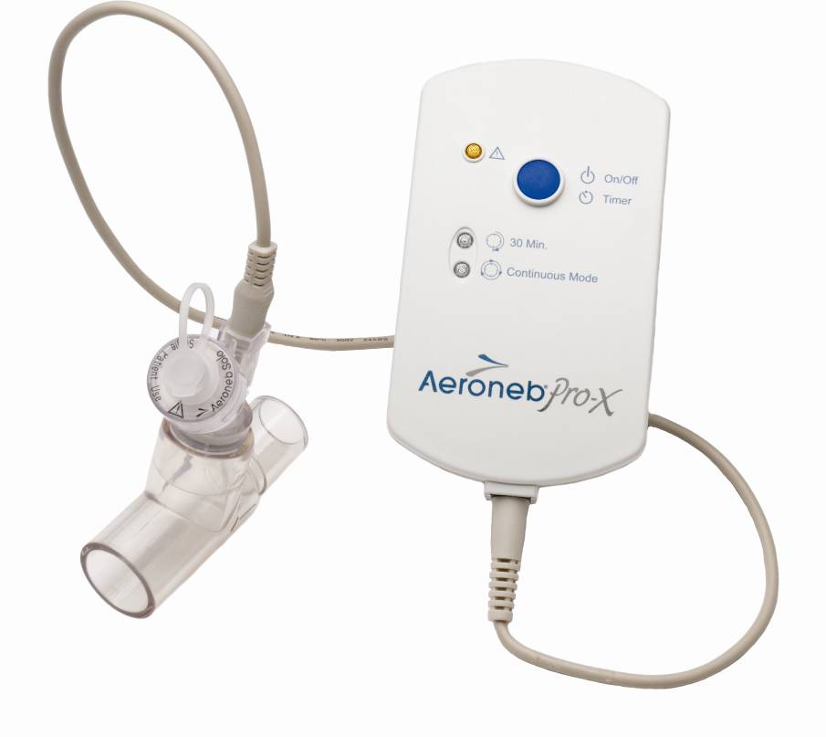
Product line extension of the Aeroneb® Pro nebulizer
Provides the user with the choice of a disposable or reusable product – therefore does not replace the Aeroneb® Pro

Slide 47
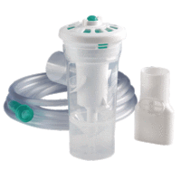
Small Volume Nebulizer - Competition
AeroEclipse (Monaghan)
Breath-Actuated Technology
    Nebulizes only during inspiration
    Patient receives more medication
    Reduces caregiver exposure
    Lengthens treatment time (same dose)
    Expensive = $5.00 ASP (US) vs. $0.80 – $1.20 SVN
    Has two modes: “BAN” & “Continuous”
        Use with mask = continuous mode only

Slide 48
Volume Incentive Spirometers (VIS)

Slide 49
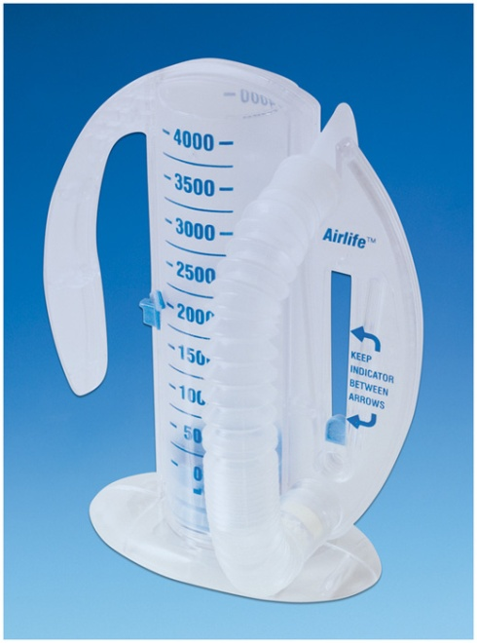
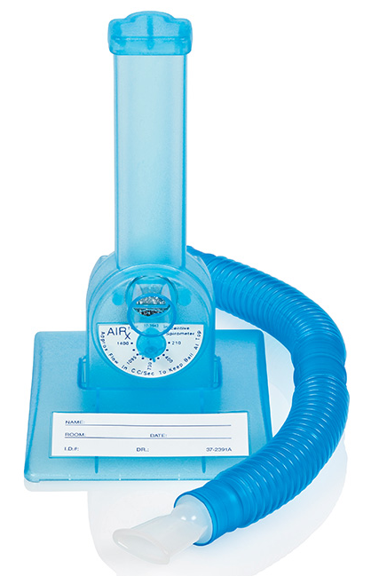
Lung Management Products
Vyaire Incentive Spirometers
An incentive spirometer is used to examine the health of your lungs by measuring inspiratory volume. This means that an incentive spirometer measures how well you are filling your lungs with each breath.
Volumetric Incentive Spirometer
Air_{x} Flow
Incentive Spirometer
001902A
001900

Slide 50
Lung Management Products
Vyaire Incentive Spirometers
Incentive Spirometer Options
  Flow (4%) & Volume (96%)
  One-way valve and w/o one-way valve (82%)
  Pediatric w/ colorful targets
P/N | Description | Pckg
001900 | AirLife Air-X Flow IS | 20/case
001902A | AirLife Volume IS, 4000 mL | 12/case
001904A | AirLife Volume IS, 2500 mL | 12/case

Slide 51
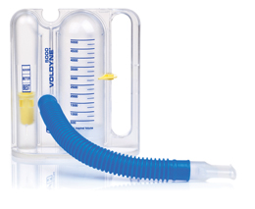
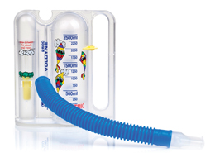
Lung Management Products
Incentive Spirometer – Competition
Voldyne (Teleflex)
  Options: 5000 mL, 2500 mL and Ped 2500 mL
  Does not include one-way valve

Slide 52
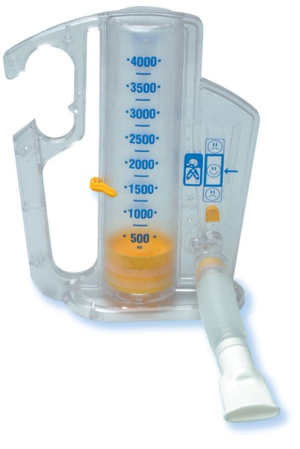
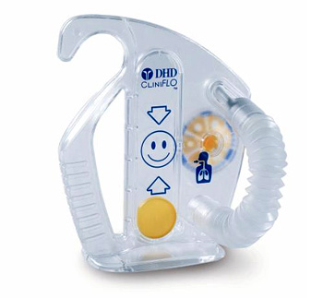
Lung Management Products
Incentive Spirometer – Competition
Coach 2/CliniFLO (Smith’s Medical)
  Offer both with and w/o one-way valve
  O2 connection for supplemental oxygen deliv
  CliniFlo for low flow applications
Smith’s Coach 2
Smith’s CliniFLO IS

Slide 53
Questions
Thank you!

