Slide 1
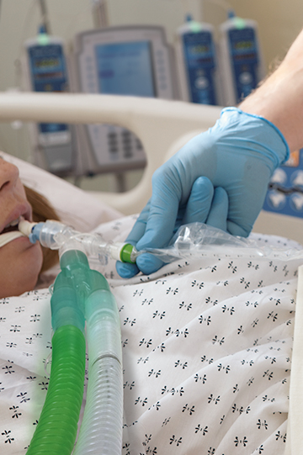
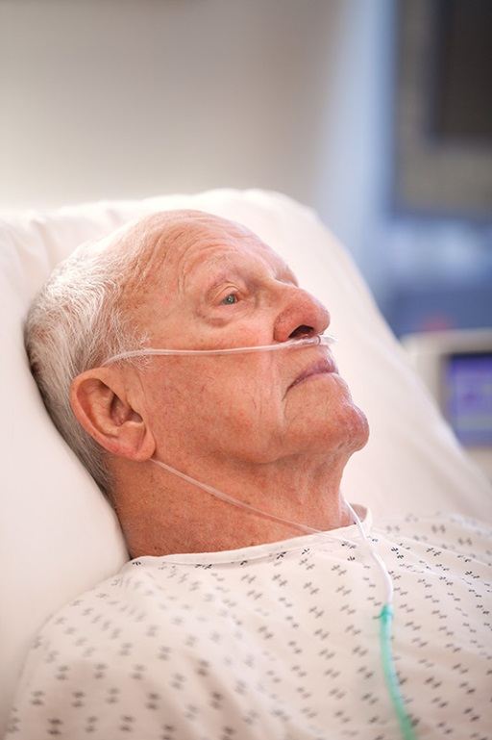
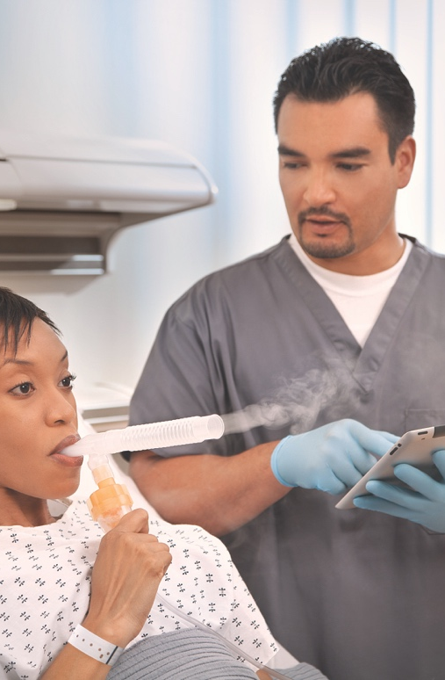
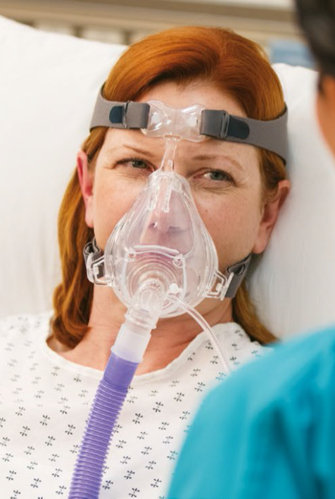
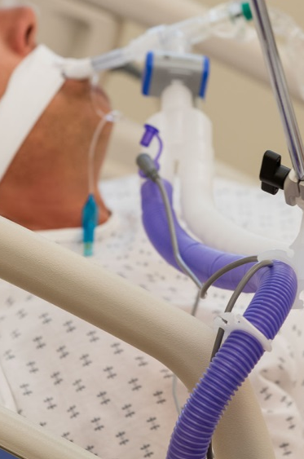
Oxygen Therapy

Slide 2
Oxygen Cannulas

Slide 3
Agenda
Focus on what do we have – what is coming soon:
  Cannulas
  Medium Conc Masks
  High Conc / 3 in 1
  Venturi
  ETCO2

Slide 4
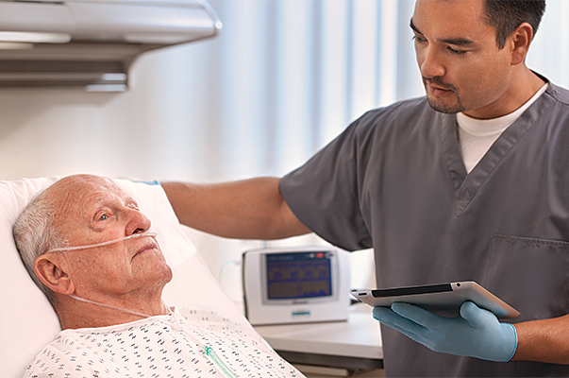
Nasal Cannula
Used for low-medium concentrations of O2
Simple
Can use continuously with meals and activity
Flow rates in excess of 4L cause drying and irritation
Depth and rate of breathing affect amount of O2 reaching lungs
adults  6 LPM
infants/toddlers  2 LPM
children  3 LPM
FIO₂ is not affected by mouth breathing
The Cannula Provides:
1L O2 = FIO2 4%
6 L O2= FiO2 24%
Room air Contains 21% Oxygen, therefore:
1lt O2 = FIO2 25%
6L O2 = FiO2 45%

Slide 5
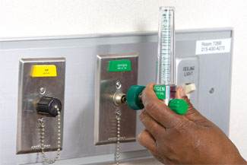
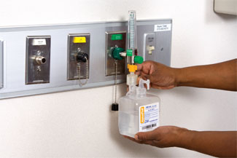
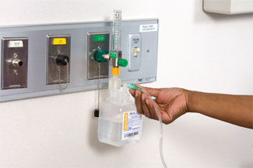
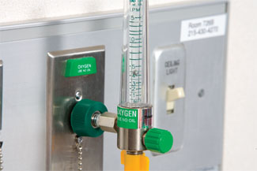
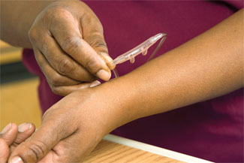
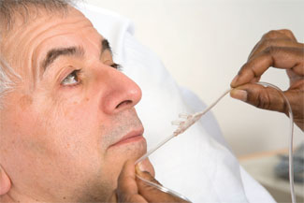
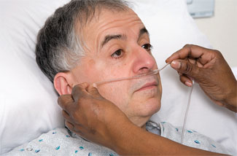
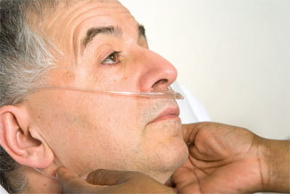
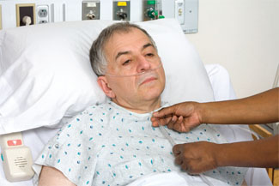
Utilising Nasal Cannula
Insert flowmeter into wall outlet
If using a high O2 flow, attach humidifier
Attach oxygen tubing to humidifier or direct to flowmeter
Turn on the oxygen at the prescribed rate
Ensure the oxygen is flowing through the tubing
Hold nasal cannula in proper position with prongs curving downward
Place cannula prongs into nares
Wrap tubing over and behind ears
Adjust plastic slide under chin until cannula fits snugly

Slide 6
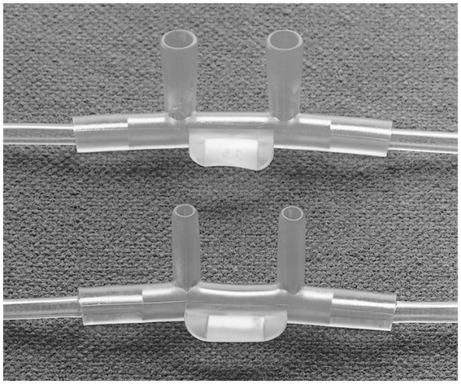
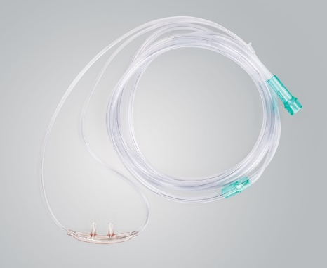
Standard & Cushion O₂ Cannulas
Available in a variety of sizes, lengths of oxygen tubing
  All cannulas come with crush-resistant tubing
Two top-selling categories: Standard & Cushion cannulas
  Standard available in flared tip and non-flared tip
  Cushion has a softer nosepiece
“Lead With”
  001320 or 001325
  002600
Code | Description
001320 | CANNULA CRVD FLAIR TIP W/7FT DISP 50/CS
001325 | CANNULA CRVD N-FLAIR TIP W/7FT
002600 | CANNULA NASAL SOFT W/7FT TUBING 50/CS

Slide 7
Standard Nasal Cannula Portfolio Expansion
Available Previously
Part Number | Description | # Languages
001309 | Nasal Cannula, Adult, curved flared tip, without tubing | 8
001320 | Nasal Cannula, Adult, Curved Flared Tip, 2.1M tubing | 8
001325 | Nasal Cannula, Adult, Curved Non- Flared Tip, 2.1M tubing | 8
Take Away
Additional Sizes 2.1 / 4.2 / 6.4m
U-connect in 2.1m
Moving to DEHP Free
More Languages
Available From January 17
SKU | Product description | Sold Now | # Languages
001309 | Nasal Oxygen Cannula Curved, Flared Tip, Over-The-Ear Style, no tubing | Y | 15
001311 | Nasal Oxygen Cannula Curved, Nonflared Tip, Over-The-Ear Style, no tubing | N | 15
001320 | Nasal Oxygen Cannula Curved, Flared Tip, with 2.1 m (7ft) Tubing | Y | 15
001365 | Nasal Oxygen Cannula Curved, Flared Tip, with 2.1m (7ft) with U-Connect tubing | N | 15
001321 | Nasal Oxygen Cannula Curved, Flared Tip, with 4.2 m (14ft) Tubing | N | 15
001322 | Nasal Oxygen Cannula Curved, Flared Tip, with 6.4m (21ft) Tubing | N | 15
001325 | Nasal Oxygen Cannula Curved, Nonflared Tip, with 2.1m (7ft) Tubing | Y | 15
001366 | Nasal Oxygen Cannula Curved, Nonflared Tip, with 2.1 m (7ft) with U-connect tubing | N | 15
001326 | Nasal Oxygen Cannula Curved, Nonflared Tip, with 4.2m (14ft) Tubing | N | 15
001327 | Nasal Oxygen Cannula Curved, Nonflared Tip, with 6.4m (21ft) Tubing | N | 15
001329 | Nasal Oxygen Cannula Curved, Nonflared Tip, with 15.2m (50ft) Tubing | N | 15

Slide 8
Cushion Nasal Cannula Portfolio Expansion
Available Previously
Part Number | Description | # Languages
002600 | Nasal Cannula, Adult, Soft, with 7ft / 2.1M tubing 50/cs | 8
002611 | Nasal Cannula, Neonate with 7ft / 2.1M tubing 50/cs | 8
002602 | Nasal Cannula, Peadiatric with 7ft / 2.1M tubing 50/cs | 8
Take Away
Infant Size
Additional Sizes 2.1 / 4.2 / 7.6 / 15m
U-connect in 2.1m / 4.2M (Adult)
Moving to DEHP free
More Languages
Available From January 17
SKU | Product description | Sold now | # Languages
002611 | Neonate Cushion Nasal Cannula, 2.1 m (7') Crush resistant Oxygen Tubing | Y | 15
002601 | Infant Cushion Nasal Cannula, 2.1 m (7') Crush Resistant Oxygen Tubing | N | 15
002602 | Pediatric Cushion Nasal Cannula, 2.1 m (7') Crush Resistant Oxygen Tubing | Y | 15
002662 | Pediatric Cushion Nasal Cannula, 2.1 m (7') No Tubing | N | 15
002692 | Pediatric Cushion Nasal Cannula, 2.1 m (7')with U-connect tubing | N | 15
002606 | Adult Cushion Nasal Cannula, 2.1 m (7') No Tubing | N | 15
002600 | Adult Cushion Nasal Cannula, 2.1 m (7') Crush Resistant Oxygen Tubing | Y | 15
002699 | Adult Cushion Nasal Cannula, 2.1 m (7') U-connect Crush Resistant Oxygen Tubing | N | 15
002600-14 | Adult Cushion Nasal Cannula, 4.2 m (14') Crush Resistant Oxygen Tubing | N | 15
002600-14U | Adult Cushion Nasal Cannula, 4.2 m (14') U-connect Crush Resistant Oxygen Tubing | N | 15
002600-25 | Adult Cushion Nasal Cannula, 7.6 m (25') Crush Resistant Oxygen Tubing | N | 15
002600-50 | Adult Cushion Nasal Cannula, 15 m (50') Crush Resistant Oxygen Tubing | N | 15
002600-4 | Adult Cushion Nasal Cannula, 1.2 m (4') Crush Resistant Oxygen Tubing | N | 15
002630-4 | Adult Cushion Nasal Cannula, Flared tip1.2 m (4') Crush Resistant Oxygen Tubing | N | 15

Slide 9
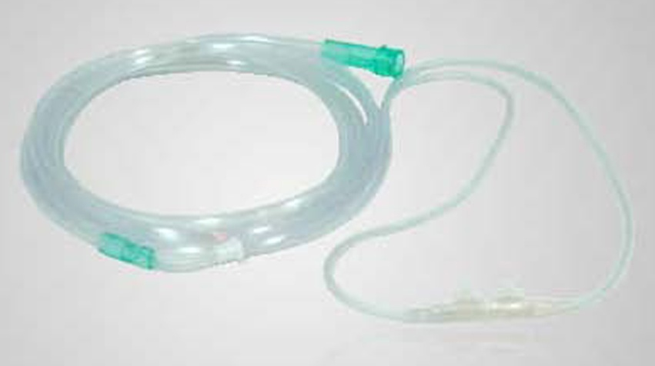
New Range!!
Available Jan 17
Soft Cushion Cannula
Features and Benefits
Softer material in the lariat helps prevent skin breakdown around the ears
Same nosepiece as cushion cannulas (002600)

Slide 10
Soft Cushion Nasal Cannula Portfolio Expansion
Not on the market now – All New for Vyaire!!
Take Away
Full Range of Sizes
U-connect in 2.1m / 4.2M (Adult)
Moving to DEHP Free
15 Languages
Available From January 17
SKU | Product description | # Languages
SFT2611 | Neonate Soft Nasal Cannula, 2.1 m (7') Crush resistant Oxygen Tubing | 15
SFT2601 | Infant Soft Nasal Cannula, 2.1 m (7') Crush Resistant Oxygen Tubing | 15
SFT2602 | Pediatric Soft Nasal Cannula, 2.1 m (7') Crush Resistant Oxygen Tubing | 15
SFT2692 | Pediatric Soft Nasal Cannula, 2.1 m (7')with U-connect tubing | 15
SFT2600 | Adult Soft Nasal Cannula, 2.1 m (7') Crush Resistant Oxygen Tubing | 15
SFT2606 | Adult Soft Nasal Cannula, 2.1 m (7') No tubing | 15
SFT2604 | Adult Soft Nasal Cannula, 1.2 m (4') Crush Resistant Oxygen Tubing | 15
SFT2699 | Adult Soft Nasal Cannula, 2.1 m (7') U-connect Crush Resistant Oxygen Tubing | 15
SFT2614 | Adult Soft Nasal Cannula, 4.2 m (14') Crush Resistant Oxygen Tubing | 15
SFT2614U | Adult Soft Nasal Cannula, 4.2 m (14') U-connect Crush Resistant Oxygen Tubing | 15
SFT2625 | Adult Soft Nasal Cannula, 7.6 m (25') Crush Resistant Oxygen Tubing | 15

Slide 11
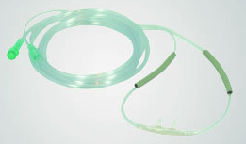
New Range!!
Available Jan 17
Cannulas w/Foam Ear Covers
Features and Benefits
Same cannulas as the cushion cannulas (e.g. 002600)
Pre-assembled covers slide smoothly on the headset tubing
Should help reduce skin irritation around the ears

Slide 12
Cushion Nasal Cannula Portfolio Expansion
Not on the market now – All New for Vyaire!!
Take Away
Full Range of Sizes
U-connect in 2.1m Pead & Adult
Moving to DEHP Free
15 Languages
Available From January 17
SKU | Product description | # Languages
FM2602 | Pediatric Cushion Nasal Cannula with Foam Ear Covers, 2.1 m (7') Crush Resistant Oxygen Tubing | 15
FM2692 | Pediatric Cushion Nasal Cannula with Foam Ear Covers, 2.1 m (7')with U-connect Crush Resistant Tubing | 15
FM2606 | Adult Cushion Nasal Cannula with Foam Ear Covers, 2.1 m (7') No Tubing | 15
FM2604 | Adult Cushion Nasal Cannula with Foam Ear Covers, 1.2 m (4') Crush Resistant Oxygen Tubing | 15
FM2600 | Adult Cushion Nasal Cannula with Foam Ear Covers, 2.1 m (7') Crush Resistant Oxygen Tubing | 15
FM2699 | Adult Cushion Nasal Cannula with Foam Ear Covers, 2.1 m (7') U-connect Crush Resistant Oxygen Tubing | 15
FM2614 | Adult Cushion Nasal Cannula with Foam Ear Covers, 4.2 m (14') Crush Resistant Oxygen Tubing | 15
FM2625 | Adult Cushion Nasal Cannula with Foam Ear Covers, 7.6 m (25') Crush Resistant Oxygen Tubing | 15
002016 | Foam Ear Covers for nasal cannulas | 15

Slide 13
Soft Cushion & Foam Cover Cannulas
Additional Notes:
Codes numbering convention:
  SFT26xx (replaced 00 with SFT)
  FM26xx (replaced 00 with FM)
Code | Description
SFT2600 | CANNULA SOFT ADULT W/7FT TB 50/CS
FM2600 | CANNULA W/COVR ADULT W/7FT TB 50/CS

Slide 14
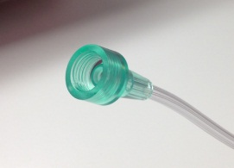
14-ft U/Connect-it Cannulas
Cannulas w/ 14-ft tubing and universal connector
  One for each style: Standard (001326U), Cushion (002600-14U), Soft Cushion (SFT2614U)
  A traditional gap for AirLife
AirLife ETCO2 cannula w/ 7-ft universal connector (2812M-10U)

Slide 15
Oxygen Masks

Slide 16
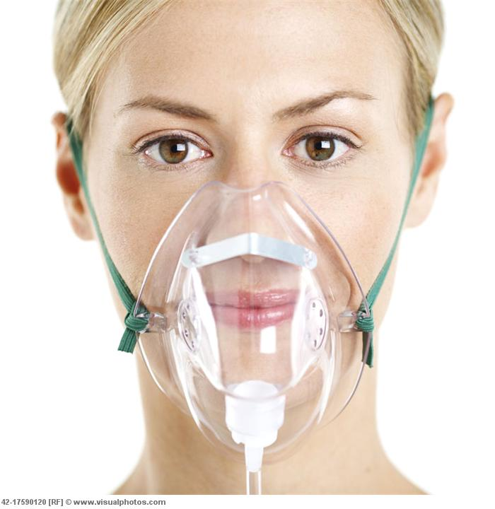
Simple Mask
Low to medium concentration of O2
Client exhales through ports on sides of mask
Should not be used for controlled O2 levels
O2 flow rate- 5 to 10L
Can cause skin breakdown; must remove to eat.
Inc Room Air:
1L O2=FIO2 35%
6L O2=FiO2 50%

Slide 17
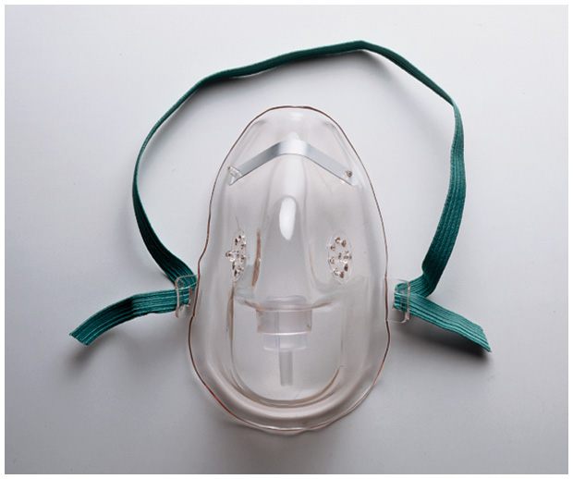
AirLife Oxygen Masks
AirLife “Simple” Mask
  Medium concentration rebreather mask (no valves, no reservoir bag)
  5-10 liters per minute*, 35%-50% FiO₂
  e.g. 001201
*AARC Clinical Practice Guideline; Respir Care 2002; 47(6):717-720)

Slide 18
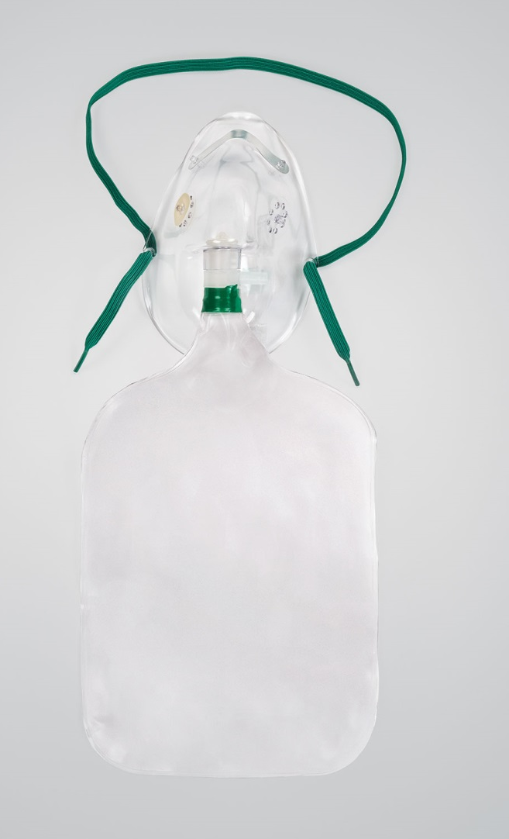
Partial Rebreather Mask
Consists of mask with exhalation ports and reservoir bag
Reservoir bag must remain inflated
O2 flow rate - 6 to 10L
FIO2= 40% - 70%
Client can inhale gas from mask, bag, exhalation ports
Poorly fitting; must remove to eat

Slide 19
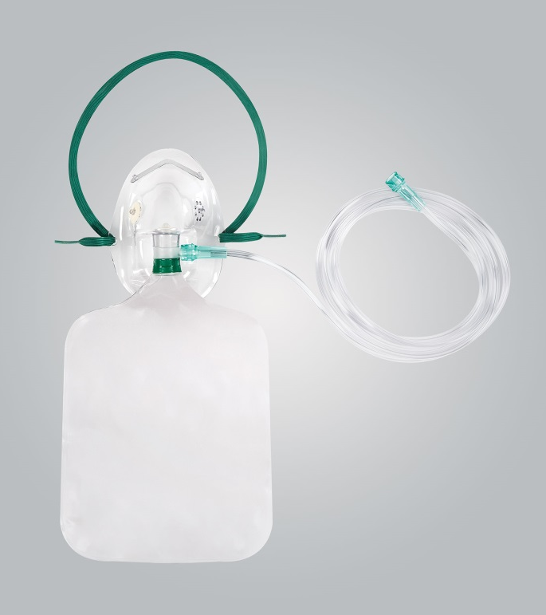
Non-Rebreathing Mask
Consists of mask, reservoir bag, 2 one-way valves at exhalation ports and bag
Client can only inhale from reservoir bag
Bag must remain inflated at all times
O2 flow rate- 10 to 15L
Fio2= 60 - 80%
Poorly fitting; must remove to eat

Slide 20
Oxygen Masks
AirLife Partial Rebreather Masks
  Simple mask with a reservoir bag
  Medium or high concentration
  6-10 liters per minute*, 40%-70% FiO₂
  e.g. 001205
AirLife Non-Rebreather Masks
  Includes reservoir bag and one-way valves
  High concentration
  Minimum flow of 10 liters per minute*, 60%-80% FiO₂
  e.g. 001203 – “3-in-1” mask
*AARC Clinical Practice Guideline; Respir Care 2002; 47(6):717-720)

Slide 21
Tracheostomy Collar/Mask
O2 flow rate 8 to 10L
Provides accurate FIO2
Provides good humidity; comfortable

Slide 22
Oxygen Mask Portfolio Expansion
SKU | Product description | New Product | # Languages
001263 | Pediatric Aerosol Mask, Vinyl, Under-the-Chin Style | No | 15
001261 | Pediatric Aerosol Mask, Vinyl, Short Style | No | 15
001264 | Pediatric Short Style Oxygen Mask, Vinyl, High concentration rebreather, mask only | Yes | 15
001206 | Adult Aerosol Mask, Vinyl, Under-the-Chin Style | No | 15
001207 | Adult high-concentration Mask, Vinyl, Under-the-Chin Style | Yes | 15
001200 | Adult Oxygen Mask Vinyl, Under-the-Chin Style, Medium Concentration Mask | No | 15
001202 | Adult Oxygen Mask Vinyl, Under-the-Chin Style, 3 in 1 Mask with Safety Vent | No | 15
001204 | Adult Oxygen Mask Vinyl, Under-the-Chin Style, High Concentration Rebreather Mask (No Valves) | Yes | 15
001220 | Face Tent Mask Vinyl | No | 15
001225 | Adult Tracheostomy Mask Vinyl | Yes | 15
001226 | Pediatric Tracheostomy Mask Vinyl | Yes | 15
001227 | Adult Tracheostomy Mask (Large) | No | 15
Take Away
Add High Concentration (with & without valves)
Add Adult & Pead Trachy Masks
Moving to DEHP Free next year
15 Languages

Slide 23
Oxygen Mask & Tubing Portfolio Expansion
SKU | Product description | New Product | # Languages
001262 | Pediatric Oxygen Mask Vinyl, Under the Chin Style, Medium Concentration Mask with 2.1m (7') Tubing | No | 15
001267 | Pediatric Oxygen Mask Vinyl, Under the Chin Style, High Concentration, Rebreather Mask (No Valves) with 2.1m (7') Tubing | No | 15
001268 | Pediatric Oxygen Mask Vinyl, Under the Chin Style, 3 in 1 Mask with Safety Vent and 2.1m (7') Tubing | No | 15
001269 | Pediatric Under the Chin Style Oxygen Mask, Vinyl, High concentration rebreather, with 2.1m (7') tubing | Yes | 15
001260 | Pediatric Oxygen Mask Vinyl, Short Style, Medium Concentration Mask with 2.1m (7')Tubing | No | 15
001265 | Pediatric Oxygen Mask Vinyl, Short Style, High Concentration, Rebreather Mask (No Valves) with 2.1m (7') Tubing | No | 15
001209 | Adult Aerosol Mask, Vinyl, Under-the-Chin Style With 1.5m (5') Corrugated tubing | Yes | 15
001208 | Adult Aerosol Mask, Vinyl, Under-the-Chin Style With 1.8m (6') Corrugated tubing | Yes | 15
001201 | Adult Oxygen Mask Vinyl, Under-the-Chin Style, Medium Concentration Mask with 2.1m (7') Tubing | No | 15
001361 | Adult Oxygen Mask Vinyl, Under-the-Chin Style, Medium Concentration Mask with 2.1m (7') U-connect Tubing | Yes | 15
001203 | Adult Oxygen Mask Vinyl, Under-the-Chin Style, 3 in 1 Mask with Safety Vent and 2.1m (7') Tubing | No | 15
001362 | Adult Oxygen Mask Vinyl, Under-the-Chin Style, 3 in 1 Mask with Safety Vent and 2.1m (7') U-connect Tubing | Yes | 15
001210 | Adult Oxygen Mask Vinyl, Under-the-Chin Style, 3 in 1 Mask without Safety Vent, with 2.1m (7') Tubing | No | 15
001211 | Adult, high-concentration, non-rebreather 3-in-1 with safety vent, 2.1m (7') O2 tubing | Yes | 15
001212 | Adult, high-concentration, non-rebreather 3-in-1, 2.1m (7') O2 tubing | Yes | 15
001205 | Adult Oxygen Mask Vinyl, Under-the-Chin Style, High Concentration Rebreather Mask (No Valves) with 2.1m (7') Tubing | No | 15
001222 | Adult Face tent Mask, Vinyl, with 1.5m (5') Corrugated tubing | Yes | 15
001221 | Adult Face tent Mask, Vinyl, with 1.8m (6') Corrugated tubing | Yes | 15
Take Away
More Pead / Adult / Aerosol / Face tent options
U-connect options
15 Languages

Slide 24
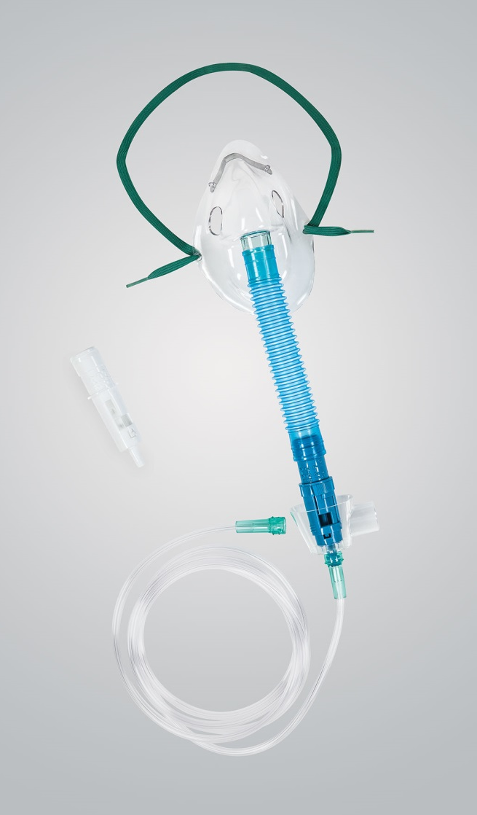
Venturi Mask
Most reliable and accurate method for delivering a precise O2 concentration
Consists of a mask with a jet
Excess gas leaves by exhalation ports
O2 flow rate 2 to 15L & Narrowed orifice
Fio2, 24%-60%
Can cause skin breakdown; must remove to eat

Slide 25
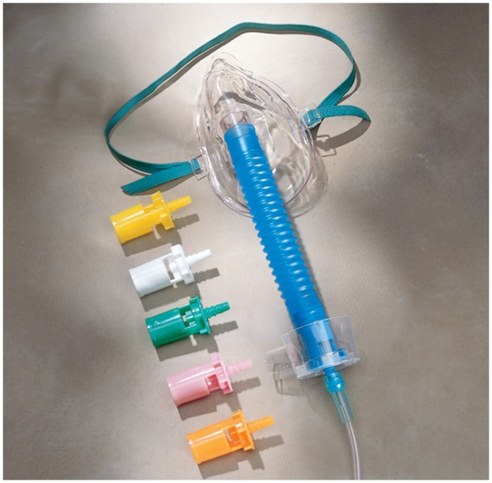
AirLife Venturi, Aerosol, Trach Masks
AirLife Venturi Masks
  Entrains oxygen with room air to achieve a
  specific FiO2
  Offered in two styles: diluter jets & dual dial
  “Lead With”: 001255
AirLife Aerosol Masks
  For medication delivery with small volume neb,
  aerosol treatment with large volume neb
AirLife Trach Masks
  For aerosol treatment direct to airway
Code | Description | US Sales
001240 | MASK AIR ENTRAIN ADULT 50/CS | $518K
001255 | MASK VENTURI DUAL DIAL ADULT 50/CS | $404K
001263 | MASK AEROSOL PED UNDER-CHIN 50/CS | $260k
001227 | MASK TRACHEOSTOMY ADULT 50/CS | $120k
Notes:
All masks (non-Southmedic) require minimum of 5 lpm
Venturi maks
-Two styles: dialed & individual nozzles
-Nozzles vary by color (differing FiO2 delivered)
-Room air entrained with O2 per the settings selected
3-in-1 masks can be used as a medium concentration (simple mask) & high concentration (non-rebreather or partial rebreather) mask

Slide 26
Oxygen Mask & Tubing Portfolio Expansion
SKU | Product description | New Product | # Languages
001250 | Peadiatric Venturi Style Mask Vinyl, Under-the-Chin Style with 15cm flextube, 6 diluter jets (24%, 28%, 31%, 35%, 40% and 50% oxygen concentrations), humidification hood and 2.1m (7') crush-resistant tubing | No | 15
001240 | Adult Venturi Style Mask Vinyl, Under-the-Chin Style with 15cm flextube, 6 diluter jets (24%, 28%, 31%, 35%, 40% and 50% oxygen concentrations), humidification hood and 2.1m (7') crush-resistant tubing | No | 15
001248 | Adult Venturi Style Tracheostomy Mask Vinyl, with 15cm flextube, 6 diluter jets (24%, 28%, 31%, 35%, 40% and 50% oxygen concentrations), humidification hood and 2.1m (7') crush-resistant tubing | No | 15
001363 | Adult Venturi Style Mask Vinyl, Under-the-Chin Style with15cm flextube, 6 diluter jets (24%, 28%, 31%, 35%, 40% and 50% oxygen concentrations), humidification hood and 2.1m (7') U-connnect tubing | Yes | 15
001241 | Adult Venturi Style Mask Vinyl, Under-the-Chin Style, 24% oxygen concentration, humidification hood and 2.1m (7') crush-resistant tubing | Yes | 15
001242 | Adult Venturi Style Mask Vinyl, Under-the-Chin Style, 28% oxygen concentration, humidification hood and 2.1m (7') crush-resistant tubing | No | 15
001244 | Adult Venturi Style Mask Vinyl, Under-the-Chin Style, 35% oxygen concentration, humidification hood and 2.1m (7') crush-resistant tubing | No | 15
001245 | Adult Venturi Style Mask Vinyl, Under-the-Chin Style, 40% oxygen concentrations humidification hood and 2.1m (7') crush-resistant tubing | No | 15
001255 | Adult Dual Dial Venturi Style Mask With 15 cm Flextube, Color Coded Low and Medium Concentration Dials, High Humidity Adapter / Humidification Hood, 2.1m (7') Crush Resistant Oxygen Tubing | No | 15
001259 | Pediatric Dual Dial Venturi Style Mask With 15 cm Flextube, Color Coded Low and Medium Concentration Dials, High Humidity Adapter / Humidification Hood, 2.1m (7') Crush Resistant Oxygen Tubing | No | 15
001247 | Venturi Style Tracheostomy Tee with 6"/15cm flextube, 6 diluter jets (24%, 28%, 31%, 35%, 40% and 50% oxygen concentrations), humidification hood, 7ft/2.1M crush-resistant tubing, 50/cs | No | 15
Take Away
Added Adult multi Venturi kit with U-connect tubing
Added 24% Venturi Mask with tubing
15 Languages

Slide 27
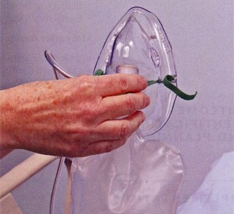
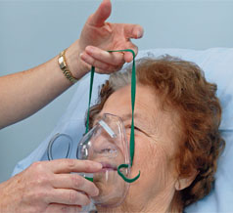
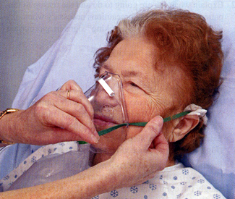
Utilising a Face Mask
Start as per Nasal Cannula
For a mask with a reservoir, be sure to allow oxygen to fill bag
Place mask on face, applying from the nose and over the chin
Adjust the metal rim over the nose and contour the mask to the face

Slide 28
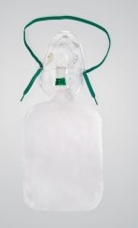

O2 range by product
Type of system | Nasal Cannula | Simple Oxygen Mask | Venturi Mask | Partial Re-breather | Non Rebreather
Type of system | Low Flow | Low Flow | High Flow | Med Flow | High Flow
Respiratory Flow Rate (L/min) | 1 – 6 | 5 – 10 | 2 – 15 | 6 - 10 | 10 - 15
Oxygen Range % | 24 – 44 | 35 – 50 | 24 – 60 | 40 – 70 | 60 - 80
Accurate delivery of FiO2 | No | No | Yes | No | No
Ability to humidify | > 4 lpm | N | N | N | N

Slide 29
What the Doctor Ordered….
Precisely 30% FiO2?
2) 30% FiO2 humidified
3) 40% FiO2 increasing if needed
4) 40% FiO2 but patient won’t tolerate a mask
5) 80% FiO2
Venturi
Nasal Cannula
Venturi or Rebreather
Nasal Cannula
Non Rebreather

Slide 30
ETCO₂ Monitoring

Slide 31
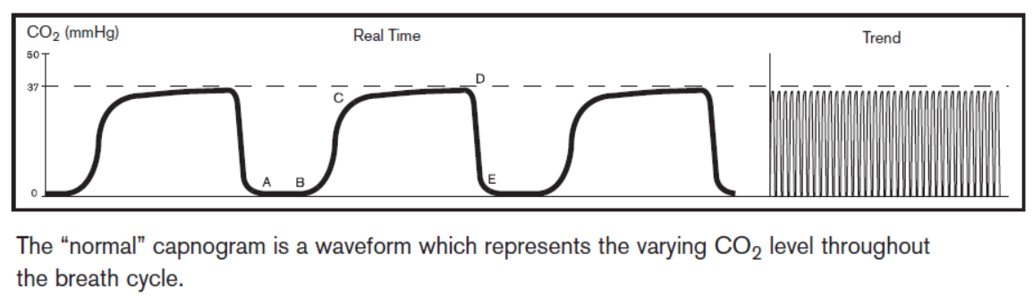
What is EtCO₂?
The CO₂ concentration at the end of expiration
Provides a clinical estimate of the PaCO₂
Breath by breath assessment of ventilation

Slide 32
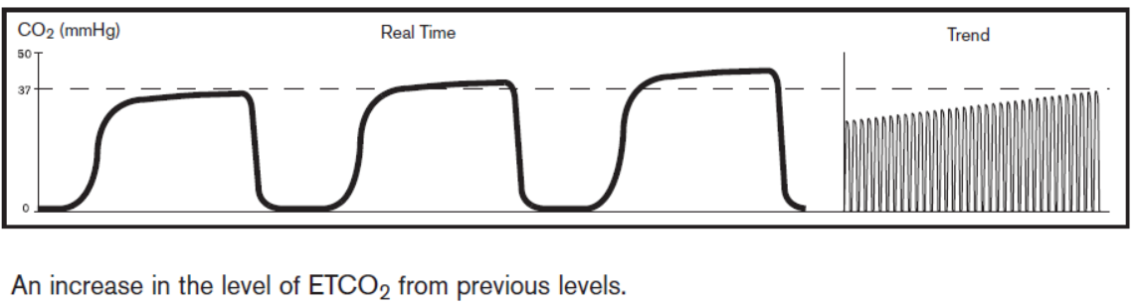
Why EtCO₂?
Oxygen & carbon dioxide levels determine how damaged or ill the body is
Allow for clinician intervention

Slide 33
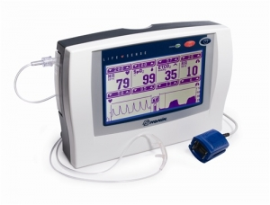

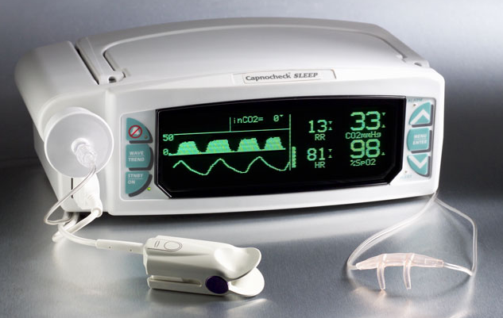
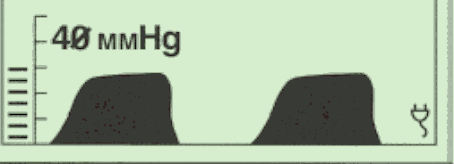
What is Capnography?
Definitions
Capnography = Contains both a numerical value of ETCO₂ and a waveform of the concentration of CO₂ present in the airway
Capnometer = Provides only a numerical measurement
of carbon dioxide (35-45 mmHg is normal CO2 value in your body – normal readings are 30-43 mmHg)
Capnogram = Is a waveform display of carbon dioxide over time (should look square)
Notes:
CO2 monitor on left is a LifeSense by Nonin ~$2,500
CO2 monitor on the right is a CapnoCheck Plus by BCI ~$3,400
Normal value of CO2 in your body is 35 to 45 mmHg which is equal to 4.7% to 6.0% CO2. Normal ETCO2 readings are 30-43mmHg, 4.0 to 5.7kPa, 4.0 – 5.6%
mmHG = millimeter of mercury (measurement of pressure)

Slide 34
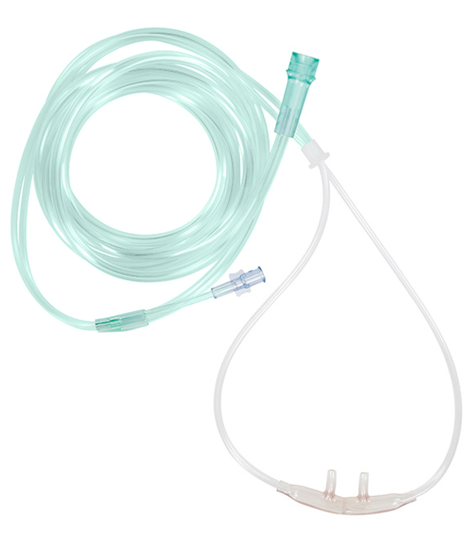
What is Capnography?
Mainstream vs Sidestream Capnography Devices
Mainstream devices measure respiratory gas directly from the airway, with the sensor located on the airway adapter at the hub of the endotracheal tube.
Sidestream devices measure respiratory gas via nasal or nasal/oral cannula by aspirating a small sample from the exhaled breath through the cannula tubing to a sensor located inside the monitor.
Our AirLife ETCO₂ cannulas are to be used with Sidestream monitoring devices.

Slide 35
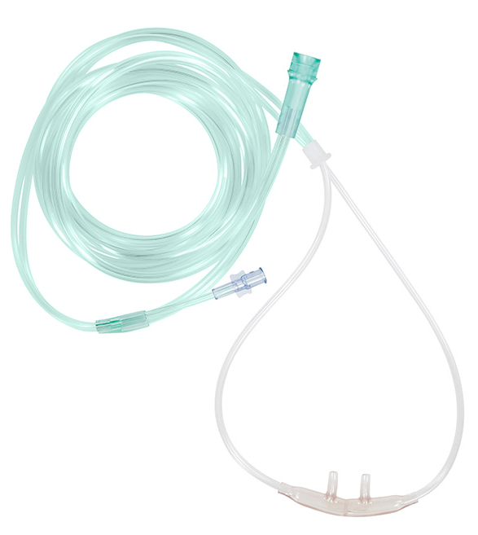
AirLife ETCO₂ Sampling Cannula
Why is it used?
Accurate information about the rate and rhythm of respiration can be obtained by sampling CO₂ using sampling nasal cannulas from patients under conscious sedation.
Pulse oximetry is a peripheral measure of oxygenation, but it does not deliver information on the adequacy of ventilation.
  It gives no immediate detection of hypoventilation, apnea, or airway obstruction
Capnography is able to provide advance warning because it monitors the respiratory effort and respiratory efficiency.

Slide 36
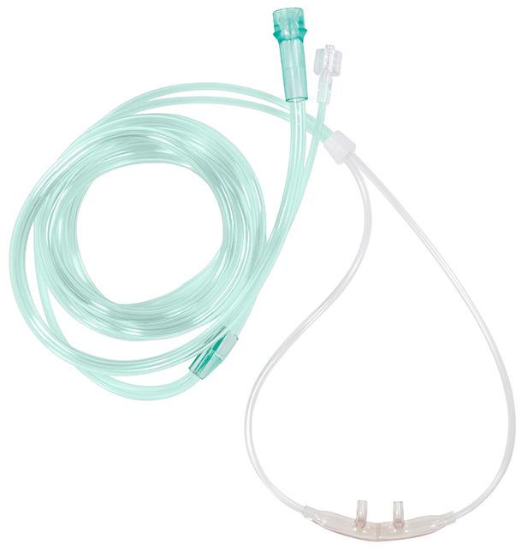
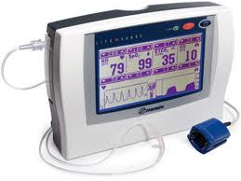
AirLife ETCO₂ Sampling Cannula
How is it used?
The oxygen tubing is connected to the gas source while the gas sampling line is connected to a capnography monitor.
The cannula nose piece is divided so that one side allows for oxygen inhalation while the other side allows for end-tidal CO₂ sampling.

Slide 37
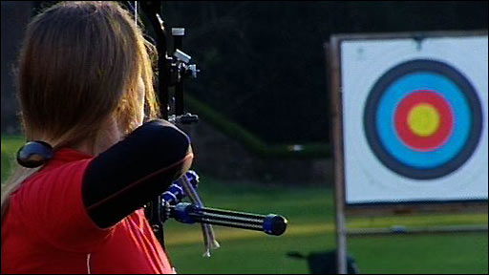
AirLife ETCO2 Cannulas: Departments
Who are your targets?
“A number of papers presented at the 2011 AARC Congress demonstrated that more RC departments are getting proactive by monitoring patients with capnography directed at preventing adverse events.”¹
Critical Care Nursing
Post-Op Nursing
Materials Management
Surgery Centers
Anesthesia Tech.
¹ RT Magazine, Respiratory Care Departments Take a Lead Role in Postoperative Monitoring, Spratt, G. and Lain, D., Pg. 10, July 2012.

Slide 38
AirLife ETCO₂ Sampling Cannula
Design
AirLife cushion cannula – has a permanent barrier in the nose piece separating the nasal prongs
Is a double tube design – one tube delivers oxygen from the source while the second tube connects to a ETCO₂ monitor (capnography)
Green oxygen tubing for easy identification
ETCO₂ sampling line contains either a male or female Luer-Lok™ connector
Code | Description
2812M-10 | ETCO2 CANNULA 7', ADULT, MALE
2812F-10 | ETC02 CANNULA 7‘, ADULT, FEMALE

Slide 39
New ETCO2 Cannulas
SKU | Product description | # Languages
2802M-10 | Pediatric ETCO2 Cannula with 2.1m (7') O2 tubing, 2.1m (7') CO2 tubing With male luer connectors | 15
2811M-10 | Adult ETCO2 Cannula with 2.1m (7') O2 tubing, 2.1m (7') CO2 tubing With male luer connectors | 15
2812M-10 | Adult ETCO2 Cannula with 2.1m (7') O2 tubing, 2.1m (7') CO2 tubing With male luer connectors | 15
2802F-10 | Pediatric with 7' O2 tubing, 7' CO2 tubing With female luer connectors | 15
2811F-10 | Adult ETCO2 Cannula with 7' O2 tubing, 2" CO2 tubing With female luer connectors | 15
2812F-10 | Adult ETCO2 Cannula with 7' O2 tubing, 7' CO2 tubing With female luer connectors | 15
28M2F | ETCO2 sampling line 10', male-to-male luer connectors | 15
28M2M | ETCO2 sampling line 10', male-to-female luer connectors | 15

Slide 40
AirLife ETCO2 Cannulas: Compatibility
Which manufacturers’ monitors will accept our ETCO₂ cannulas?*
BCi
Datascope
Datex-Ohmeda
GE Marquette
Invivo Research
Philips Healthcare
Physio-control
Nonin
As long as the monitor accepts a male or female Luer-Lok connection, the AirLife ETCO₂ Sampling Cannula can be used.
*Partial list; Isn’t necessarily compatible with all styles/products offered by these vendor

Slide 41
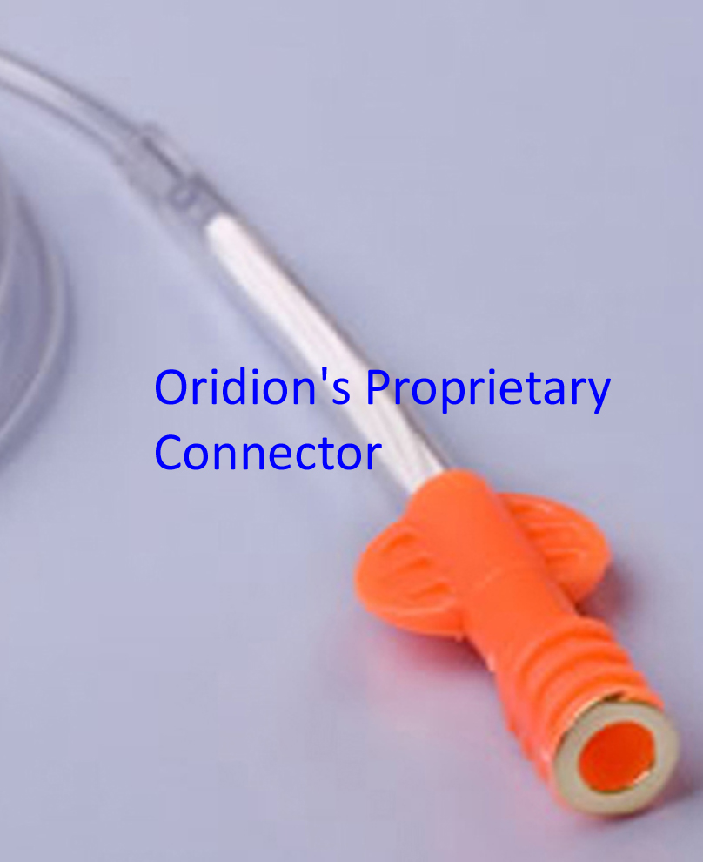
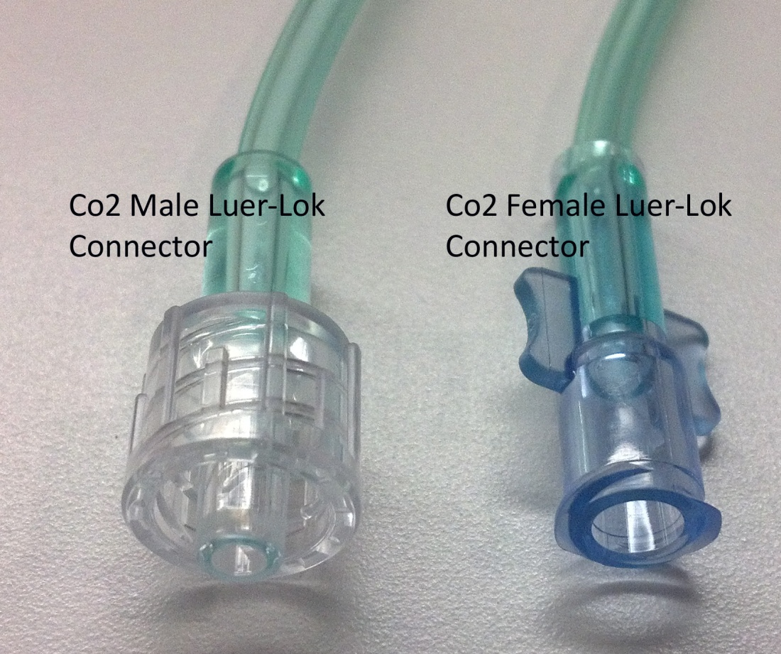
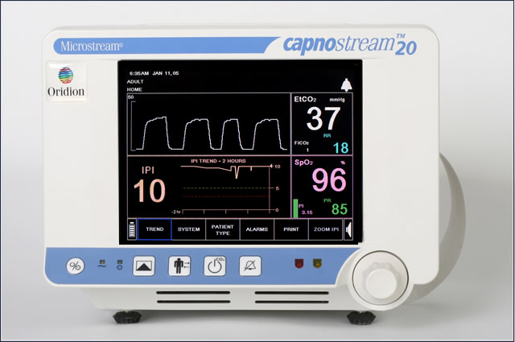
AirLife ETCO2 Cannulas: Compatibility
Which monitors won’t accept our ETCO₂ cannulas?
Oridion monitors have a proprietary fitting for the ETCO₂ cannula; Oridion monitors will only accept an Oridion cannula
(e.g. Capnostream, Microstream, Microcap, Omnistream, Surestream, FilterLine)

Slide 42
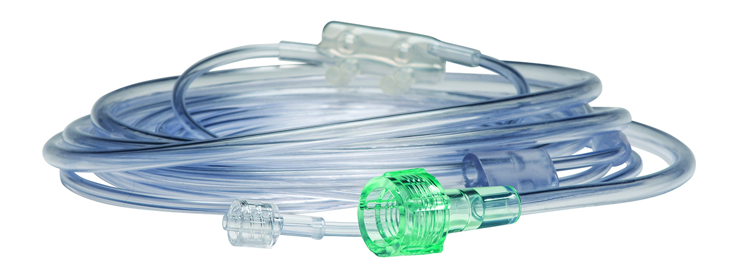
CARESCAPE™ ETCO₂ Cannulas:
Private label manufactured by Uno Medical
O₂ delivered & CO₂ sampled from independent pathways/tubes
Available in adult and pediatric sizes
Compatibility tested with GE CARESCAPE respiratory modules
End of Life
©2014 CareFusion Corporation of one of its subsidiaries. All rights reserved. GE CARESCAPE is a registered trademark of the General Electric Co.

Slide 43
Questions?

