Slide 1
ETCO2
Region Meetings 2023

Slide 2

Capnography Definition
Non-invasive measurement of carbon dioxide (CO2) exhaled with every breath.
Known as ETCO2 or End tidal CO2
Utilized in Multiple Settings
OR - PACU Transport
GI IR
ICU Progressive Care
ED Cardiology
Labor Delivery EMS
Med-Surg Cath Lab
Important because it can indicate the interventions the clinician can do like adjust medications or ventilator settings
Notes:
Is an excellent marker for how much CO2 is in a pts blood.
Direct relationship between cardiac output and capnography, so if there is a decrease in cardiac output there will be a decrease in CO2 levels.
Important because it can indicate the interventions the anesthesiologist can do like make adjustments to ventilator or medication

Slide 3
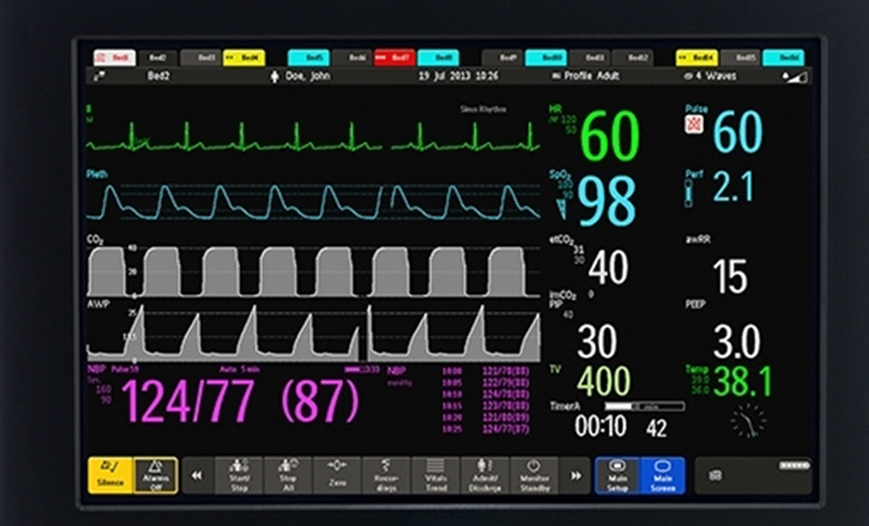
Clinical Benefits
Setup is quick - fast - easy
Non-invasive
Immediate airway assessment
Catch problems early
Fastest indicator of respiratory compromise
Promotes confidence
All patients - newborns to adult
Portable
Safe quality care
Continuous ETCO2 waveform and numerical value of 40
Goal – Minimize Incidence of Respiratory Compromise

Slide 4
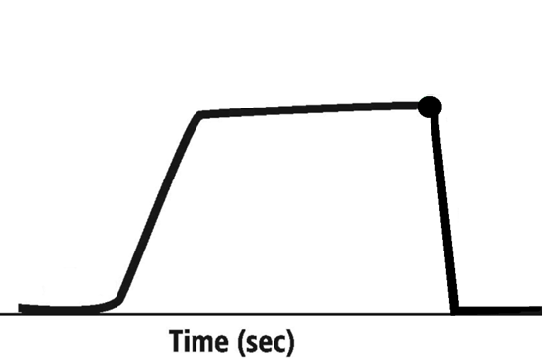
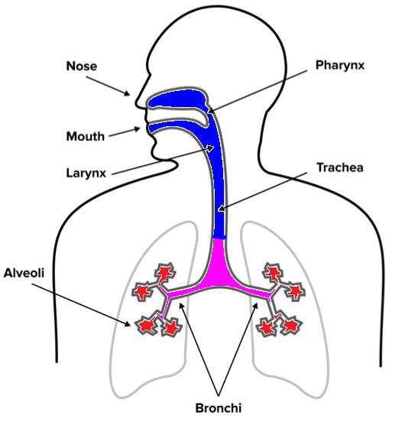
Basic Waveform Reading
D
(Measurement)
C
35-40mm HG - - - - - - - - - - - - - - - - - - - -
A
B
E
A-B: Baseline (begin exhalation)
B-C: Expiratory Upstroke
C-D: Expiratory Plateau
D: End Tidal Concentration
D-E: Inspiration

Slide 5
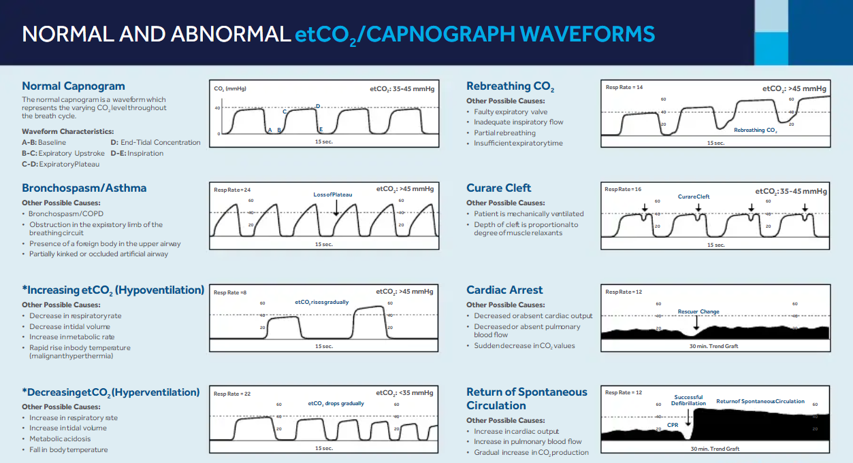
Basic Waveform Readings

Slide 6
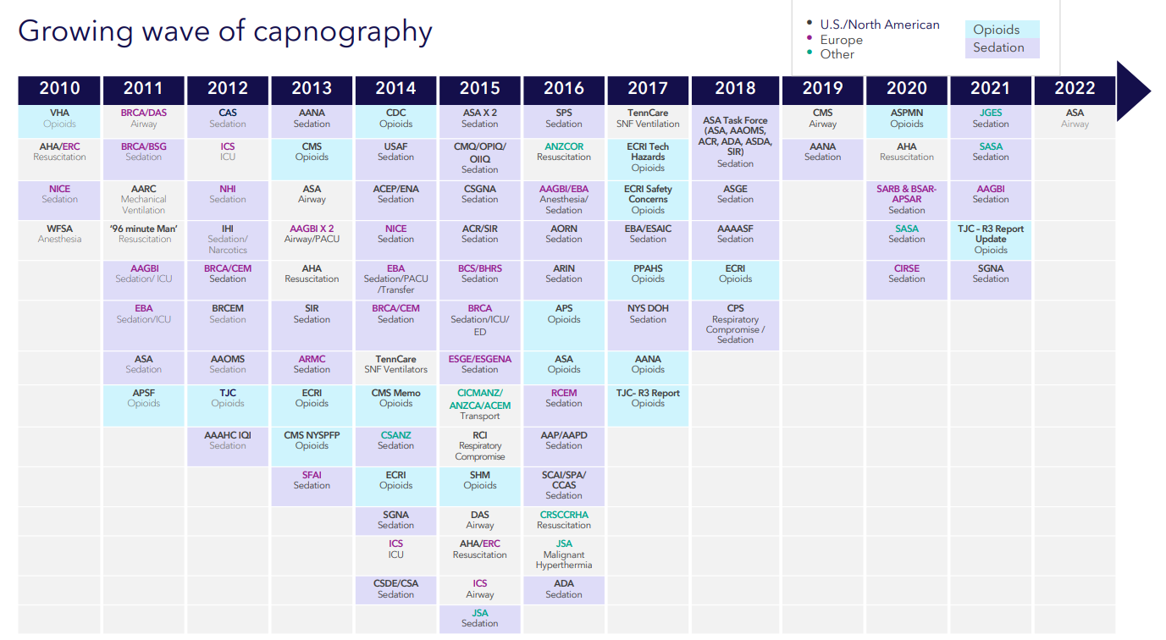
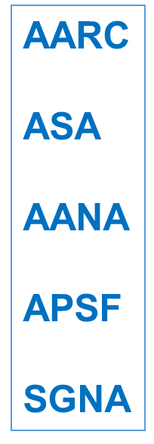
Society Recommendations - Pain management - Procedural sedation - CPR - Transport - Intubation - Ventilator management - Supplemental oxygen
Clinical Societies
ETCO2 Guidelines

Slide 7
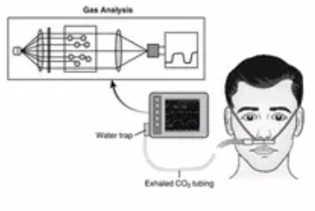
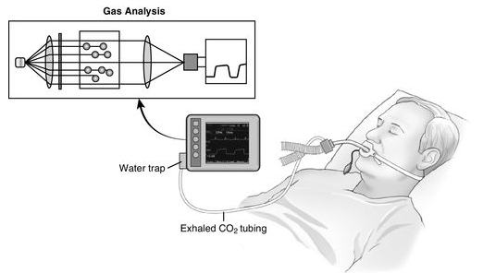
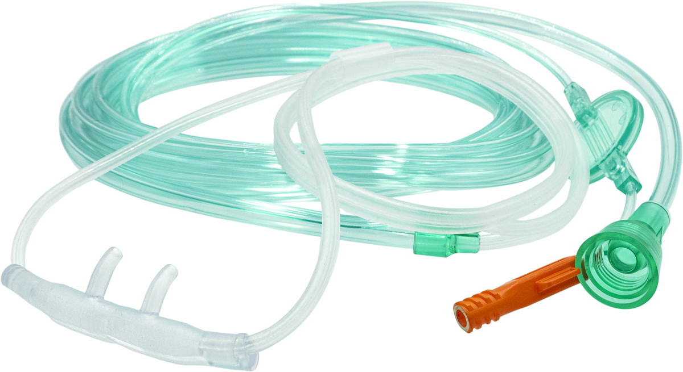
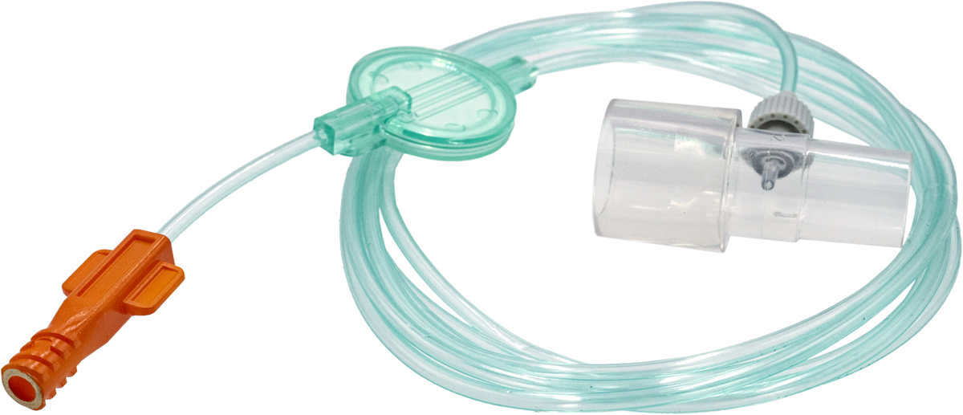
Sidestream vs Mainstream
Sidestream takes a portion of the patient’s breath from the circuit (tubing) to be analyzed by a monitor.
Occurs via a cannula or mask from a spontaneously breathing patients or for an intubated patient via a sample line.

Slide 8
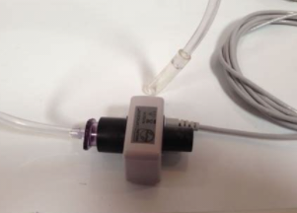
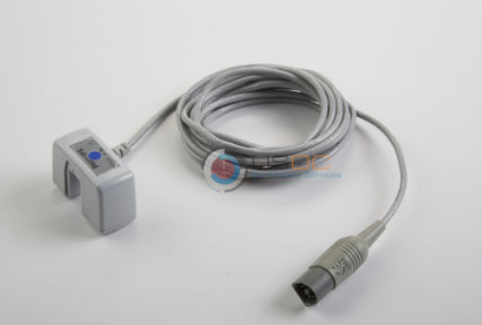
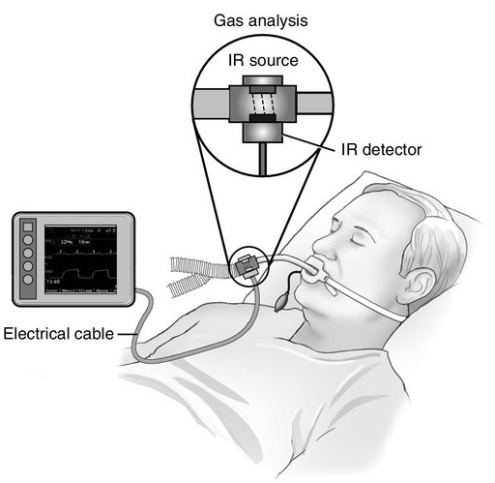
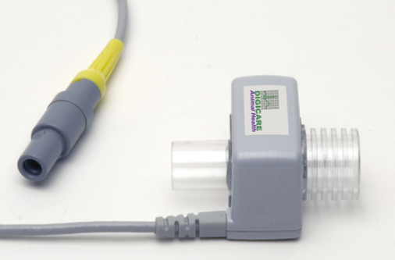
Sidestream vs Mainstream
Mainstream* measurement of the ETCO2 is done at the airway, or the sample site, thus providing a real-time measurement of the CO2 pressure
Used only on intubated patients
*AirLife does not sell this type

Slide 9
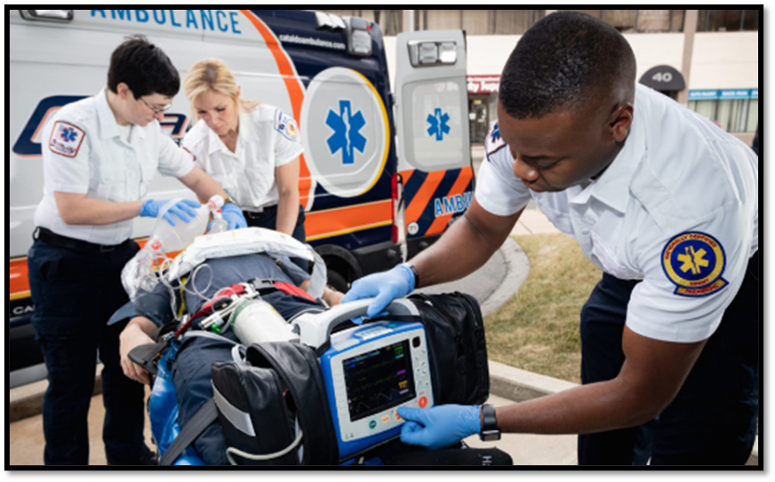
The WHY Patient Safety Catch Problems Early Gold Standard Society Recommendations
Minimize Incidence of Respiratory Compromise
Airway placement (intubation, tracheostomy, LMA)
Ventilator management
Procedural sedation
Administration of opioids for pain management
CPR
Transport of mechanically ventilated patients

Slide 10
Portfolio Overview

Slide 11
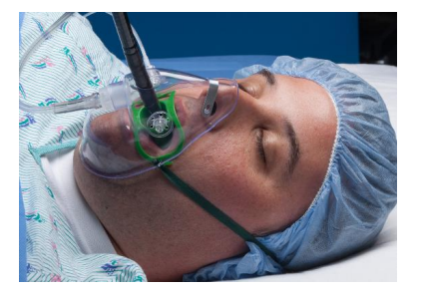

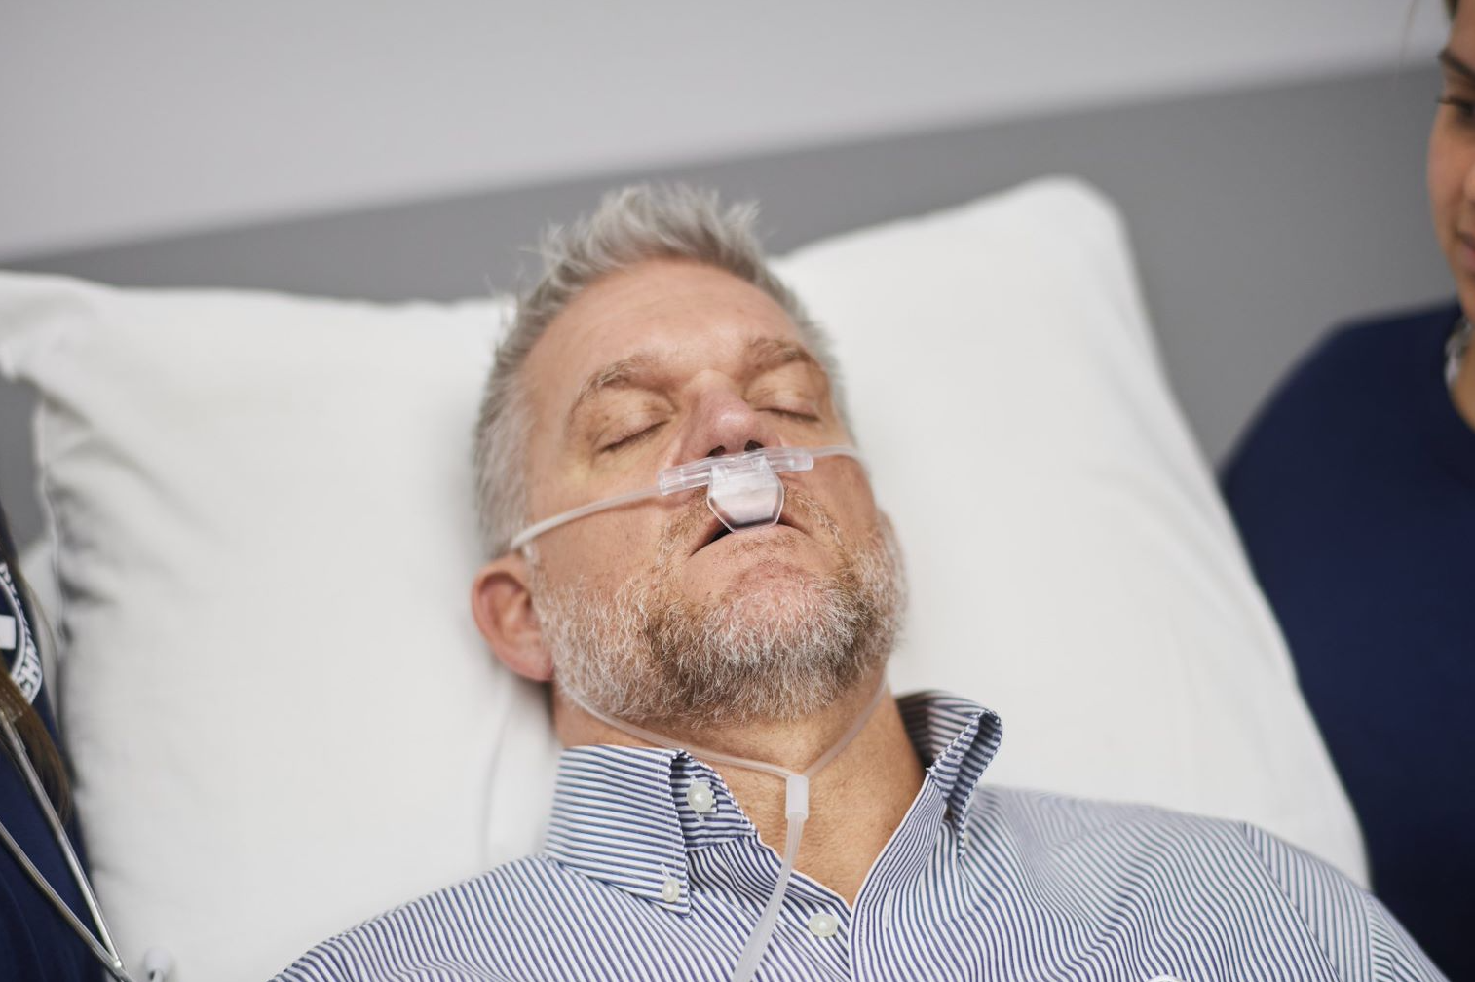
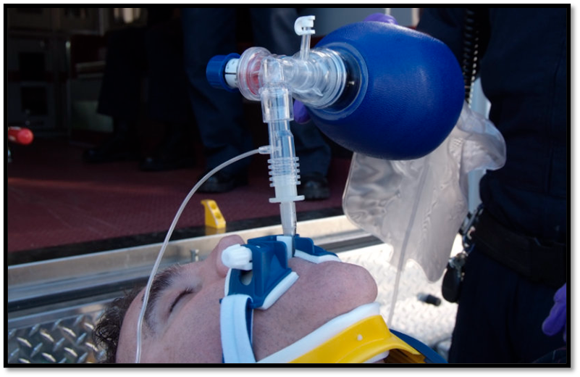
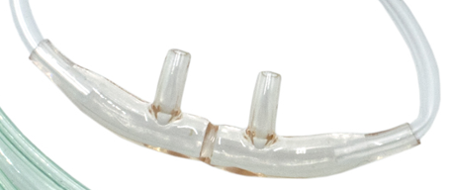
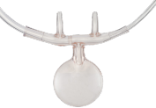
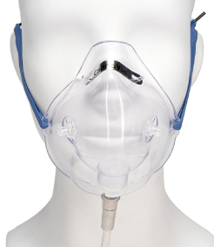
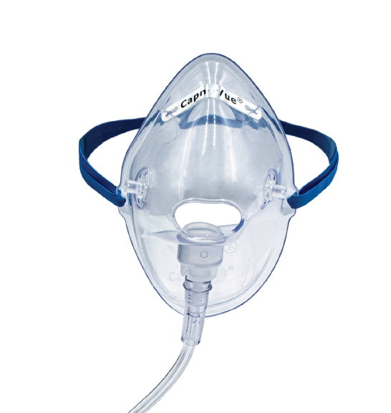
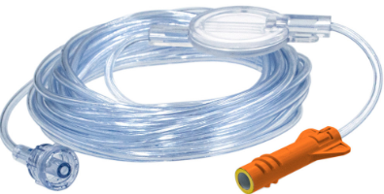
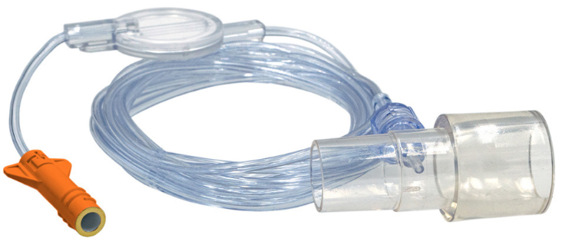
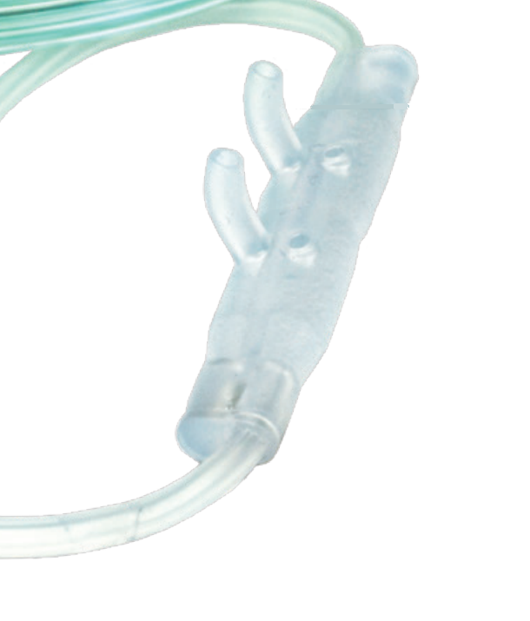
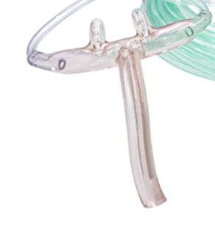
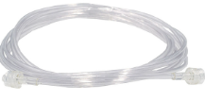
Patient interfaces
Cannulas
Masks
Gas sample lines
EtCO2/O2 – Provides oxygen and draws CO2 sample
EtCO2 – draws CO2 sample only
Used when higher O2 is needed than a cannula can provide
Used with intubated patients on anesthesia machine or ventilator
Or when resuscitation bags are in use
Nasal
Oral/Nasal
Divided
Scoop
With scope and without scope
Piggyback / Dual / Blow by/ Bifurcated
With ET adapter
Trunk
11

Slide 12
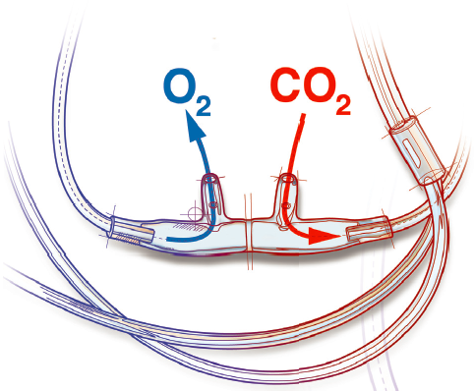
Divided Facepiece
Salter, Westmed, Vyaire and Capnoflex
One prong samples, the other delivers O₂
No gas mixture
Crisp waveform
Low dead space
Most effective design in delivering O₂ per Ebert study
Salter Eyes® – provide alternate pathway for air to travel. Allows gasses to pass even if prongs are occluded due to continuous use. (47 series)
Don’t mistake Salter Eyes for Piggyback design!

Slide 13
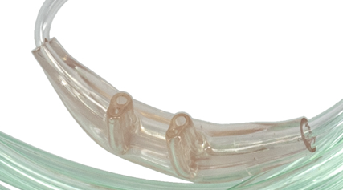
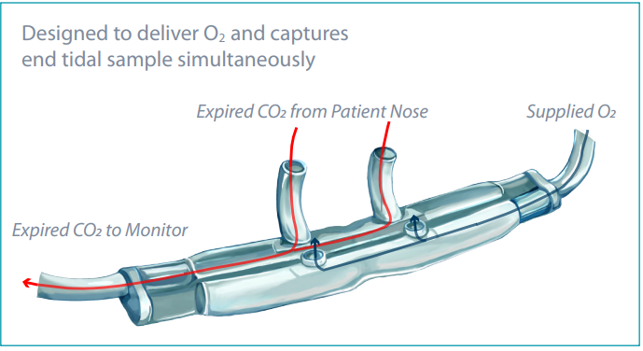
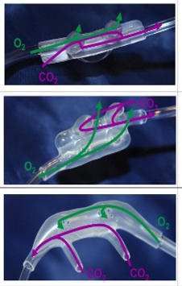
Piggyback Facepiece
Salter (not as popular)
Also called Dual, Bifurcated or Blow-by
Samples through one set of prongs, while also delivering oxygen through another set of prongs or holes.
Ventlab/
Curaplex
Competitors
Medtronic (blow by)

Slide 14
Piggyback Facepiece
Also called Dual, Bifurcated or Blow-by
Samples through one set of prongs, while also delivering oxygen through another set of prongs or holes.
Salter (not as popular)
Competitors
Ventlab/ Curaplex
Medtronic (blow by)

Slide 15
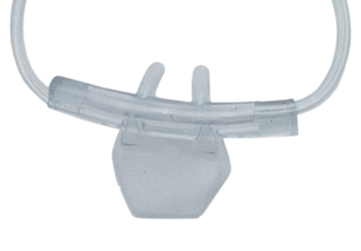
Oral-Nasal Facepiece
Delivers O₂ and samples just like a cannula (divided or piggyback), but also has a piece that goes over mouth to sample
Salter Labs
Divided trunk
Divided Scoop
Good for patients who go back and forth breathing through nose and mouth during surgery
Ventlab/Curaplex
Piggyback Scoop

Slide 16
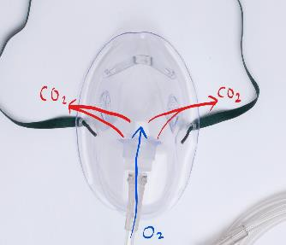
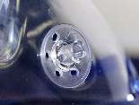
Salter CapnoVue Mask w/o scope
Oxygen Mask with CO2 sampling capability
Bilateral CO₂ sample ports
4LPM – 10LPM; tested to 15 but signal is washed out
Flow dynamics separate gases
Patented luer placement at vents causes CO2 to be “pulled” with exhaled air

Slide 17
Salter CapnoVue Scope Mask
Bilateral CO2 sample ports
4LPM – 10LPM; tested to 15 but signal is washed out
40-60% FiO2
Can compete with POM
POM goes up to 85% or greater FiO2
POM aperture has flaps that close around the scope
POM has 2 entry points, oral or nasal, depending on the procedure
Used During Aerosolization Concerns or Increased O2 Requirements
Notes:
New sales force, Tri-anim used to sell POM, no real focus

Slide 18
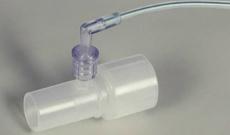
Gas sample lines
With ET adapter
Standard connector GSL only come in Westmed branded
ET adapter only comes separately

Slide 19
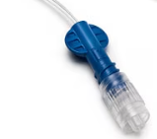

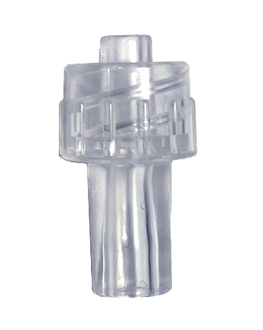
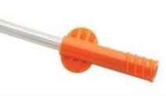

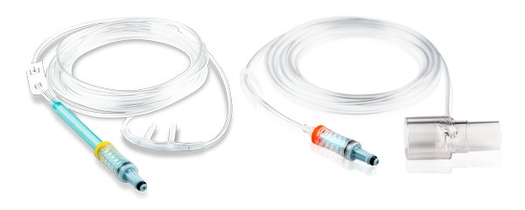
Blue luer connector (Medtronic only)
Monitoring Interfaces
Standard Connectors
Reflective Connectors
Proprietary Connectors
Work with any non-proprietary monitor
Generic male or female luer lock
Microstream monitors
Capnoflex Connectors
Medtronic, Philips, Stryker/Physio Lifepak, Criticare, Masimo, BD Alaris pain pumps, Mindray
GE DASH & Carescape, Philips, Spacelabs
AirLife now has access do these through the legacy Vyaire portfolio!
Female Male
Used on anesthesia machines in OR or GI suite
Orange
Short Term Use
Yellow
Long-Term Use
Masimo NomoLine
Not in our portfolio
Used on pain pumps, multi-parameter monitors, transport monitors

Slide 20
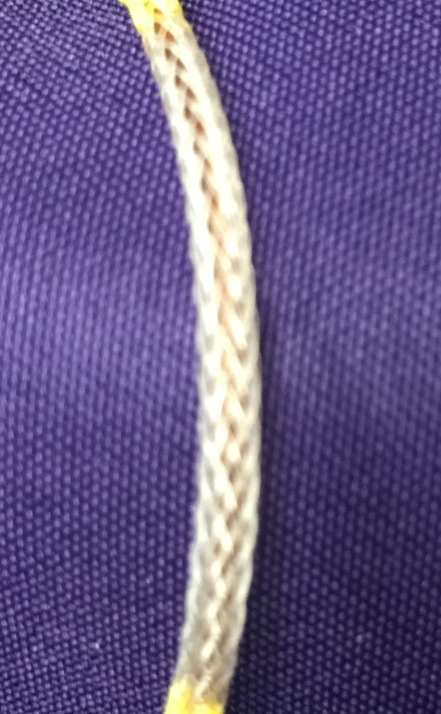
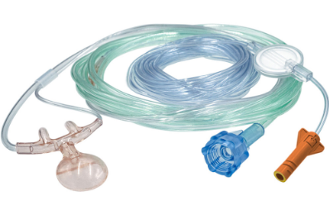
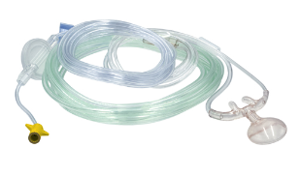
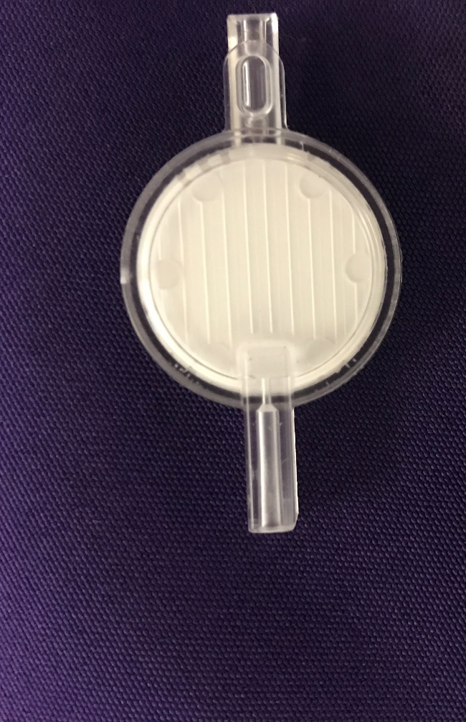
Salter Reflective Connector Cannulas
Microstream monitors are extremely sensitive to moisture
Our cannulas use a 0.2-micron barrier, hydrophobic disc filter that physically impedes line when moisture reaches certain level.
Fibers go horizontally so as to not impede the signal
Long term (yellow) cannulas in addition to disc filter have nafion tubing (moisture wicking material) in between connector and filter

Slide 21
Offering by brand
Only talk about if customer demands a soft cannula with reflective connector!
Do NOT sell branded VentFlo. Go through Tri-anim rep with Curaplex
 | SALTER (lead with) |  | WESTMED |  | Ventlab/Tri-anim |  | Vyaire
Features | Standard (STAT Green) | Reflective (STAT O) | Standard | Reflective | Standard | Reflective | Standard | Capnoflex
Facepiece | Divided/ Piggyback | Divided | N/a | Divided | Piggyback | Piggyback | Divided | Divided
Headset tubing | Soft Tubing options | No soft option | N/a | Soft | No soft option | Soft Ears | No soft option | No soft option
Occlusion Prevention | Salter eyes optional | No | N/a | No | No | No | No | No
Oral/Nasal | Divided or Piggyback Trunk | Divided Scoop | N/a | Divided Trunk | Piggyback Scoop | Piggyback Scoop | No | Divided Trunk
Airway adaptor | Not Available | Yes | N/a | Yes | Not Available | Not Available | Yes | No
Gas sampling lines | No | Yes | Yes | Yes | Not Available | Not Available | Yes | Yes
O2 Connection | Thread Grip / Standard | Thread Grip | N/a | Thread Grip | Thread Grip and Standard | Thread Grip | Thread Grip (U/Connect-It) | Standard
Brand | STAT Green | STAT Orange (short)/Yellow (long) | Westmed | Comfort Soft Plus | Ventlab | VentFlo/ Curaplex | AirLife | Capnoflex

Slide 22
Sales Strategy

Slide 23
Strategy – always lead with Salter!
Call Points:
Anesthesia Tech, CRNA, OR buyer, RT director, ED RT, ICU, Surgery centers
Supply chain
30 second pitch:
“Salter offers a broad portfolio of capnography configurations in both standard luer lock and Microstream short- and long-term reflective connectors that can help healthcare systems improve patient safety and outcomes by making capnography monitoring possible in more situations.”
Initial Fact-Finding Questions:
Who makes the clinical decisions? And who makes the buying decision?
What type of connectors do you use? Are your connectors colored orange or yellow?
What styles of cannulas do you use and on what patient population?
23

Slide 24
Messaging against Medtronic
Medtronic Strategy
OEM manufacturer
Connectors developed and tested specifically for Microstream monitors
Claims non-OEM product will damage monitors and void warranty
Ties consumables sales to capital purchases through contracts
Soft line of reflective line
Medtronic LETTER
“Our reflective connectors offer equivalent performance to Medtronic in wave output and O2 delivery at a lower cost of up to 25%. They have a special hydrophobic filter to protect the monitor and are backed by a AirLife limited warranty.”
GOAL: “If you can share your usage, I can create a cross-reference and bid that you can take to value analysis.”
Notes:
Other competitors: Flexicare, Philips, Medline, Intersurgical, Physio-control, Zoll

Slide 25
Messaging against Medtronic
Objection
AirLife response
STAT O quality isn’t as good as OEM Medtronic
Medtronic claims using non-OEM cannulas will void the monitor warranty
We only use reflective connectors w/ soft head tubing
“STAT O connectors have over 200 evaluations in the Hospital and EMS environments with a variety of Microstream monitors. We also can provide you with a 3rd party study*, demonstrating STAT O superior quality against Medtronic’s.”
“Our cannulas use a 0.2-micron barrier, hydrophobic filter that physically impedes line when moisture reaches certain level. AirLife stands behind their cannulas and offers their own limited product warranty for monitors still under Oridion Medical or Medtronic warranty.”
“We have a full line of Westmed Comfort Soft Plus™ reflective cannulas” Or partner with your Curaplex rep.
Salter STAT O Limited WARRANTY
25

Slide 26
Messaging against Medtronic
Objection
AirLife response
Medtronic blow-by technology sampling CO2 from both nares is the most effective design
We have a free use agreement with Medtronic
“Approx 70-80% of population are born with septal deviation, but only a few require corrective treatment. A divided cannula can accommodate for this. There is no mixture of gases with a divided cannula. The result is a EtCO2 waveform with an unaffected signal superior to Medtronic’s blow by design (see Ebert study) and it delivers significantly higher O2 at 4LPM compared to Medtronic.”
Confirm how much consumable spend is needed in total. Sometimes oximeters are tied to the deal. If so, they might be able to just increase their oximeter spend to maintain their compliance, while still allowing them to switch to STAT O.
Medtronic Agreement EtCO2 DECISION TREE
26

Slide 27
Resources (All can be found on Summer School Portal)
EtCO2 Cannula PLAYBOOK
EtCO2 Targeting TOOL
Salter STAT Savings CALCULATOR
ETCO2 Salter STAT SAMPLE KIT

Slide 28
Appendix

Slide 29
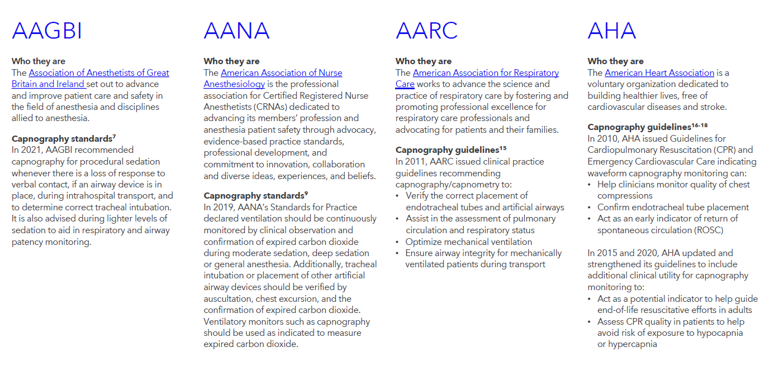

Slide 30
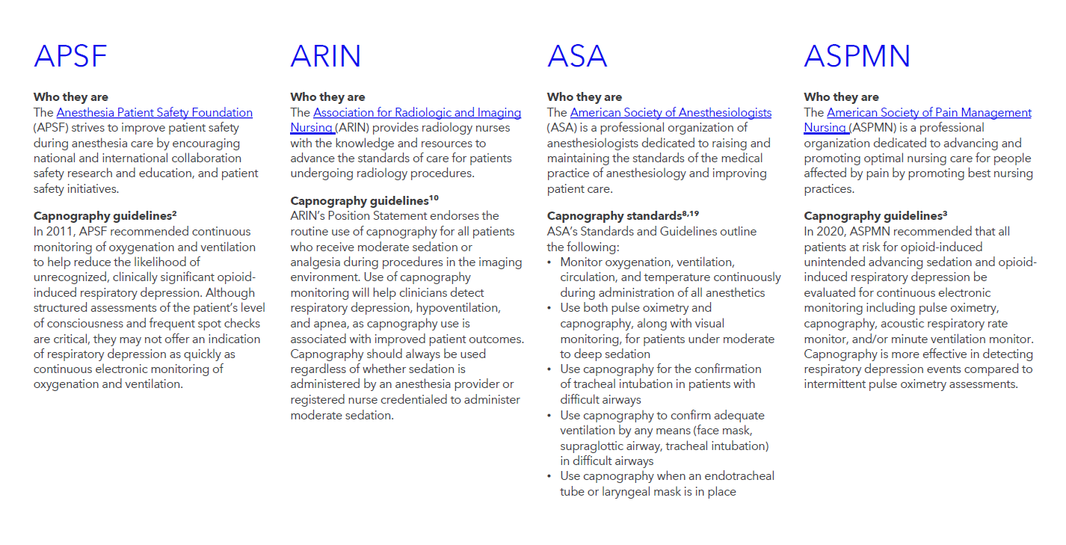

Slide 31
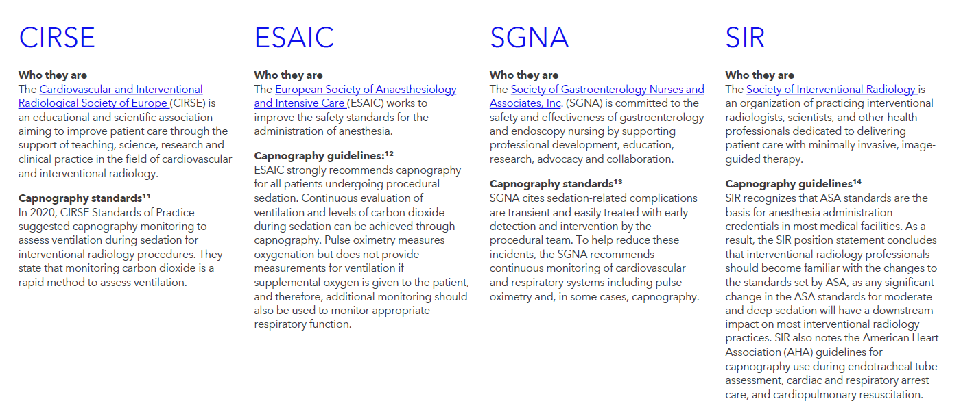

Slide 32
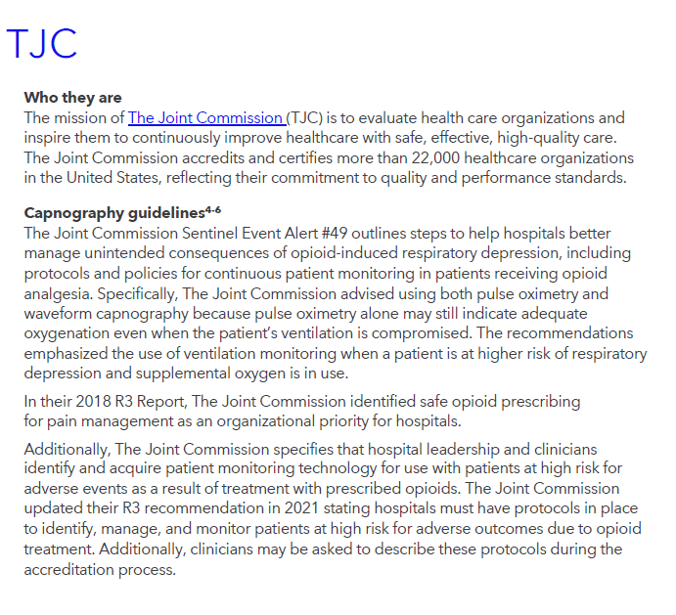

Slide 33

Video: Basic Waveform Reading

