Slide 1
SUPERNO2VA Clinics UK Sales Meeting January 2023
Helga Gascó
Product Specialist South EMEAC - Consumables
Business Development team

Slide 2
Protocol supporting the use of the SuperNO2VA positive airway pressure device
Introduction
Risk factors : Patient co-morbidities
Risk factors : High-risk procedures
The objectives required to address respiratory compromise
The optimal solution: The SuperNO2VA™ device

Slide 3
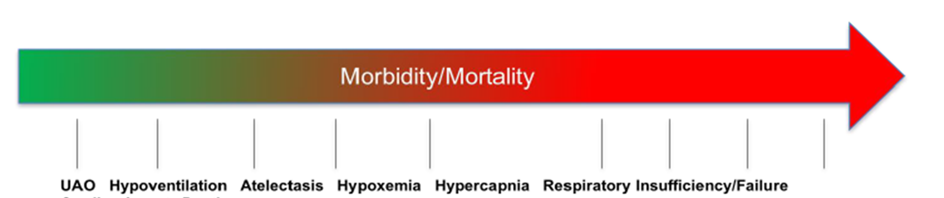
Introduction
Sedation and anesthesia have long been associated with high rates of hypoxemia and hypoventilation, which can ultimately result in Respiratory Compromise 1-3
Yilmaz M, Aydin A, Karasu Z, et al. Risk factors associated with changes in oxygenation and pulse rate during colonoscopy. Turk J Gastroenterol 2002;13(4):203-8. [PMID: 16378306]
3. Qadeer MA, Lopez AR, Dumot JA, et al. Hypoxemia during moderate sedation for gastrointestinal endoscopy: causes and associations. Digestion 2011;84:37-45. PMID: 21304242 DOI: 10.1159/000321621]
Notes:
This occurs due to a disproportionate decrease in genioglossus tone leading to upper airway obstruction and central respiratory depression. 4-5

Slide 4
Introduction
American Society of Anesthesiologists recommends:
delivery of supplemental oxygen
monitoring of pulse oximetry
continuous quantitative capnography monitoring
Notes:
In an attempt to prevent these complications the American Society of Anesthesiologists recommends:
Despite these recommendations inadequate oxygenation/ventilation remains the most common cause of morbidity and mortality. 7

Slide 5
Introduction
Risk factors :
1 - Patient co-morbidities
2 - High risk procedures
Notes:
These complications are multifactorial and the risk factors can be broken down into the following categories

Slide 6
Risk factors : Patient co-morbidities
Morbid Obesity
Obstructive Sleep Apnea (OSA)
Limited oxygen reserve
Difficult ventilation/intubation
Notes:
Respiratory Compromise is a result of either low blood oxygen levels and/or high carbon dioxide levels. Therefore, patients who start with low oxygen levels or high CO2 levels (ie: ASA III – V) are at a higher risk.11-12

Slide 7

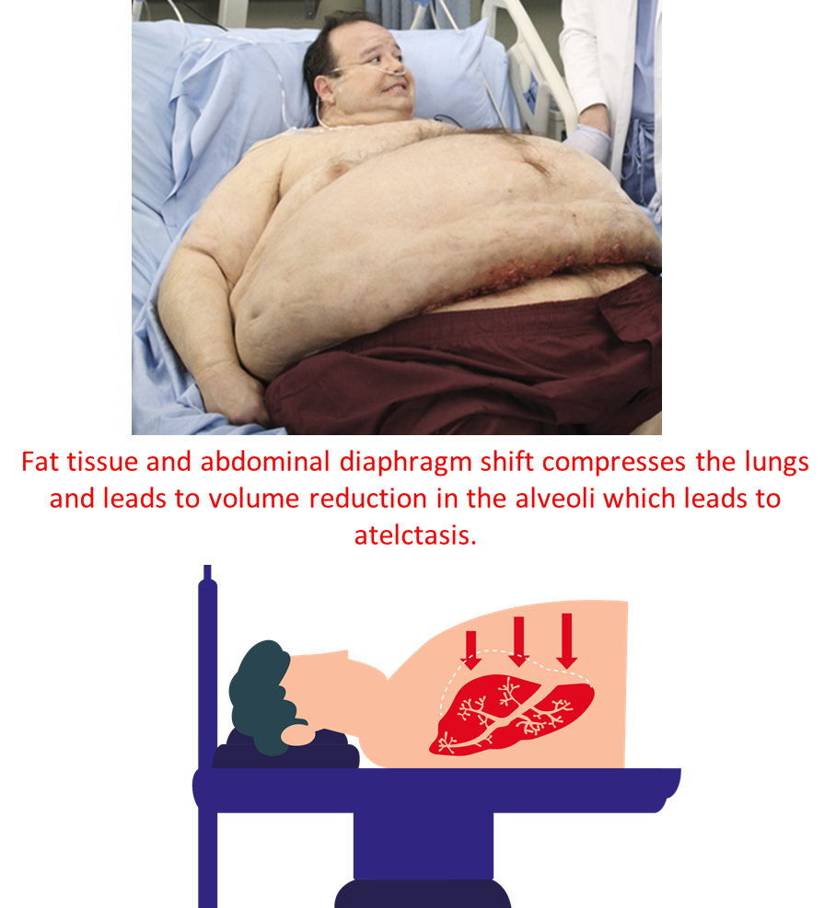
Risk factors : Patient co-morbidities
Morbid obesity
Significantly larger amount of pharyngeal soft tissue
Larger amount of abdominal tissue compresses their lungs
Oxygen consumption significantly increased
Notes:
Morbid obesity has been shown to significantly increase the risk of hypoxemia during endotracheal intubation as well as during procedural sedation.15
The incidence of oxygen desaturation for morbidly obese patients has been shown to be up to 47%.16

Slide 8
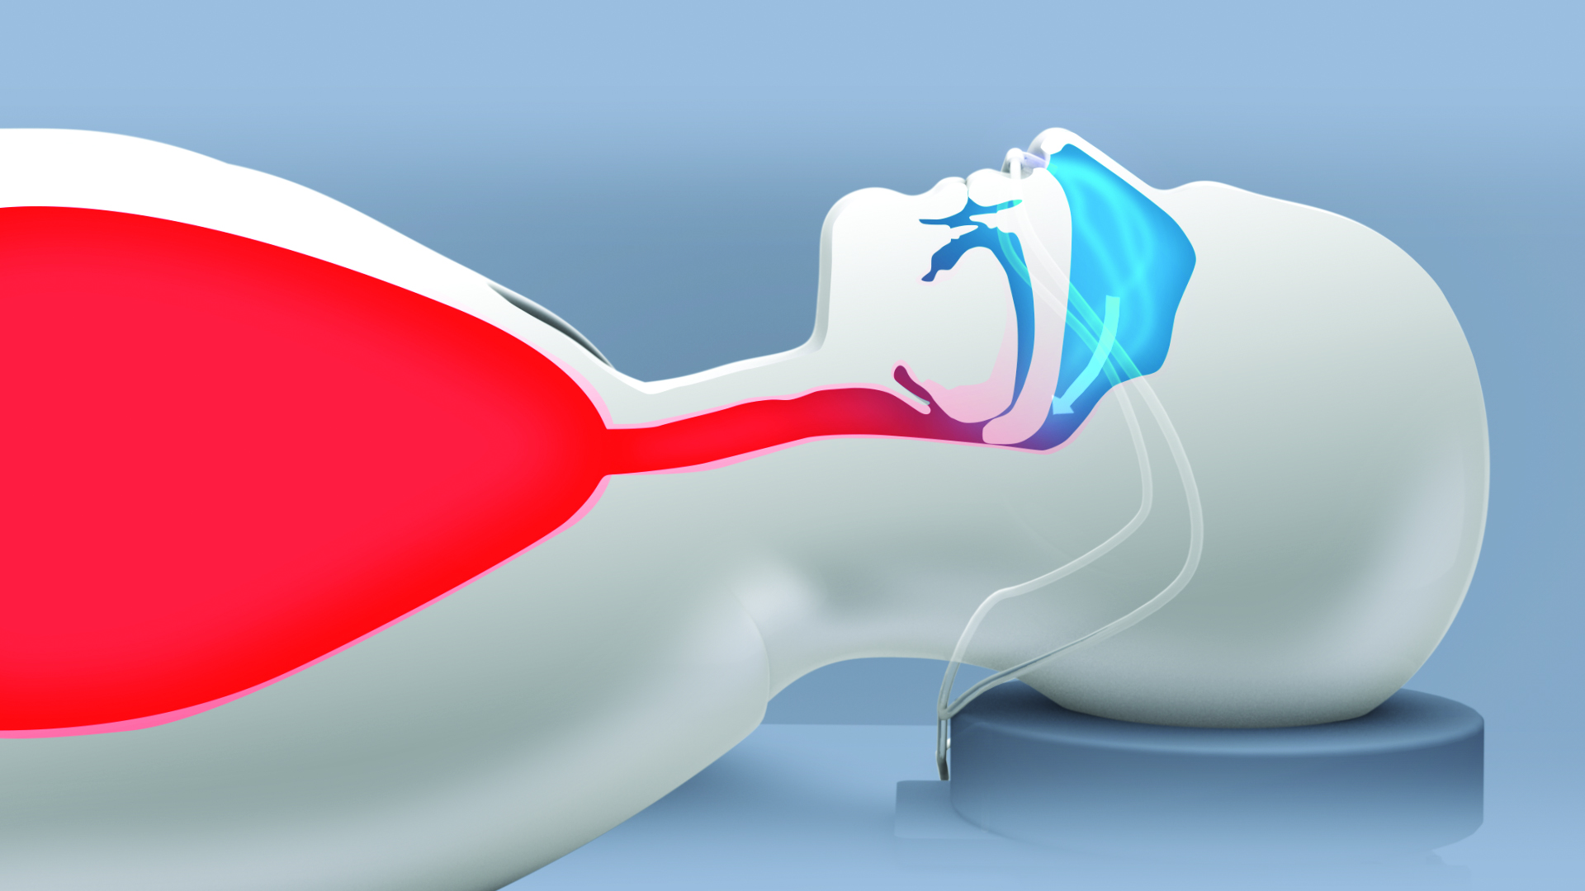
Risk factors : Patient co-morbidities
Obstructive sleep apnea (OSA)
Tendency towards upper airway collapsibility.17
Chronic hypercarbia and hypoxemia
Notes:
Over time chronic hypercarbia and hypoxemia leads to a reduced responsiveness of the normal respiratory centre in the brain. This leads to chronically elevated pCO2 levels at baseline, and a further reduced responsiveness under anesthesia.19

Slide 9
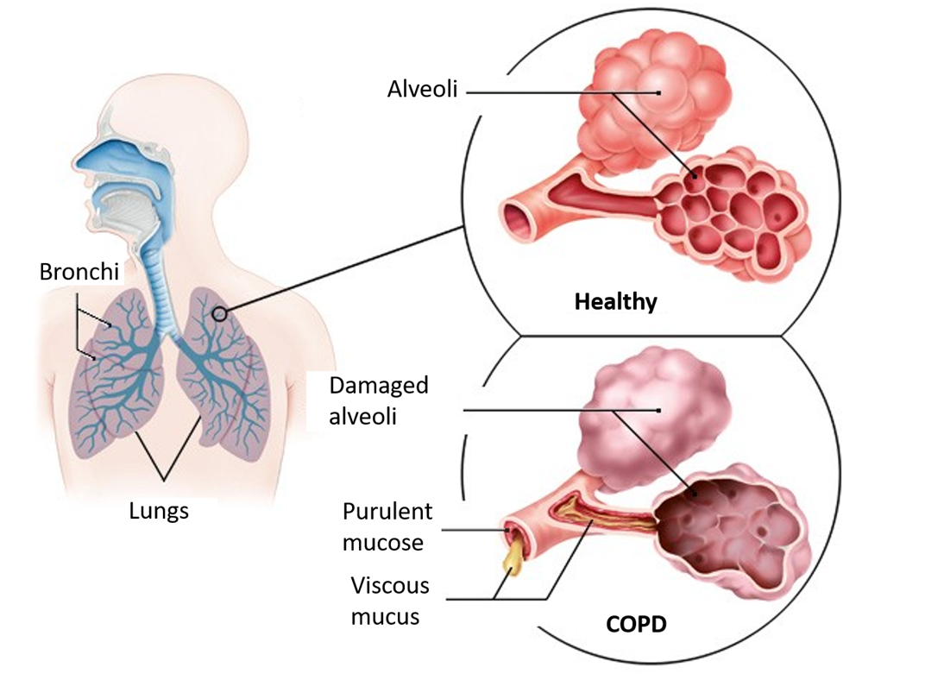
Risk factors : Patient co-morbidities
Limited oxygen reserve
Congestive Heart Failure
(CHF)
Chronic Obstructive Pulmonary Disease
(COPD)

Slide 10
Risk factors : Patient co-morbidities
Difficult ventilation/intubation
“can’t intubate, can’t ventilate,”
Notes:
The most dangerous situation in all of airway management is “can’t intubate, can’t ventilate,” where the clinician attempts both mask ventilation and endotracheal intubation, and fails at both
To avoid this life-threatening situation, clinicians examine patient’s airways for specific risk factors that are associated with difficult mask ventilation as well as difficult intubation.22-23

Slide 11
Risk factors : Patient co-morbidities
Difficult ventilation : Risk factors
Body Mass Index (BMI) > 26
Age > 55 years
Edentulous (no teeth)
Beards
History of Snoring
Notes:
Difficult ventilation has been defined as the inability of a trained anesthetist to maintain the oxygen saturation > 90% using a facemask for ventilation and 100% inspired oxygen.22

Slide 12
Risk factors : Patient co-morbidities
Difficult intubation : Risk factors
History of difficult intubation
Small mouth opening
Increased Mallampatti classification
Notes:
La intubación difícil se define como la necesidad de más de tres intentos de intubación, o intentos de intubación que duran > 10 minutos.23

Slide 13
Risk factors : Patient co-morbidities
Difficult ventilation/intubation
Difficult Airway Society (DAS) recommends:
provide the patient with a continuous source of high flow oxygen (apneic oxygenation) to help to maintain their oxygen saturation levels and prevent life-threatening Respiratory Compromise.24
Notes:
High flow oxygenation during intubation has been shown to significantly prolong the time to oxygen desaturation.25

Slide 14
Risk factors : High-risk procedures
Non-operating room anesthesia (NORA) sedation procedures
post-operative complications after major head and neck surgery, thoracic surgery, and major abdominal surgery

Slide 15
Risk factors : High-risk procedures
Non-operating room anesthesia (NORA) sedation procedures
new minimally invasive procedures being performed without advanced airways
managing older and more medically complex patients
need to recover patients more quickly
Notes:
Specifically, NORA has grown significantly over the last decade but has also presented unique challenges to anesthesia providers

Slide 16
Risk factors : High-risk procedures
Post-operative complications
pulmonary complications:
longer ICU stays
increase in mortality
Notes:
With regards to major head and neck surgery, the incidence of postoperative pulmonary complications (PPCs) is between 9% - 44% and is associated with longer ICU stays, hospitals stays, and an increase in mortality. 9,29-31

Slide 17
The objectives required to address respiratory compromise
Today’s practice
1- An increasing frequency of deeper levels of sedation
it renders the patient amnestic
allows for physical relaxation during highly stimulating procedures
improves turn-round time
Notes:
preferred method

Slide 18
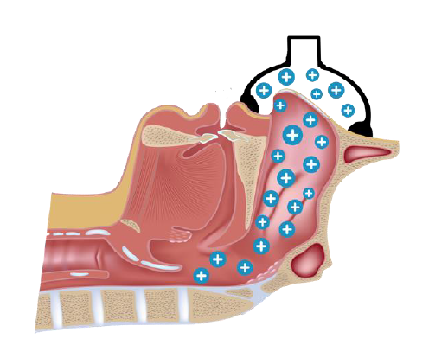
The objectives required to address respiratory compromise
Today’s practice
2 - complex patients
require access to the patient’s mouth, such as upper endoscopy, transoesophageal echocardiography …
with the inability to apply positive pressure ventilation as the current devices cover both the nose and mouth.
Notes:
which significantly increases the risk of Respiratory Compromise due to the inability to apply positive pressure ventilation as the current devices cover both the nose and mouth.

Slide 19
The objectives required to address respiratory compromise
Objective 1
Effectively pre-oxygenate
Notes:
Delivering 100% FiO2 effectively pre-oxygenates by denitrogenating the alveoli, which allows the entire lung volume and FRC to be exchanged with 100% oxygen to maximize the stores of oxygen. This maximum storage of oxygen has been shown to prolong the time to oxygen desaturation and thus reduce Respiratory Compromise.34

Slide 20
The objectives required to address respiratory compromise
Objective 2
Provide apneic oxygenation
Notes:
All patients who receive anesthesia incur the risk of apnea, and current recommendations are to maximize oxygen stores during anesthesia to best prepare for apnea even if it is not expected.34
In current practice, pre-oxygenation during NORA procedures and intra-oral procedures is nearly impossible and therefore not performed.

Slide 21
The objectives required to address respiratory compromise
Objective 3
Relieve upper airway obstruction
Notes:
Patients who receive anesthesia develop upper airway obstruction, due to relaxation of the muscles of the airway and decreased central (brain) control of ventilation.1-3
Nasal continuous positive airway pressure (CPAP) has been shown to be an effective means of relieving upper airway obstruction in patients receiving deep sedation as well as significantly lowering the PaCO2 compared to the current standard.
36-37 That said, the use of intra-operative nasal CPAP is rarely performed.38

Slide 22
The objectives required to address respiratory compromise
Objective 4
Maintain effective ventilation in unconscious patients
Notes:
As apnea is common and at times unpredictable during anesthesia, maintaining effective ventilation in unconscious patients is essential in order to prevent the complications associated with Respiratory Compromise.

Slide 23
The objectives required to address respiratory compromise
Objective 5
Provide access to the oral cavity during
intra-oral procedures
Notes:
several procedures, such as upper endoscopy, TEE, and laryngoscopy, require the surgeon/proceduralist to have access to the patient’s mouth. This makes full facemask ventilation impossible.
nasal mask ventilation has been shown to be an effective alternative and actually superior to full facemask ventilation by providing similar tidal volumes with lower peak airway pressures.39
The current challenge with nasal mask ventilation, which has prevented widespread adoption is the cost and workflow requirement for the additional capital equipment that’s needed.

Slide 24
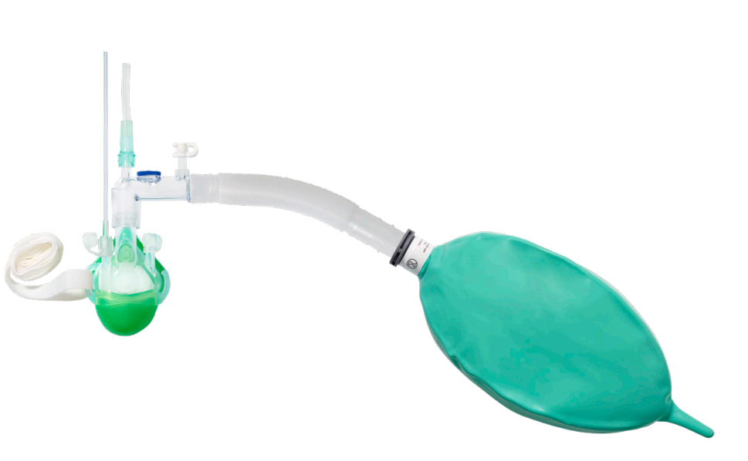
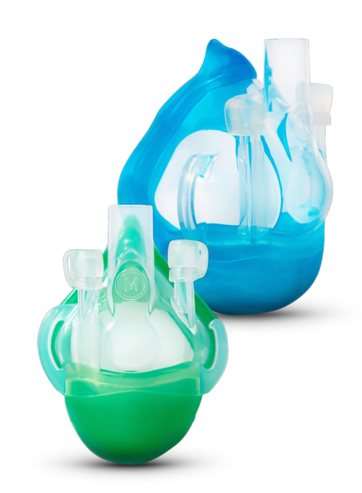
The optimal solution:The SuperNO2VA™ Et device
Nasal anesthesia mask
Notes:
designed to maintain upper airway patency and support ventilation in patients who are undergoing general anesthesia, procedural sedation, or recovering in the post anesthesia recovery unit (PACU).

Slide 25
The optimal solution:The SuperNO2VA™ Et device
Nasal anesthesia mask
1- Maintain upper airway patency
2- support ventilation:
procedural sedation / general anesthesia/ post anesthesia recovery

Slide 26
The optimal solution:The SuperNO2VA™ Et device
Nasal anesthesia mask
Effective pre-oxygenation and rescue ventilation
SuperNO2VA™ device creates an airtight seal that prevents air leak and allows positive end-expiratory pressure (PEEP)
Notes:
It was designed to address all of the objectives required to minimize the impact of respiratory compromise
We have studies, and in one of them demonstrated that the SuperNO2VA™ device could be used to both effectively pre-oxygenated obese patients and nasal mask rescue ventilate patients after being induced with general anesthesia and paralyzed.41

Slide 27
The optimal solution:The SuperNO2VA™ Et device
Nasal anesthesia mask
Provide apneic oxygenation
SuperNO2VA™ device could be used to successfully deliver up to 30 liters per minute
Notes:
Other study demonstrated that the SuperNO2VA™ device could be used to successfully deliver up to 30 liters per minute (LPM) of oxygen allowing for effective apneic oxygenation and PEEP during endotracheal intubation in obese and OSA patients and rescue patient’s suffering from acute respiratory failure secondary to angioedema

Slide 28
The optimal solution:The SuperNO2VA™ Et device
Nasal anesthesia mask
Relieve upper airway obstruction
SuperNO2VA™ device was the first completely disposable nasal positive airway pressure (PAP) device that effectively relieves anesthesia and sedation related upper airway obstruction in obese patients.45
Notes:
We also have studies demonstrating thata SuperNO2VA™ device significantly reduced the incidence of oxygen desaturation compared to their standard of care (4.7% vs 22% respectively).44

Slide 29
The optimal solution:The SuperNO2VA™ Et device
Nasal anesthesia mask
Maintain effective ventilation
in unconscious patients
Notes:
An study showed that the SuperNO2VA™ device maintained a statistically significant higher minute ventilation immediately after a bolus of Propofol, while recovering from the Propofol bolus, and until the Propofol infusion was stopped.44

Slide 30
The optimal solution:The SuperNO2VA™ Et device
Nasal anesthesia mask
Provide access to the oral cavity
during intra-oral procedures

Slide 31
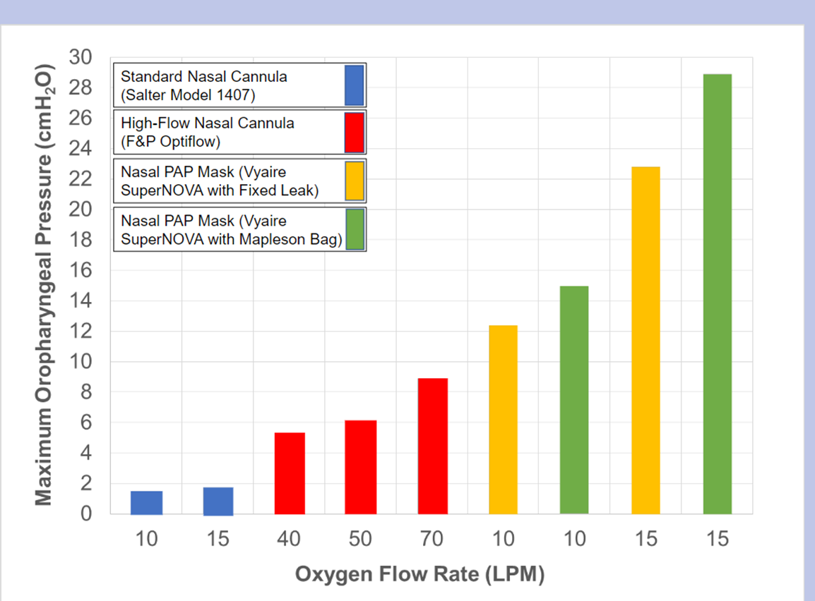
The optimal solution:The SuperNO2VA™ Et device

Slide 32
The optimal solution:The SuperNO2VA™ Et device
Summary of BENEFITS
1º
The SuperNO2VA™ device is a nasal anesthesia mask designed to maintain upper airway patency and support ventilation in patients who are undergoing general anesthesia, procedural sedation, or recovering in the post anesthesia recovery unit (PACU).

Slide 33
The optimal solution:The SuperNO2VA™ Et device
Summary of BENEFITS
2º
Delivers 100% oxygen via the mask and can
be used for pre-oxygenation with PEEP

Slide 34
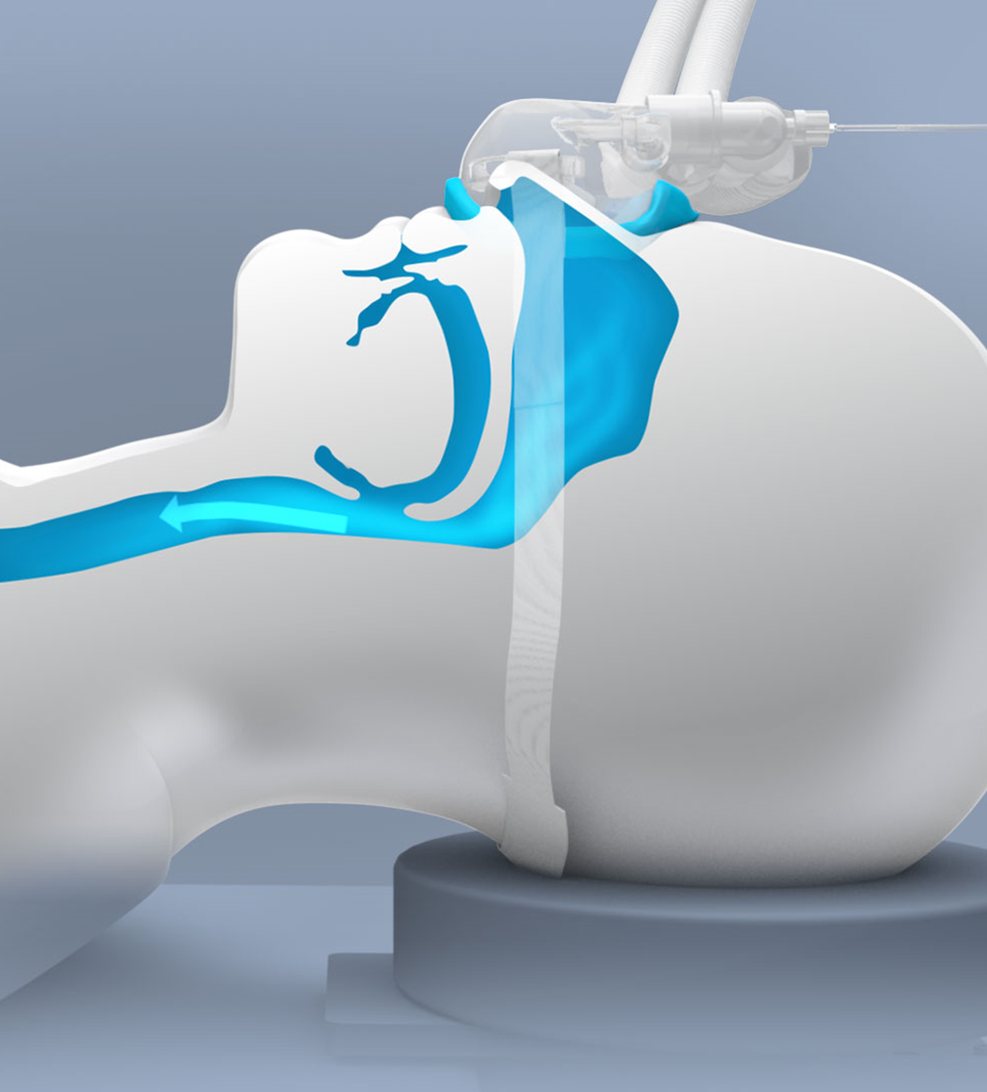
The optimal solution : The SuperNO2VA™ Et device
Summary of BENEFITS
3º
Creates a pneumatic stent in the posterior pharynx, used to maintain upper airway patency.

Slide 35
The optimal solution:The SuperNO2VA™ Et device
Summary of BENEFITS
4º
Provides access to the oral cavity and allows for rescue ventilation in apneic patients

Slide 36
The optimal solution:The SuperNO2VA™ Et device
Summary of BENEFITS
5º
Delivers >30 L/min fresh gas flow during open airway procedures

Slide 37
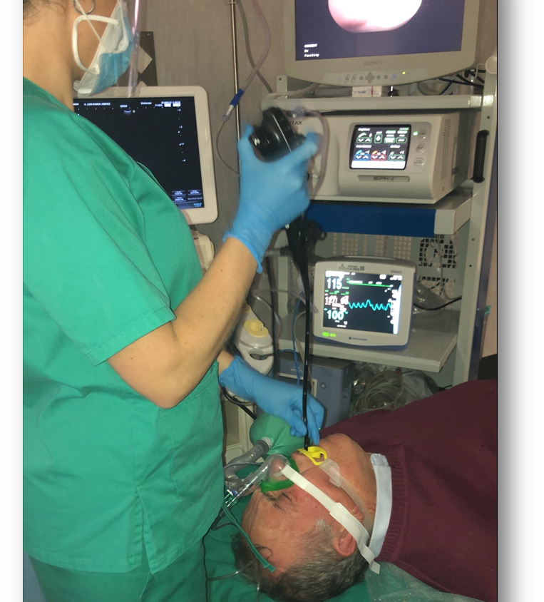
The optimal solution The SuperNO2VA™ Et device
Summary of BENEFITS
6º
Connects to standard anesthesia equipment or O2 connections readily available in procedural areas.

Slide 38
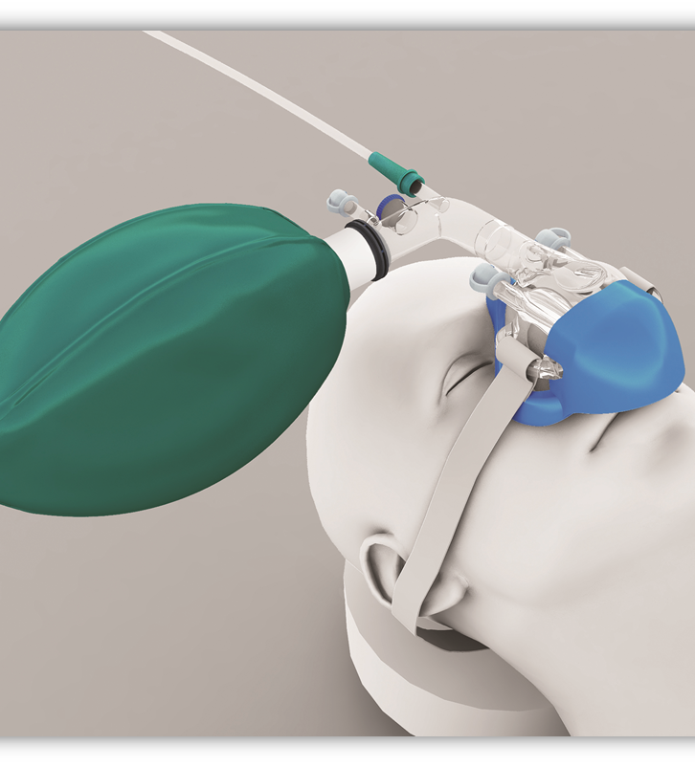
The optimal solution The SuperNO2VA™ Et device
Summary of BENEFITS
7º
Allows the monitoring of cuantitative capnography

Slide 39
The optimal solution:The SuperNO2VA™ Et device
Summary of BENEFITS
8º
It was designed to utilize all the benefits of nasal ventilation both inside and outside the OR.
Notes:
En general,

Slide 40
The optimal solution:The SuperNO2VA™ Et device
Recommendations for use
High-risk patient undergoing deep sedation
Severe cardiovascular disease
Severe chronic respiratory disease
Morbidly obese
Obstructive sleep apnea
Notes:
Therefore, we recommend the SuperNO2VA™ device be used during deep procedural sedation in these patients in order to maximize oxygen reserves prior to the induction of anesthesia and prevent upper airway obstruction as well as assist ventilation throughout the procedure and offer the possibility of rescue outside the OR.

Slide 41
The optimal solution:The SuperNO2VA™ Et device
Recommendations for use
High-risk patients postoperatively
BMI >26
Age >55
Obstructive Sleep Apnea (OSA)
Congestive Heart Failure (CHF)
Chronic Obstructive Pulmonary Disease (COPD)
Notes:
The Society for Sleep Medicine recommends all patients either at risk for or has a history of sleep disordered breathing be placed on positive airway pressure while recovering from general anesthesia.39
There we recommend the SuperNO2VA™ device to be used on patients postoperatively who are at risk for upper airway obstruction.

Slide 42
The optimal solution:The SuperNO2VA™ Et device
Recommendations for use
Anticipated difficult ventilation/intubation
Body Mass Index (BMI) > 26
Age > 55 years
Edentulous (no teeth)
Beards
History of Snoring
History of difficult intubation
Small mouth opening
Increased Mallampatti classification
Notes:
The current recommendations for the Difficult Airway Society and the Journal of Anesthesiology is to provide >15 LPM of oxygen during tracheal intubation in patients with known risk factors for difficult ventilation or intubation in order to prevent severe oxygen desaturation.24,46
Therefore, we recommend the SuperNO2VA™ device to be used on patients with >1 risk factor listed below for pre-oxygenation during the induction of general anesthesia and apneic oxygenation while attempting to ventilateand/or intubate.

Slide 43
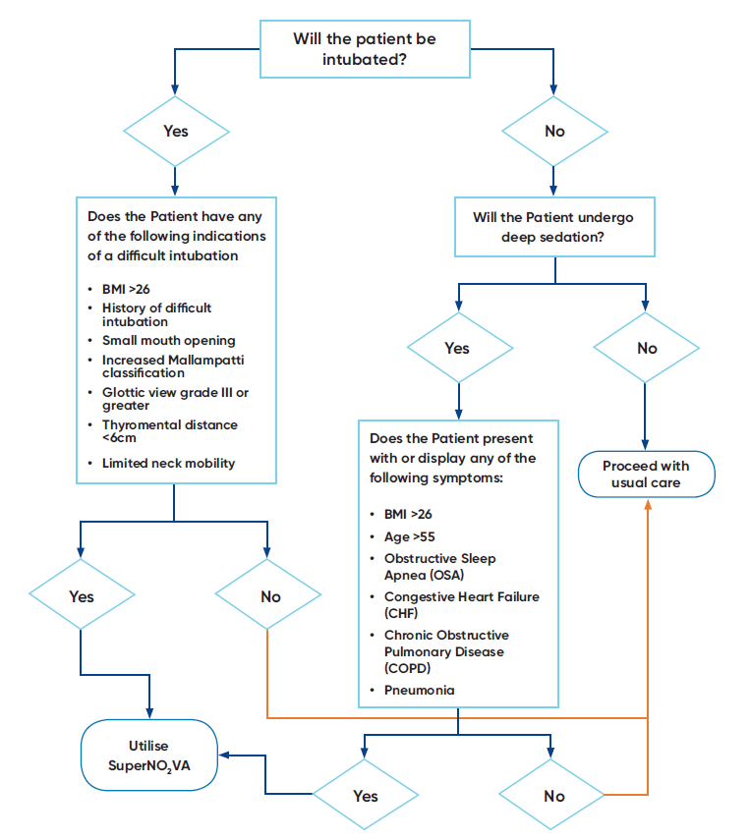
The optimal solution:The SuperNO2VA™ Et device
Decision tree

Slide 44
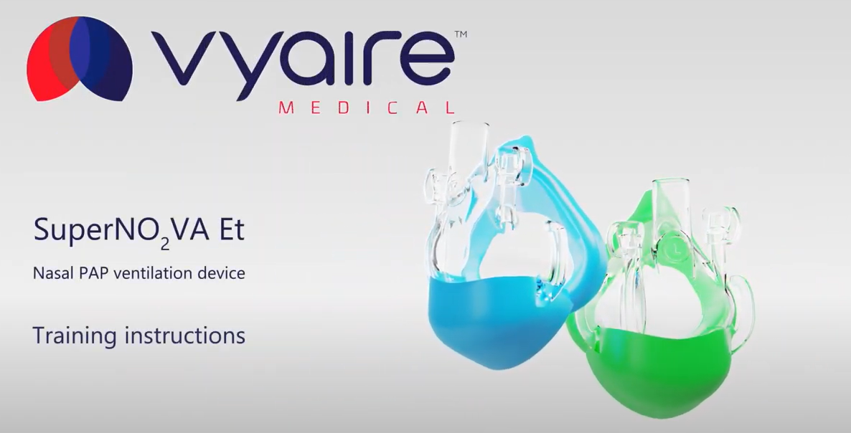
https://www.youtube.com/watch?v=7emvQtfQpFg

