Slide 1
Sedation & Respiratory Compromise Overview

Slide 2
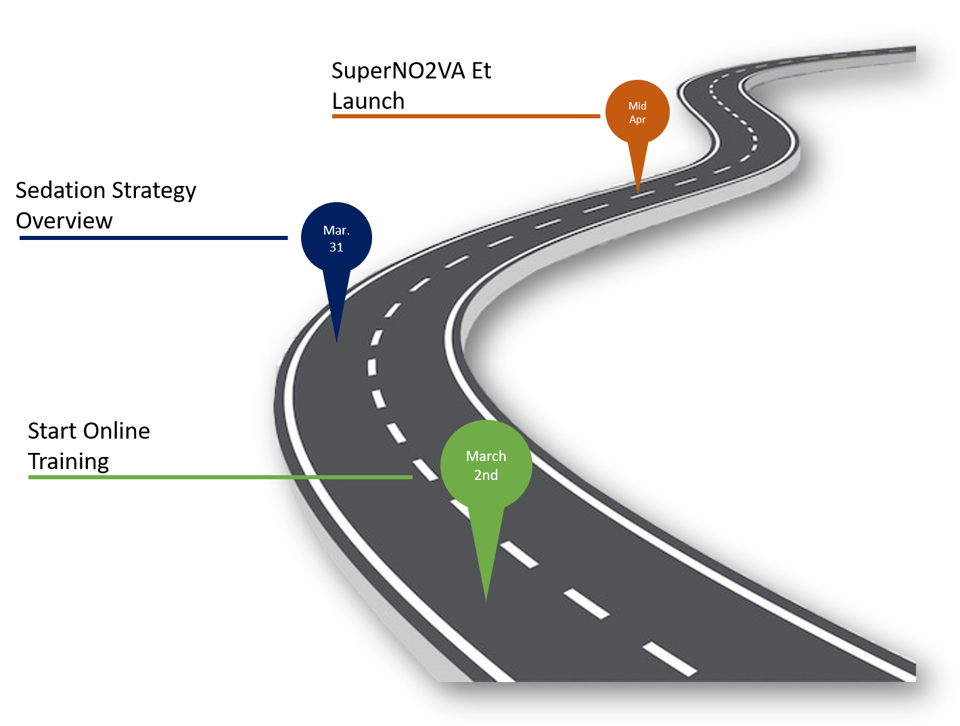
Way to success!
Ben Green
Marketing Director EMEAC

Slide 3
Anatomy, Physiology & Pathophysiology
Sedation
Fields of application
Target groups
Way to success!

Slide 4
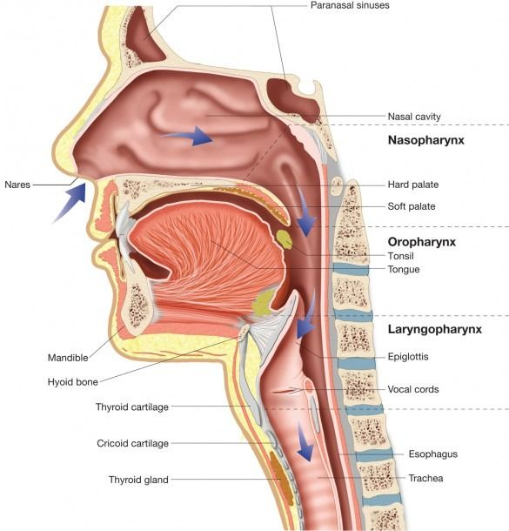
Upper Airway
Oral cavity:
Mouth, tongue, soft palate
Nasal cavity:
Nostrils, nasal mucosa
Pharnyx:
Nasopharynx: connects nasal cavity to pharynx
Oropharynx: connects oral cavity to pharynx
Laryngopharynx/Hypopharynx connects larynx to pharynx
Larynx: an organ that divides the upper and
lower airways and contains the vocal cords
Notes:
The upper airway is divided into different segments
The tongue is a muscle

Slide 5
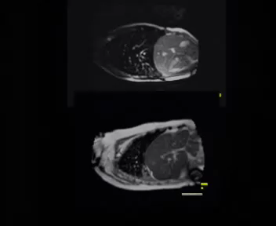
Spontaneous ventilation
Inhalation & Exhalation
Breathing starts with movement of the diaphragm
Space gets created in Lungs, breath in through Nostrils
Then nasal cavity, Pharynx, Larynx, through the vocal cords to the Trachea to the Lungs, Bronchioli, Alveoli to the capillary systems
Where the Gas exchange takes place
Notes:
That means negative pressure is created and this is how physiological breathing works
If you have a disturbance in the respiratory pump that leads to respiratory compromises
It is similar to double action pump by stand up paddling boards

Slide 6
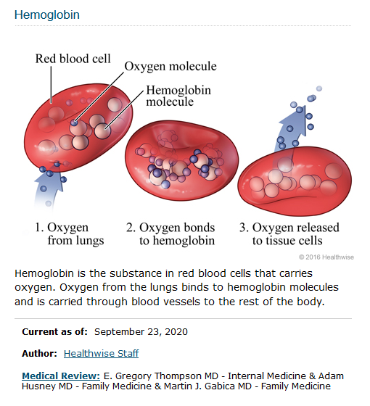
Hemodynamic & Oxygenation
Hemoglobin
Oxygen is binding on Hemoglobin and will be transported to the organs, tissue and cells.
It is driven by Cardiac Output (L/min) and dependent on different variables e.g. volume status of the patient this is why patients get infusions.
The best oxygenation is worthless without adequate hemodynamics therefore both components are important parameters for sedated patients.

Slide 7
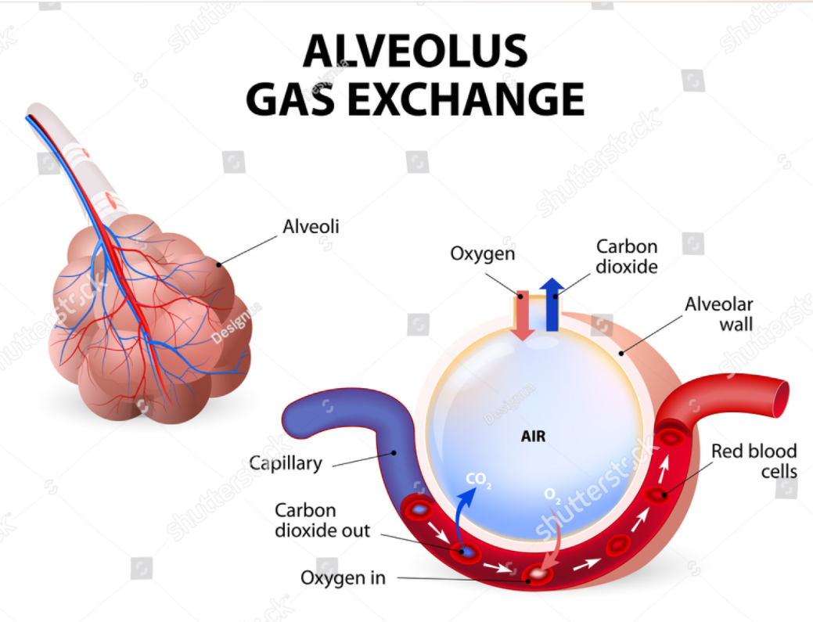
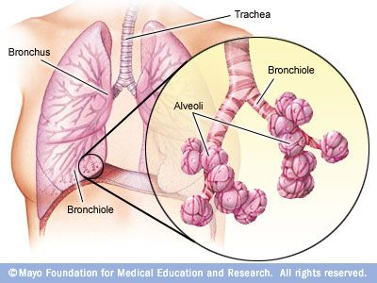
Physiology of respiratory system
Gas Exchange
Gas exchange is a physiologic process
Oxygen and carbon dioxide are transferred in opposite directions within the lower airways across the alveolar-capillary membrane.
It is important to understand that every cell in the body uses oxygen to create energy and perform metabolic tasks. During this cellular process, carbon dioxide is formed as a waste product that must be eliminated.
The ultimate goal of breathing is to supply O₂ to the blood and body’s tissues as well as remove CO₂ waste from the blood gathered from the tissues.
Notes:
The O2 enters the lungs through the trachea, which is divided into bronchioles and then alveoli
The blood flows through the capillaries past the alveolus, releasing CO2 into the alveolus and absorbing O2.

Slide 8
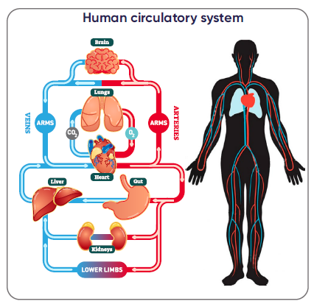
Hemodynamic & Oxygenation
Human circulatory system
The arterial system carries oxygenated blood away from the heart to the organs and cells, the venous system carries deoxygenated blood toward the heart.
In order to transport the blood it is necessary to have enough fluids such as blood in the vascular system, therefore it is important to give infusions to critically ill patients because otherwise the blood circulation thus the oxygenation cannot run adequately.
Notes:
Exactly why you have to drink during sport

Slide 9
Oxygenation & Ventilation
Gas Exchange
Oxygenation
Oxygenation is the delivery of oxygen to the tissues to maintain cellular activity.
Ventilation
The exchange of air between the lungs and the atmosphere so that oxygen can be exchanged for carbon dioxide in the alveoli.
Notes:
Oxygenation – Uptake Oxygen
Ventilation – Exhale carbondioxide

Slide 10
Respiratory Failure
Respiratory Failure
Type I Lung tissue |  | Type II Respiratory pump
Arterial Hypoxemia PaO2 < 70mmHg PaCO2 normal or <35 mmHg |  | Hypercapnia PaCO₂ > 45 mmHg
Alveolar Hypotension | Pneumonia ARDS Lung edema | Central | Intra-cerebral bleeding Coma
Distribution/ Diffusion | Lung fibrosis | Neuro muscular | Muscle dystrophie
Perfusion | Lung embolism | Obstruction | COPD Asthma
 |  | Restriction | Lung fibrosis Pneumo-thorax
Type III Combined Disorder
Notes:
Lung failure is divided into several types
What do you think which type is oxygenation problem and which type is ventilation problem?

Slide 11
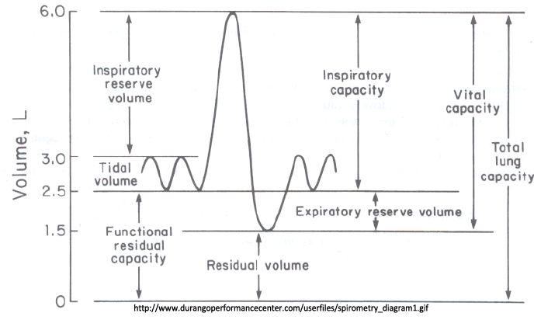
Spirometry Diagram
Tidal Volume (TV) – volume of air that moves into and out of the lungs with each respiratory cycle (approximately 500 mL under normal conditions).
Inspiratory Reserve Volume (IRV) – volume of air that can be inspired forcibly with maximal inspiratory effort beyond the tidal volume (approximately 2100–3200 mL).
Expiratory Reserve Volume (ERV) – volume of air that can be forcibly evacuated from the lungs with maximal expiratory effort beyond a tidal volume expiration (approximately 1000–1200 mL).
Residual Volume (RV) – volume of air remaining in the lungs after maximal forced expiration (approximately 1200 mL).
Total Lung Capacity (TLC) – sum of all lung volumes, aka total amount of air in lungs after maximal inspiratory effort (approximately 6000 mL).
Functional Residual Capacity (FRC)** – amount of air remaining in the lungs after a passive tidal volume expiration. It is the sum of the Residual Volume and Expiratory Reserve Volume (RV + ERV).

Slide 12
FRC
Full oxygen tank
O₂

Slide 13
FRC
Functional Residual Capacity
FRC represents the volume of air present in the lungs at the end of passive expiration and is critically important to airway management and anesthesia.
When large doses of anesthetic medications are given it is very likely that the patient will stop breathing spontaneously.
This is referred to as apnea.
During this time, oxygen continues to be taken away from the lungs by the blood and tissues but fails to be replenished because the act of breathing has been halted.
The patient continues to utilize the oxygen remaining in the lungs until it is exhausted, after which a lack of oxygen may contribute to extreme morbidity in the patient leading to tissue and organ injury, even brain damage and death.
Therefore the clinician initiates mechanical ventilation.
The patient will eventually exhaust the stores of oxygen in the FRC, causing oxygen desaturation, hypoxemia and patient harm.

Slide 14
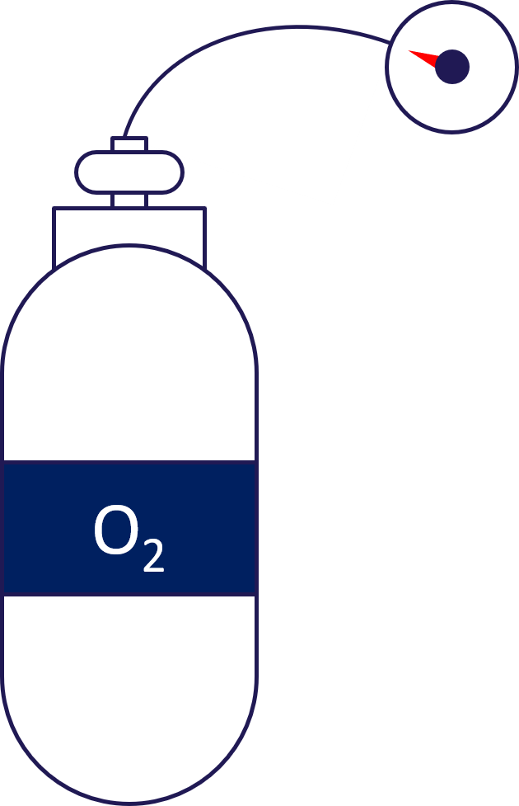
FRC
Empty oxygen tank
Patients stop breathing after sedation administration.
The patient continues to utilize the oxygen remaining in the lungs until it is exhausted.
Notes:
In this case the physiciance starts with positive airway pressure that means mechanical ventilation

Slide 15
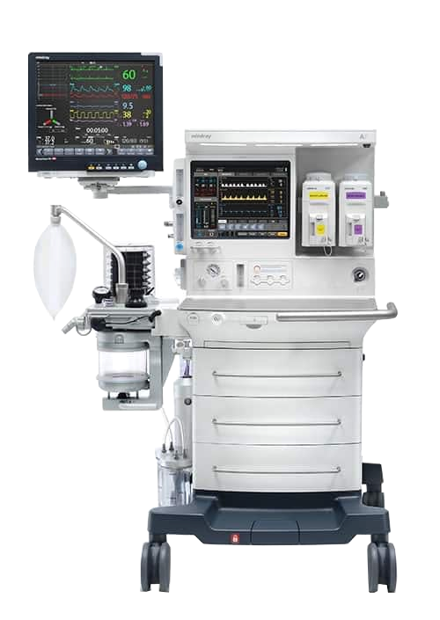
Positive Pressure Ventilation (PPV)
PPV refers to the process by which clinicians or ventilators may “breathe” for patients.
When they are unable to do so themselves, or support breathing in patients for whom spontaneous ventilation is inadequate.
Both of these states may be encountered in a patient under the effects of anesthesia.
This practice requires forcing air into the lungs through the respiratory tract via the generation of external positive pressure.

Slide 16
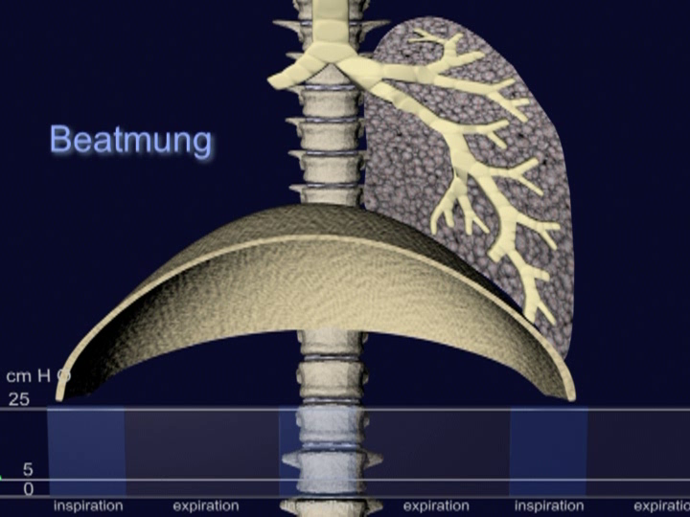
Positive Pressure Ventilation
Postive Pressure Ventilation
Notes:
The air/oxygen is forced into the lungs by positive pressure
Negative pressure is only by physiological ventilation

Slide 17
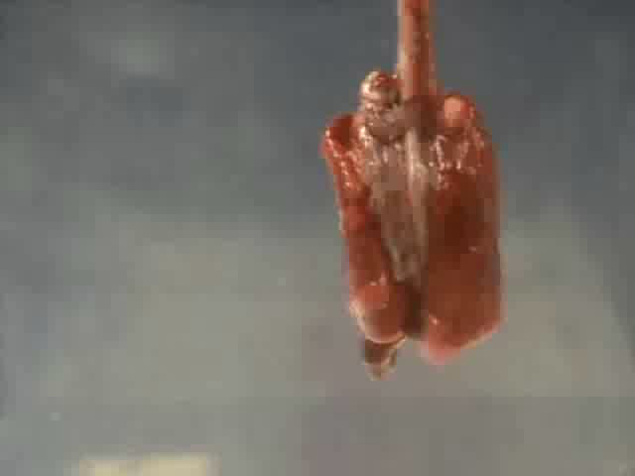
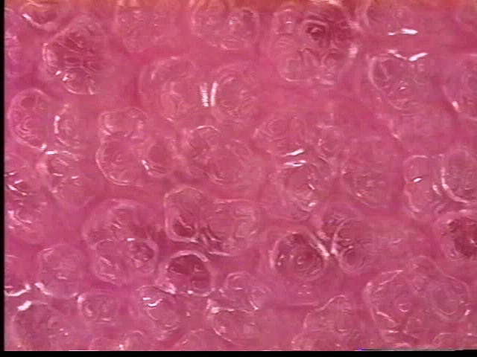

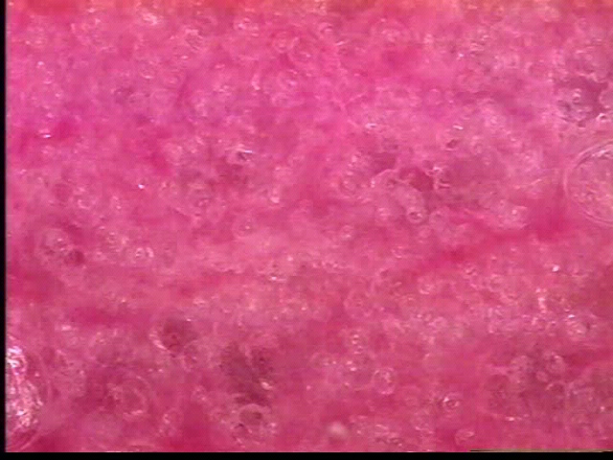
Atelectasis
Gas Exchange
Notes:
This video shows us what would happen if the lungs do not have positive pressure ventilation during anesthesia. The FRC would be zero and the lung would collapse. Here it is shown how to recruit the lung areas with positive pressure, the lung fills with O2 and the non-ventilated areas are perfused again.
Video 1: Movement of healthy alveolae during inspiration/expiration
Video 2: Shows overdistention of the alveolae that means membrane wall is any time in the inspiration overinflated what happen is like a balloon when you overinflate this they tear in and will be destroyed this
Video 3: Shows destroyed alveolae which are converted to atelectasis, what we can see is that there are no movements anymore and that means there is no gas exchange

Slide 18
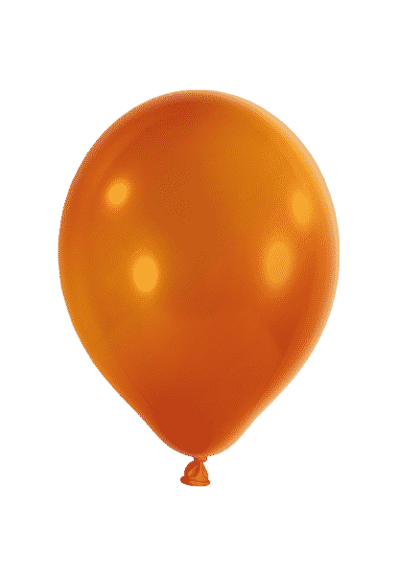
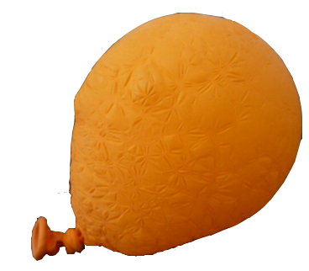
Notes:
The balloon represents the healthy alveolus
a diseased alveolus is shown on the right it can no longer absorb as much O2 as the healthy alveolus
and when it collapses, the walls stick together and no more O2 can enter, then more force is needed to inflate it again.
I think you all tried it once to blow up an old ballon where you need more force (positive pressure) to inflate the ballon

Slide 19

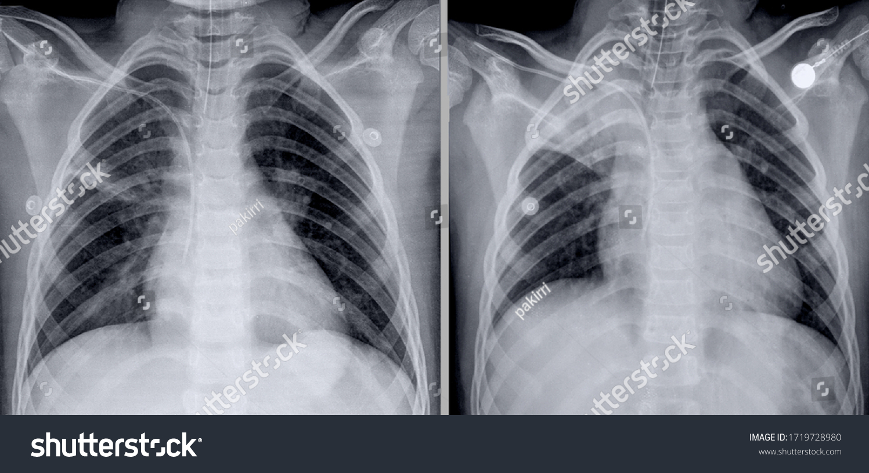

Atelectasis
Atelectasis is a complete or partial collapse of the entire lung or area (lobe) of the lung. It occurs when the tiny air sacs (alveoli) within the lung become deflated or possibly filled with alveolar fluid.
Atelectasis leads to severe hypoxaemia
Intrathoracic positive pressure is the most important approach in the prevention and management of atelectasis
Atelectasis, this area is not more involved on the gas exchange.
Overdistension cause also to atelectasis and cell death
Notes:
Overdistention cause to lung damages and can also leads to atelactasis and Baro- and/or Volutrauma
Lung protective ventilation is in these patients very important

Slide 20
Monitored Anesthesia Care (MAC)
Sedation
MAC is a planned procedure which the patient undergoes local anesthesia together with sedation and analgesia.
Actually, MAC is the first choice in 10-30% of all the surgical procedures.
Goal:
Safe sedation
Control of anxiety
Pain control
Ghisi et al., MINERVA ANESTESIOL 2005;71:533-8
Notes:
When medical intervention is need for example Endosopy, Orthopedic procedure a monitored anesthesia care and sedation is needed

Slide 21

Sedation depth
Sedation and anesthesia have long been associated with high rates of hypoxemia and hypoventilation, which can ultimately result in Respiratory Compromise.¹⁻³
There are three different types of sedation:
Minimal
Moderate
Deep sedation
As the depth of sedation increases, adapted monitoring of the patient is needed.
During sedation, the patient’s respiratory effort is reduced by the medication or suspended by the relaxation, so they need respiratory and hemodynamic support or even mandatory ventilation.
 | Minimal sedation (anxiolysis) | Moderate sedation (conscious sedation) | Deep sedation | General anesthesia
Responsiveness | Normal response to verbal stimuli | Purposful response to verbal or tactile stimuli | Purposeful response to noxious stimuli or insistent verbal stimuli | Unarousable
Airway | Normal | No intervention needed | Intervention may be needed | Airway support needed
Spontaneous ventilation | Normal | Adequate | Usually inadequate | Ventilatory support usually needed
Cardiovascular function | Normal | Usually maintained | Usually inadequate | May be impaired
Notes:
To check the risk of the patients it is usual to score them

Slide 22

Risk Score
American Society of Anesthesiologists (ASA) Score
The ASA Physical Status Classification System has been in use for over 60 years.
The purpose of the system is to assess and communicate a patient’s pre-anesthesia medical co-morbidities.
The classification system alone does not predict the perioperative risks, but used with other factors (eg, type of surgery, frailty, level of deconditioning), it can be helpful in predicting perioperative risks.
Notes:
The ASA Score is worldwide recognized scoring system for the assessment of patients before anesthesia.

Slide 23
ASA Score
ASA I | A normal healthy patient Normal BMI Nonsmoker No or minimal alcohol consumption | ASA IV | A patient with severe systemic disease with constant threat to life Heart attack less than 3 months ago CVA or TIA CAD with stents Ongoing cardiac ischemia or severe valve dysfunction Severe reduction of ejection fraction Sepsis Disseminated intravascular coagulation (DIC) ESRD, not undergoing regular scheduled dialysis
ASA II | A patient with mild systemic disease without significant functional limitation Active smoker Social alcohol consumption Pregnancy Obesity – BMI 30 – 40 Controlled Diabetes mellitus (DM) and hypertension Mild Lung Dysfunction | ASA V | A critically ill patient not expected to survive without the operation Ruptured thoracic or abdominal aneurysm Massive trauma Intracranial bleeding with mass effect Ischemic bowel with significant cardiac pathology Multiple organ or system dysfunction ASA 6: A declared brain-dead patient with plans for organ donation
ASA III | A patient with severe systemic disease with significant functional limitation Alcohol depencence or abuse Morbid obesity – BMI of more than 40 Poorly controlled DM and hypertension Acitve hepatitis Implanted pacemaker Moderate reduction of ejection fraction End-stage renal disease, undergoing regular, scheduled dialysis COPD Premature infant with a post-conceptual age of less than 60 weeks Hear attack history Stroke or Trans ischemic attack (TIA) Coronary artery disease with stents Obstructive sleep apnea | ASA VI | A declared brain-dead patient with plans for organ donation
Notes:
ASA V – VI patients are rescue procedures no elective procedures
CVA – cerebrovascular accident
TIA – Tranischemic Attack
CAD – Coronary artery disease
ESRD – Endstage renal disease

Slide 24
Sedation Strategy
Risk Classification
High Risk
Patients
Mid Risk Patients
Low Risk Patients
ASA III - IV
ASA II
ASA I
Notes:
The surface of the colors also reflects the numbers of the patients

Slide 25
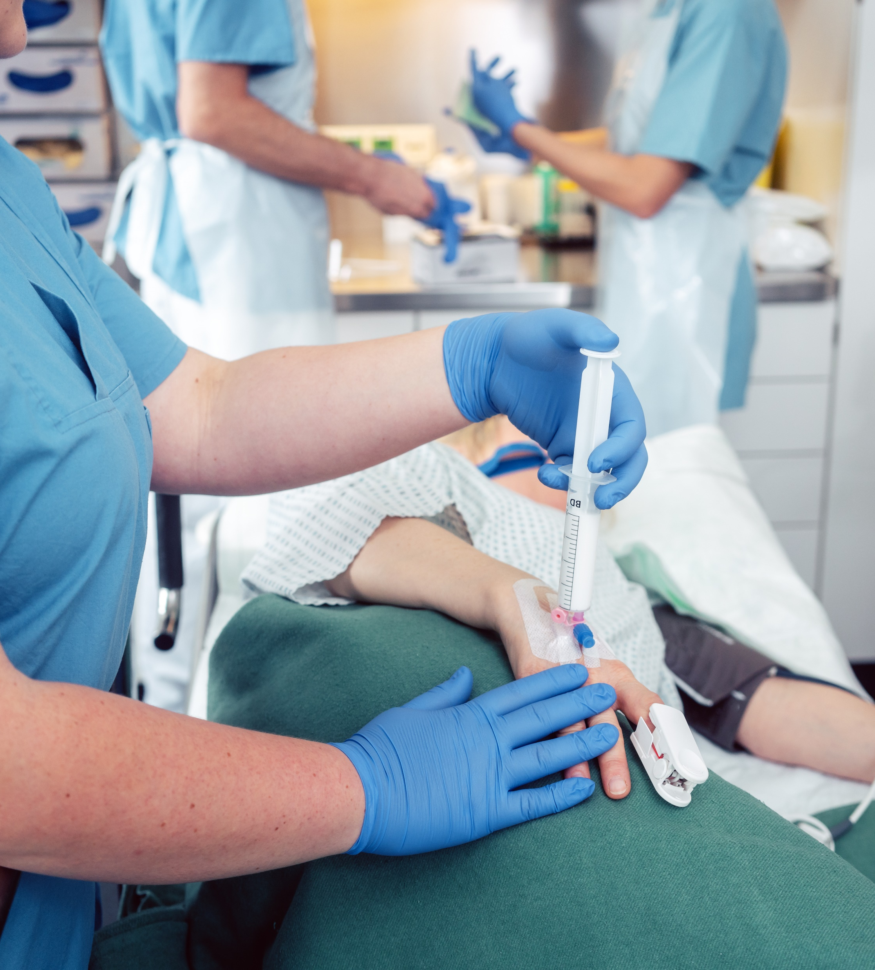
Deep sedation
Deep sedation is defined as “a controlled, pharmacologically induced state of depressed consciousness from which the patient is not easily aroused, and which may be accompanied by a partial loss of protective reflexes, including the ability to maintain a patent airway independently and/or respond purposefully to physical stimulation or verbal command.”
Propofol is a common sedative-hypnotic agent that can be used for Monitored Anesthesia Care (MAC).
Risk of Propofol Sedation:
Airway collapse
Hypoxia
Hypotension
Arrhythmia
Apnea
Hypoventilation
Co-morbidities
Undiagnosed Sleep Apnea
Cardiopulmonary pre-existing diseases
Clinical Review of Oral and Maxillofacial Surgery (Second Edition), 2014
Notes:
Monitoring these patients during anesthesia is therefore extremely important
To avoid sedation complications

Slide 26
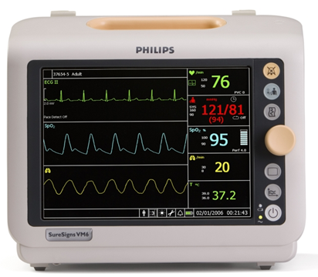
Deep Sedation
Patient Monitoring
Blood pressure
Heart rate
Pulse oximetry/SpO₂
Patient vital signs before, during, and after the procedure
ECG monitoring should be continuous for high-risk patients, during prolonged procedures, or during deep sedation.
Monitor airway patency.
Monitor response to physical stimuli and verbal command.

Slide 27
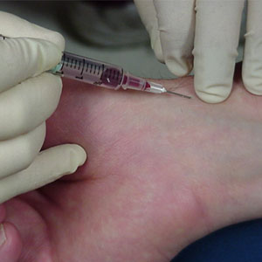
Patient Monitoring
Blood Gas Analysis
The most common monitor for both oxygenation and ventilation is the arterial blood gas (ABG). An ABG test is the most commonly used method to measure both oxygenation and ventilation.
It is an invasive procedure that involves taking blood from an artery and measuring the amounts of oxygen and carbon dioxide dissolved in the blood.
Normal Range
 | Arterial
pH | 7.40 (7.35 - 7.45)
pCO2 | 35 - 45 mm Hg
pO2 | 80 - 100 mm Hg
HCO3 | 22 - 26 mEq/L
Base Excess | -2 to +2
Notes:
The gold standard to monitor O2 uptake and CO2 release is the BGA
Unfortuneately it is not possible to measure it continuously the last company which did this gave up this business 15 years ago

Slide 28
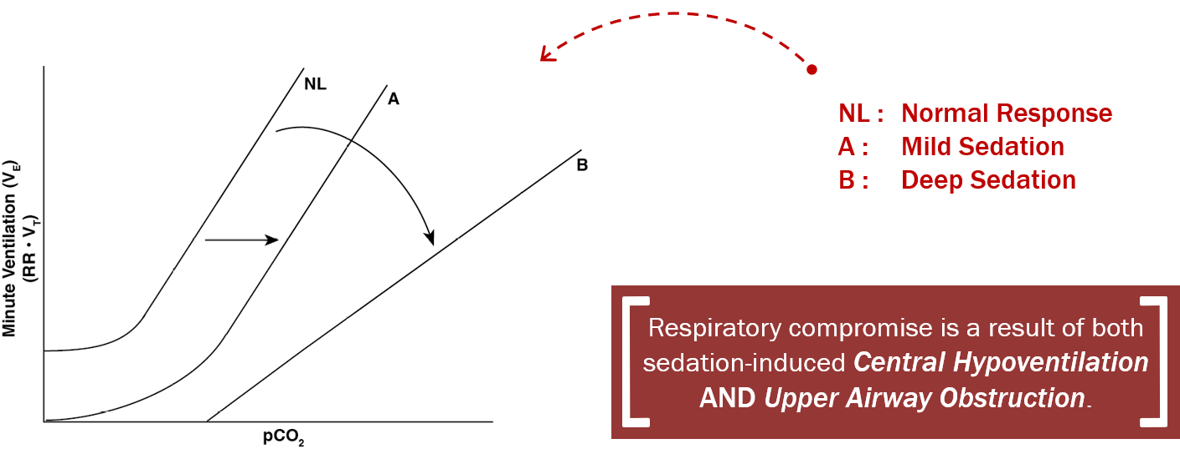
Hypoventilation
Increase in CO₂ causes respiratory drive (breathing)
Sedation dampens the central nervous system, i.e. respiration is reduced and the musculature tonus relaxed.
CO₂
RR
Notes:
Hypoventilation is breathing that is too shallow or too slow to meet the needs of the body
If you run a high mountain or a long distance fast, you have also used up your O2 level and therefore have to breathe faster because your CO2 level in the blood has risen high. But if you are sedated now this is not possible because the sedation paralyzes your CNS and muscles.

Slide 29
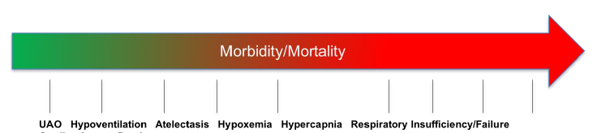
Morbidity/Mortality
Complications associated with UAO and hypoventilation
Cardiac Arrest
Death
Hypoventilation and upper airway obstruction are the two mechanisms that result in a life-threatening complication known as Respiratory Compromise (RC).
RC is a continuum of respiratory complications that consists of minor complications such as oxygen desaturation to life-threatening complications such as respiratory failure.
UAO and respiratory depression are the most common serious adverse effects associated with sedative drug administration.
The greater the degree of sedation, the greater the degree of respiratory depression
Notes:
When a patient’s airway is obstructed during sedation, oxygen cannot diffuse into the blood, which may result in oxygen desaturation. Simultaneously, sedation drugs depress the respiratory drive resulting in hypoventilation.
Think about the drugs and the patient if you give a lot of drugs to a healthy patient their respiratory drive is reduced but at least the airway is open and there are breathing
If you give the same amount of drugs to a high risk patient then they have also a reduced respiratory drive and their airway will collapse.
As showed before the patient monitor only has SpO2 measurement.
What are we doing when we have only SpO2 and not a continuous monitoring for CO2? How can we assure that the patient is exhaling his CO2?

Slide 30
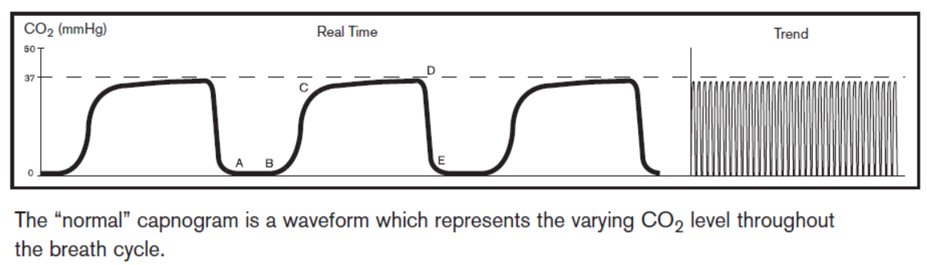
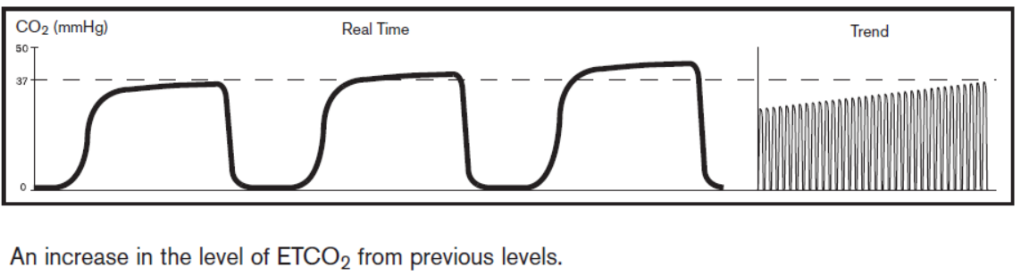
CO₂ measurement
ETCO₂ measurement
What is ETCO₂?
The CO₂ concentration at the end of expiration
Provides a clinical estimate of the PaCO₂
Breath by breath assessment of ventilation
Oxygen & carbon dioxide levels determine how sufficient the ventilation is
Allow for clinician intervention
Using equipment to measure the CO₂ is important because dangerous levels of excess carbon dioxide can build up in the system even though the level of oxygen saturation in the blood is adequate, such as when supplemental oxygen is given.
CO₂ can be dangerously high even if the SpO₂ is normal.
Notes:
ETCO2 will captured by a sensor which is placed on the patients interface e.g. Nasal cannula, O2 mask

Slide 31
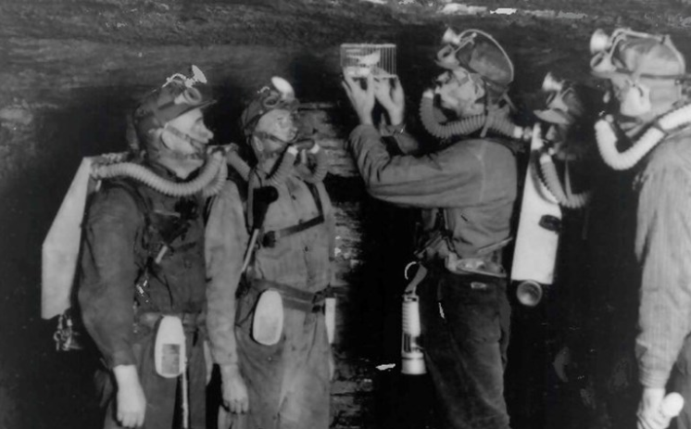
Canary bird in the coal mine
ETCO₂

Slide 32

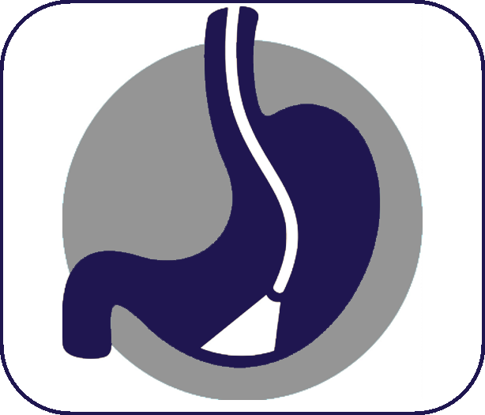

Fields of application
Where can SuperNO₂VA help the most?
Operating Room
GI Endoscopy
Cardiology
Notes:
We are familiar with OR and recently we are also begin with the GI Endoscopy
but we should also look at cardiology or minimal cardiac surgery in this field is a very high potential
Patients are old, sick and get sedated => high risk patients

Slide 33
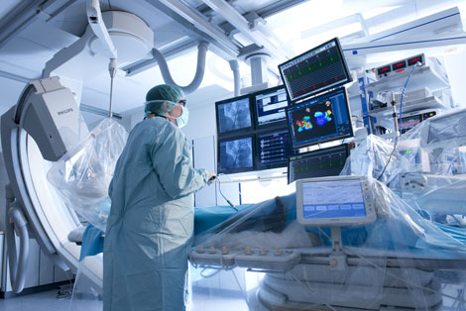
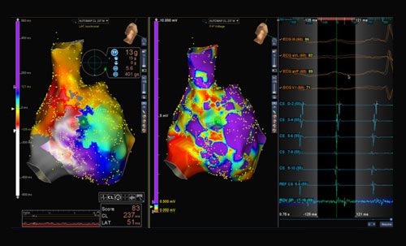
Cardiology
Electrophysiology Unit (EPU)
An electrophysiology (EP) study is a test performed to assess your heart's electrical system or activity and is used to diagnose abnormal heartbeats or arrhythmia.
The test is performed by inserting catheters and then wire electrodes, which measure electrical activity, through blood vessels that enter the heart.
Patients need sedation for this procedure.

Slide 34
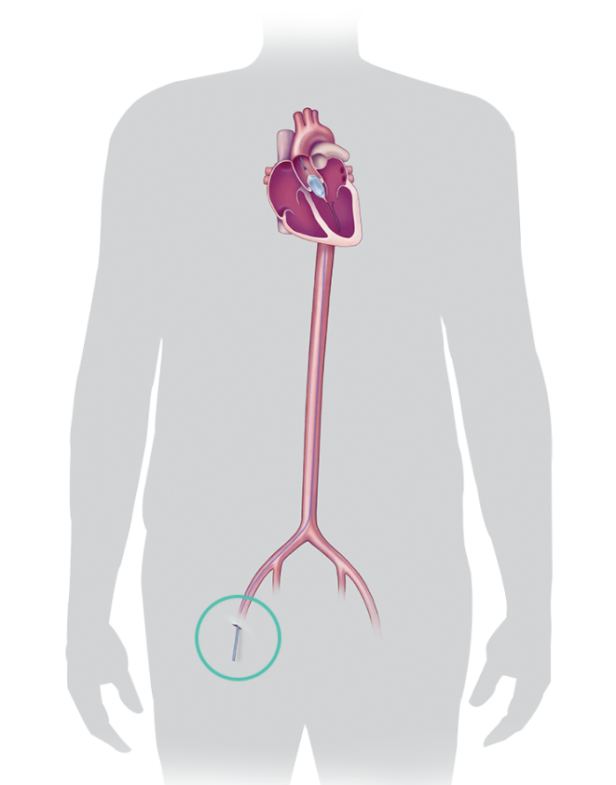
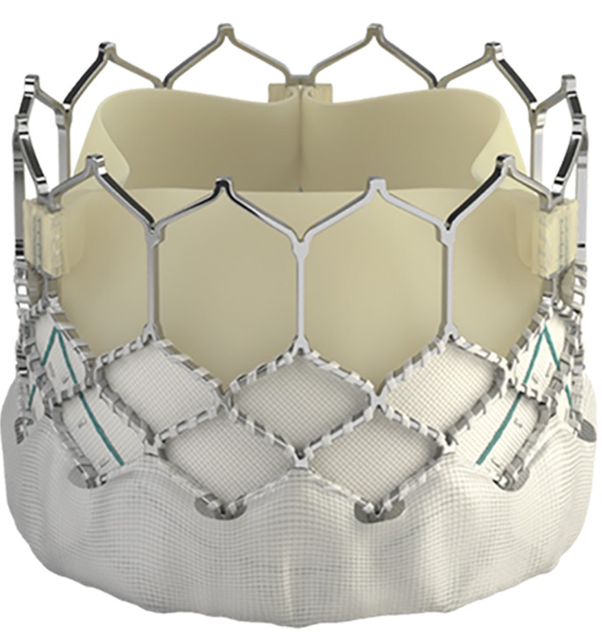
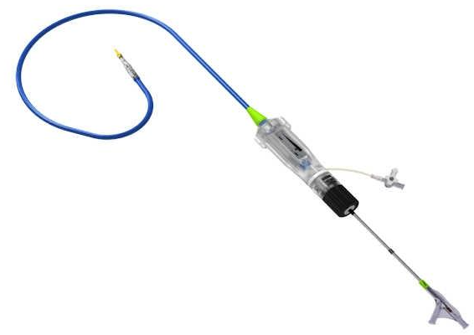
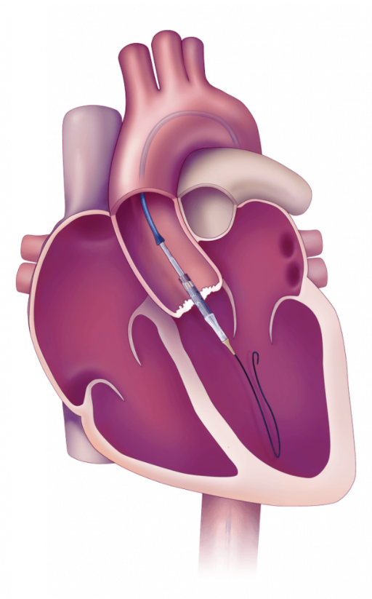
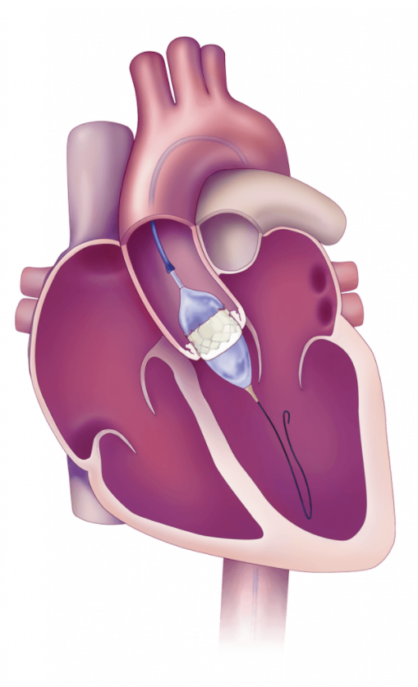
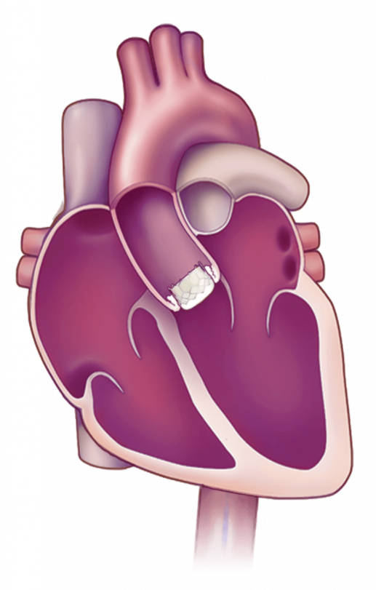
Transaorthic Catheter Valve Implantation
TAVI / TAVR
During this minimally invasive procedure a new valve is inserted without removing the old, damaged valve. The new valve is placed inside the diseased valve.
The surgery may be called a transcatheter aortic valve replacement (TAVR) or transcatheter aortic valve implantation (TAVI).
This procedure is performed under deep sedation.

Slide 35
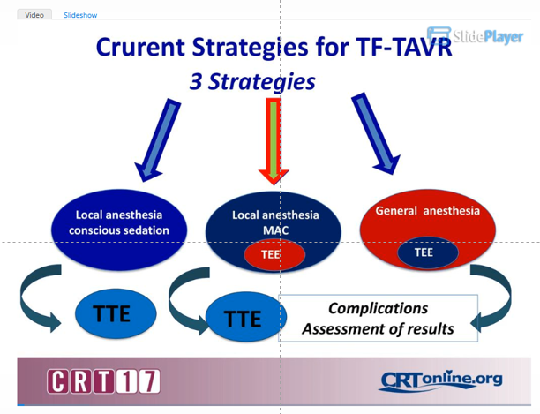
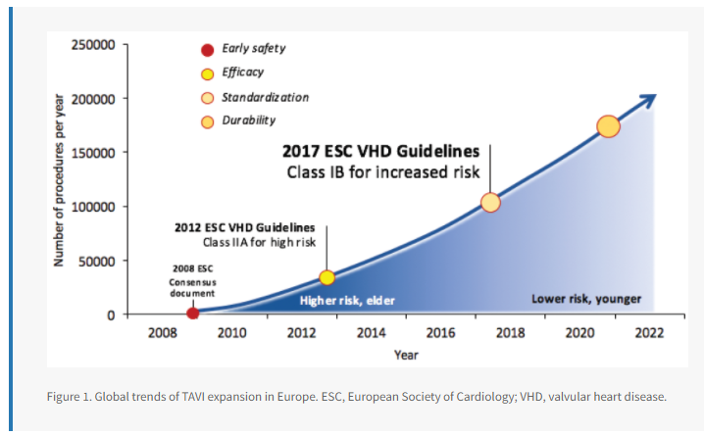
Transaorthic Catheter Valve Implantation
Procedures

Slide 36
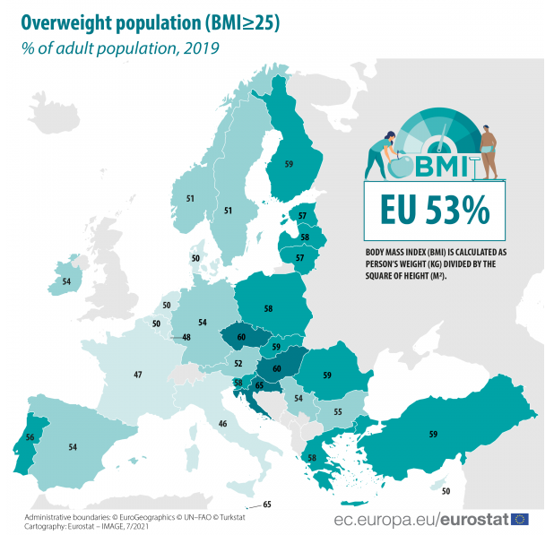

Obese patients
Overweight population

Slide 37
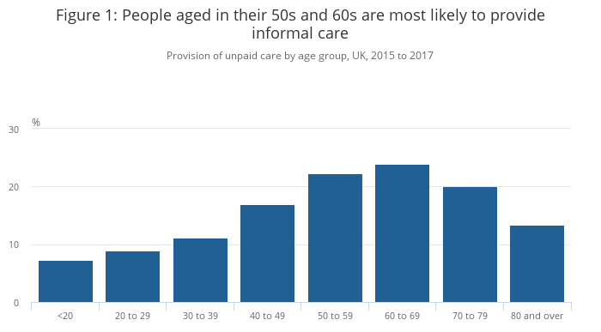
Population demography
Ages
Source: Understandig Society

Slide 38
Medical Interventions
Sedation needed
Patients are older, sicker and have more comorbidities in this case the risk is increasing in those patients.
Therefore it is important to avoid sedation complications for those patients.

Slide 39
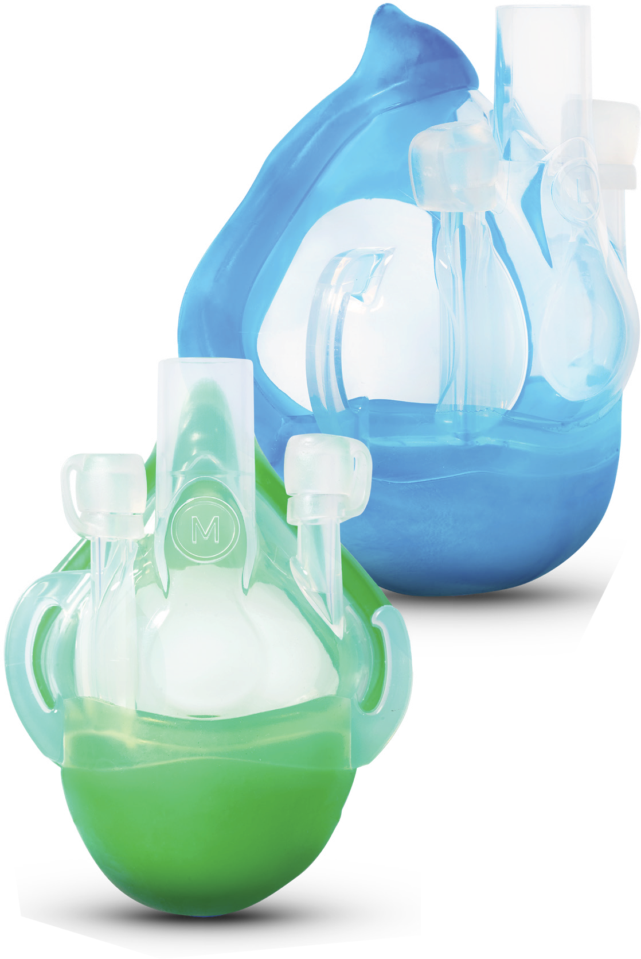
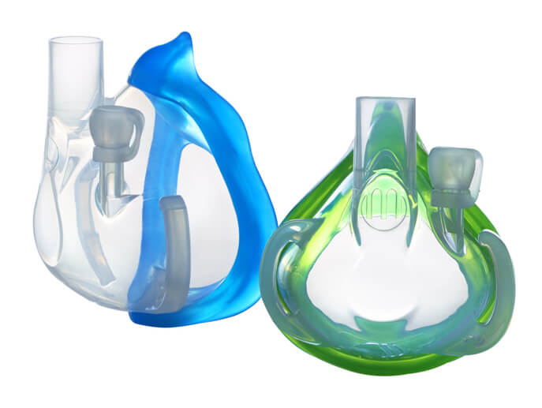
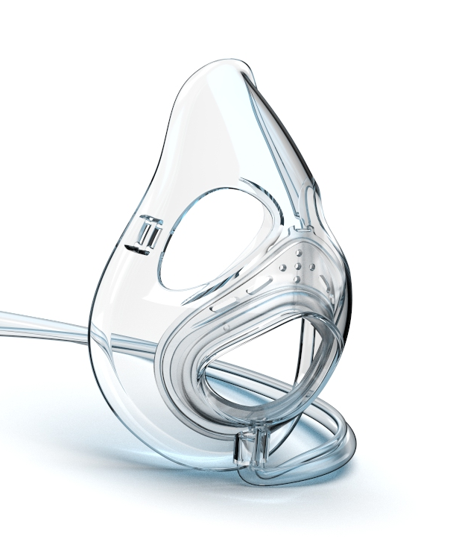
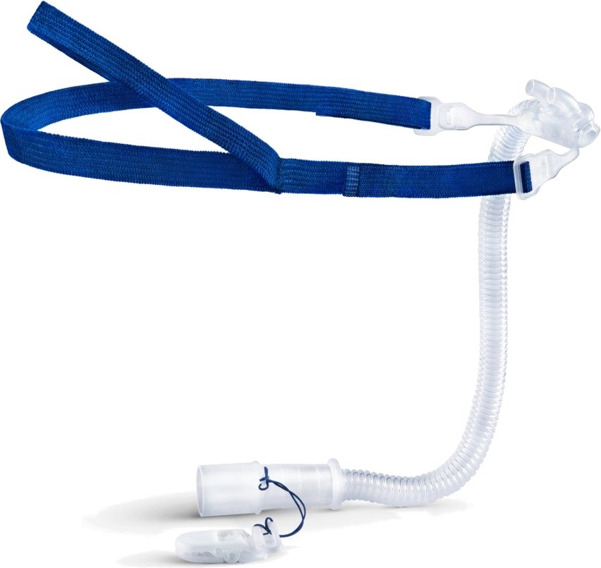
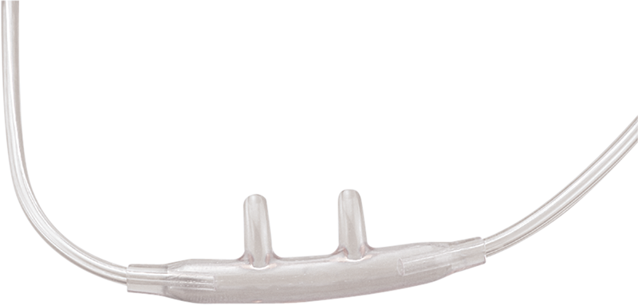
Sedation Strategy
Risk Classification
High Risk
Patients
Mid Risk Patients
Low Risk Patients

Slide 40
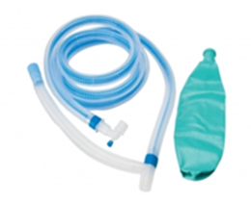
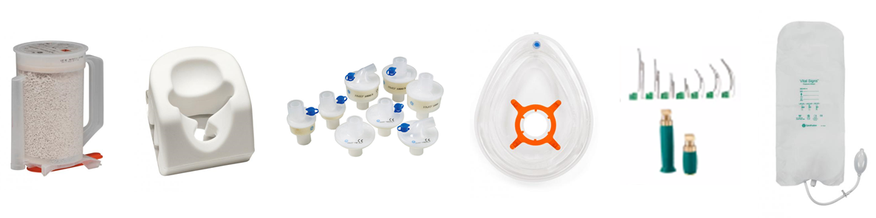
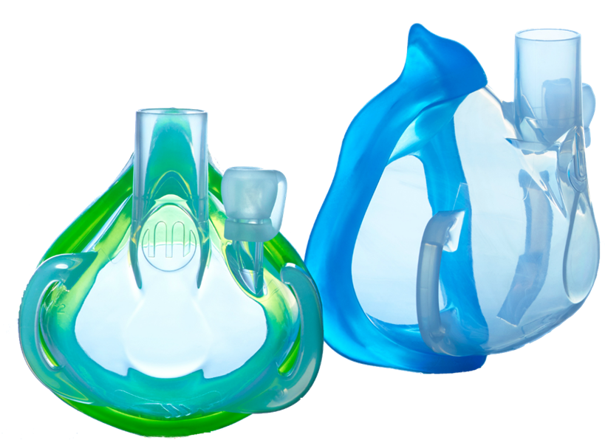
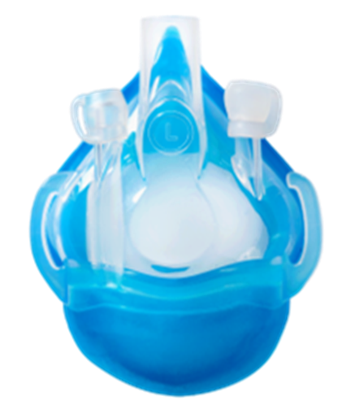
Sedation Strategy
Cross Dept. / ED
Endoscopy / GI
Operating Room
 | Minimal sedation (anxiolysis) | Moderate sedation (conscious sedation) | Deep sedation | General anesthesia
Airway | Normal | No intervention needed | Intervention may be needed | Airway support needed
Spontaneous ventilation | Normal | Adequate | Usually inadequate | Ventilatory support usually needed
Low Risk Patients
Pull through legacy portfolio of OR consumables
Medium Risk Patients
High Risk Patients

Slide 41
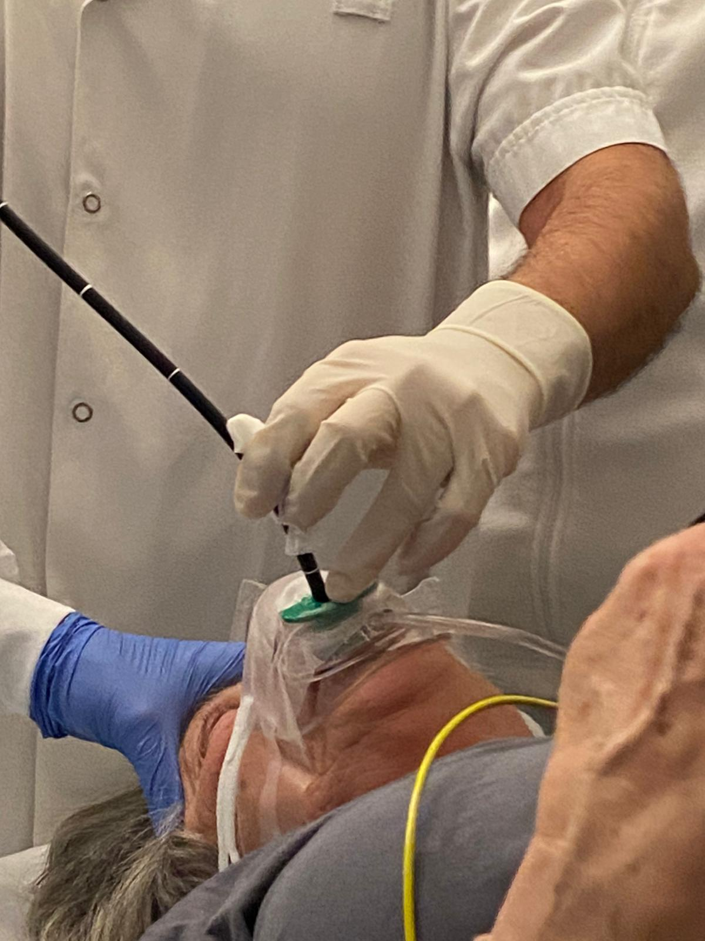
Sedation in patients
Mid Risk patients
Upper airway obstruction rarely occurs in intermediate-risk patients, so adequate oxygenation can bridge sedation in these patients.

Slide 42
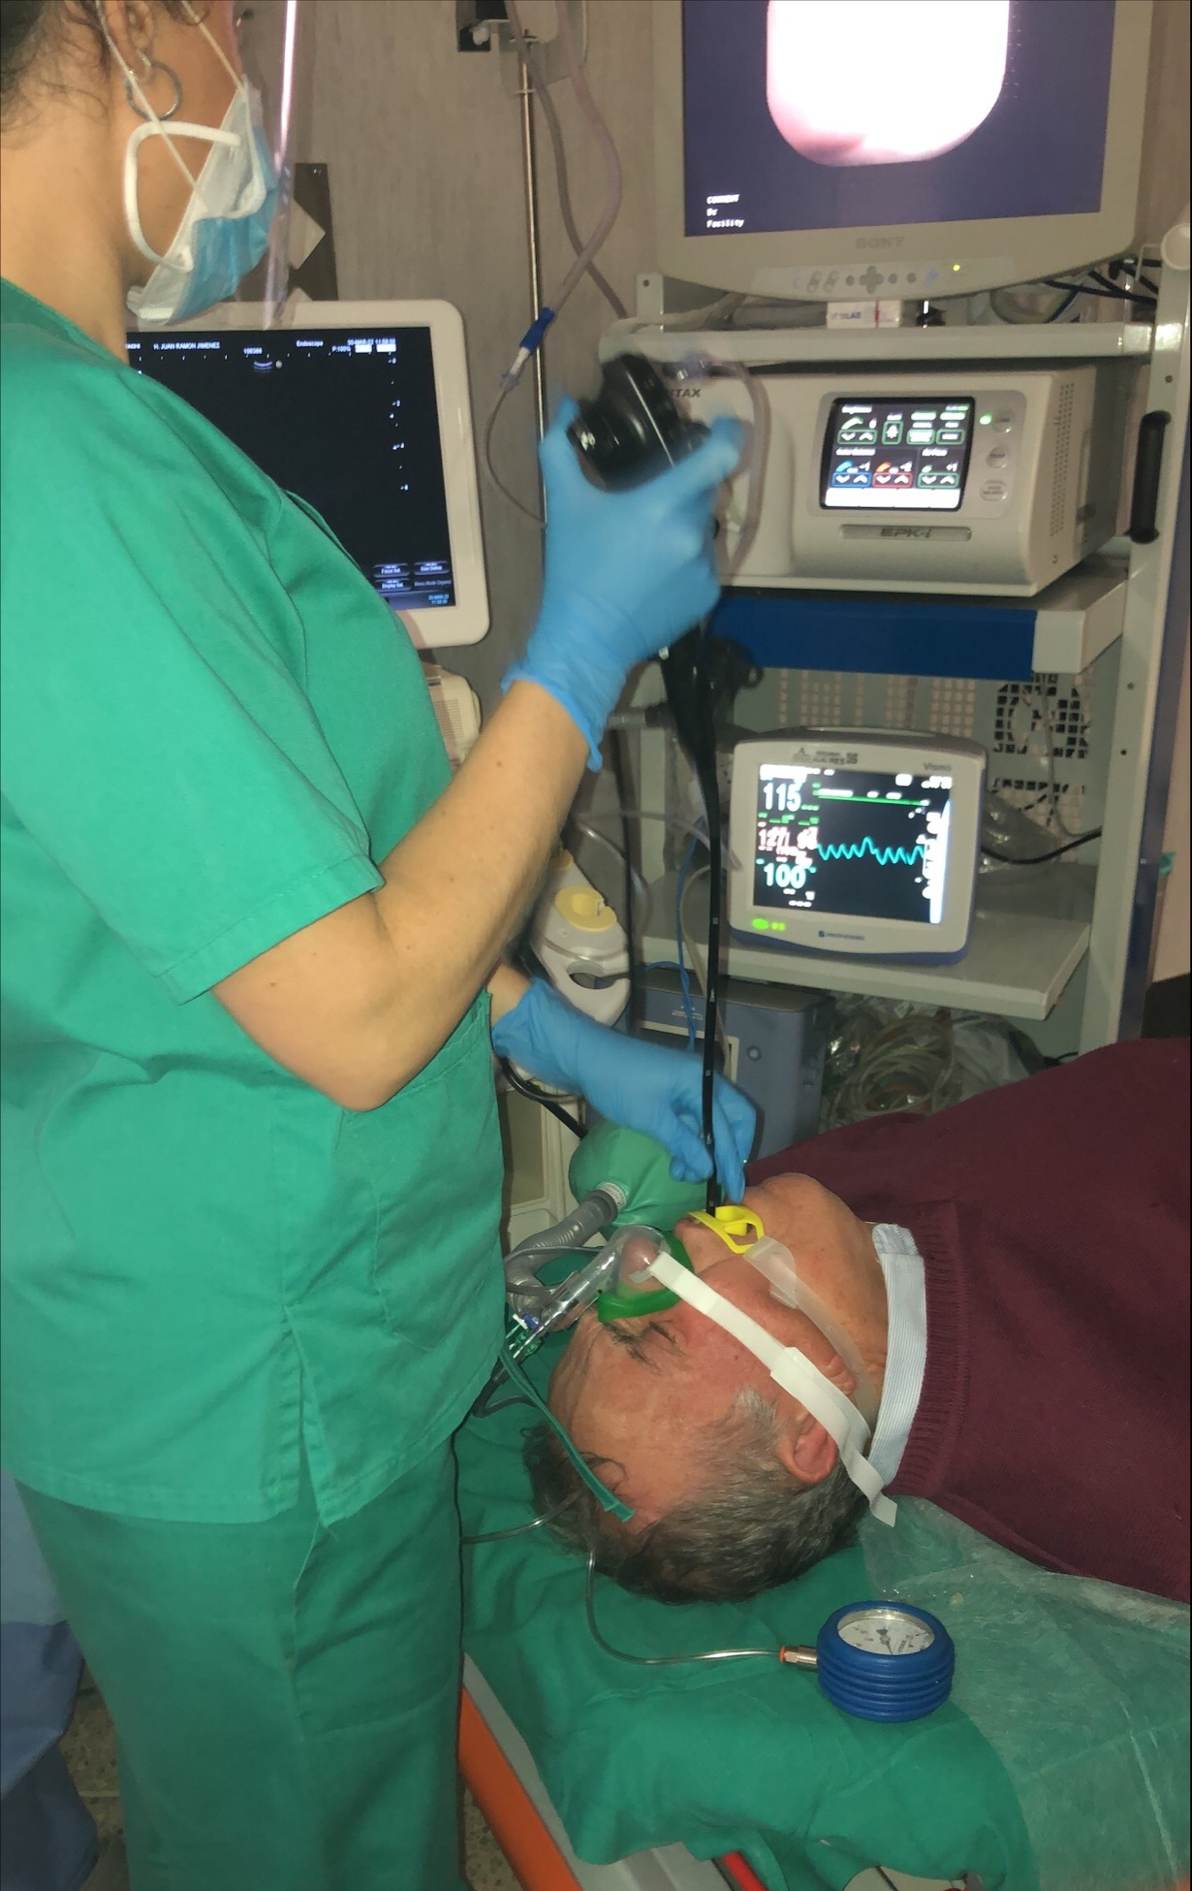
Sedation in patients
High risk patients
In high risk patients upper airway obstruction occurs often.
Positive pressure is needed to stent open the upper airway and provide adequate oxygenation.

Slide 43

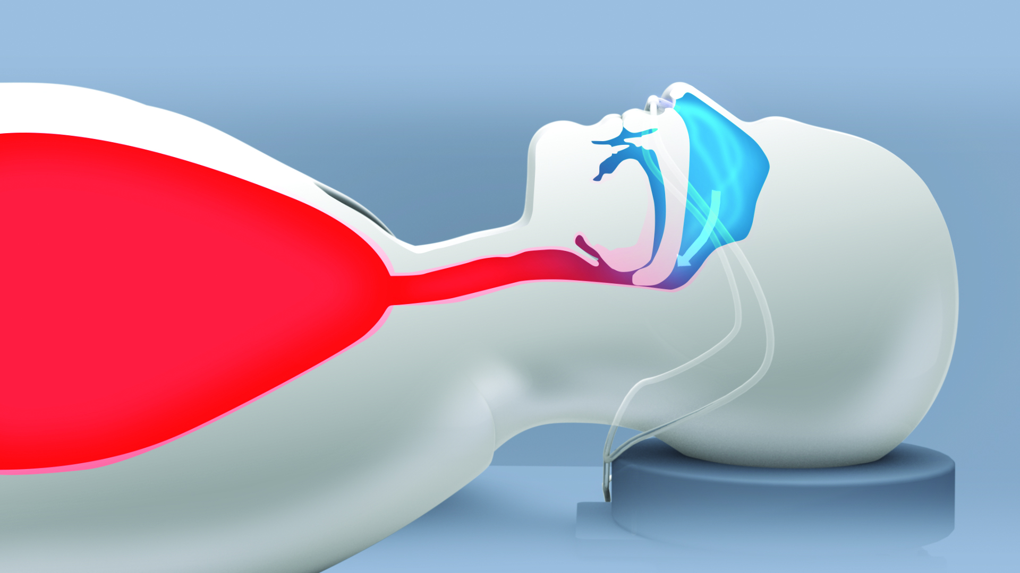
Upper Airway Obstruction (UAO)
Upper airway obstruction and severe atelectasis induced by sedation and/or opioids are known causes of hypoxemia, hypoventilation and acute respiratory failure in the perioperative setting or during endoscopic examinations.⁴⁻⁵
High risk patients:
BMI ≥ 30kg/m2
Obstructive sleep apnea (OSA)
Congestive heart failure (CHF)
Chronic obstructive pulmonary disease (COPD)
Oxygen saturation <95% on supplemental oxygen
Patients are older, sicker and have more comorbidities in this case the risk is increasing.
Therefore, it is important to avoid sedation complications for those patients.
Notes:
Diagram shows the obstruction of the upper airway the tongue is falling in the soft palate and the soft palate obstruct the airway

Slide 44


Morbidly Obese
There are three reasons why morbidly obese patients are at a higher risk for Respiratory Compromise.
They have a significantly larger amount of pharyngeal soft tissue, which increases their risk for Upper Airway Obstruction under sedation.
Their larger amount of abdominal tissue compresses their lungs, resulting in decreased FRC, increased atelectasis, and a reduction in oxygen delivery.
The oxygen consumption in obese patients may be up to 5 – 10x higher than average. Therefore, not only do they have less oxygen entering their blood, but their oxygen requirements are also much higher.
Fat tissue and abdominal diaphragm shift compresses the lungs and leads to volume reduction in the alveoli which leads to atelctasis.

Slide 45

Obstructive Sleep Apnea
The first reason for increased risk in this population is the tendency towards upper airway obstruction.
A patient who obstructs during normal sleep will certainly obstruct during anesthesia, leading to increased risk for hypoxemia and hypercarbia.
Second, over time chronic hypercarbia and hypoxemia leads to a reduced responsiveness of the normal respiratory center in the brain.
This leads to chronically elevated pCO₂ levels at baseline, and a further reduced responsiveness under anesthesia.
Therefore, even small amounts of sedative medications can cause significant depression in respiratory drive.
https://www.indiamart.com/proddetail/osa-obstructive-sleep-apnea-19402856388.html

Slide 46
STOP BANG Score
STOP | Result |  | Score
Do you often SNORE loudly (louder than talking) | Yes | No | 1
Do you often feel TIRED, fatigued or sleepy during day | Yes | No | 1
Has anyone OBSERVED you stop breathing during sleep | Yes | No | 1
Do you have high blood PRESSURE | Yes | No | 0
BANG
BMI more than 35Kg/m2 | Yes | No | 0
AGE over 50 years | Yes | No | 0
NECK circumference >40cm | Yes | No | 0
GENDER Male | Yes | No | 1
Score 1 point for each positive response
Scoring Interpretation: 0-2 Low Risk; 3-4 Intermediate Risk; 5 or more High Risk

Slide 47

Congestive Heart Failure (CHF)
CHF is associated with two processes that significantly decrease the oxygen reserves and therefore increase risk for RC.
First, the heart is unable to pump sufficiently to maintain blood flow to meet the body's demands, which means that the amount of oxygen being delivered to the patient is less than what the body is consuming (ie: oxygen delivery < oxygen demand).
Second, the heart as a pump may be so weak that it cannot effectively pump the blood out, leading to a backup of blood in the pulmonary system (like traffic).
This causes blood to back up into the lungs (ie: alveoli) resulting in fluid to be built up (ie: pulmonary edema).
As fluid fills the alveoli, there is no opportunity for air or oxygen to enter, and therefore no opportunity for gas exchange in those lung segments.
The gas exchange is not possible because the alveolae are filled with fluids

Slide 48

Chronic Obstructive Pulmonary Disease (COPD)
COPD is an obstructive lung disease in which poor airflow and inability to breathe out fully (air trapping) exist.
In COPD, more than half of alveoli are destroyed, which leaves them only able to fill half as many alveoli with oxygen for diffusion.
The second process is due to inflammation of the small airways, which blocks the small airways and prevents the patient from exhaling CO₂.
Since a significant amount of CO₂ remains in the lungs, it prevents oxygen from entering.
These patients are a very high risk for oxygen desaturation once sedation is induced because they have significantly less oxygen stored in their alveoli.
Notes:
Less oxygen tank due to damaged alveoli and therefore less oxygen amount
The first process is the breakdown of lung tissue, which prevents a significant amount of oxygen from being able to diffuse from the alveoli into the blood.
Therefore, patients with COPD have significantly less oxygen in their lungs because they have less alveoli and CO2 taking its place.

Slide 49


Difficult mask ventilation
Difficult ventilation has been defined as the inability of a trained anesthetist to maintain the oxygen saturation > 90% using a facemask for ventilation and 100% inspired oxygen.
Risk factors:
Body mass index (BMI) >26
Age >55
Edentulous (ie: not teeth)
Beards
History of snoring
Notes:
Patients that are obese (BMI > 26) or have a history of snoring are difficult to ventilate because they have an abundance of soft tissue surrounding their airway that collapses into the airway once they are sedated.
The more soft tissue that collapses into the airway, the more pressure that will be required to stent it open.
Patients that are over 55 years old are also more likely to have obstruction under anesthesia secondary to decreased muscular control of the upper airway and depressed airway reflexes associated with age.
Having no teeth (edentulous) is a risk factor for difficult ventilation because the oral cavity collapses when closed, forcing the tongue posterior into the soft palate. In addition, it is more difficult to create a mask seal around the mouth, making leaks more common.
Finally, patients that have beards are at risk for difficult ventilation because the facial hair creates an uneven surface, over which it is difficult to create a proper air-tight seal. This causes gas to leak out around the mask, which prevents positive pressure from being generated.

Slide 50


SuperNO₂VA™
Nasal positive airway pressure
The SuperNO₂VA™ nasal PAP ventilation system uses the flow from any oxygen source.
It delivers both oxygen and nasal positive pressure ventilation to patients, which can maintain a patent upper airway.
With no need for additional equipment.

Slide 51
SuperNO₂VA™

Slide 52

SuperNO2VA Et
Open Airways Expand Possibilities

Slide 53

SuperNO₂VATM Et
Coming soon
Mask and System
Consistently capture end tidal CO₂ from either the mouth or nose.
To provide guidelines for the use of nasal positive airway pressure and continuous EtCO₂ monitoring in sedated patients.
Can be used with all conventional ETCO₂ monitors
SuperNO₂VATM Et is the ONLY positive pressure nasal mask with the capability of measuring CO₂ from the nose and mouth!

Slide 54



Collaterals
SuperNO₂VATM & SuperNO₂VATM Et
Teaser
SuperNO₂VA video Endoscopy
SuperNO₂VA video Aneasthesia
Appointment
SuperNO₂VA Brochure
SuperNO₂VA Et Brochure
Education
Respiratory Compromise Handbook
SuperNO₂VA Et clinical protocol
Useful literature
Regulatory documetns
Data sheets
Labels
IFU
DoC

Slide 55
Thank you for your attention!

