Slide 1
IntuBrite Product Detailing

Slide 2
IntuBrite - Direct Product Portfolio
Direct
IntuBrite Name | Dual LED Disposable | GreenLine Disposable
Lighting System | Standard LED | Fiberoptic LED
Handle & Blade Options | 3 handles; 18 blades, Combos | 3 handles; 14 blades

Slide 3
All IntuBrite Products have Dual Lighting System
1st major innovation in standard laryngoscopy in many years
Patented, custom blended UV/white light waveforms
  provides brightest, clearest view of the airway
    → 2+ X’s brighter than most other systems on the market
  reduced glare
  superior anatomical definition
  eliminates “white wash” effect common to standard intubation system lighting
  greater depth perception and detail
  phosphorescent reaction with tissues and vocal cords

Slide 4
IntuBrite Spectral Advantage
Custom LEDs tuned to the “cooler” colors of the spectrum
UV light wave is outside of the visible spectrum
Total illumination increased
Results in less glare and feedback
Anatomical definition, depth perception and color is increased
IntuBrite blended ultraviolet + white LED light spectrum

Slide 5
Comparative Airway Images
The result is superior illumination of the airways:
  Reduced glare
  Superior anatomical definition
  Greater depth perception and detail
IntuBrite Ultraviolet/White LED
Competitive Fiber Optic LED

Slide 6
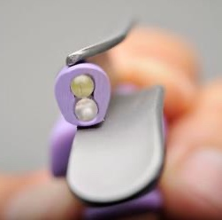
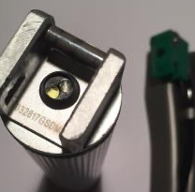
IntuBrite Dual Lighting System
Two bulbs provide the blended ultraviolet /white LED light
When on, only the white LED light bulb appears to be working. The UV light is not visible to the naked eye.
White LED Light Bulb
(sl. yellow color)
Ultraviolet LED light bulb
(very clear)
IntuBrite Dual LED
(Standard LED)
Two bulbs in blade
IntuBrite Greenline
(Fiberoptic) LED
- Two bulbs in handle

Slide 7
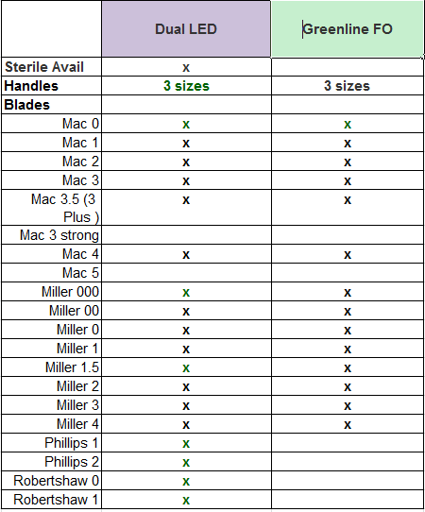
IntuBrite Disposable Product Offering
Broad range of Handle and Blade options
Including less common sizes
  Miller 000, 00, 1.5
  Mac 3.5
  Robert Shaw 0, 1
  Phillips 1,2

Slide 8
IntuBrite Disposable Dual LED
UV/White LED lighting technology: Both bulbs in the Blade
Sold separately or blade/handle combo
Available Sugically Clean or Sterile
5 year shelf life (One year sterile*)
Surgical steel blade
Aircraft aluminum handle
  3 sizes: Medium, Pediatric, Stubby
Broad blade options
  Mac 0-4, including 3.5
  Miller 000 – 4, including 1.5
  Robert Shaw 0, 1
  Phillips 1,2
Battery life - 2 hours of continuous use

Slide 9
IntuBrite Disposable Greenline FO
UV/White LED lighting technology:
  Both bulbs in the handle
  Enclosed fiberoptic pipe delivers light to tip of blade
Handles and blades sold separately
Available Medically Clean (not sterile)
5 year shelf life
Surgical steel blade
Aircraft aluminum handle
  3 sizes: Medium, Pediatric, Stubby
Broad blade options
  Mac 0-4, including 3.5
  Miller 000 – 4, including 1.5
Battery life - 2 hours of continuous use

Slide 10
IntuBrite Greenline FO
Built to ISO Green Standard System specifications ISO7376
Compatible all other manufacturer’s green handles and blades
If BLADE used with another manufacturer’s handle, no benefit of the IntuBrite UV/White LED light – because the unique light source is in IntuBrite handle
If HANDLE used with another manufacturer’s blade, will have benefit of the UV/White LED light, but it will be diminished
  Do not have the higher voltage of IntuBrite battery

Slide 11
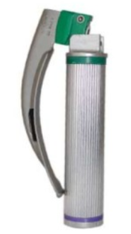
How to position Dual LED & Greenline FO
Always our lead product
Highest light quality
Strongest differentiation
Greatest ‘stickiness’ – more difficult for competitor to unseat
If require green system compatibility,
present Greenline FO
Best green system available

Slide 12
Disposable Competition

Slide 13
Disposable Market Share
Flexicare is on numerous GPO contracts
Aggressive

Slide 14
Major DL Competitor Product Offerings
 | Direct Laryngoscopy
 | Standard LED or Proprietary |  | Greenline (FiberOptic LED)
 | Reusable | Disposable | Reusable | Disposable
Salter IntuBrite | Handle |  |  | 
Flexicare |  |  (new) |  | 
Teleflex Rusch |  |  |  | 
SunMed |  | Blade |  | 
Vital Signs |  |  |  | 
Verathon | Handle | Blade |  | 
Medtronic
Ambu
Karl Storz |  |  |  | 

Slide 15
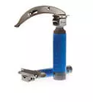
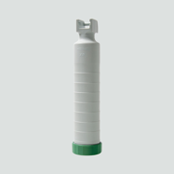
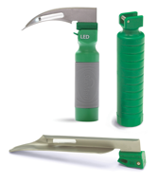
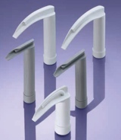
Disposable Major products overview
ASP
Strengths
Weaknesses
Flexicare
BritePro
BritePro Omni
$10-15
$11? (new)
Recycling program
Contracts
Reliability
Handle-blade give (flex)
Teleflex
DispoLED
DispoGrip
TruLite
Reliability
Light quality
Handle-blade give
$10-15
UV light
Light quality
Metal construction
Reliability, strength, and quality
True Recycling Program
IntuBrite Dual LED
$11-12
Smaller Players (not comprehensive)
Heine XP
Sunmed SunOne
Storz
Laryngobloc
OBP
Surescope

Slide 16
Key Disposable Competitor Product Offerings
 | Standard LED or Proprietary | Greenline (FiberOptic LED)
Salter IntuBrite | Dual LED | Greenline FO
Flexicare | BritePro Omni | BritePro Solo
Teleflex Rusch | DispoGrip Handle Equiplite Blade Lite Slim Blade TruLite Secure Combo | DispoLED Handle GreenLite blade
SunMed | Standard/D blade (no handle) | GreenLine/D
Vital Signs | Vital Signs Blade (no handle) | GreenBright handle GreenBright Blade GreenLight Blade

Slide 17
Disposable Competition Overview
Lots of players, but Flexicare is market giant.
Pricing is competitive in disposable blade/handle systems
Tiered offerings to enable ‘Premium’ product while still having a value offering to compete on price
  Flexicare: New BritePro Omni – differentiation, higher price
  Teleflex: Trulite value offering (<$9)

Slide 18
FlexiCare: Greenline FO LED
BritePro Solo
Sold separately or with Blade Combo
Sterile
5 year shelf life
Metal blade with metal heel
Plastic, textured grip handle – 2 sizes: Medium, Pediatric
Blade options
  Mac 1 – 4, including 3.5 and 3 strong
  Miller 00 – 4 (not 1.5)
  Philips 1, 2

Slide 19
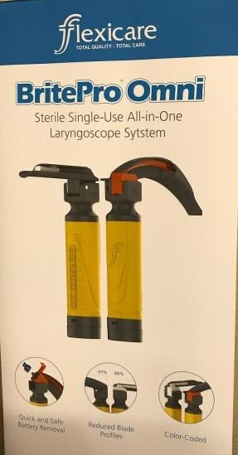
FlexiCare: Standard LED
BritePro Omni - New
Sterile
Plastic, textured grip handle
Claims:
Quick release battery removal
Reduced blade profile
Color coded blade size
Price – not known, but rep claim it will be higher than BritePro Solo
Blade and handle options not yet known
Expect similar to BritePro solo

Slide 20
Flexicare Tradeoffs
Strengths
Weaknesses
Market share leader
Tri-anim aggressively selling
Contract Positions: Premier, Premier Ascend, Vizient, HPG, Kaiser, Sutter, UMCSC
5 yr expiration on their sterile BritePro Solo combo pack
Recycling program
Overall good quality product
Lighting technology
Inferior Greenline lighting quality to IntuBrite Dual LED
Image with fiber optic blade is hot reds and bright yellow
Blade - No Miller 000 or Miller 1.5
Handle – All Plastic
Batteries - difficult to remove before disposal
How IntuBrite wins: Lighting system
Complete blade range, including Miller 000 and 1.5
Surgical grade stainless steel blade and aluminum handles
Good quality feel at competitive price

Slide 21
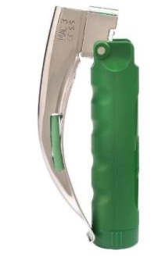
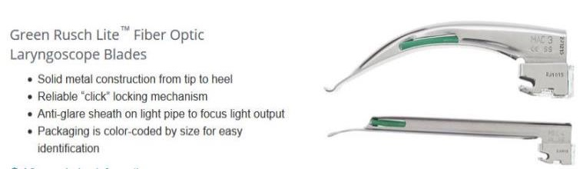
Teleflex: Greenline FO LED
DispoLED handle + Green Rusch Lite Blade
Plastic handle, medium only
Not Sterile, 3 yr shelf life
All metal blades
Color coded blade packaging
Standard range of blade sizes
  Miller 00 – 4 (not 1.5)
  Mac 1 – 4, including 3.5

Slide 22
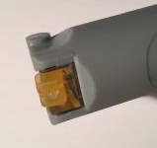
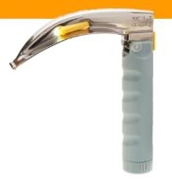
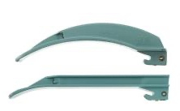
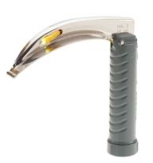
Teleflex Standard LED
DispoGrip Handle 1 size, all plastic with grip Available with battery tester – can test battery without removing from package Compatible with Standard LED blades | Equiplite Blade All Metal blade Color coded by size Standard size range Miller 00 – 4 (not 1.5) Mac 0 – 5, including 3.5 Lite Slim Blade All Plastic, xenon light Miller 0, 1, 2, 3 Mac 1, 2, 3 4 Compatible with Standard LED handles | TruLite Secure Combo Plastic handle (1 size) with attached metal blade Miller 00 – 4 (not 1.5) Mac 1, 2, 3 4
DispoGrip + Equiplite Blade
TruLite Secure Set
DispoGrip battery tester
Lite Slim Blade

Slide 23
Teleflex Tradeoffs
Strengths:
Weaknesses:
Greenline quality vs. IntuBrite Dual LED
The open fiber optic light pipe causes the light to “scatter”, not focus on the cords
Design:
Light escapes through clear plastic piece at back of the blade making it difficult for providers who wear glasses to see, focus.
Clear plastic piece can fall off
Blade
Shiny blade finish increases glare
No Miller 000 or Miller 1.5
High profile of the blade
Plastic handle in only 1 size
3 yr shelf life
Extremely aggressive on pricing – are lead with price
GPO contracts – Premier, Vizient
Bundled with committed airway programs
Recycling program
Tiered offering
New Plastic Handle & Plastic Blade Combo at <$9 price point
How IntuBrite wins: Lighting system
Quality and feel: Matte finish on blades, no plastic pieces that break
Surgical grade stainless steel blade and aluminum handles
5 year shelf life

Slide 24
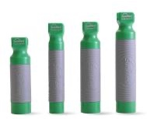
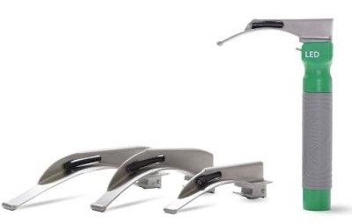
SunMed Greenline LED
GreenLine/D
Handles – All plastic, 3 style grips Textured Grip: 4 sizes: Medium, Pen, Stubby, Standard Ribbed Grip: 2 sizes Smooth Grip: 1 size Blades – 2 styles All Metal blade Miller 00 – 4 Mac 1 – 4 Plastic Heel Miller 00 – 4 Mac 1 – 4, incl 3.5 Robert Shaw 0,1
Textured Handles
Smooth Handle
Textured Handle with all metal blade
Ribbed Handle with plastic heel blade

Slide 25
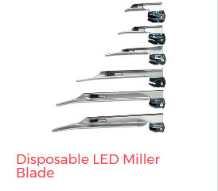
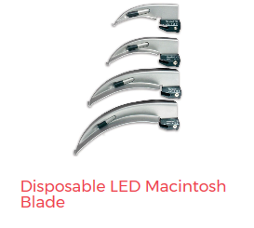
SunMed Standard LED
Standard/D blades
(do not offer disposable handles)
All Metal blades
Miller 00 – 4
Mac 1 – 4
Patented safety heel inhibits blade tip from contacting handle (to prevent cross-contamination from reusable handle)

Slide 26
SunMed Tradeoffs
Strengths:
Weaknesses:
Aka Tri-Anim Curaplex
GPO contracts – Premier, Vizient
Wide range of blades and handles
Recycle program
Lighting technology
Greenline quality vs. IntuBrite Dual LED
Design:
All plastic handle
How IntuBrite wins: Lighting system
Contract positions
Quality & feel: Surgical grade stainless steel blade and aluminum handles
Textured handle feels like reusable
5 year shelf life

Slide 27
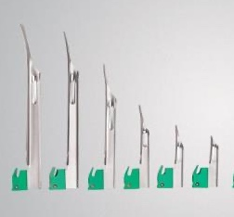
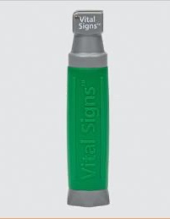
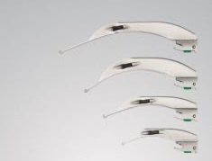
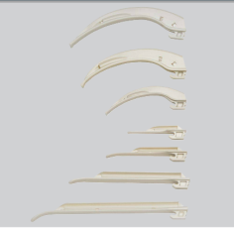
Vital Signs Greenline LED
GreenLight System
Handles – 4 sizes
All plastic with textured grip
Blades – 3 styles
All stainless
  Miller 00 – 4 (no 1.5)
  Mac 1-4, 3.5
Stainless with green plastic heel
  Miller 00 – 4 (no 1.5)
  Mac 1-4, 3.5
Glass reinforced nylon
  Miller 0-3; Mac 2,3,4
  Can be ‘incinerated with no negative by-products’

Slide 28
Vital Signs - Tradeoffs
Strengths:
Weaknesses:
Carefusion/Vyaire Rewards Program
Wide range of blades and handles
Lighting technology
Greenline quality vs. IntuBrite Dual LED
Design:
All plastic handle, 1 size
Blades -No Miller 000 or Miller 1.5
How IntuBrite wins: Lighting system
Contract positions
Quality & feel: Surgical grade stainless steel blade and aluminum handles
3 handle sizes, textured metal feels like reusable
Miller 000 and 1.5 blades for Ped/NICU
5 year shelf life

Slide 29
Recycling Programs
Flexicare, Teleflex and SunMed all offer recycling programs
What we know about them:
Not all are actually ‘recycling’ programs
Flexicare & Teleflex = Removal & disposal programs
Customers frequently comment on a desire to have a ‘recycling’ program. However:
Most are not recycling now
What they really want is to ease their conscience – not be the one to throw it in the trash
Recycling programs have a price-tag… most not willing to pay for it

Slide 30
Flexicare, Teleflex, and SunMed offer ‘Recycling’ programs
The details of the programs varies by region & state due to different requirements for handling medical waste, difficult to precisely define programs
Teleflex – customer pays ~$1 per blade+handle combo
  Actual recycling
  Collected product is shipped to recycler
  “Turn into KWH benefit from recycling (feel good statement)
SunMed – customer pays for program
  Reports of both true recycling and Incineration (minimizes landfill waste)
Flexicare
  Incinerate; report of how much landfill space you saved
“You Did Good” Report: All provide customers with a report that translates the volume of product they ‘recycled’ into a tangible benefit
  KWH of energy generated, landfill space saved, playground equipment made

Slide 31
Product Breadth Comparison
IntuBrite product breadth advantages:
Blade offerings for Pediatrics, NICU
Handle breadth vs. Flexicare and Teleflex

Slide 32
Reusable Costs
Sterilization Process Costs
Labor for collection & redistribution
Replacement costs for loss/breakage
Lost time/inconvenience if delay due to laryngoscope failure
Additionally, there is risk of cross-contamination
A single Hospital Acquired Infection (HAI) costs HP $40,000 avg.

Slide 33
Economics: Reusable vs. Disposable
Significant saving opportunity for hospitals when considering actual cost of reusable
Cost per intubation: $11-13 IntuBrite disposable vs. $17 – 26 Reusable
Eliminates risk of HAI

Slide 34
Cost of Reprocessing Reusable Laryngoscopes
Glendale Adventist Hospital
Glendale, CA
Reprocessing cost $25.97/intubation
If 1 HAI: Add’l $8/intubation
Southeast Health
Cape Girardeau, Missouri
Reprocessing cost $17.12/intubation
If 1 HAI: Add’l $10.28/intubation

Slide 35
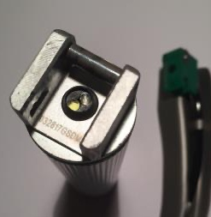
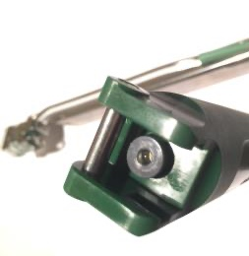
Recap - IntuBrite Dual Lighting vs Competition
All IntuBrite laryngoscopes utilize a patented, custom blended ultraviolet + white LED light waveform created by two light sources
In both our Standard and Greenline LED laryngoscopes
IntuBrite UV/white LED
Competitors
IntuBrite Dual LED
(Standard LED)
- Two bulbs in blade
IntuBrite Greenline
(FiberOptic LED)
- Two bulbs in handle
Competitive Greenline (FiberOptic LED)
- Single bulb in handle

