Slide 1
Laryngoscopes – sunmed portfolio

Slide 2
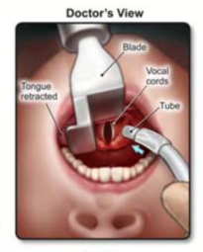
Intro to Laryngoscopy
Laryngoscopy (la·ryn·go·sco·pi ): Laryngoscopy is a term describing the visualization or examination of the larynx by distraction of the upper airway structures.
It is typically used to enable intubation and airway management in anesthesia, critical care, and trauma scenarios.

Slide 3
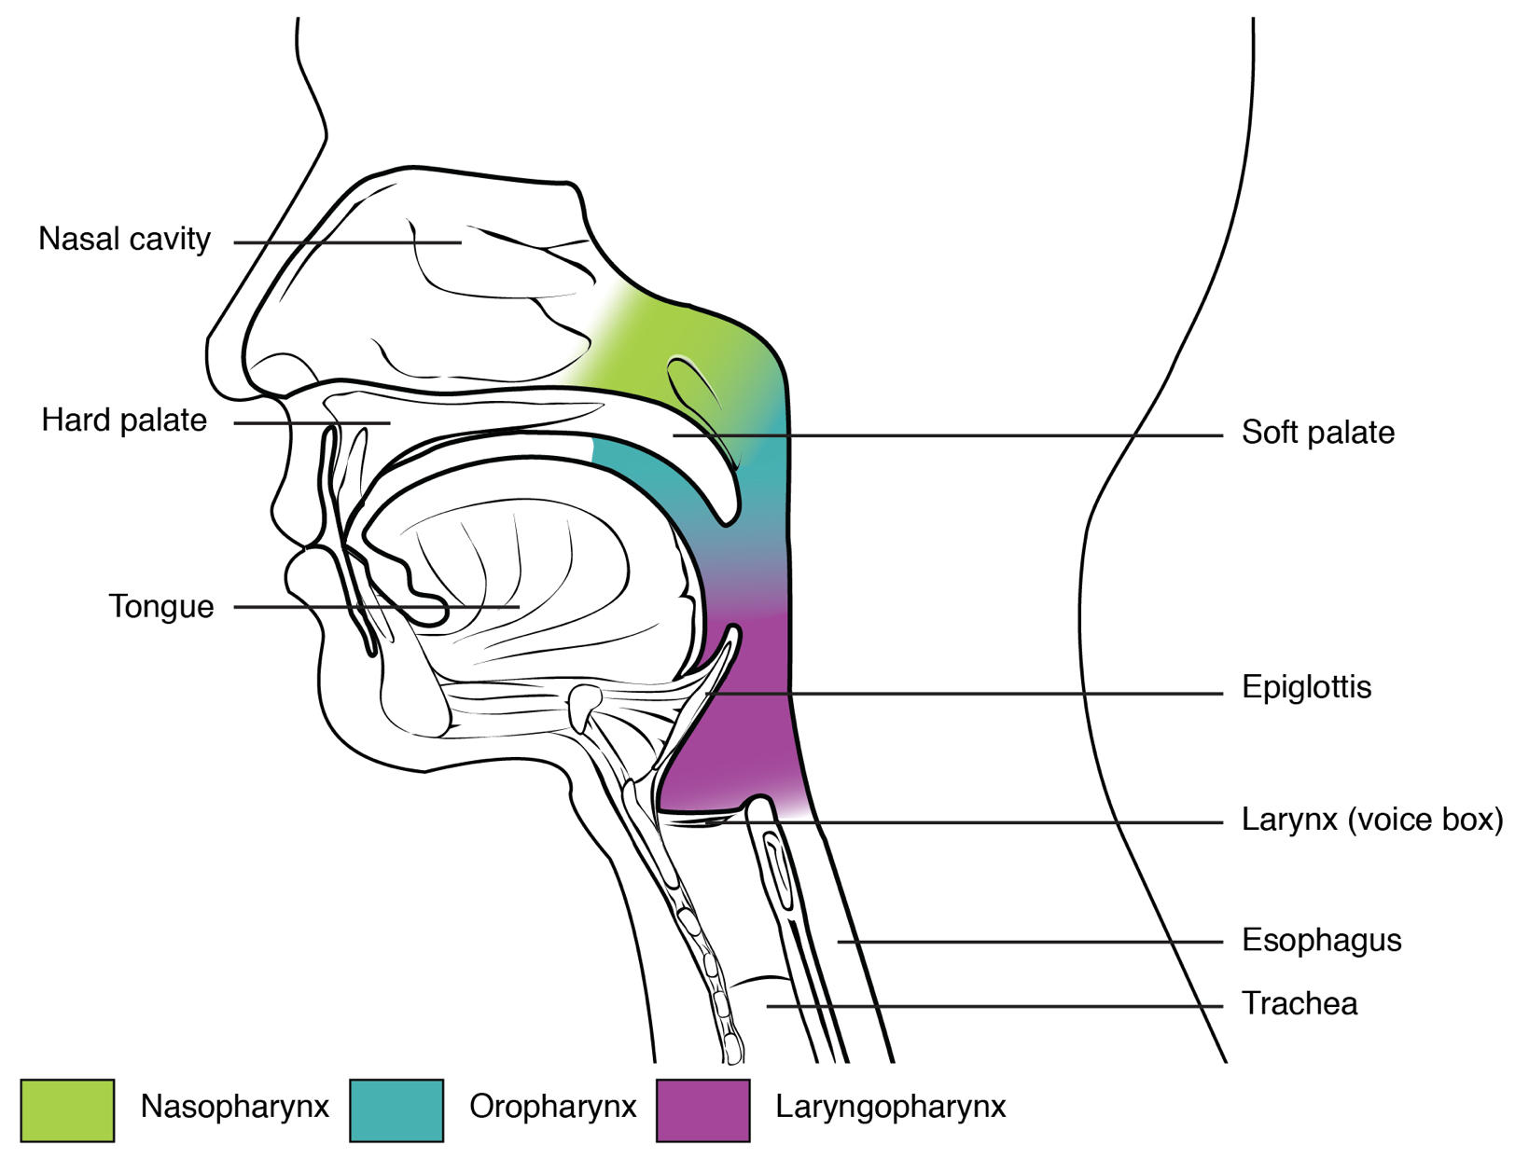
Airway anatomy
Notes:
The pharynx is a tube formed by skeletal muscle and lined by mucous membrane that is continuous with that of the nasal cavities
The pharynx is divided into three major regions: the nasopharynx, the oropharynx, and the laryngopharynx
The nasopharynx is flanked by the conchae of the nasal cavity, and it serves only as an airway. The uvula is a small bulbous, teardrop-shaped structure located at the apex of the soft palate. Both the uvula and soft palate move like a pendulum during swallowing, swinging upward to close off the nasopharynx to prevent ingested materials from entering the nasal cavity. In addition, auditory (Eustachian) tubes that connect to each middle ear cavity open into the nasopharynx. This connection is why colds often lead to ear infections.
The oropharynx is a passageway for both air and food.

Slide 4
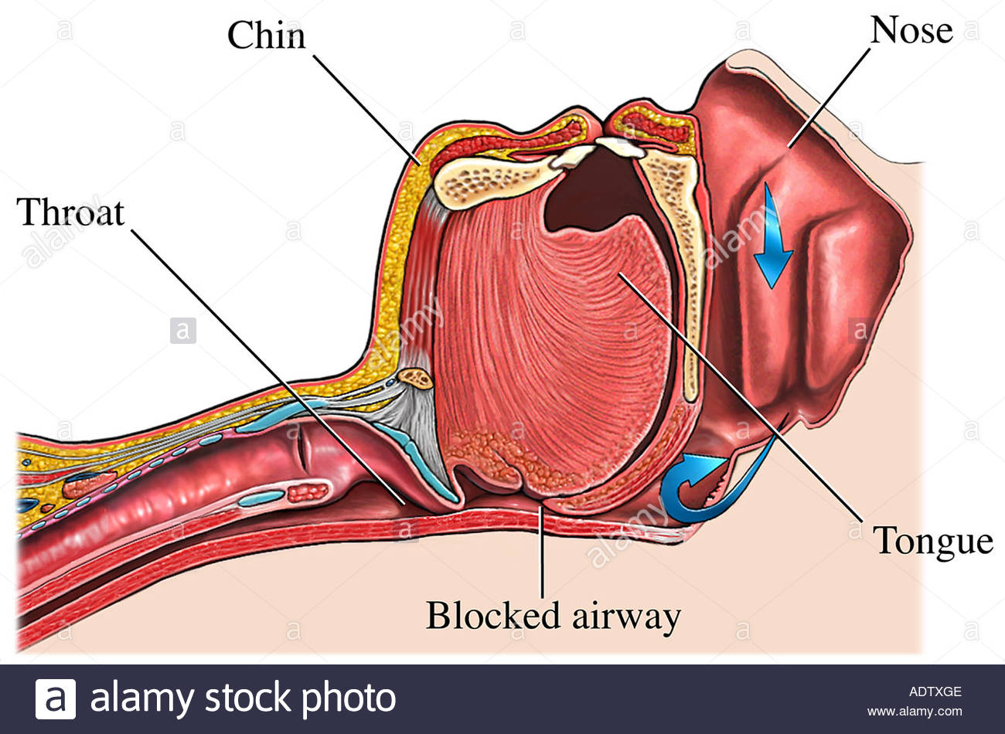
Airway view in supine position

Slide 5
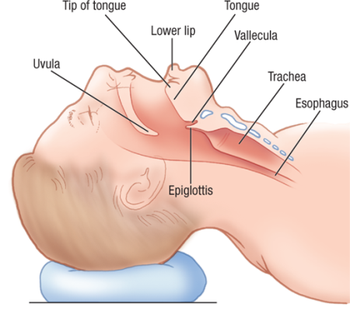
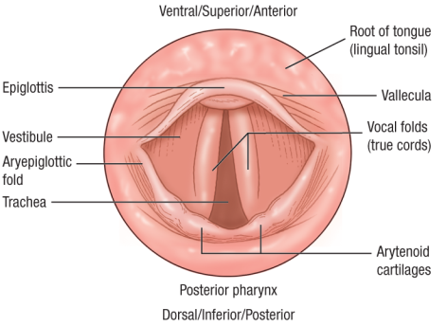
Key Airway Anatomy for Laryngoscopy:
Glottic opening
(tracheal opening)
Glottic opening: the opening between the vocal cords. This is the target for tracheal intubation.
Vallecula (val·lec·u·la): the space between the base of the tongue and the epiglottis
Arytenoid cartilages (ar·y·te·noid): A pair of small triangular cartilages in the larynx that help to move the vocal cords

Slide 6
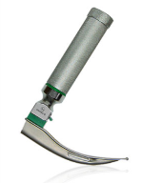
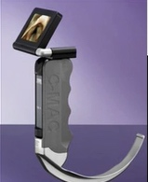
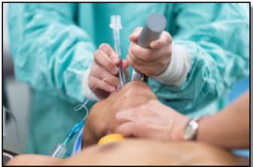
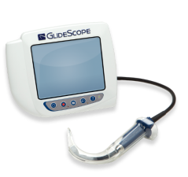
Introduction to Laryngoscopes
A laryngoscope (la·ryn·go·scope) is used to lift the upper airway structures, such as the epiglottis, out of the way to allow visualization of the vocal cords (larynx) and enable intubation through the glottic opening.
Laryngoscopes are used where-ever tracheal intubations are performed, including OR, ED, ICU, NICU, PICU, EMS

Slide 7
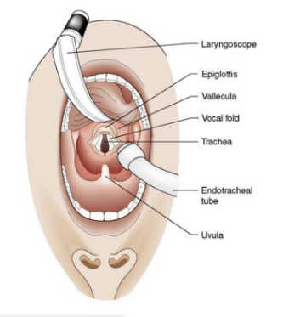
Optional videos
Good views from practioner’s POV
https://www.youtube.com/watch?v=4V_pouIbcnA
Direct Laryngoscopy https://www.youtube.com/watch?v=AZeBumPaj4g
Use of Mac and Miller blades for intubation
Anatomy and Intubation
https://youtu.be/iOPpSGbuYmQ
Skip to the 6:30 min mark: @ 6:30 Anatomy; Great view of vallecula lift at 7:30 / Mallampati overview
@ 8:30 Intubation Equipment; @ 12:00 Direct laryngoscopic intubation
The first 6.5 mins are pharmacology – double back to it if you can
Intubation using Direct and Indirect (Video) Laryngoscopes
https://www.youtube.com/watch?v=gnkYGRMaw7o
First 6 min shows use of different direct and video laryngoscopy devices

Slide 8
Objectives & Content Outline
You will have the knowledge, tools, support and target list to be successful with IntuBrite Day 1 post-NSM
Session | Deliverables
Laryngoscopy Intro | Review of Key Basics Market Overview
Product Details | IntuBrite Products Competitive Products
Sales Process | Clear sales process Targeting Detailed Talk Track Evaluation planning & management FAQs/ Objection Handling
Planning Your Success | Intubation training Leading an Effective In-Service

Slide 9
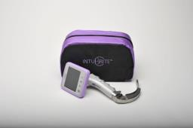
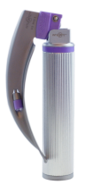
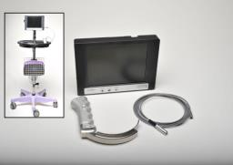

Why is IntuBrite so Exciting?
Patient Safety Reduced HAI Risk with Disposables
Salter Opportunity
Significant account value, GPO Contracts
Clinician Preference Enhanced Visibility and Ease of Intubation
Notes:
Hospital acquired infections are an area of increasing concern to hospitals, driving a trend towards use of disposable handles and blades. IntuBrite is well positioned to capture the benefits of this trend.
IntuBrite products are proven. The clearly differentiated lighting system and high quality products are recognized and valued by clinicians
The growth opportunity for Salter is SIGNIFICANT, with OR disposable accounts commonly >$100K annualized value and major GPO contract positions with >$10M potential value.

Slide 10
IntuBrite Demo Kits
Demo Kit Contents:
Dual LED Disposable Handles & Blades
Greenlight Disposable Handles & Blades
VLS Edge Video Laryngoscope, Reusable Blades, Wands, Rigid Styles, Disposable Sheaths, Accessories
Competitive Disposable Samples: Flexicare, Teleflex Rusch
Misc accessories: Cases, PFHV & STLT, cloth

Slide 11
POP QUIZ
Name the Airway Anatomy
A
F
B
C
Glottic opening
(tracheal opening)
E
D
Glottic opening: the opening between the vocal cords. This is the target for tracheal intubation.
Vallecula (val·lec·u·la): the space between the base of the tongue and the epiglottis
Arytenoid cartilages (ar·y·te·noid): A pair of small triangular cartilages in the larynx that help to move the vocal cords

Slide 12
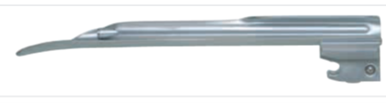
POP QUIZ:
Which Blade is Mac Style & which is Miller Style?
A.
B.
Mac Blade
- The most common Curved blade design
- MaC
Miller Blade
- Most common straight blade design
- MiLLer

Slide 13
Blade Sizes – Mac, Miller size ranges
Mac and Miller blades overlap in many, but not all size offerings
Straight blades are preferred for NICU use – reflected in size range of Miller blades.
  000, 00 and 1.5 are important differentiators to NICU and children’s facilities
Size | Patient Size | % of market | Mac | MIller
000 | Small premature infant | Minimal |  | 
00 | Premature infant | 1.2% |  | 
0 | Neonate | 2.8% |  | 
1 | Small Child | 3.7% |  | 
1.5 | Child | 1.2% |  | 
2 | Child | 19.2% |  | 
3 | Adult | 37.5% |  | 
3.5 | Adult | 1.8% | 
4 | Large adult | 22.6% |  | 
5 | Extra-large adult | Minimal | 

Slide 14
More Blade shapes
Curved
Macintosh
Mac Reduced Flange
Mac Improved View
Mac Left Handed
Bizzari-Guiffrida
Mac Prism
Polio
Mac Oxiport
Tull Macintosh (suction)
Fink
Upsher Low Profile
Upsher ULX
Flexible
52.7%
Straight
Miller
Wis-Hipple
Phillips
Tull Miller
Oxiport Miller
Wis-Foregger
Shcapira
Alberts
Michaels
Robertshaw
Wisconsin
Cranwall
Seward
Eversole
Racz-Allen
Oxford Infant
Bainton
Dopuble-Angle
Blechman
Belscope
Henderson
Vital View
Cardiff
Bennett
Flagg
Snow
Heine
Soper
Straight
Guedel
40.0%
0.8%
1.1%
0.5%
0.3%
<0.1%
<0.1%
Key Takeaways
> 90% of intubations are done with Mac and Miller blades
Many specialty blades are for Ped/NICU
IntuBrite blades cover > 93% of all intubations
<0.1%
<0.1%
Percentages indicate 2017 sales (by % of intubations)
IntuBrite Configuration

Slide 15
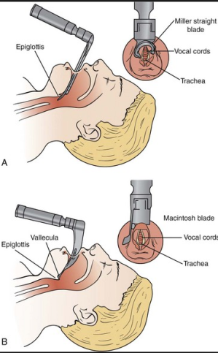
Blade Design impacts technique
Straight blade (e.g. Miller): Tip goes under the epiglottis and lifts it directly
Curved blade (e.g. Mac) : Tip fits into the vallecula and indirectly lifts the epiglottis

Slide 16

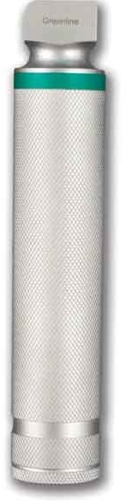
Fiber Optic (or Greenline) Lighting Systems
>90% of market
Handles and blades built to the Green ISO Standard 7376 can use the term Green, Green System
Indicated by green color coding on blade and handle
Why is this important?
  Indicates compatibility with any other handle or blade that is also “Green”
  Can mix & match disposable & reusable
Fiberoptic LED
AKA: Green Line, Green system
Greenline = ISO 7376
Clear “fiberoptic” tube runs light from bulb to tip
Bulb is in handle
Battery is in handle

Slide 17
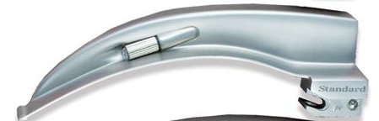

Standard LED Lighting Systems
<10% of market
Generally have a superior lighting system than fiberoptics
  fiber optic pipe degrades light quality
Not compatible with Green systems
Standard LED
AKA: Conventional
Bulb is in blade
Electric conduit runs current from handle to bulb
Battery is in handle

Slide 18
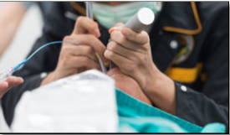
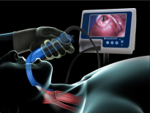
POP QUIZ
Which illustrates use of Direct Laryngoscopy _____?
A.
B.
Indirect, or Video Laryngoscopy
Direct Laryngoscopy

Slide 19
Laryngoscopy Market
SALTER LABS CONFIDENTIAL

Slide 20
Major Competitor Product Offerings
 | Direct |  |  |  | Video
 | Standard LED or Proprietary |  | Greenline (FiberOptic LED) |  | Handheld | Rollstand
 | Reusable | Disposable | Reusable | Disposable
IntuBrite | Handle |  |  |  |  | 
Flexicare |  |  (new) |  | 
Teleflex Rusch |  |  |  |  | 
SunMed |  | Blade |  | 
Vital Signs |  |  |  | 
Verathon | Handle | Blade |  |  |  (new) | 
Medtronic |  |  |  |  | 
Ambu |  |  |  |  | 
Karl Storz |  |  |  |  |  | 

Slide 21

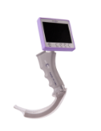
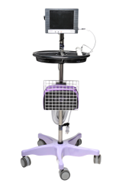
Salter is positioned to take advantage of laryngoscope market trends
Safer
Direct Laryngoscopy
Fully Disposable Handle & Blade
Infection Control Rigor
Legacy
Reusable Handle w/ Reusable or
Disposable Blade
Video Laryngoscopy
Current Practice
Easier
Patient intubation difficulty
Harder

Slide 22
Our Greatest Opportunity is Hospitals with Disposable Handles and Blades
Why Hospitals?
Why Disposable?
Perform 19 out of 20 intubations annually
Leverages our existing relationships
Leverages our acute product portfolio
3x the unit growth rate of reusables
  Driven by JCAHO guidelines
  Increased focus on HAI
Ongoing, consistent purchase, not a one time or infrequent purchase

Slide 23
Reusable → Disposable: JCAHO drives change
FDA and JCAHO follow the Spaulding Classification…
…which results in citations when hospitals are only doing low-level disinfection on handles
Type | Contact | Req
Critical | Enters sterile tissue or blood flow | Sterilization
Semi-Critical | Contacts mucus membrane | High-level disinfection
Non-critical | No- or intact-skin contact | Low-level disinfection
Correct Practice:
Typically, submerged in solution by central reprocessing
JCAHO citation
Current Practice:
Wipe down between cases

Slide 24

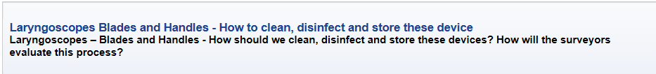
JCAHO Guidelines
Laryngoscope blades are processed via either high-level disinfection or sterilization.
Laryngoscope handles, the organization is following the manufacturer's instructions-for-use for cleaning/disinfection guidance.
Packaged
Stored in a way to prevent contamination
https://www.jointcommission.org/standards_information/jcfaqdetails.aspx?StandardsFaqId=1201&ProgramId=46

Slide 25
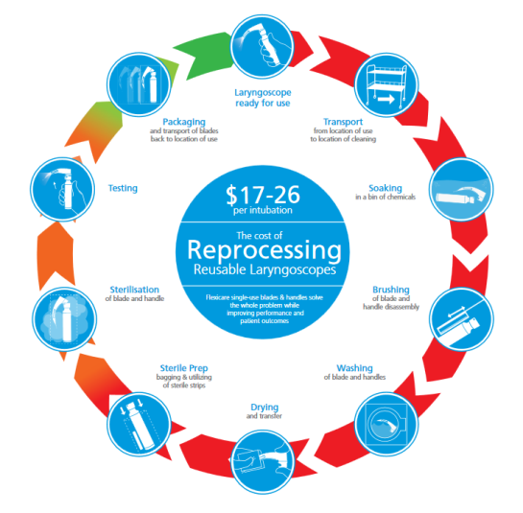
Sterilization Steps & Cost
High cost per intubation:
$17-$26
Laryngoscope failure due to wear & tear, improper re-assembly
Risk of cross-contamination resulting from poor cleaning or bacteria that remains
Loss of product , replacement
Time delays in product availability
Diminished light quality over time
From ‘ Flexicare Cost of Reprocessing Brochure’ http://www.briteprosolo.com/images/downloads/Cost%20of%20Reprocessing.pdf

Slide 26
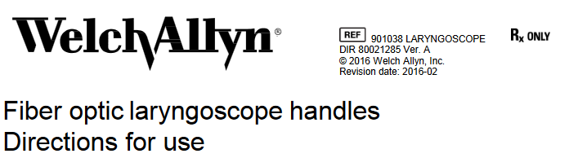
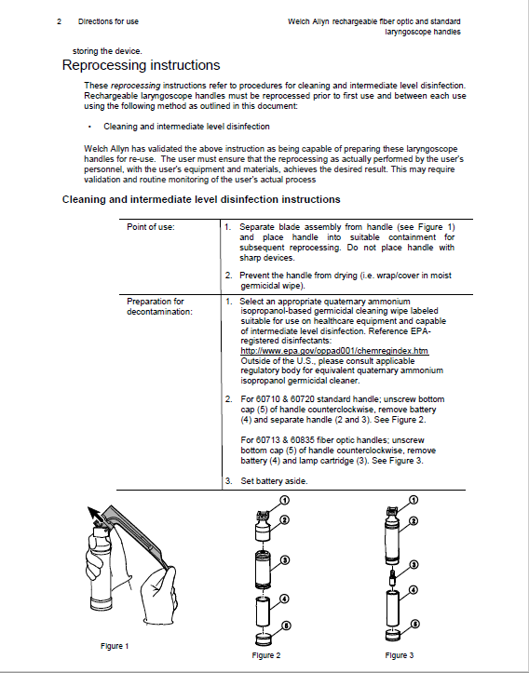
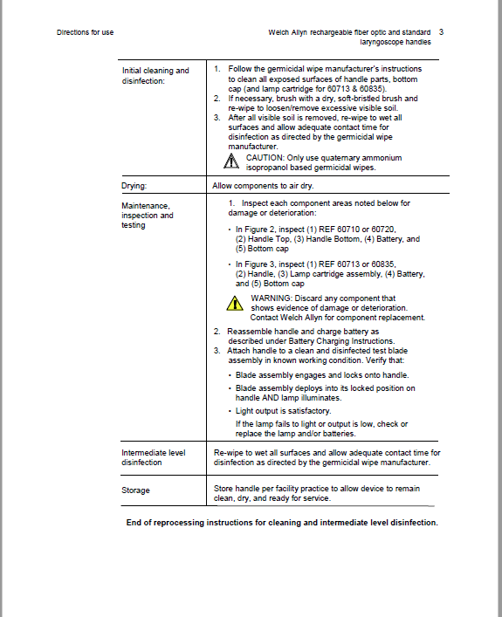
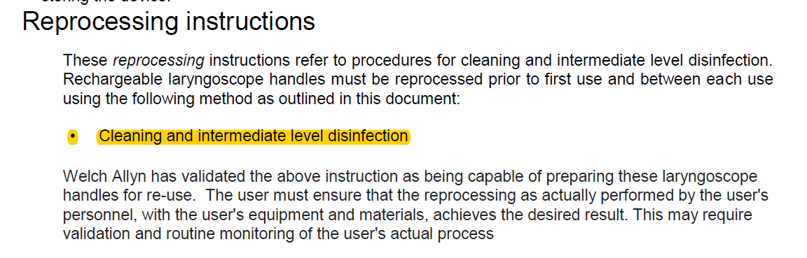
Accessed 9/20/2017 https://www.welchallyn.com/content/dam/welchallyn/documents/sap-documents/LIT/80021/80021285LITPDF.pdf
Notes:
Even if high level disinfection or sterilization is not required, there are a lot of steps in following Handle manufacturer reprocessing instructions. Welch Allyn recommends “Cleaning and intermediate level disinfection’ for their FO handles.

Slide 27
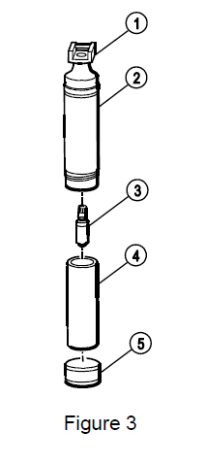
Accessed 9/20/2017 https://www.welchallyn.com/content/dam/welchallyn/documents/sap-documents/LIT/80021/80021285LITPDF.pdf
Clean and Intermediate Level Disinfection:
Prepare for Cleaning
Separate blade from handle
Prevent handle from drying
Initial Cleaning
Remove the battery
Clean with germicidal wipe
Brush to remove any visible soil
Re-wipe with germicidal wipe and let sit per germicidal wipe instructions
Air dry
Inspect parts and reassemble
Test by attaching to a clean and disinfected blade
Re-wipe all surfaces with germicidal wipe and let sit per germicidal wipe instructions
Store per facility practice

Slide 28
Simplest way to keep JCAHO complaint
“We use disposable handles and blades”

Slide 29
Direct Laryngoscopy → Video Laryngoscopy
Clinical advantage of video
  More compelling for less skilled intubationists
  Strong for EMS, ED, ICU
  Less for anesthesiologists
Clinical advantage for difficult cases
Seen as best, newest technology
More affordable technology options
Drivers of conversion to Video

Slide 30
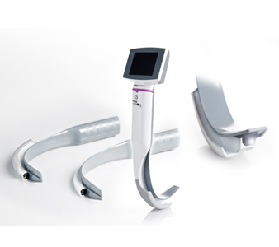
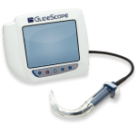
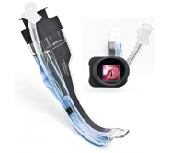

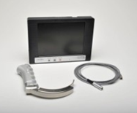


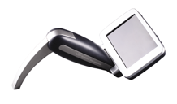


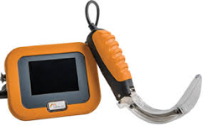
Video Laryngoscopy Competition for ‘Routine’
Emergent Intubations
Planned Intubations
EMS
ED
ICU
Routine
Difficult
Two video Approaches
Portable, simple, inexpensive device with standard blades for field and unexpected intubations.
Rugged, high-quality, expensive device with hyper-angled blade for difficult OR intubations.
Video manufacturers trying to capture the big prize: routine use for all OR intubations.

Slide 31
Major players by segment
Reusable
Vyaire | 19%
Teleflex | 16%
Sun-Med | 10%
Tri-Anim | 8%
Welch-Allyn | 7%
Heine | 6%
Propper | 5%
Flexicare | 5%
All Others Armstrong, Mercury, Medline, Sharn, Anesthesia Service, > 30 others | 24%
Fully Disposable
Flexicare | 65%
Teleflex | 21%
IntuBrite | 12%
All Others (Heine, Welch Allyn, OPB, Sun-Med, Tri-Anim, Vyaire) | 2%
Video
Verathon | #1
Karl-Storz | #2
Medtronic | #3
Ambu | #4
Others Teleflex, Venner, McGaw, DRE, Pentax | Minimal
* Reusable includes disposable blades used with reusable handles

Slide 32
OTHER TOOLS & INFORMATION

Slide 33
Reusability
Reusable
Disposable
Reusable items are designed to withstand reprocessing (high-level disinfection or sterilization). Most are guaranteed for duration (e.g. 5-7 years) and/or a defined number of autoclave cycles (e.g.) 4,000. Often, the electronic parts (bulb, battery, etc.) can be replaced when broken
Disposable items are designed for single-patient use.
Key Takeaways
All the money is in disposables.
Winning disposable blades only to use with current reusable handles is a pot. wedge
Winning reusables is unlikely. Don’t devote time here.

Slide 34
Reusable vs Disposable: Trade offs
Reusable Handle & Blade
Disposable Handle & Blade
High quality weight and feel
What most physicians are accustomed to using – viewed as the gold standard
Fresh battery and light for each use
No maintenance or reprocessing resources
Single patient use – no risk of cross-contamination
Benefits
Performance failure/variability due to reprocessing wear & tear
  Light quality degrades/ flicker
  Battery failure, incorrect reinstallation
  Component failure
High initial capital investment
Maintenance & replacement
Reprocessing time & costs (chemicals, time, labor, supplies)
Not perceived to have the quality of a reusable
Cost is more ‘tangible’ to department
Environmental impact perceived to be more than reusable
Drawbacks

Slide 35
Reusable → Disposable: Compliance challenges
Customers are reluctant to believe this
Switching to high-level disinfection of handles is expensive
$
Cost of high-level disinfection
Cleaning solution and sterile water
Labor costs
$17-$26 per intubation for reprocessing handle and blade
Must invest in many more reusable scopes
Go from 1 set per OR to multiple sets per OR to cover time while being cleaned
Higher breakage and loss rates during cleaning
$
Compliance to high-level disinfection is impractical
Staff are frequently non-compliant
Unanticipated breakage due to
  Leaving batteries in handle during cleaning or incorrect insertion
  Losing scopes during transport
  Faster wear-and-tear due to reprocessing
Going disposable is the simplest way to stay compliant

Slide 36
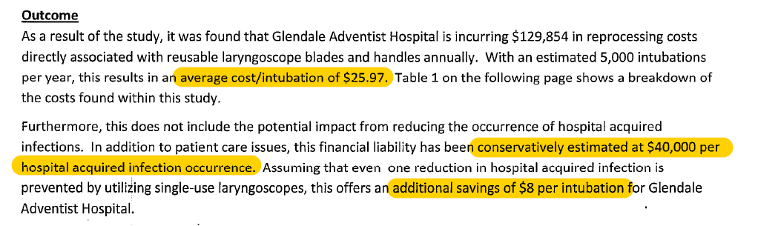
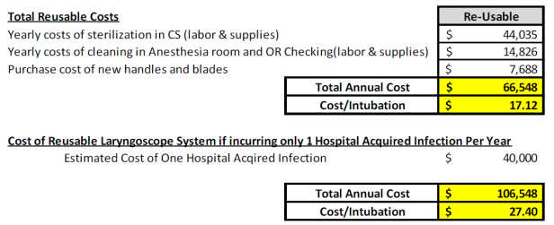
Cost of Reprocessing Reusable Laryngoscopes
Glendale Adventist Hospital
Glendale, CA
Reprocessing cost $25.97/intubation
If 1 HAI: Add’l $8/intubation
Southeast Health
Cape Girardeau, Missouri
Reprocessing cost $17.12/intubation
If 1 HAI: Add’l $10.28/intubation

Slide 37
Market segment sizes and growth

Slide 38
Market size
Salter’s greatest opportunity is in the Hospital market with Disposable handles & blades
* Reusable includes disposable blades used with reusable handles

Slide 39
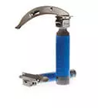

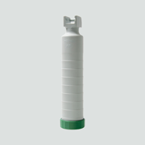
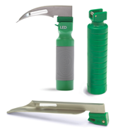
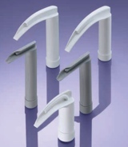
Major products, pricing, strengths and drawbacks: Disposable
ASP
Strengths
Weaknesses
Flexicare
BritePro
$10-15
Recycling program
Contracts
Reliability
Handle-blade give
Teleflex
DispoLED
Reliability
Light quality
Handle-blade give
$10-15
None
UV light
Light quality
Metal construction
Reliability, strength, and quality
Intubrite
$11-12
Smaller Players (not comprehensive)
Heine XP
Sunmed SunOne
Storz
Laryngobloc
OBP
Surescope

Slide 40

Major products and pricing:
Video
Disposable Config
Reusable Config
Monitor
Blades
Cable
Wands
Blades
Verathon Glidescope
~$5k
$2-3k
~$5-$6k
~$4k
~$20-30
ROLLSTAND
Karl-Storz C-MAC
Over $5k
~$4k
~$500
unknown
unknown
Intubrite VLS 8800
$4-$5k
$1k
N/A
~$1k
$8-10
Ambu
King Vision
$1.0-$1.5k
N/A
N/A
included
$8-10
Medtronic
McGrath MAC
$1.6-$2.6k
Sometimes free
HANDHELD
N/A
N/A
included
$12-20
Intubrite 6600 Edge
$1.5 - $2.5k
$1k
~$1k
$8-10
Smaller Players (not comprehensive)
Venner APA
dist. by Vyaire
Airtraq
Dist. by TFX
Karl Storz C-MAC PM
Verathon Glidescope Go (NEW)
Magaw Co-Pilot

Slide 41
Questions?

