Slide 1
SuperNO₂VA™ Et
Say goodbye to airway management and
hello to airway confidence
May 10, 2021

Slide 2
Global Deep Sedation Market
Deep sedation
Drug-induced depression of consciousness
Airway intervention may be required
Spontaneous ventilation may be inadequate
Sedation Market 250M procedures
40% Deep Sedation Procedures
30% High Risk Procedures
High risk patients:
BMI ≥ 30kg/m2
Obstructive sleep apnea (OSA) or STOP BANG ≥ 3
Congestive heart failure (CHF)
Chronic obstructive pulmonary disease (COPD)
Oxygen saturation <95% on supplemental oxygen
How do you treat these patients today?

Slide 3
What Anesthesiologists and CRNAs are Saying*
Concerned with maintaining the airway for
  Clinically obese patients
  History of sleep apnea
Want to avoid expensive respiratory complications and perform less patient airway manipulation
75 -100% of deep sedation procedures monitor EtCO₂
Currently, using nasal cannula for oxygenation during deep sedation
Nasal cannula doesn’t maintain the airway during deep sedation
SuperNO₂VA™ Et uniquely maintains airway patency using positive pressure to stents open a patient’s airway reducing respiratory complications
*Research conducted with 201 Anesthesiologist and CRNA’s in USA.

Slide 4
Open Airways, Expand Possibilities
SuperNO₂VATM Et
Open Airways
Pneumatically stents open a patient’s airway reducing respiratory complications
Optimizes oxygenation and ventilation
Minimizes the need for airway manipulations
Delivers accurate and consistent EtCO₂ capture
Expand Possibilities
Easy access to the oral cavity
Confidence throughout the patient’s continuum of care
Integrates easily into practice, with minimal staff training required

Slide 5
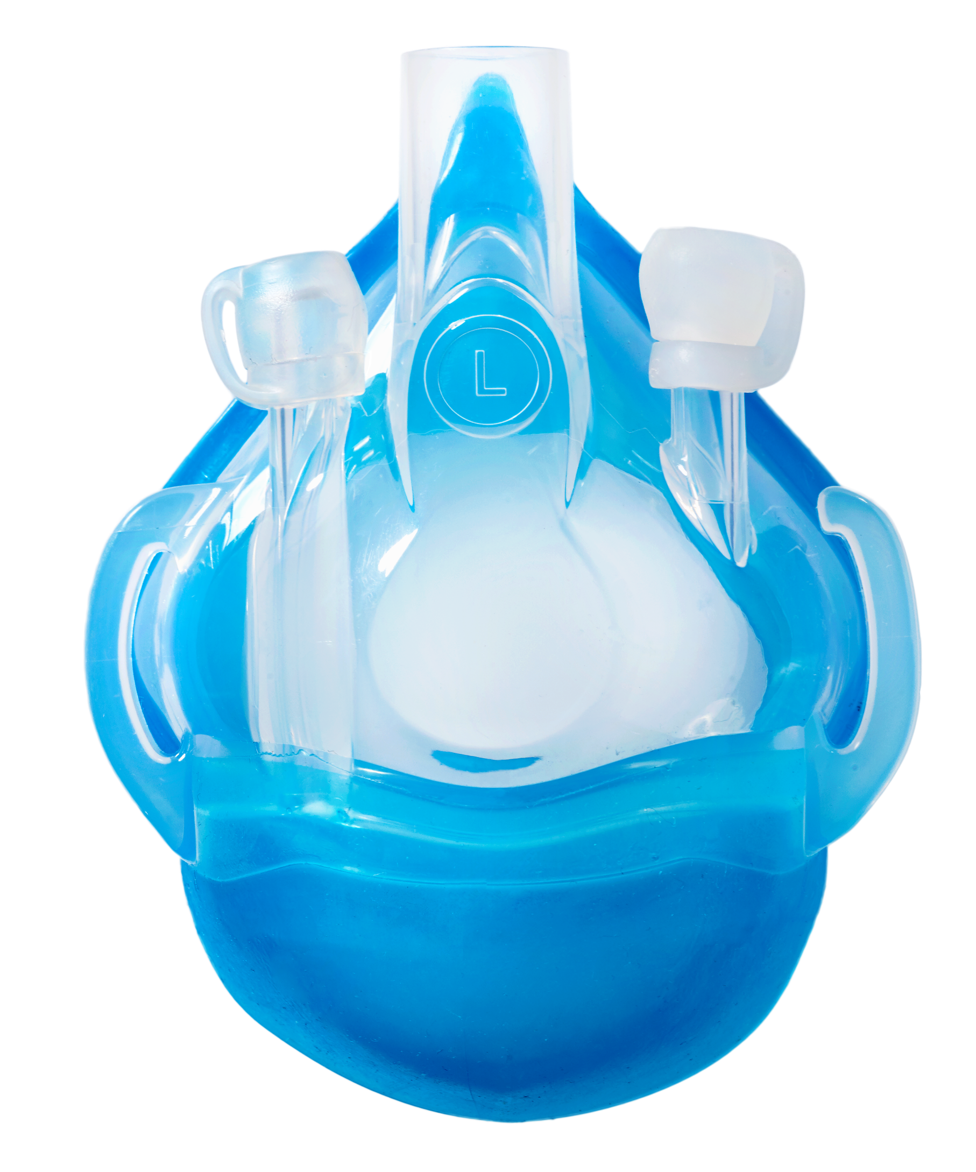
SuperNO₂VA™ Et
Reason to believe:
  Maintains upper airway patency reducing incidence of upper airway obstruction (2 publications)
  Effective oxygenation and support ventilation (2 publications)
  Confirming adequate ventilation by consistent and accurate capture of end tidal CO₂ (1 publication)
  Investigator initiated clinical study at IU
Accurate EtCO₂ sampling
EtCO₂ capture from
both oral/nasal areas

Slide 6
SuperNO₂VATM Et Value
Respiratory Complications are expensive
Could be $3.7M annually for average hospital*
Clinical studies show SuperNO₂VA™ can potentially reduce hypoxemia by 75% compared to current standard of care ^{1,2}
This reduction in respiratory compromised events provide significant cost reductions compared to current standard of care (see Value Analysis Tool)
Data based on VyaireTM Medical Value Analysis Tool. Hospital results may vary
*Based on an average center with ~ 9k procedures (Reference value Analysis Tool)

Slide 7
SuperNO₂VA™ Brand
SuperNO₂VA™ Et is the next generation in the SuperNO₂VA™ brand
It builds on the proven benefits of SuperNO₂VA™ - pneumatically stents open a patient’s airway reducing respiratory complications and reducing the number of procedures requiring airway intervention
Responded to customer requests with innovative solutions
  Ability for accurate EtCO₂ capture from oral and nasal areas
May reduces setup time
May simplifies supply chain

Slide 8
SuperNO₂VATM Et
Say goodbye to Airway Management and hello to Airway Confidence
Clinically obese or a history of obstructive sleep apnea patients are at high risk for upper airway obstruction during deep sedation
Clinical studies show SuperNO₂VA™ can potentially reduce hypoxemia by 75% compared to current standard of care^{1,2}
SuperNO₂VATM Et pneumatically stents open a patient’s airway reducing respiratory complications, minimizes the need for airway manipulations, and allows for monitoring of EtCO₂
We want to help your members do more.
SuperNO₂VATM Et is a transformative solution for deep sedation.
Help your members do more for patients with SuperNO₂VATM Et.

Slide 9
Francesca Dimou. Nasal positive pressure with the SuperNO2VA device decreases sedation-related hypoxemia during pre-bariatric surgery EGD. Surgical Endoscopy 2019
Bai Yiping. Comparison of a simplified nasal continuous positive airways pressure device with nasal cannula in obese patients undergoing colonoscopy during deep sedation. A randomized clinical trial. European Journal of Anesthesiology. 2019
Michael Pedro. Validation of Novel Completely Sealed Nasal Positive Airway Pressure Device: SuperNO2VATM EtCO2 Measurement and Pressure Test Performance. Open Journal of Anesthesiology. 2020
VYR-GBL-2100104 For US Distribution only

